Slide 1
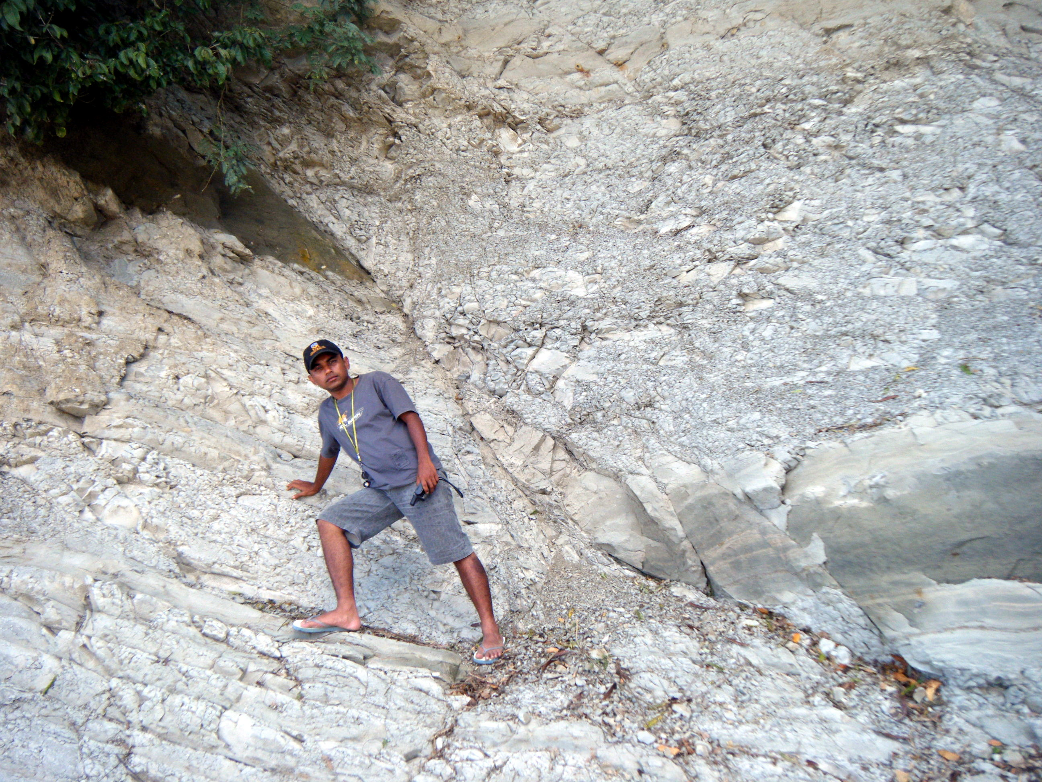
Geol 244 – structural geology
Geol 244 – structural geology
Lecture 10 – Brittle fault rocks and deformation
Lecture 10 – Brittle fault rocks and deformation

Slide 2
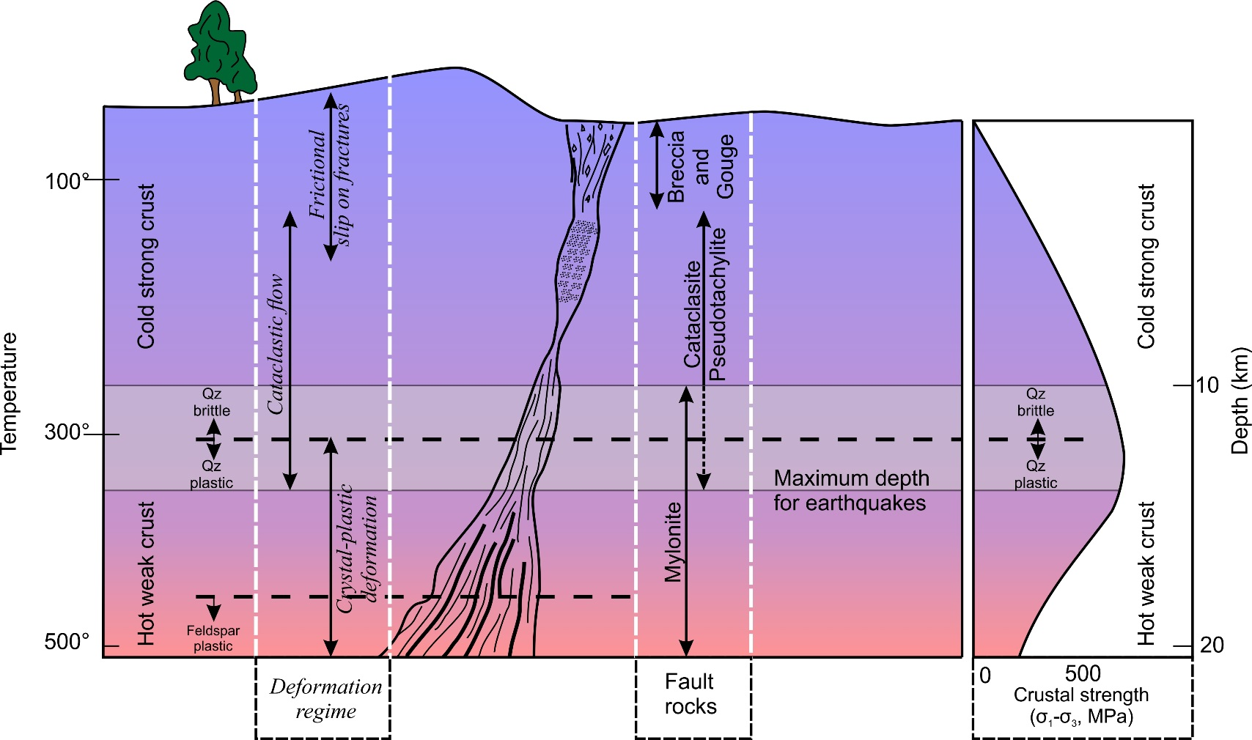
Faults
Fault is a surface or zone that shows measurable displacement
Otherwise it is a …………………
Develops in the frictional regime – brittle rocks at low temperature and low lithostatic pressure
You need to know the fault rocks, the deformation mechanisms, and the relationship between stress and fault geometry

Slide 3
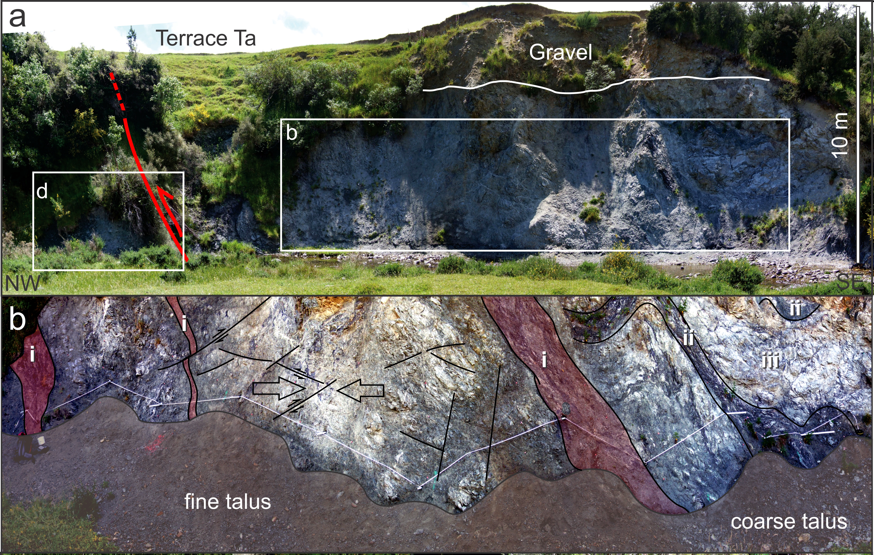
What does a fault zone look like
This is the fault
This is the damage zone

Slide 4
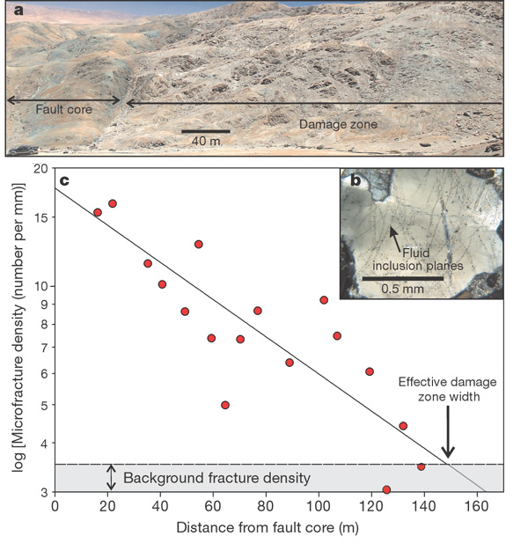
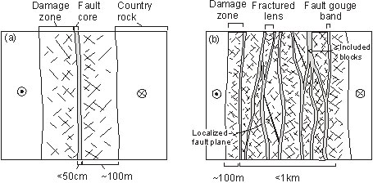
What does a fault zone look like
Damage zone
small scale faults and joints
Fault core
High permeability
Low permeability
Faulkner et al., 2006

Slide 5
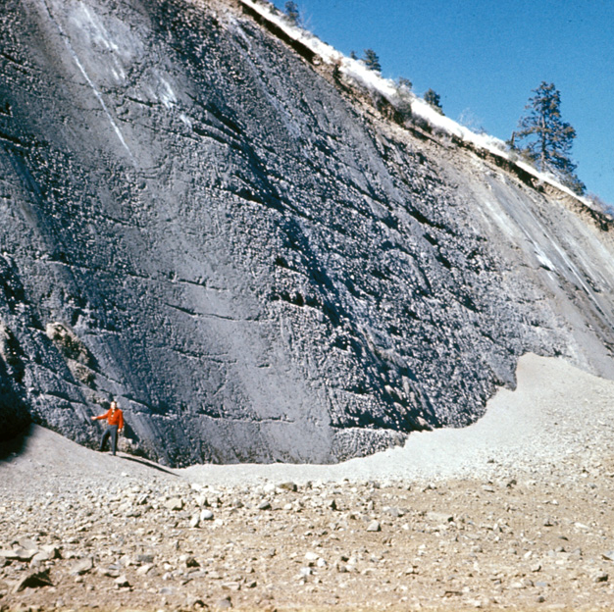
How does it get like that? Fault deformation mechanisms
Cataclasis - the brittle fracturing, crushing and breaking up of rock. Includes deformation mechanisms that result in brittle failure:
Fracturing - irreversible and very rapid propagation and connection of cracks and fractures
Frictional Sliding – on planar discontinuities, orientation dependent on stresses

Slide 6
Fault rock: Breccia
Incohesive fault rock consisting of angular fragments of rock >1mm
>30% visible angular fragments
Mechanism – cataclasis
Fracturing, rotation and frictional sliding on a rock mass scale
Blocks may be cemented by vein fill to form indurated breccia

Slide 7
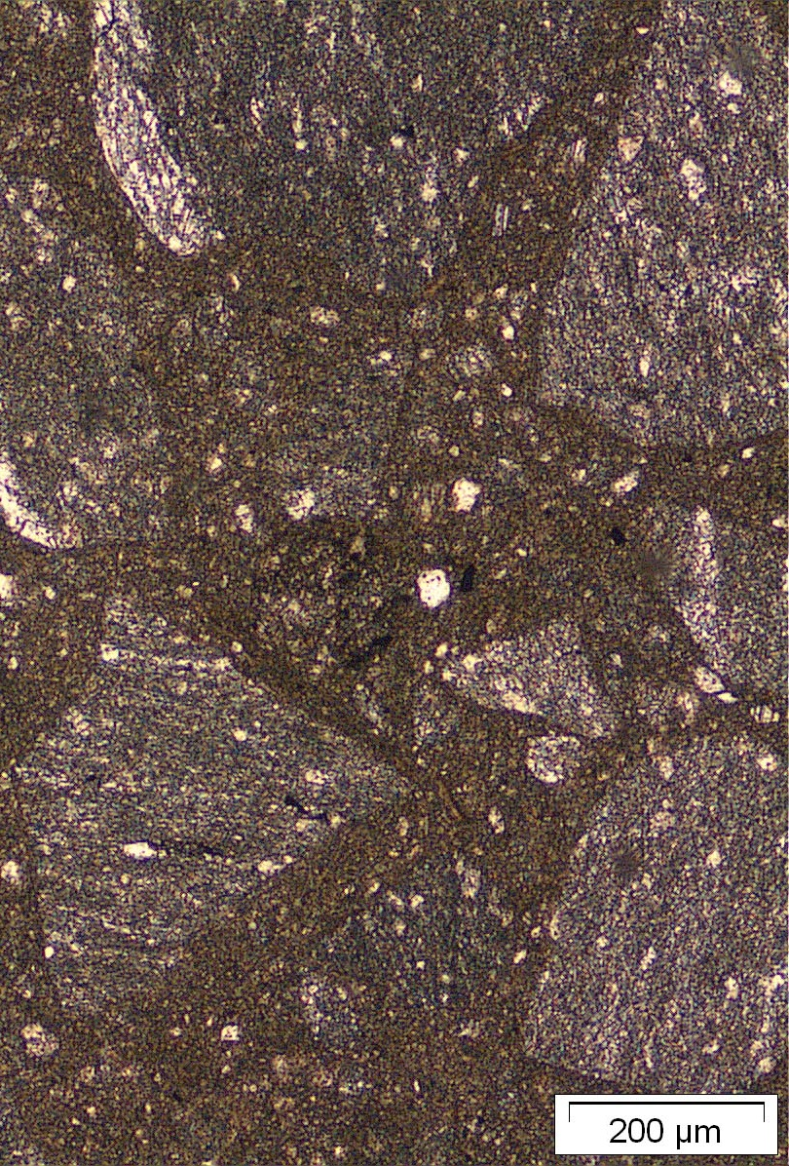
Fault rock: Cataclasite
<30% visible angular fragments
cohesive fault rock composed of broken, crushed, or rolled grains (sub mm scale).
does not disintegrate when struck with a hammer.
Broken grains in a matrix
<30% visible angular fragments (cf breccia)
Matrix dominated with few grains = ultracataclasite
Mechanism - cataclasis
fracturing, rotation and frictional sliding of grains past one another. Ie, a grain-scale process (cf breccia)
distributed over a band of finite width, e.g. peppercorns between a mortar and pestle
Also cataclastic flow
Cataclasis distributed across a relatively broad band of rock (several cm)
Distributed = mesoscopically ductile

Slide 8
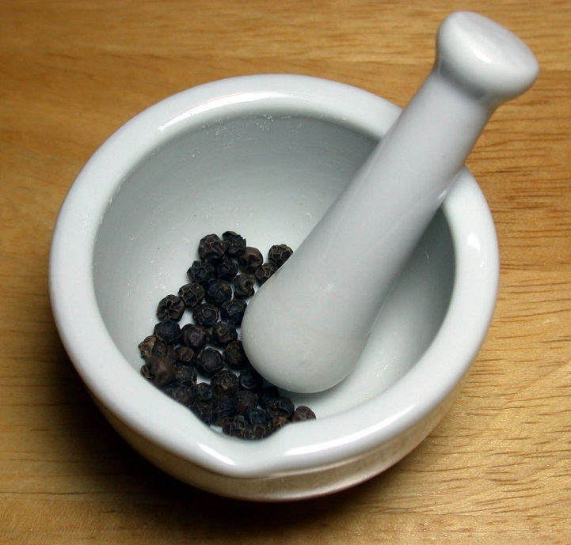
What is Cataclastic flow?
Granular flow requires grains to roll past each other
Significant amount of dilation – grains move apart
Cataclastic flow – grains are crushed and broken as they move past each other

Slide 9
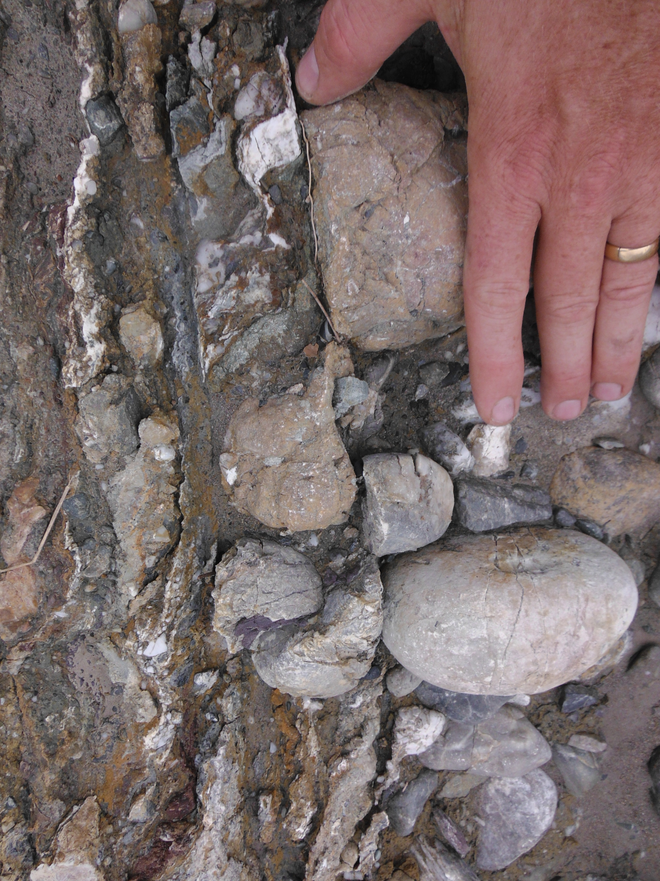
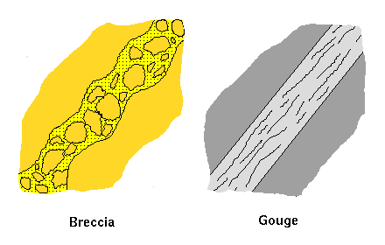
Fault rock: Gouge
Non-cohesive, clay-rich rock composed of pulverised grains much less than 1mm diameter
more that 70% clay size (<4μm)
Develops along principal slip surface.
May be foliated by shearing along the fault surface
Mechanism – Fracturing and cataclasis where deformation is localized

Slide 10
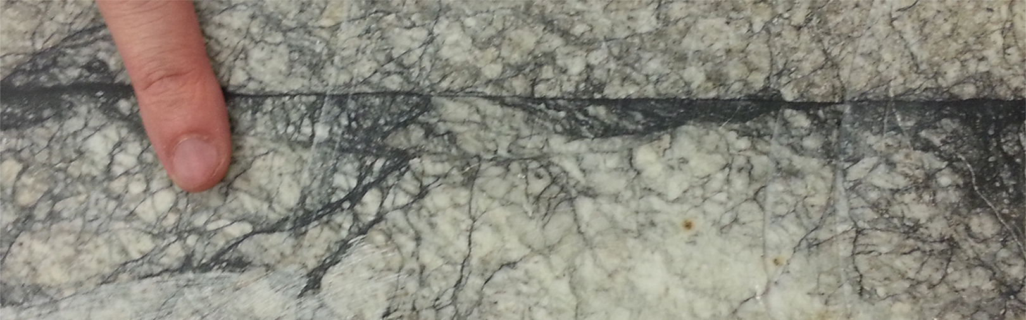
Pseudotachylite
Tachylite is volcanic glass created by swift (tachy) cooling of basalt
Pseudotachylite is fake volcanic glass, created by frictional melting of rock in a fault zone, during an earthquake
Found on the fault surface, often as the matrix to a breccia, or as veins injected into the walls of the fault.
Frictional heating enough to cause coseismic melting will weaken rocks until they cool! (example of strain softening)

Slide 11
Alpine fault rocks
1.5 m thick gouge
Major faults can have
multiple gouges developed in different lithologies
Deformation fabrics many 10s to 100s of meters wide

Slide 12
Summary: fault rocks
Form by cataclasis – fracturing, crushing, rotation
fault breccia (incohesive or indurated/veined): >30% angular fragments
fracturing
cataclasite (cohesive): <30% angular fragments
Cataclastic flow – mesoscopically ductile
fault gouge: (incohesive) very few isolated fragments in >70% clay-sized matrix
Pseudotachylite – frictional melt product

Slide 13
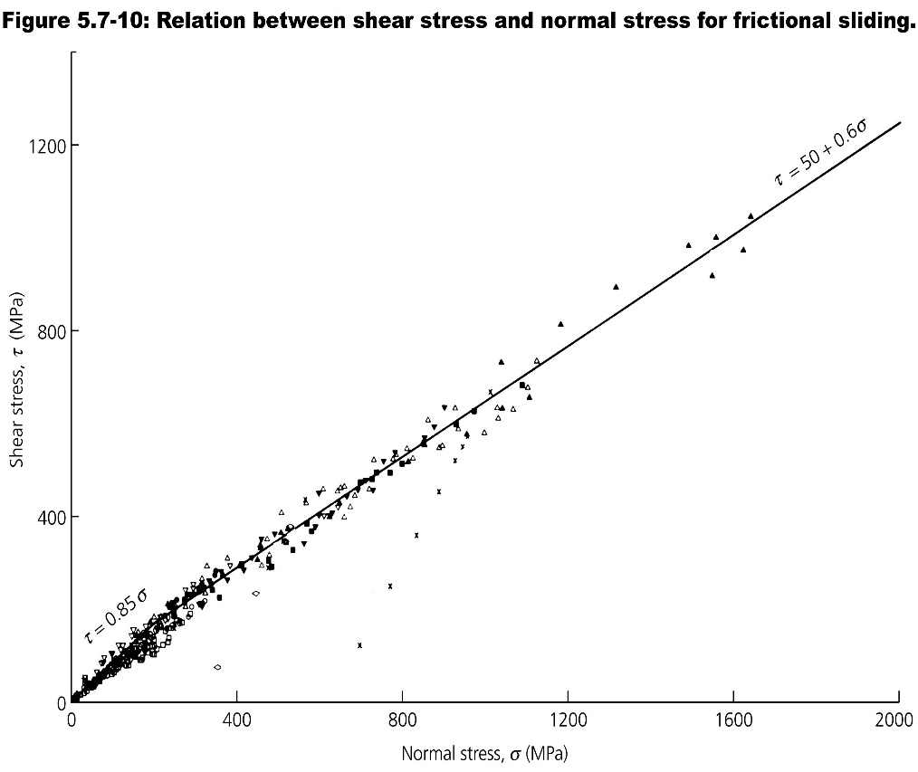
Mechanical properties of fault rocks - Byerlee’s law
In the laboratory,
At low confining stresses, static friction varies widely up to 0.85
Surface roughness (lithology) dominates the friction
at moderate to large confining stress
Friction is reduced to 0.5-0.6
STATIC frictional resistance to sliding is independent of lithology and uniformly proportional to normal stress
Surface roughness is irrelevant
Swelling clay content can reduce it further
However…..
Shear stress (Mpa)
Mostly μ = ~0.55
Mostly μ 0.6>0.85
Normal stress (Mpa)
Byerlee, 1978

Slide 14
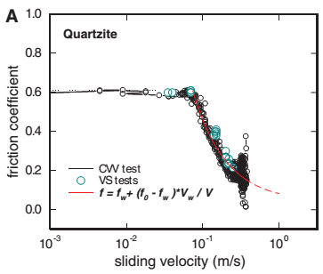
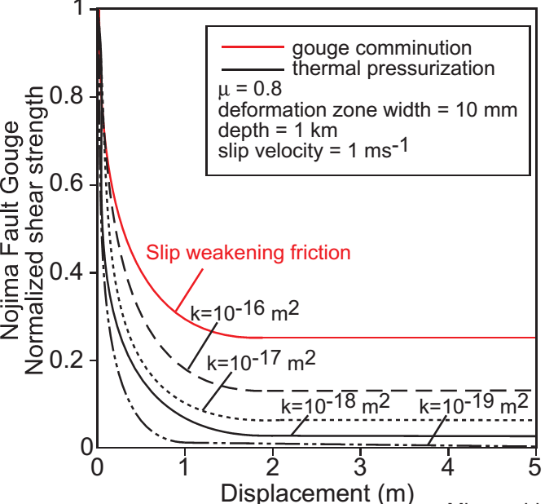
Fault rock dynamic friction depends on permeability
High permeability fault rocks – pore fluid drains during earthquakes
If fault core and host rocks are porous (depends on mineralogy and texture) juxtaposes the fault plane, slip may be essentially dry
Forms pseudotachylyte (melted rock)
and/or ultracataclasite (powdered rock) during frictional grain flow
Equivalent to oil or talcum powder acting as lubricant
Gouge comminution
Frictional melting
Reduces friction
Reduces friction

Slide 15
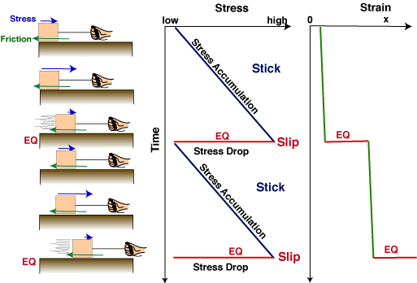
Dynamic friction during an earthquake
coseismic reduction in frictional resistance to sliding is common in mature faults = slip at lower differential stress
Initiation of sliding
End of sliding
Stress drop

Slide 16
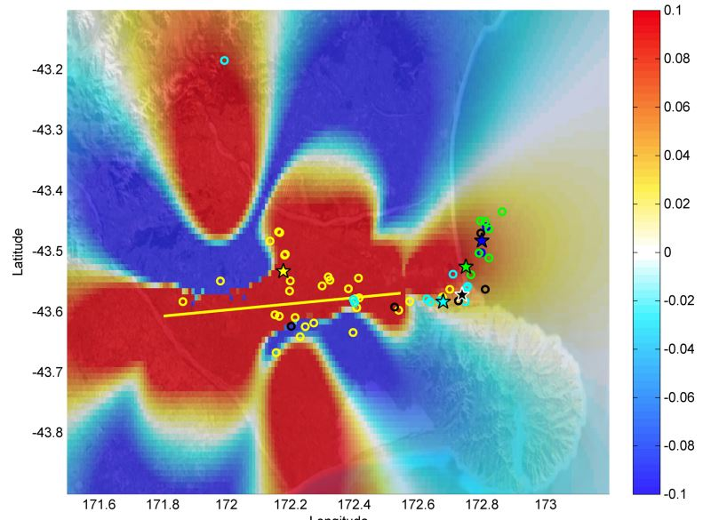
Stress triggering of earthquakes by other earthquakes
Failure is favored when Coulomb failure stress increases
Failure σ = c+μσ
Changes in Canterbury due to the Earthquake sequence reflect the strike slip focal mechanism, with increased stress in the compressional quadrants of the fault
Stein et al., 1994
Generally aftershocks and triggered earthquakes occur in areas of increased stress

Slide 17
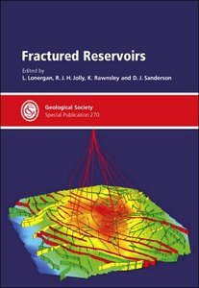
Economic importance of faults/fractures
loss of continuity in intact rocks provides permeability for migration and accumulation of fluids (groundwater, geothermal fluids, oil, gas etc.)
fractured reservoirs and aquifers typically anisotropic
Different transmissivity in different directions
controlled by conductive properties of fractures
Controlled in turn by local stress field
Fluids may precipitate minerals, healing fractures and giving rise to ore deposits

Slide 18
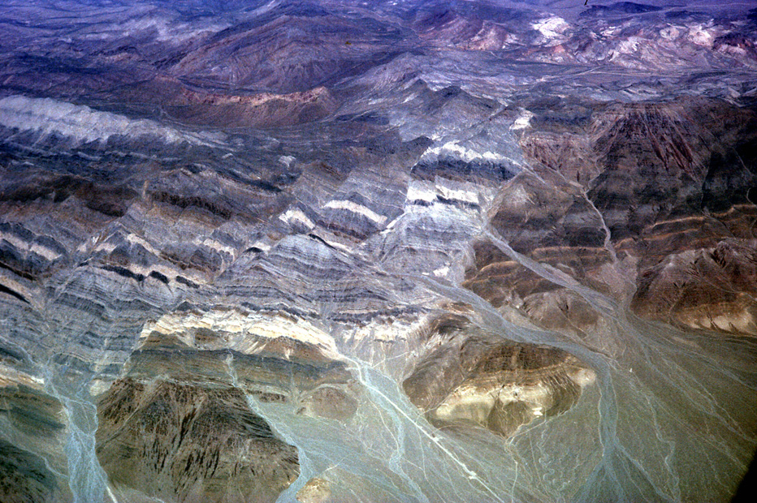
Types of Faults
What do you see ?
Fundamentally, need to understand if outcrop length is growing or reducing

Slide 19
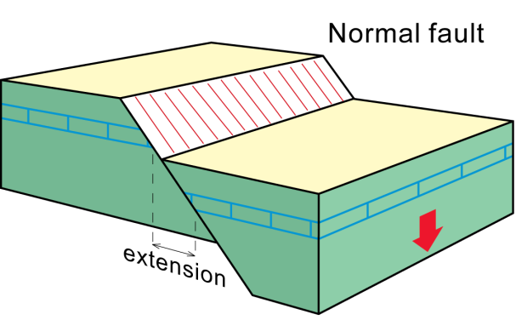
Normal fault
high angle, dip slip fault on which hangingwall has moved down relative to footwall
brings younger rocks down to lie over older ones

Slide 20
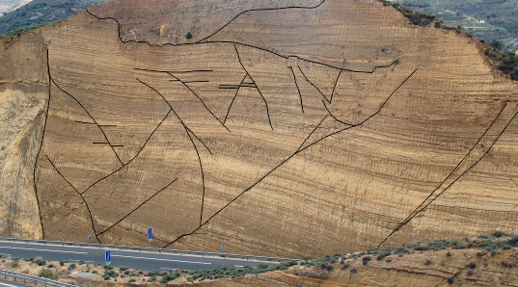
Normal faults
Extension
Outcrop is being lengthened

Slide 21
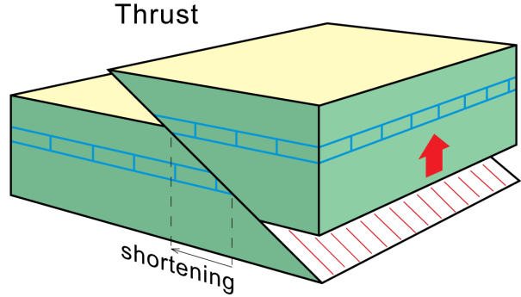
Thrust or Reverse fault
dip slip fault on which hanging-wall has moved up and over footwall - old rocks brought over younger ones
Thrust fault: low-angle fault along which hanging wall forms thrust-sheets (nappes) of allochthonous rocks emplaced over autochthonous or parautochthonous footwall
Reverse fault –refers to high angle faults, which are often reactivated normal faults (think about pore pressure)
Allochthonous – far travelled, ie originated elsewhere
Autochthonous – deposit formed where it is found, typically synorogenic
Para-autochthonous – has been transported from afar but is not overthrust – ie footwall rocks

Slide 22
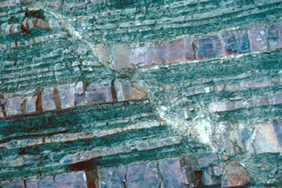
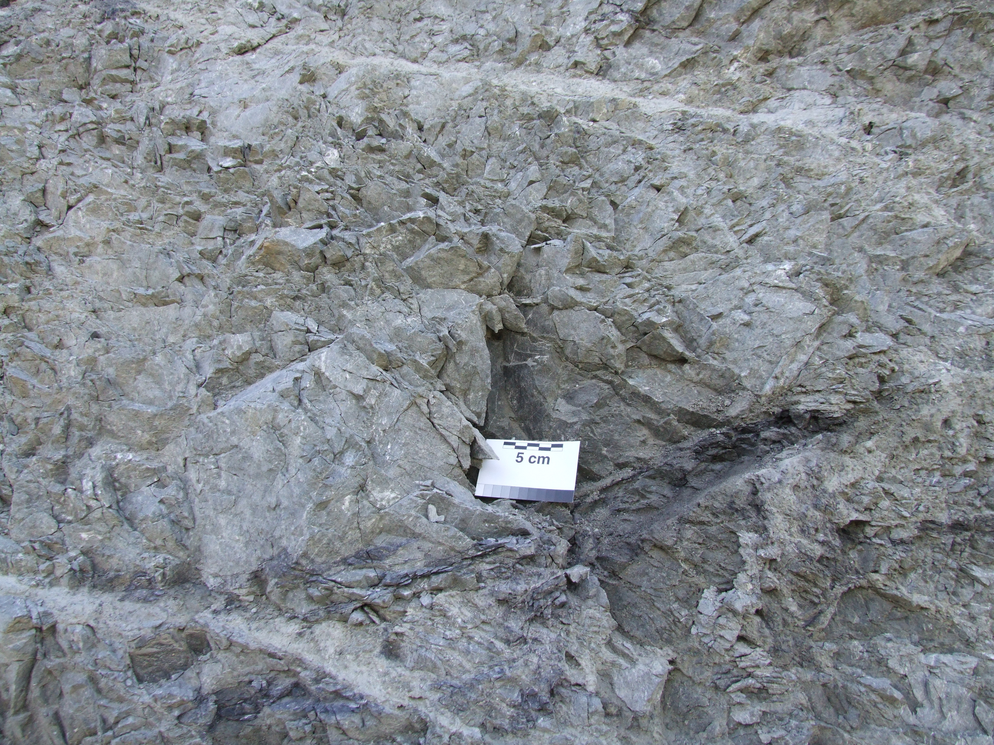
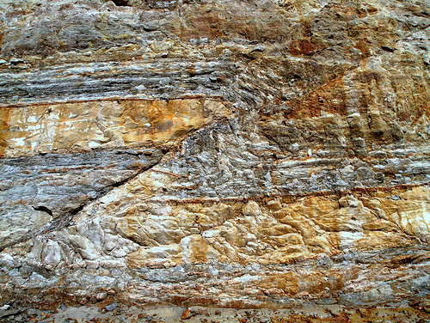
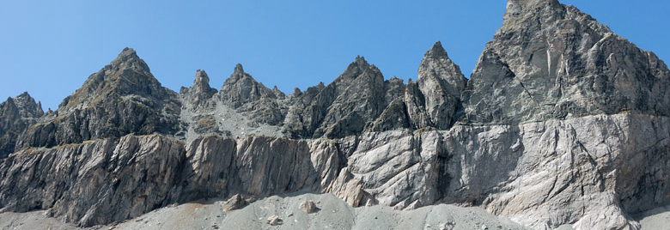
This photo seriously needs a scale!

Slide 23
Strike slip faults
have very steep or vertical dips
relative movement between adjacent blocks is horizontal
parallel to strike of fault plane

Slide 24
