Slide 1
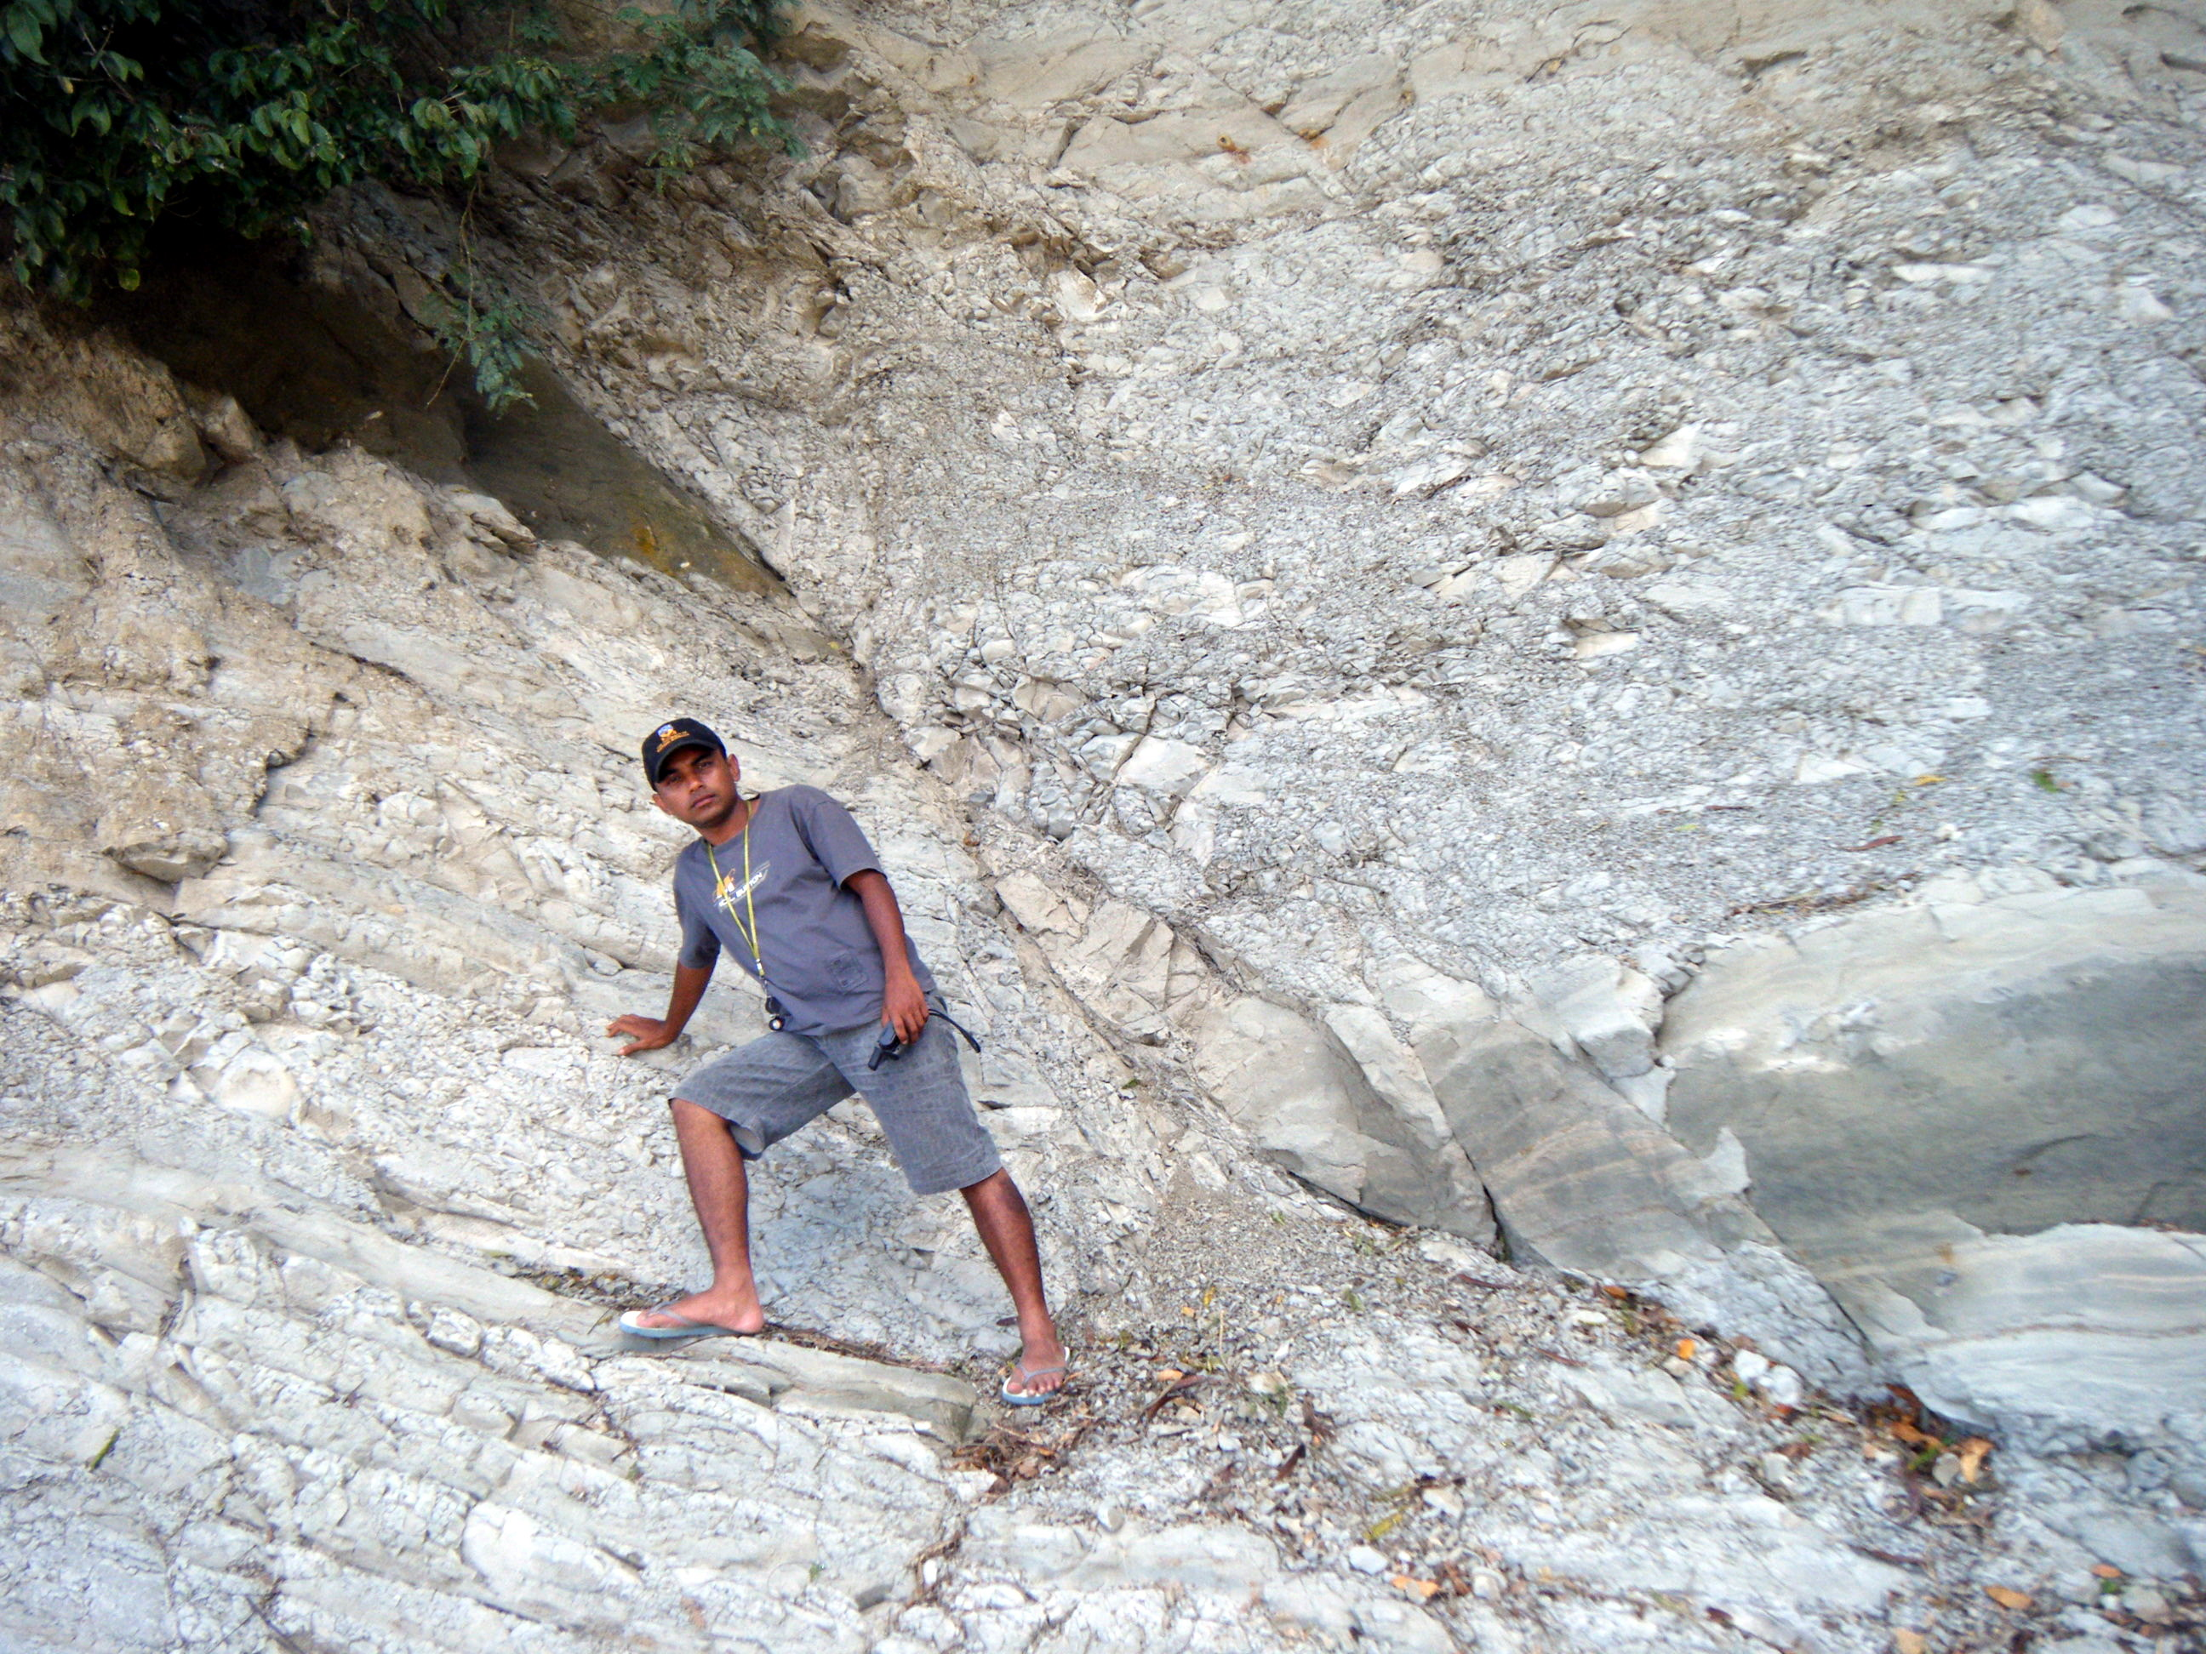
Geol 244 – structural geology
Geol 244 – structural geology
Lecture 11 – Brittle faulting
Lecture 11 – Brittle faulting

Slide 2
Types of Faults – Anderson’s theory
Explains conjugate fault systems
Fault planes inclined ~30° either side of σ1
describes 3 situations, each with
1 principal stress vertical
2 principal stresses horizontal
Shortening in the direction of σ1
Need to remember which stress is vertical:
Normal faults - σ1 vertical
Strike slip faults – σ2 vertical
Thrust faults – σ3 vertical
You should be able to draw these Andersonian diagrams

Slide 3
Types of Faults – Anderson’s theory
Anderson’s theory works for
High-angle normal faults
Low-angle thrusts
Strike-slip faults
not for
Low-angle normal faults
High-angle reverse faults
Non-conjugate faults

Slide 4
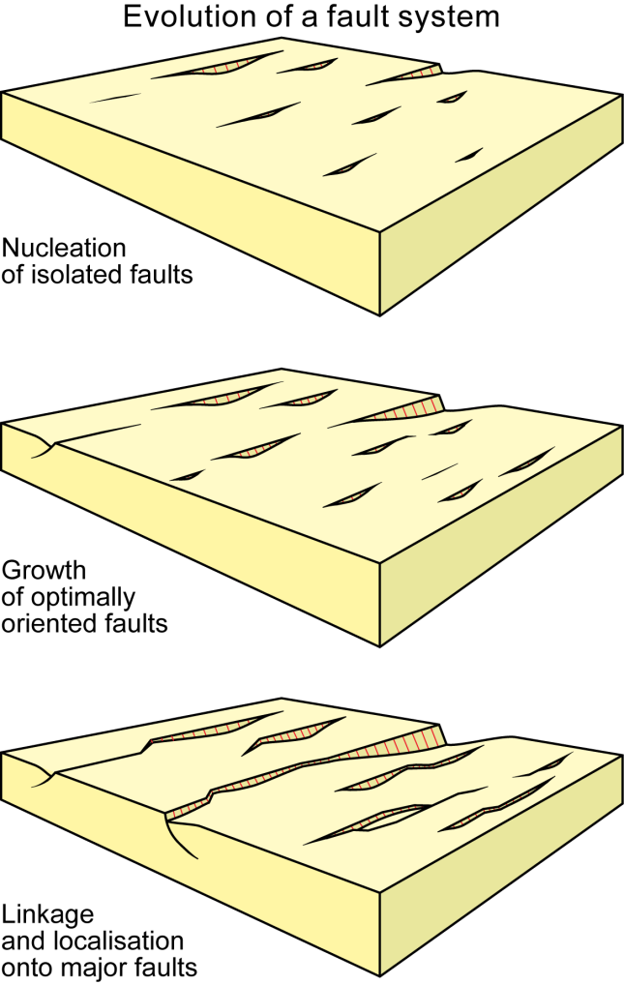
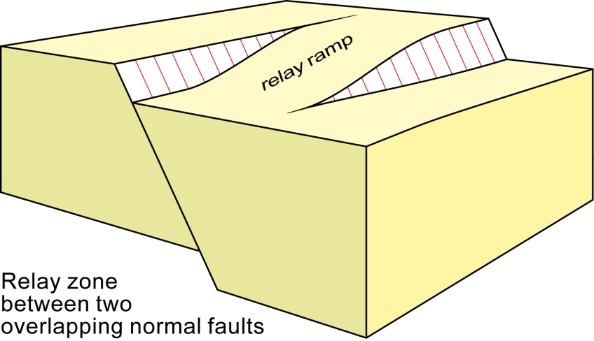
How do faults grow
New research suggests that growth is very rapid

Slide 5
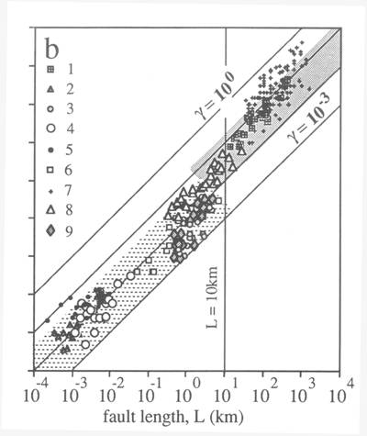
How do faults grow
Faults appear to attain their full length quickly, then grow in displacement
Big faults start big
Small faults start small

Slide 6
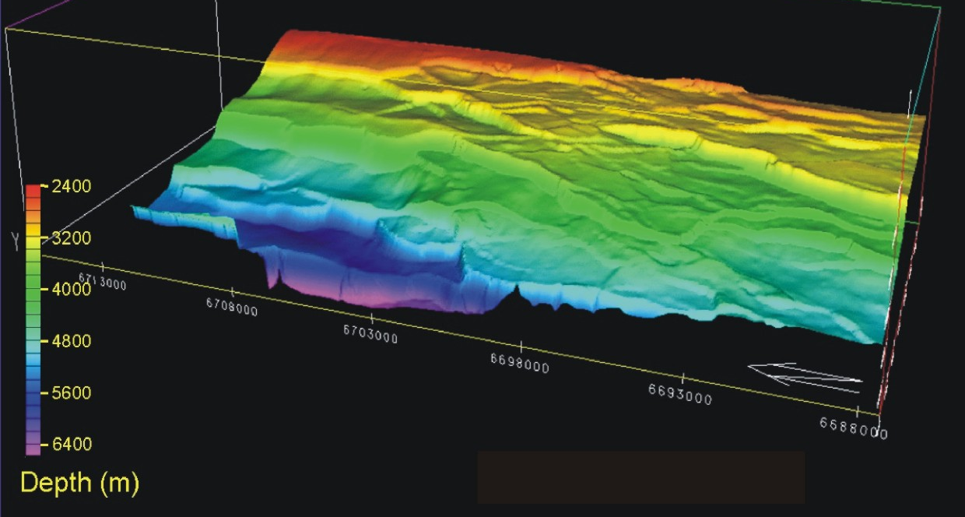
Normal faulting in the north sea
Oil rich North Sea
Arrays of normal faults connected by relays

Slide 7
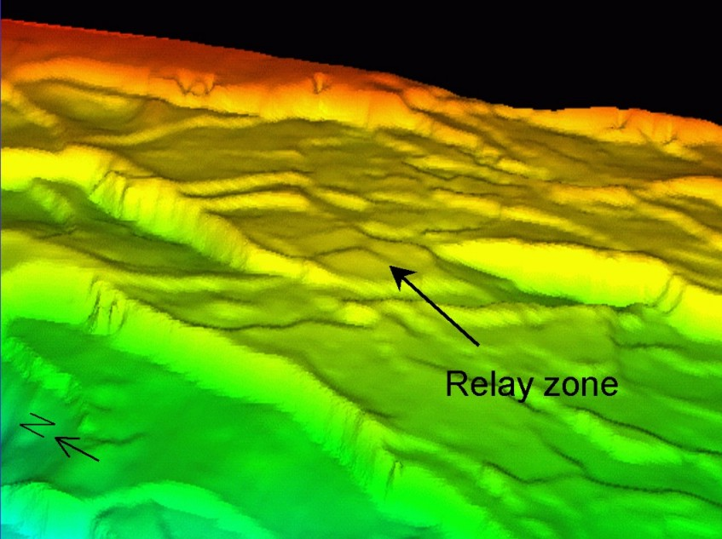
Fault segmentation - Relay zones
Displacement decreases
Displacement increases
b
a
Relay ramp
c
a+b=c

Slide 8
Linkage of en-echelon fault segments
Ramp
Relay ramp
Slip here gets split between two faults

Slide 9
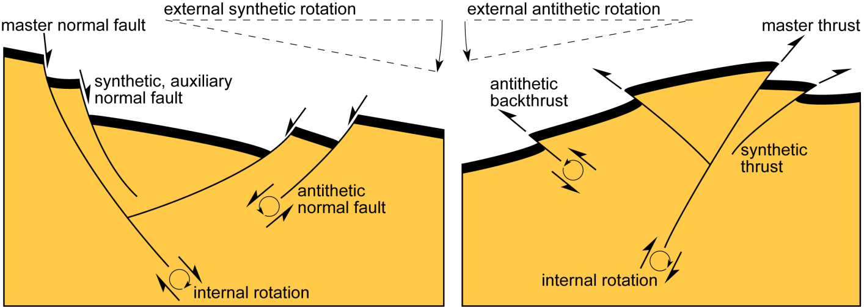
Synthetic and antithetic faults
Synthetic faults are parallel and have same relative movement as master fault
subsidiary yet genetically related set of conjugate faults, dipping in opposite direction to master fault, are antithetic faults

Slide 10
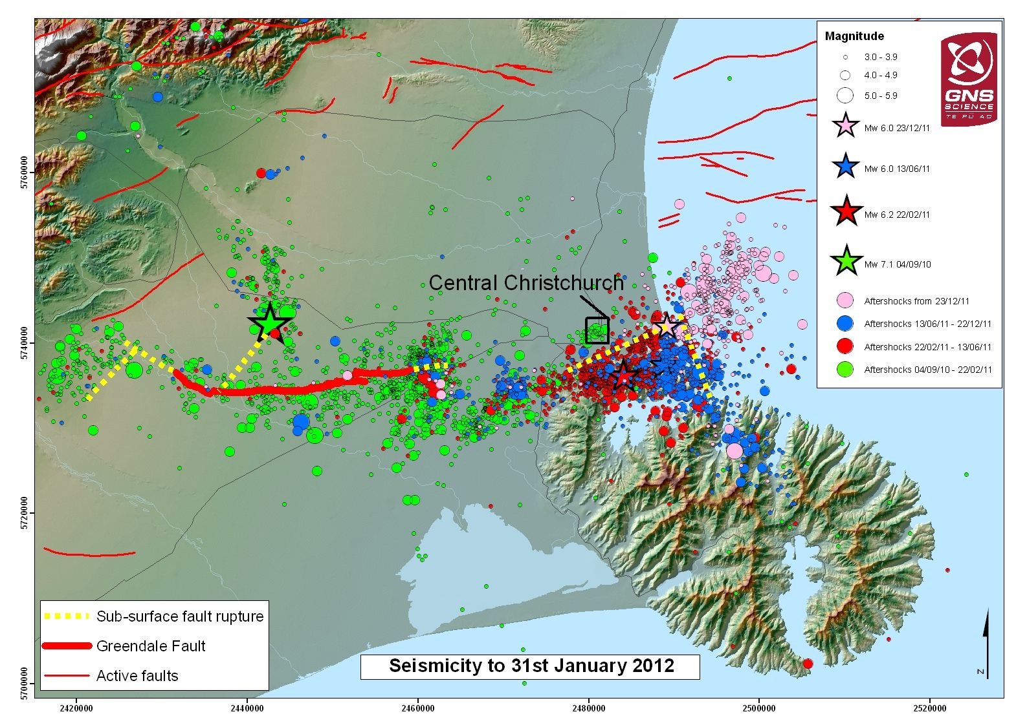
Fault systems
Strike slip fault segmentation – part of a fault system

Slide 11
Describing fault systems
3 views on the geometric, mechanical and mathematical nature of faults:
Euclidean geometry – treat faults as planar zones at all scales
Some allowance for segmentation and heterogeneity
Granular geometry – treats faults as bounding particles that rotate at multiple scales
Compatible with observations of rock particles in fault zone gouge; regional block rotation; rotating mosaic of plates on the earth’s surface
Fractal geometry – treats faults as rough surfaces that branch at all scales
Scale invariance is compatible with power law statistics of earthquakes, whatever the scale or area of investigation
Compatible with geometrical analysis of fault traces
Compatible with measurements of joint and fault surface topography.

Slide 12
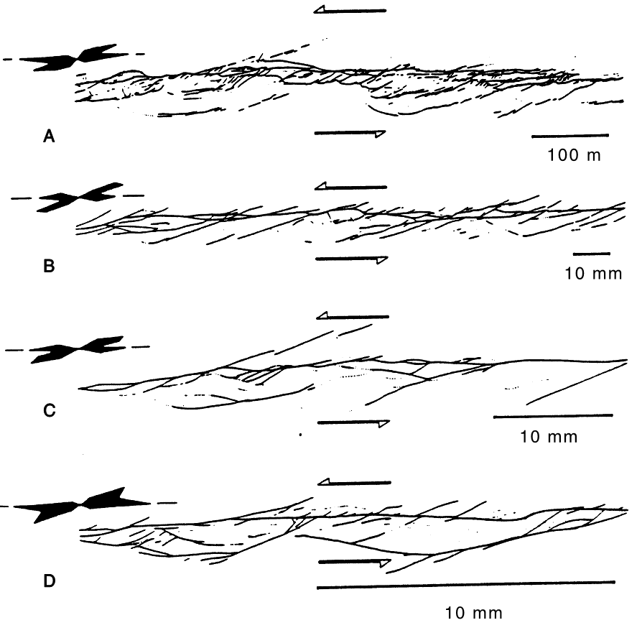
Example of fault system geometry
Euclidean - Localization onto one major plane accommodating most displacement at all scales
Granular – rotation of particles at all scales by shear on bounding faults
- Think grains in gouge all the way to rotating plates
Fractal - self-similar roughness shown by geometry of branching structures at all scales
Mature fault zones rapidly evolve towards relatively simple narrow zones, dominated by sliding

Slide 13
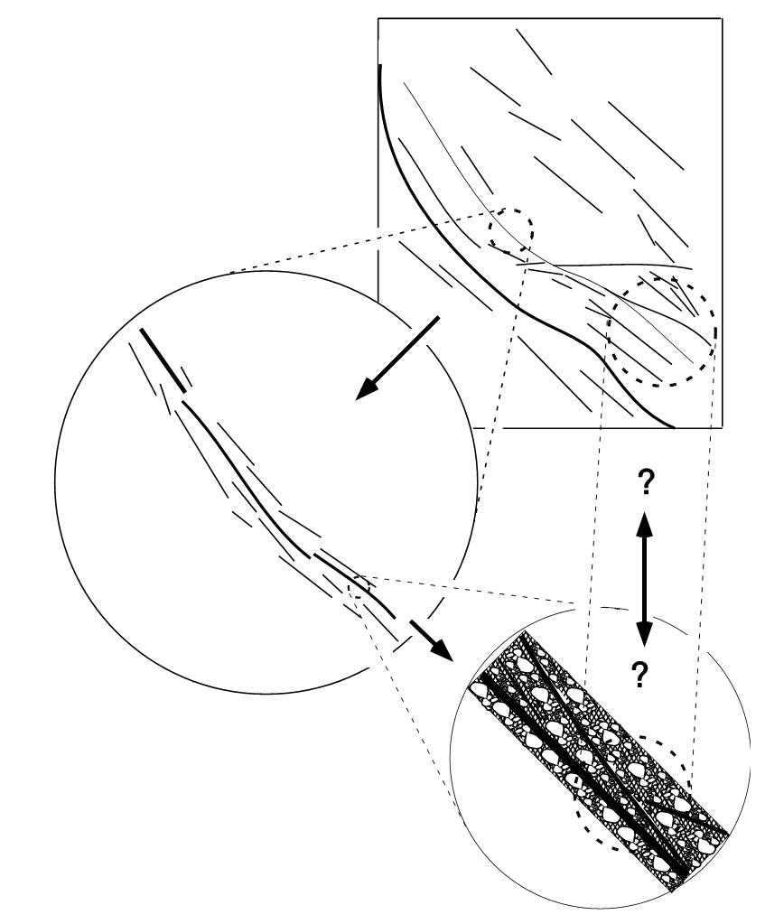
Fractal fault systems
Regional plate-boundary system
Tend to be relatively similar at all scales
At the largest plate boundary scale, the shear is distributed over a network of faults.
Within the plate boundary zone, individual major faults in the network consist of a quasi-linear array of subparallel strands.
At internal fault-zone scale, each strand consists of a distributed band of intense fracturing, with one or more zones of strain localization and intense fragmentation.
Key structural elements repeat at different scales.
Individual fault zone
Fault outcrop

Slide 14
Normal fault systems
Graben - a down-dropped block bounded by conjugate normal faults dipping towards each other
Horst - a relatively elevated block bounded by outward-dipping normal faults
Half graben – a tilted fault block bounded by single set of normal faults. Creates a basin with a triangular cross section
Rift systems of grabens may extend for long distances – e.g. North Sea

Slide 15
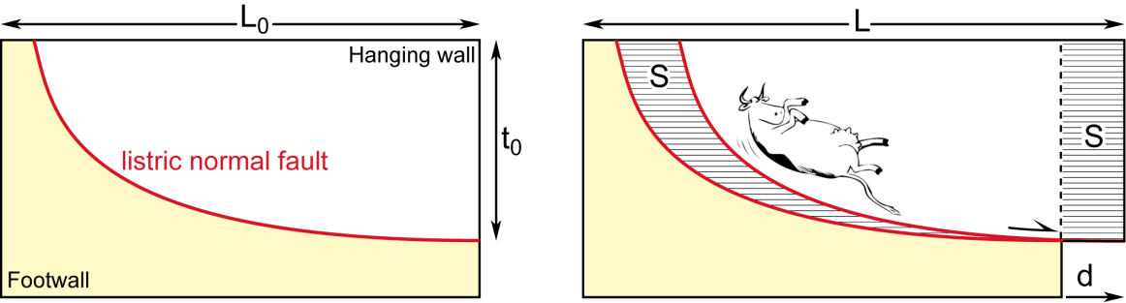
Normal fault systems – Planar vs listric faults
Planar faults can only accommodate small amounts of extension
To really extend, you need to go listric
How is this change from high to low angle faulting expressed at the surface?

