Slide 1
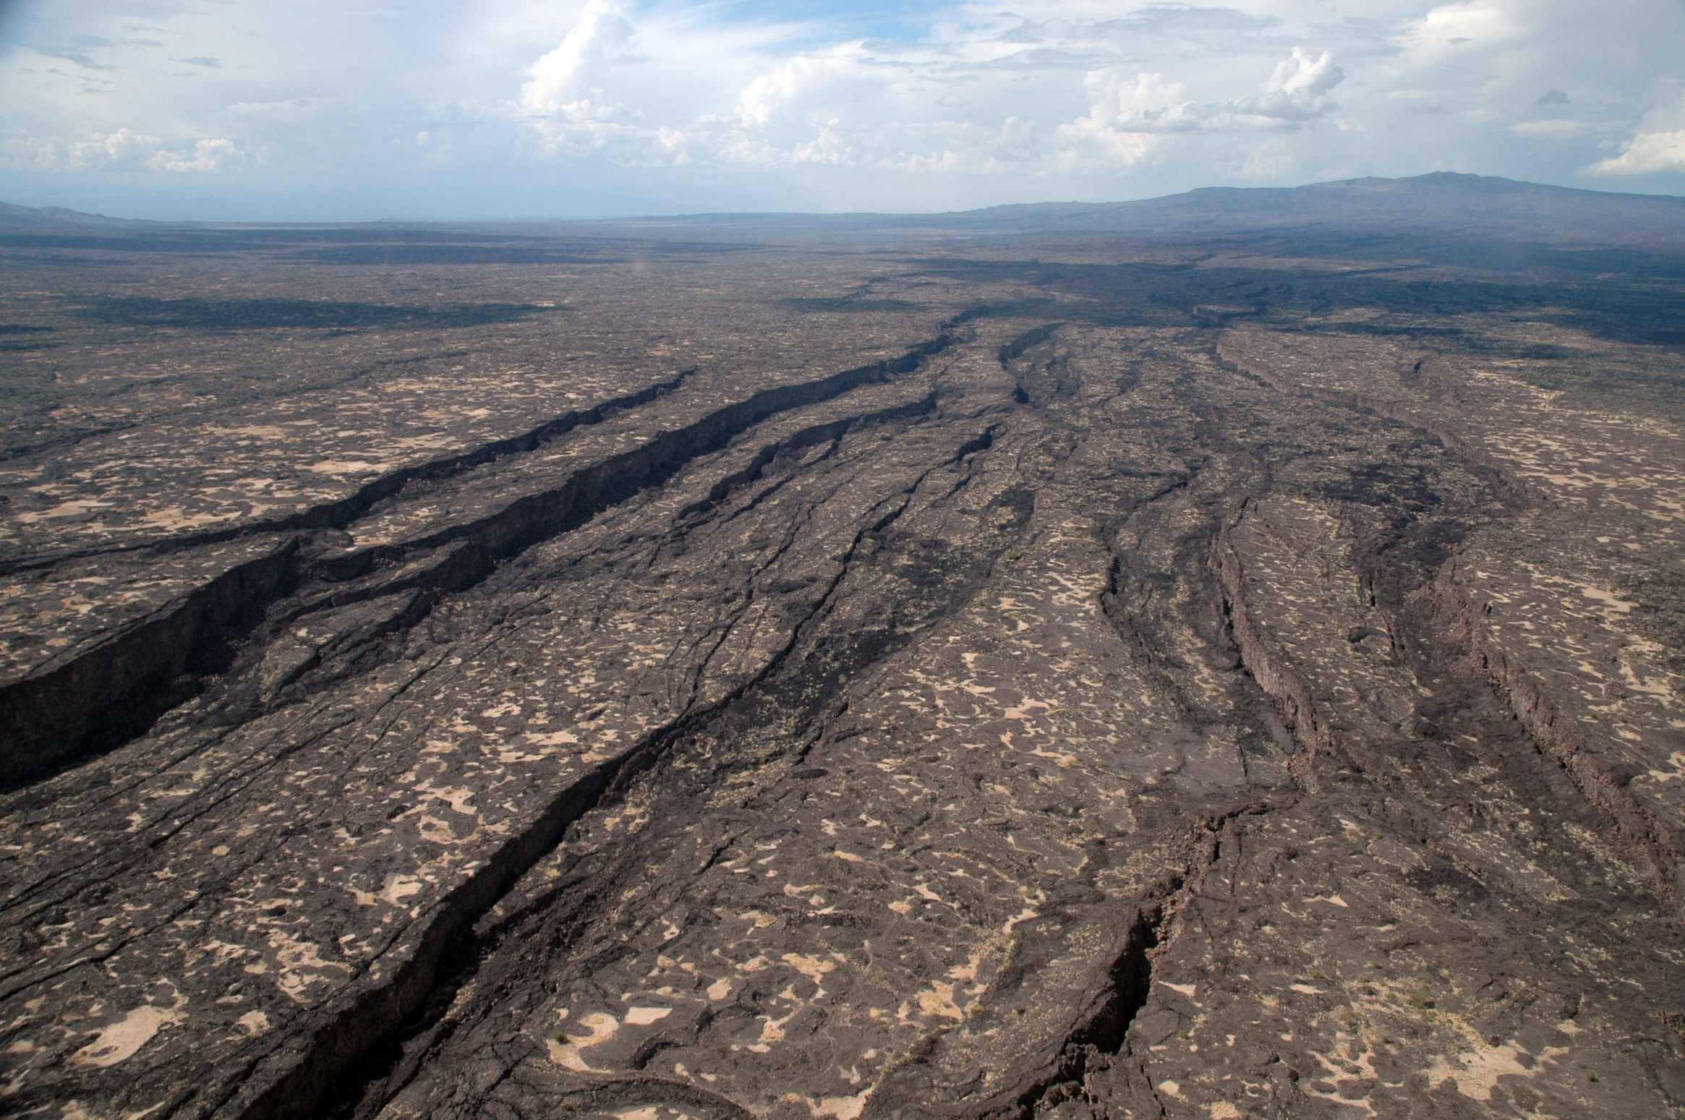
Geol 244 – structural geology
Geol 244 – structural geology
The Afar Rift in Ethiopia
Spot the relay ramps
Lecture 12 – Fault systems
Lecture 12 – Fault systems

Slide 2
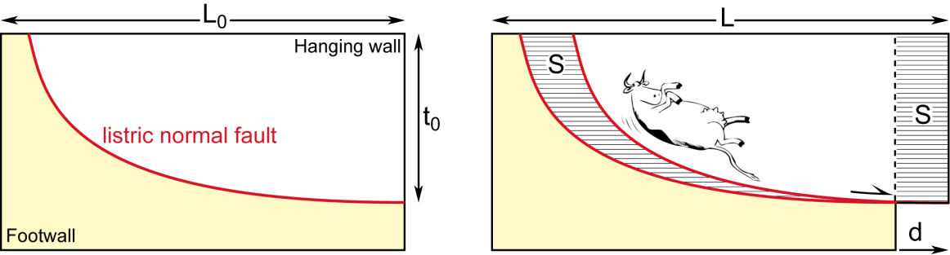
Normal fault systems – Planar vs listric faults
Planar faults can only accommodate small amounts of extension
To really extend, you need to go listric
How is this change from high to low angle faulting expressed at the surface?

Slide 3
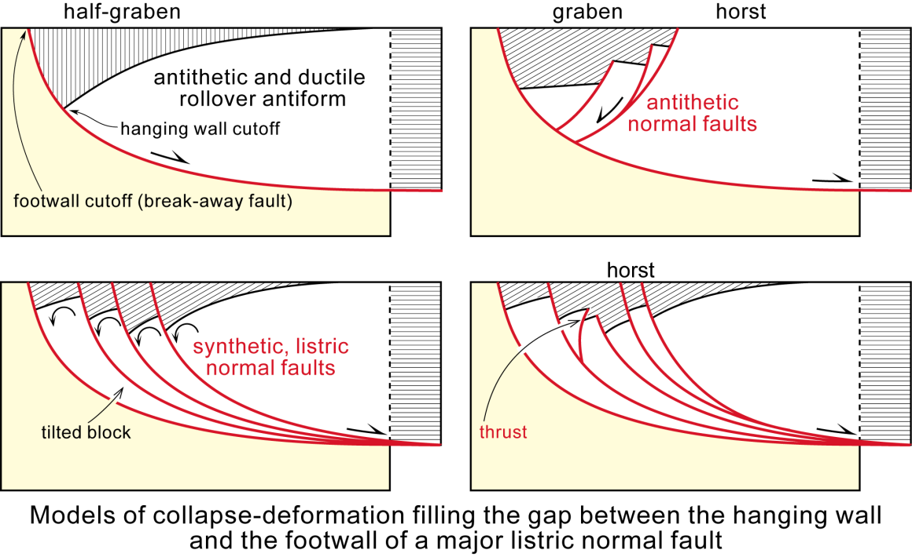
Normal fault systems – Planar vs listric faults

Slide 4
Low angle detachment faults – a kinematic enigma
Field investigations consistently measure Byerlee friction values in crustal rocks
Low angle normal faults dip <30 degrees
How do you overcome Byerlee friction with stresses resolved on low angle faults? – need to substantially reduce Byerlee (static!) friction (ie not dynamic friction)
Necessary to accommodate large scale extension

Slide 5
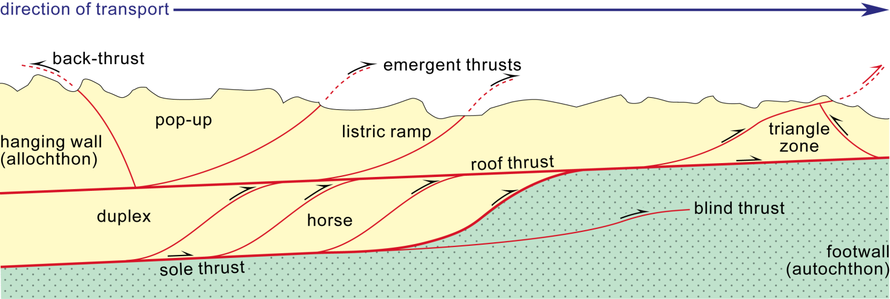
Thrust belts – thick or thin
Two styles in thrust tectonics: thin-skinned vs thick-skinned tectonics
Thin-skinned tectonics - sedimentary cover detached from basement typically along fault planes with ramp-flat geometries
sole thrusts remain above strong crystalline basement that is left undeformed – only thin skin deforms
bedding plays controlling factor in generating staircase, flat–ramp systems

Slide 6
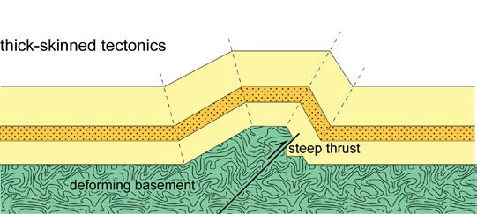
Thick-skinned thrusting
thrust zones tend to follow surfaces of rheological contrast and can involve basement
You will come back to thrust belts when discussing Folds
Thrust-and-Fold Belts

Slide 7
Strike-slip faults
Strike-slip faults in general vertical and develop at ca. 30° to horizontal compression direction
major strike-slip faults can be traced over several hundred kilometres, at which scale they are not simple straight and planar planes
often develop system of right-stepping and left-stepping faults
generates local extensional zone and/or contractional zones

Slide 8
Hanmer Basin

Slide 9
Hanmer Basin
Releasing bend basin
Releasing bend basin
Restraining bend pop-up

Slide 10
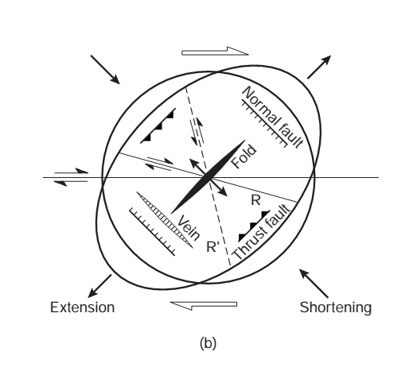
Riedel shears – subsidiary fractures
Subsidiary Riedel shear fractures that propagate short distance out of main fault
Riedel shears form network commonly developed during embryonic stages of faulting.
They form systematic array that seems to be self-similar for wide variety of materials over wide scale range
basic geometry consists of conjugate R and R’ fractures so that acute bisector is direction of maximum compressive stress
Riedel shears develop at small angle (typically 20-30°) to main fault, and are synthetic to main fault

Slide 11
Strike slip shear patterns
Strike slip faults develop distinctive patterns of subsidiary shears that reveal their slip sense
Riedel (R) shears are SYNTHETIC
R’ shears are ANTITHETIC, conjugate Riedel shears
Riedel prime (R’)
σ1
Riedel (R)
σ3
Notes:
Candice, Haircut, coat, tv, Stefan, earthquake

Slide 12
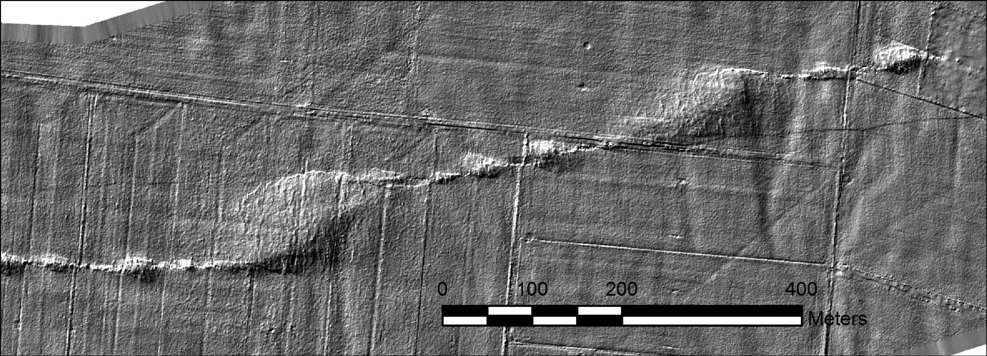
Other strike slip shears
Folds and thrusts (P shears) form perpendicular to σ1
T (tension) shears form parallel to σ1, like veins and joints.
σ1
T Shears
P (pressure) shear
Fold

Slide 13
Worth learning this…

Slide 14
Enechelon
Describes structures that form in approximately parallel formation at an oblique angle to the overall trend
Most faults that have a component of strike slip display en echelon behaviour

Slide 15
What is the sense of shear
En echelon anticlines
sinistral
dextral

Slide 16
Next week
Folds and folding

