Slide 1
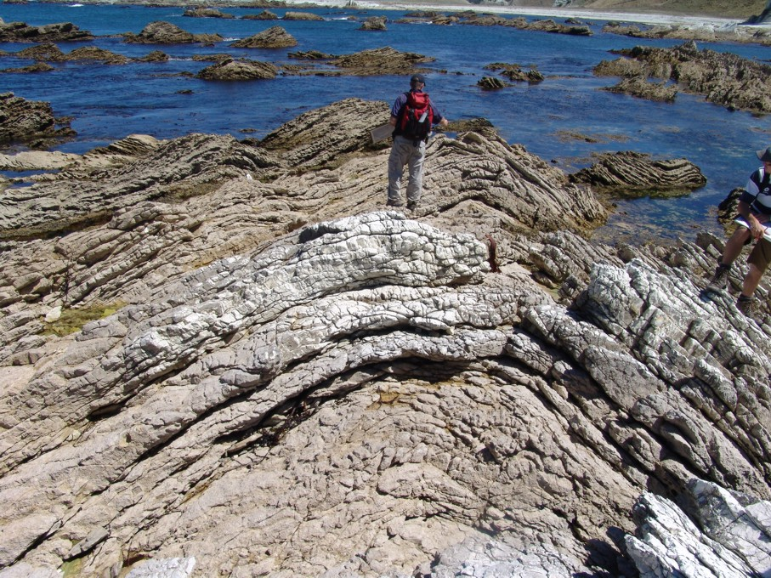
Geol 244 – structural geology
Lecture 13 – fold classification and geometry

Slide 2
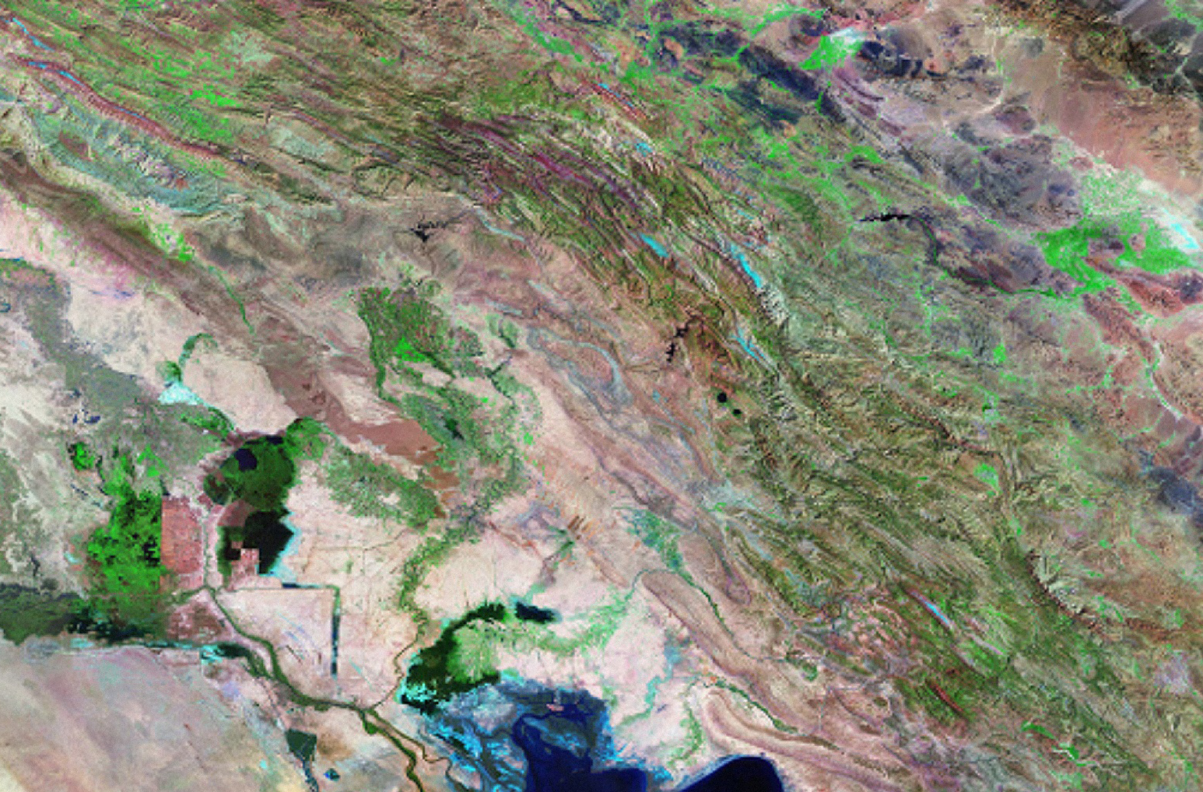
Fold and thrust belts
Folds are visually most spectacular structures on Earth.
conspicuous natural images of how original shapes of rock bodies can be changed during deformation.
Zagros
fold-and-thrust belt
Iraq
Iran
200km

Slide 3
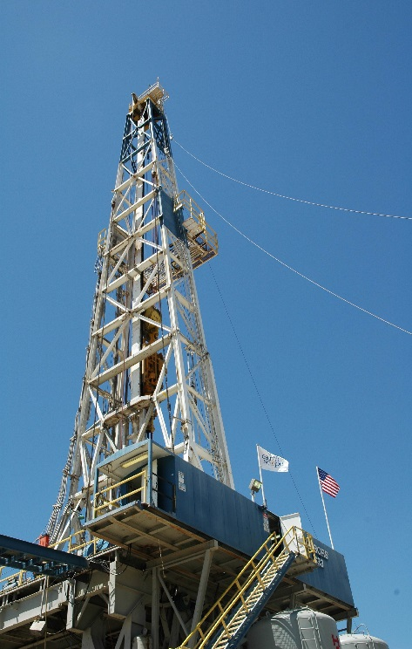
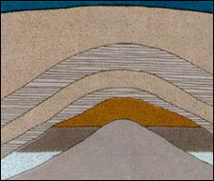
Importance of folds for oil exploration
Oil in porous rock layers (e.g. sandstone) is less dense than water and solid material → it migrates upward.
If roof of antiform trap is made up of non-porous material (e.g. clay), oil can rise no further.
Similar to upside-down bucket trapping bubbles of air as they rise in pond of water.

Slide 4
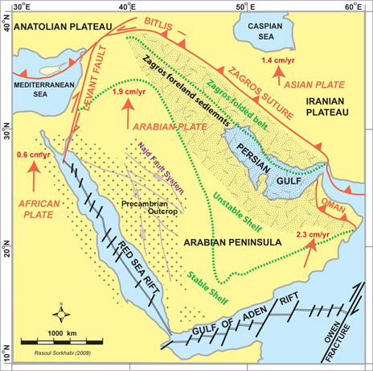
Middle east oil
Middle eastern oil fields were buried to oil generation temperatures at the same time in the Cenozoic that Zagros deformation was developing large anticlines

Slide 5
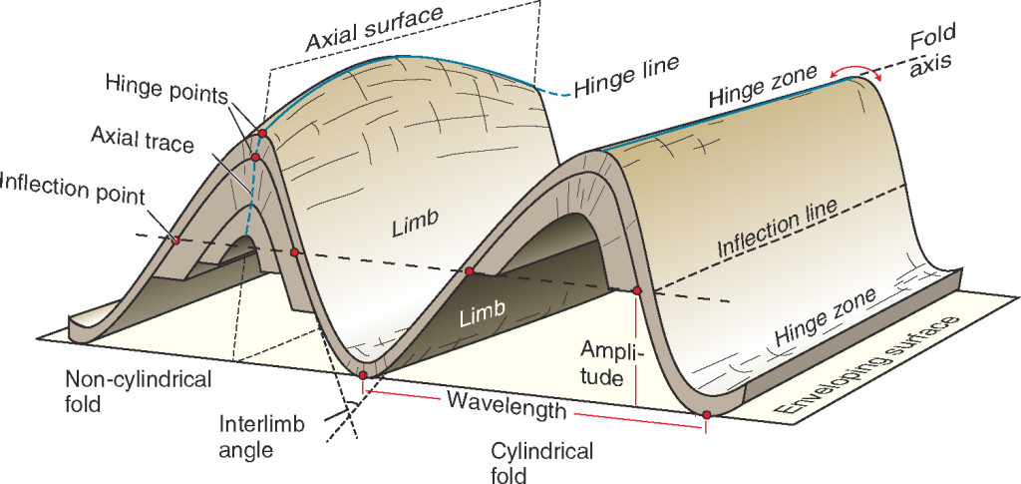
Geometric elements of folds
Folded layers are real, composed of rocks that have been folded.
Hinge is also real, fixed in position and contained in real rocks.
Axial surfaces and inflection points are imaginary geometric objects.
Convenient for helping to define orientation and form of fold.
Arc length

Slide 6
Fold terminology
Arc length
Interlimb angle: The angle between fold limbs as measured in the profile plane - more intense folding produces smaller interlimb angles

Slide 7
Geometric elements of folds
Wavelength: distance between two hinges of the same orientation
Arc length

Slide 8
Geometric elements of folds
Arc length
Amplitude: half the height of the fold measured from crest to trough

Slide 9
Geometric elements of folds
Arc length
Arc length: distance between two hinges of the same orientation, measured over the folded surface

Slide 10
Fold classification
3 D shape
2 D shape
Interlimb angle
Dip isogons
Facing
Right way up, upside down or overturned
Orientation
Relative changes in the dip of the axial surface and the plunge of the fold axis (line) on that surface

Slide 11
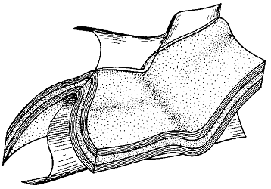
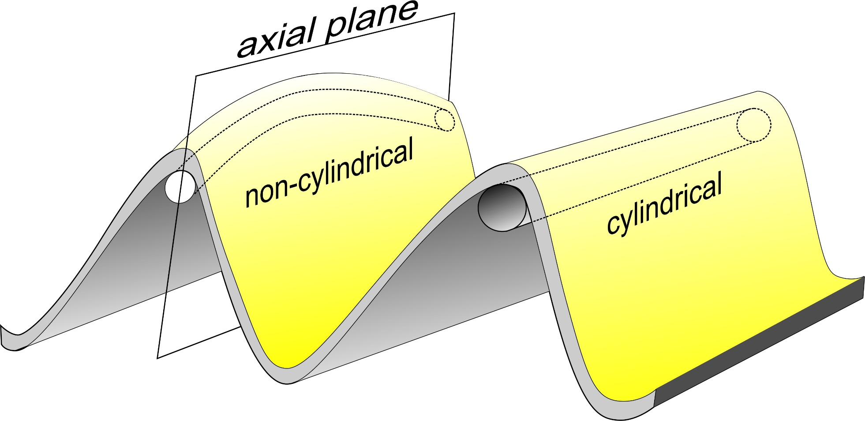
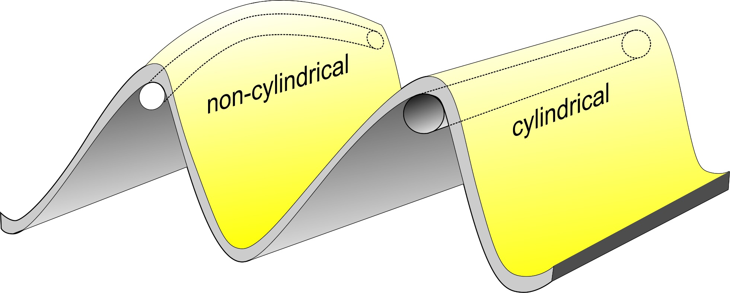
Fold classification by 3D SHAPE
Cylindrical – straight hinge line
Non-cylindrical – curved hinge line
True cylindrical folds are rare in nature; however, many folds closely or locally approximate purely cylindrical forms and can be considered (near-)cylindrical folds.
Non-planar axial surface
Non-cylindrical folds do not possess a uniform fold axis

Slide 12
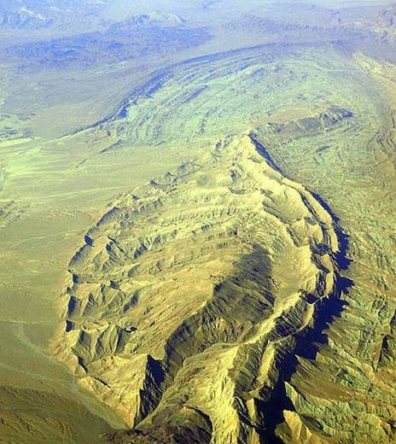
Non-cylindrical anticlines
Doubly plunging anticlines termed periclines
1/3 of Persian gulf periclines contain hydrocarbons
Like upside down cups of oil

Slide 13
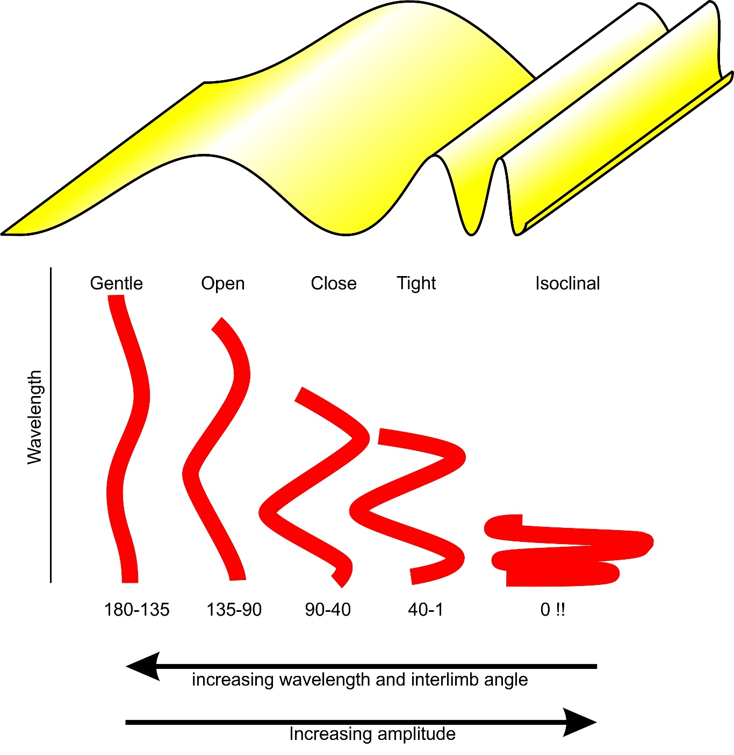
Fold classification by SHAPE – interlimb angle

Slide 14
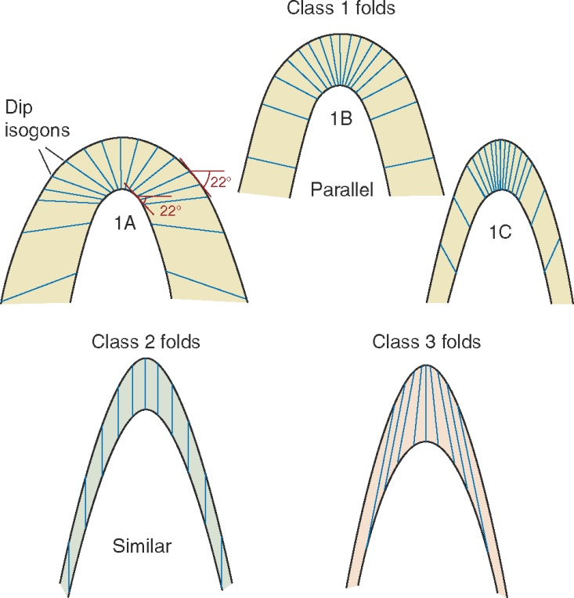
Fold classification by SHAPE - Dip isogons
lines joining equal limb dip on adjacent surfaces
Construct the tangent of limb dip on the inner and outer suface of the fold element, then join parallel tangents
class 1 folds - dip isogons passing from outer to inner arc converge on the axial plane trace of the fold
Most class 1 folds are parallel folds
Parallel folds – bedding everywhere parallel, maintain constant layer thickness and dip isogons are perpendicular to bedding
Constant layer thickness
Notes:
Class 1 folds can be subdivided into three subclasses called sub-class 1A, sub-class 1B and sub-class 1C. In sub-class 1A folds the dip isogons are very strongly convergent and dip isogon for any value of alpha makes an angle beta with the axial plane trace which is always greater than the alpha value of that dip isogon. For example a dip isogon of 40° value makes an angle b of 48° with the axial plane trace which is greater than a value of 40°. In subclass 1B folds, the thickness of the layer remains uniform and dip isogons are perpendicular to layer surfaces. Dip isogons for any value of alpha make an angle with the axial plane trace, beta which to equal to alpha. In subclass 1C folds the dip isogons are weakly convergent and any dip isogon such as one for 20° a value, makes an angle beta with the axial place trace <20 for this isogon. In class 2 folds, since isogons are parallel to the axial plane trace, beta value in simply non-existent or it has a value of zero or 180°. In class 3 folds the dip isogons are divergent to the axial plane trace and take negative values which could be greater or less than alpha depending upon the difference in the degree of curvature of the two arcs.If adjacent isogons are inclined towards each other, curvature of the outer arc between the isogons is less than that for the same region on the inner arc. If adjacent isogons are parallel the curvature of the outer are between the isogons is the same as that of the inner arc. If adjacent isogons are inclined away from each other, the curvature of the outer arc between the isogons exceeds that of the inner arc. This implies that in a single fold all isogons may not be convergent or all divergent but that some may converge & others diverge because of the complexities involved in the generation of fold structures.

Slide 15
Fold classification by SHAPE - Dip isogons
class 2 folds, curvatures of both the arcs is the same
dip isogons are parallel to each other and to the axial plane trace of the fold
class 3 folds - dip isogons diverge away from the axial trace as they traverse from outer to the inner arc.
In the field, we normally discriminate between approximately parallel (for all class 1 folds) and similar folds (for class 2 and 3 folds)
Constant layer thickness

Slide 16
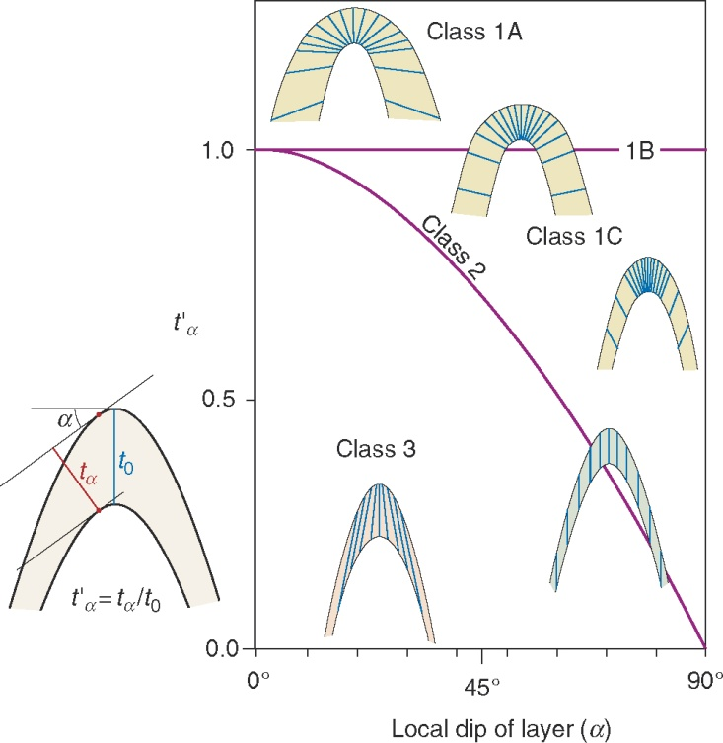
Limb:hinge thickness
Assuming upright fold, ratio of limb thickness to hinge thickness varies with local limb dip
1A has thickened limbs
Parallel folds have constant ratio of 1
1C, 2 and 3 represent increasing hinge thickening

Slide 17
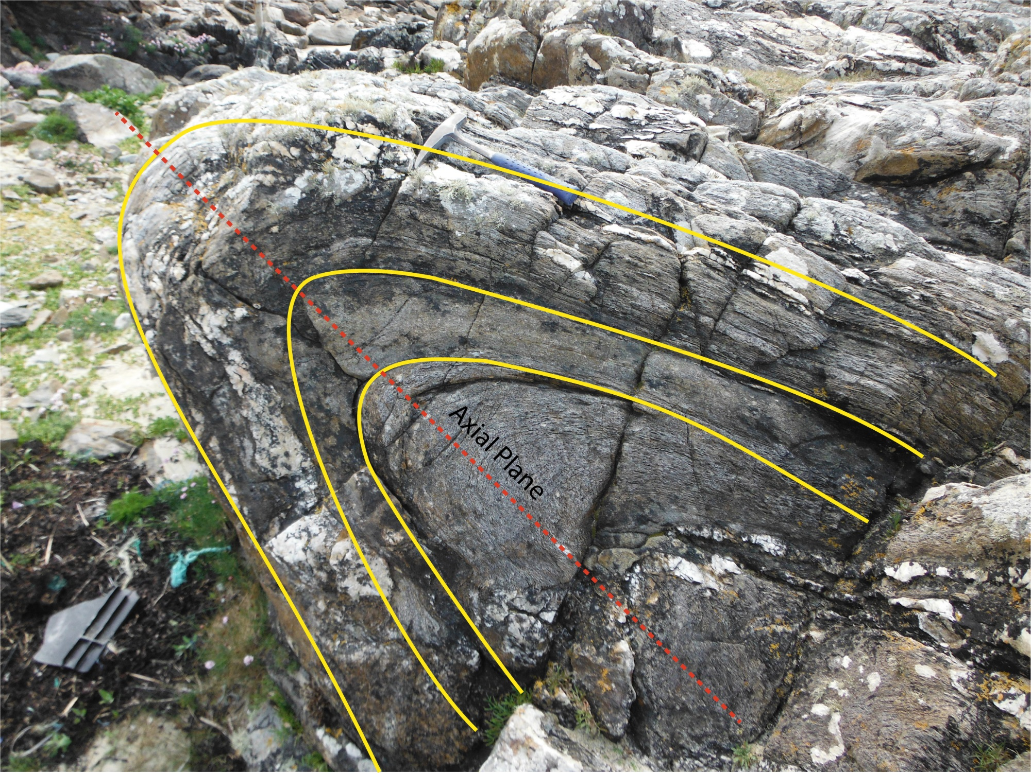
What class of fold?
Class 1C – convergent isogons, slightly thickened hinge

Slide 18
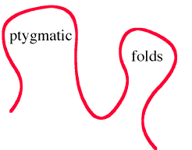
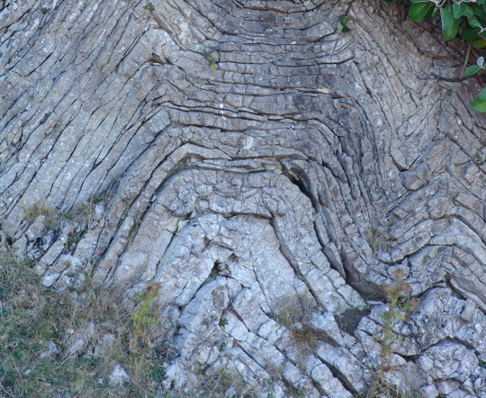
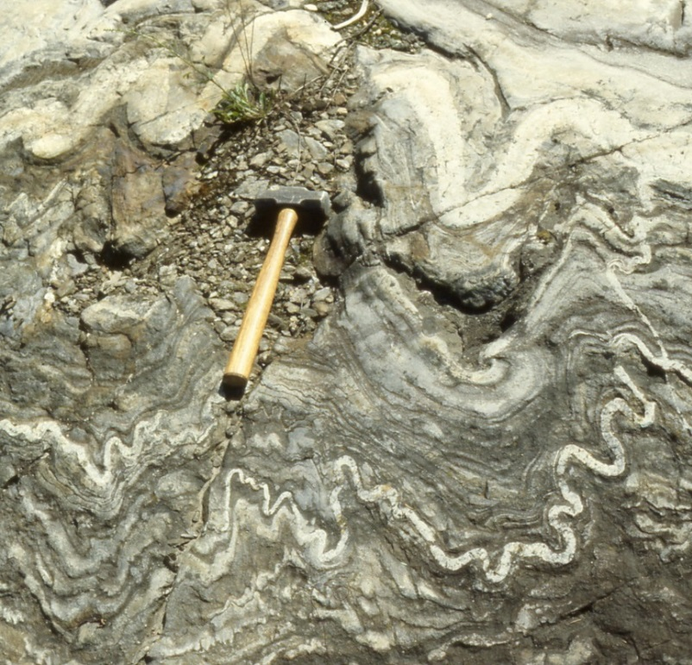
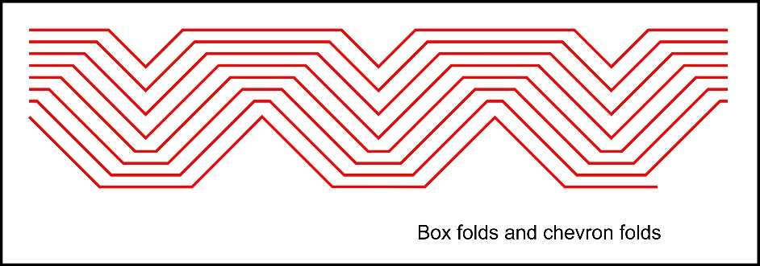
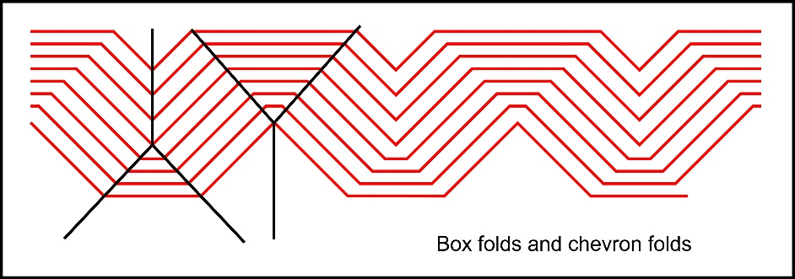
Folds not always simple shapes
Box or conjugate folds are composed of three planar limbs connected by hinge points or narrow, restricted subangular hinge zones
Ptygmatic folds have irregular shapes.

Slide 19
Fold classification by FACING – clinal v. formal
Use of terms anticline and syncline implies that stratigraphic succession is known
Antiform and synform is normally used in reference to folds when stratigraphic order unknown – form = shape
Where sequence is ‘upside-down’, older beds may be above younger beds creating antiformal synclines and synformal anticlines.
Anticlines are old in the core. Sinners (Synclines) are young at heart.
convex upward (Antiformal), and also convex in direction of younger bed (old at heart) - anticline
concave upward (Synformal), and also concave in direction of younger bed (young at heart) - syncline
Upward facing folds
Young upwards
convex upward - antiform, but concave in direction of younger bed – syncline
concave upward - synform, but convex in direction of younger bed - anticline
Downward facing folds
Young downwards

Slide 20
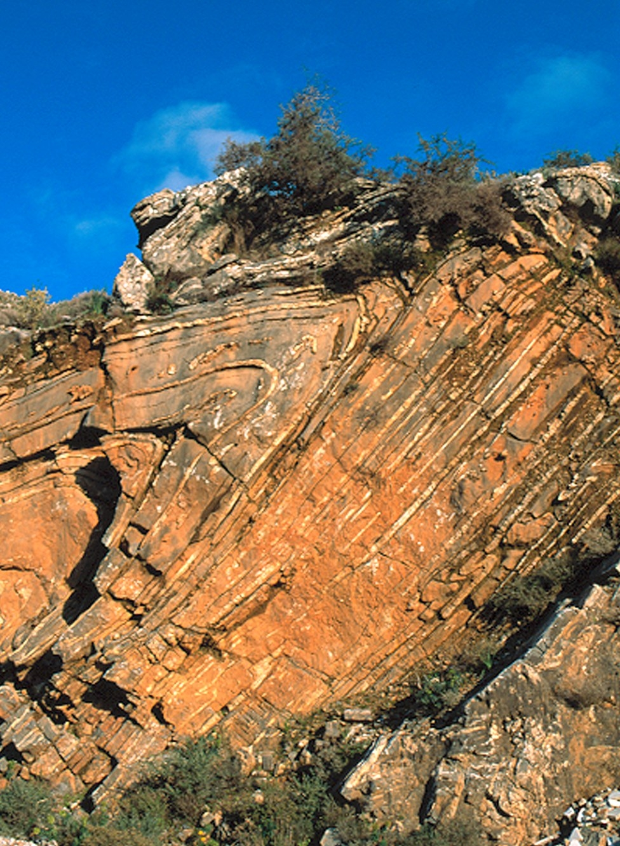
Overturned folds
Upside-down folds are totally inverted
antiformal synclines or synformal anticlines
Only rarely are folds completely upside-down, usually they are overturned.
Fold is considered overturned if at least one limb is overturned.

Slide 21
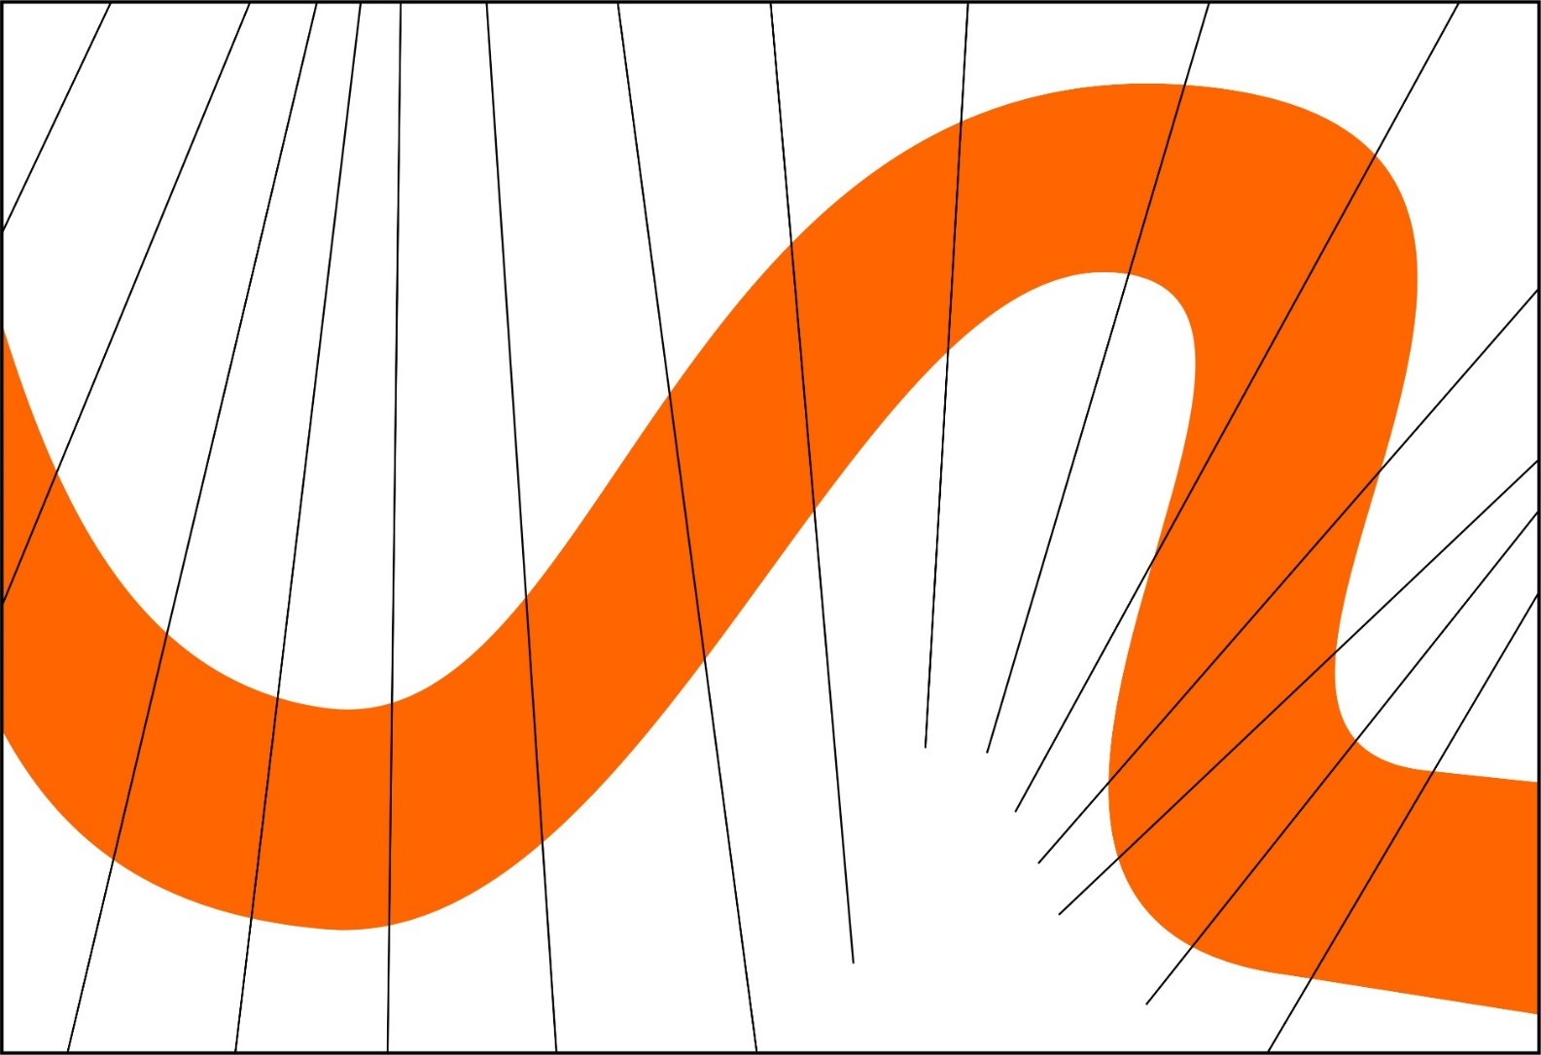
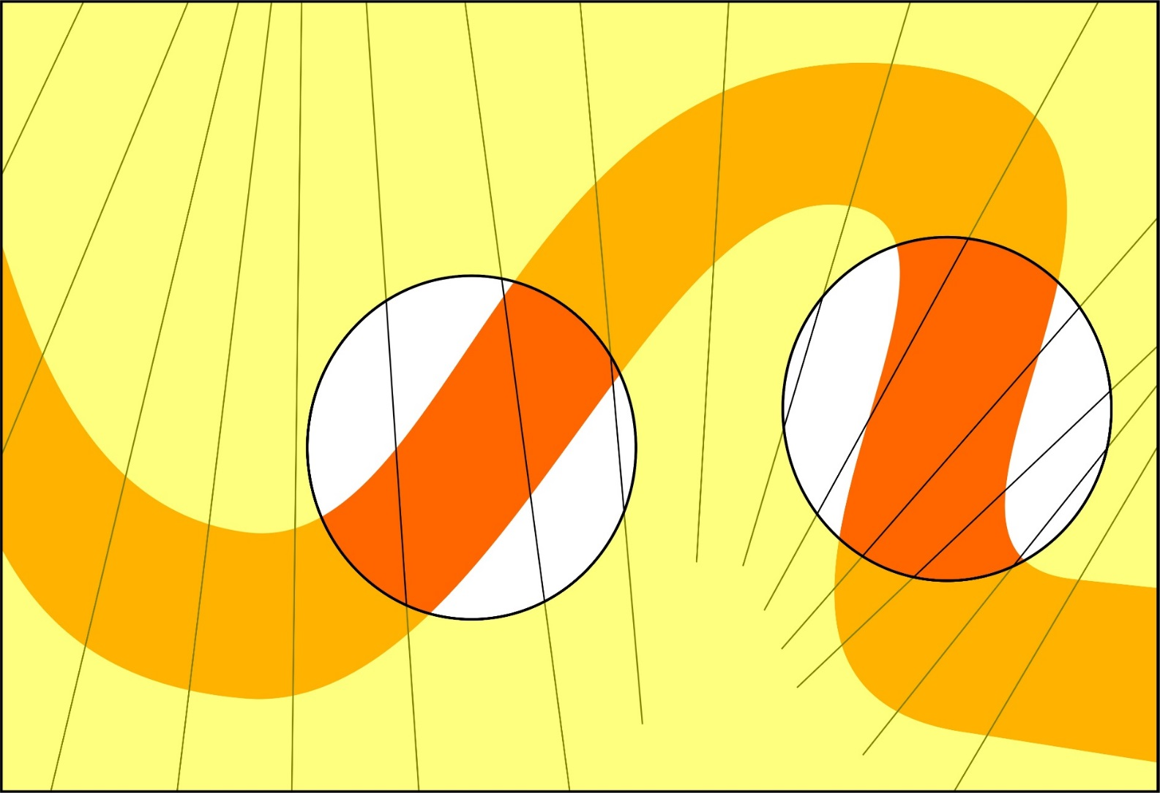
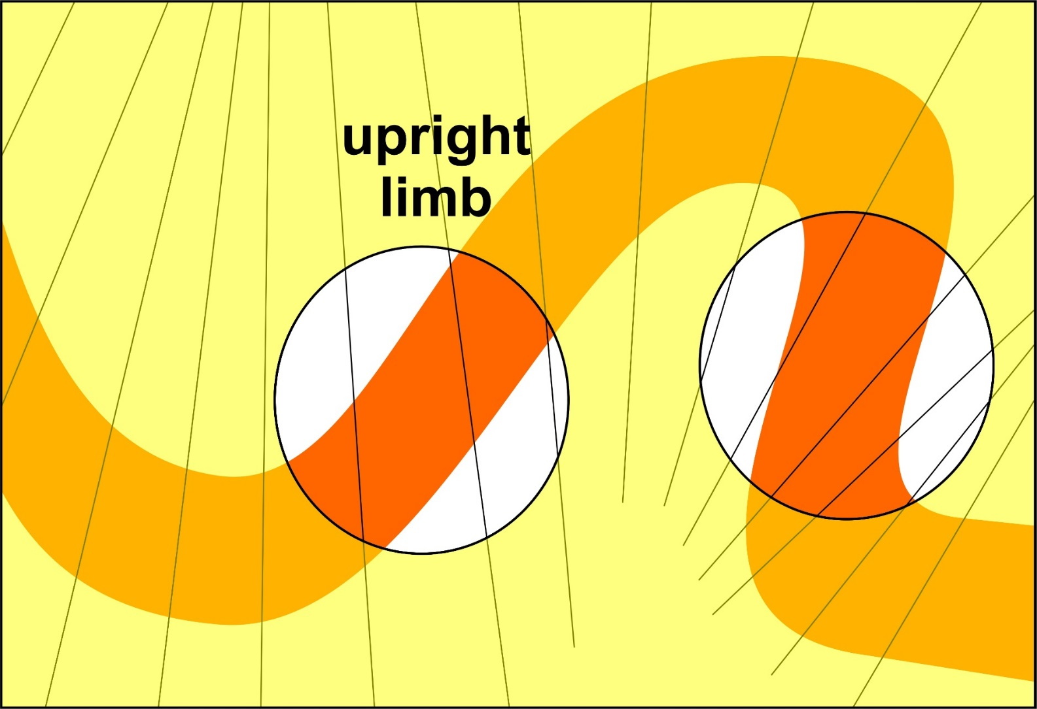
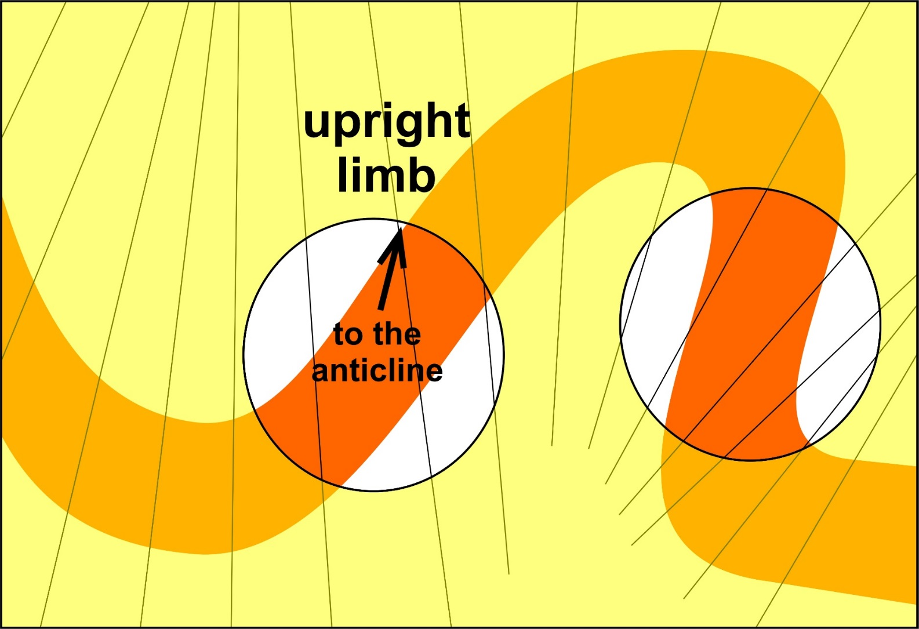
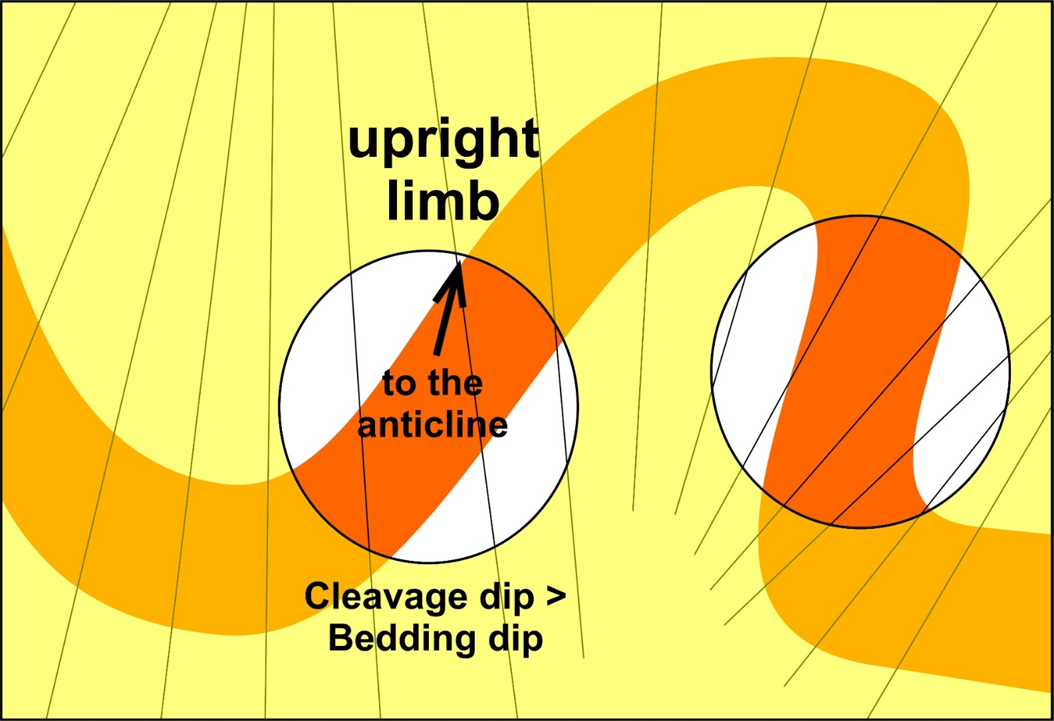
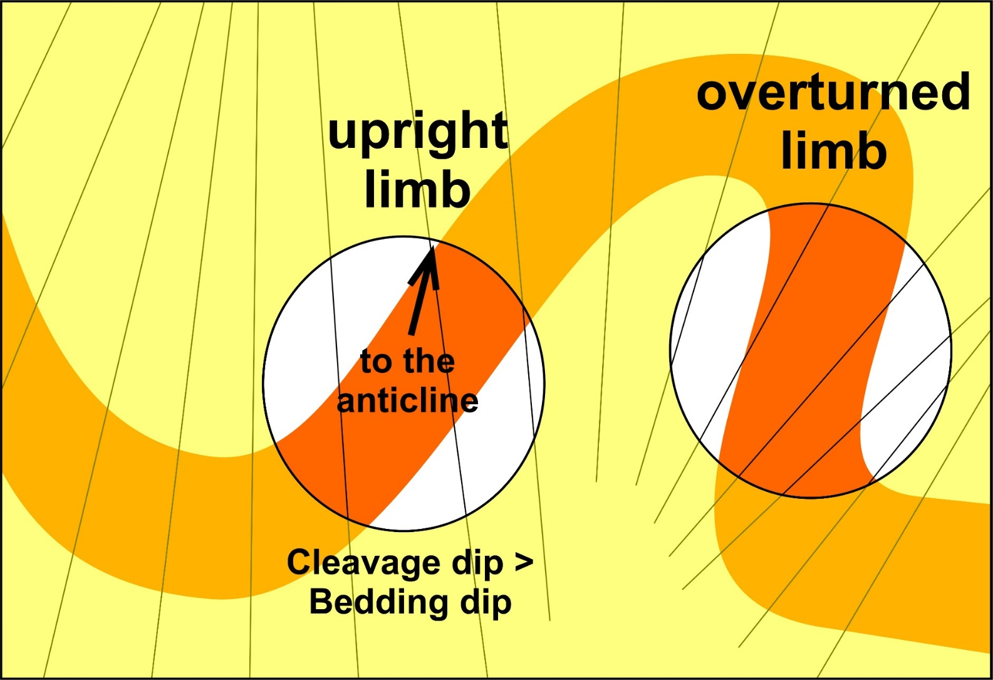
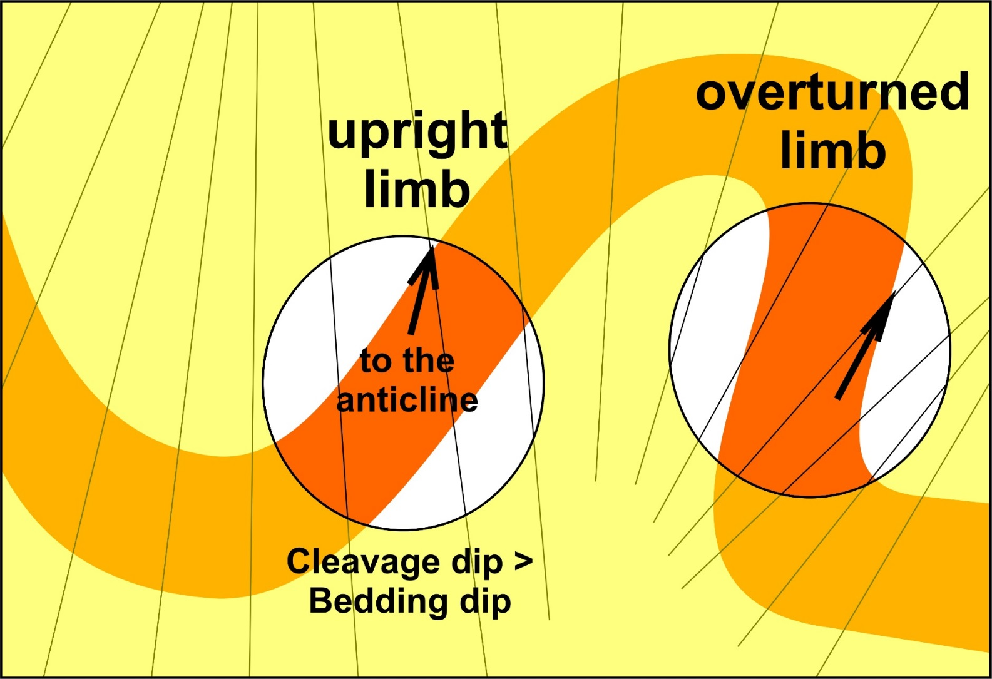
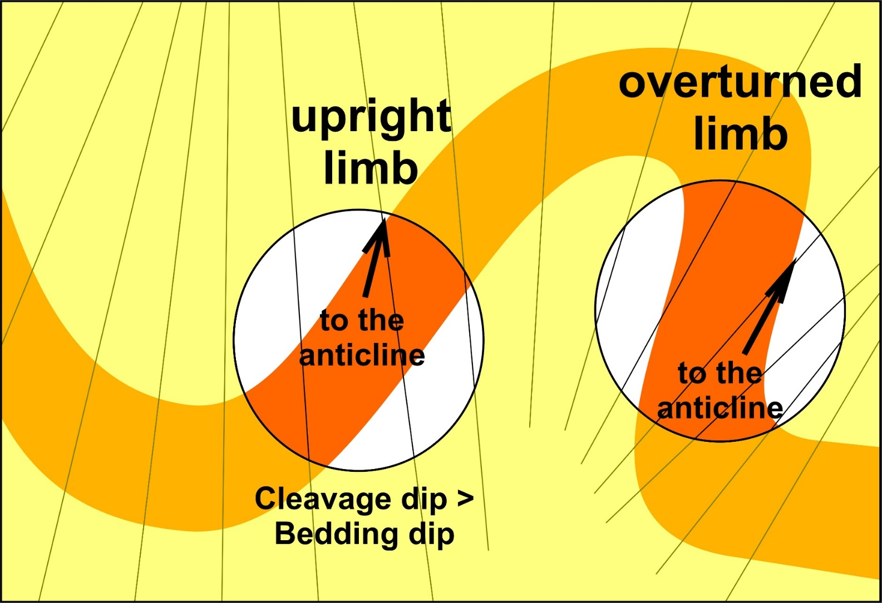
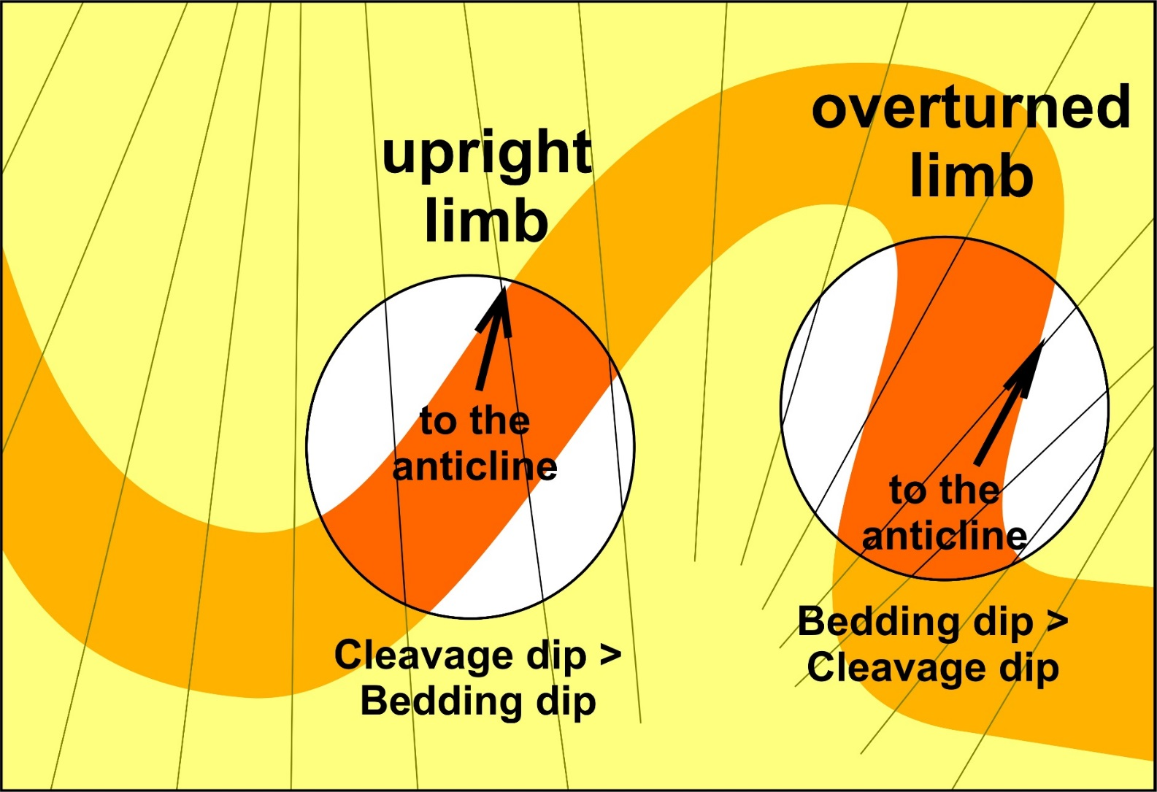
Cleavage bedding relationships
Axial Planar Cleavage forms approximately parallel to axial surfaces of folds
Forms perpendicular to maximum shortening by pressure solution
Useful for identifying anticlines
and overturned limbs
Both in same direction

Slide 22
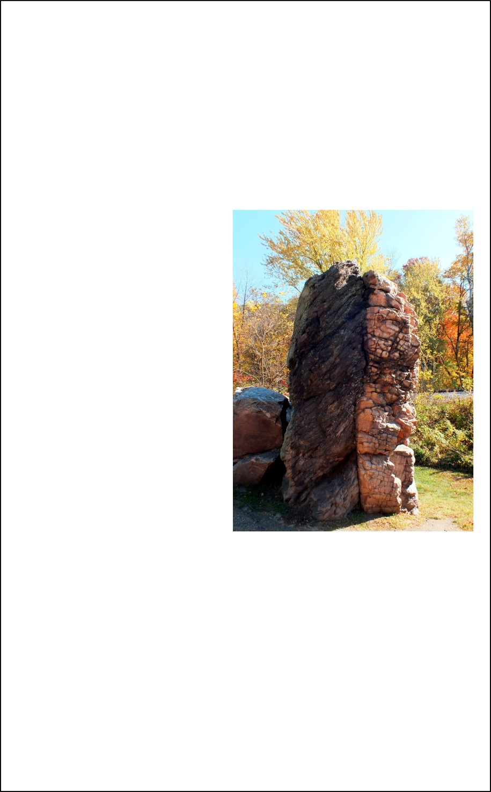
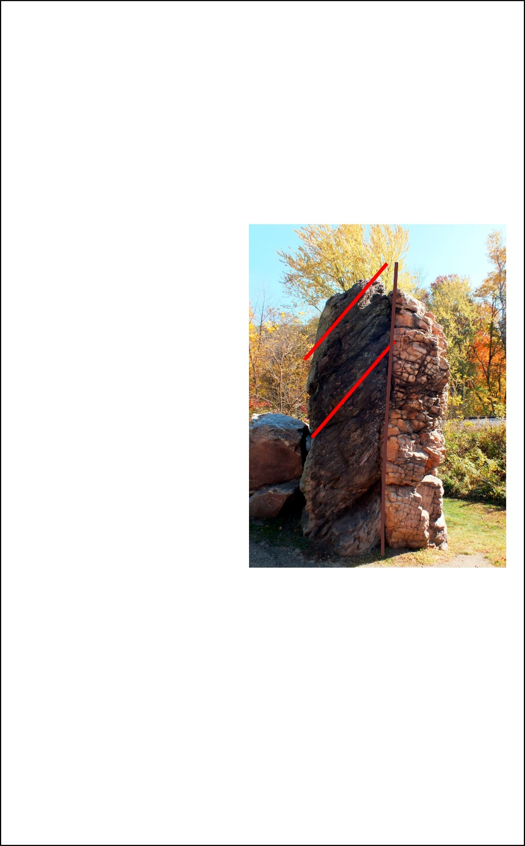
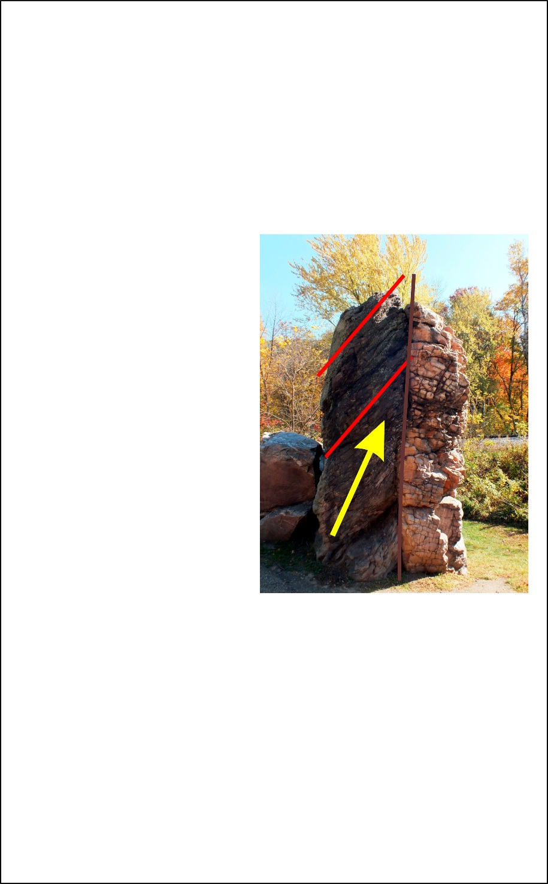
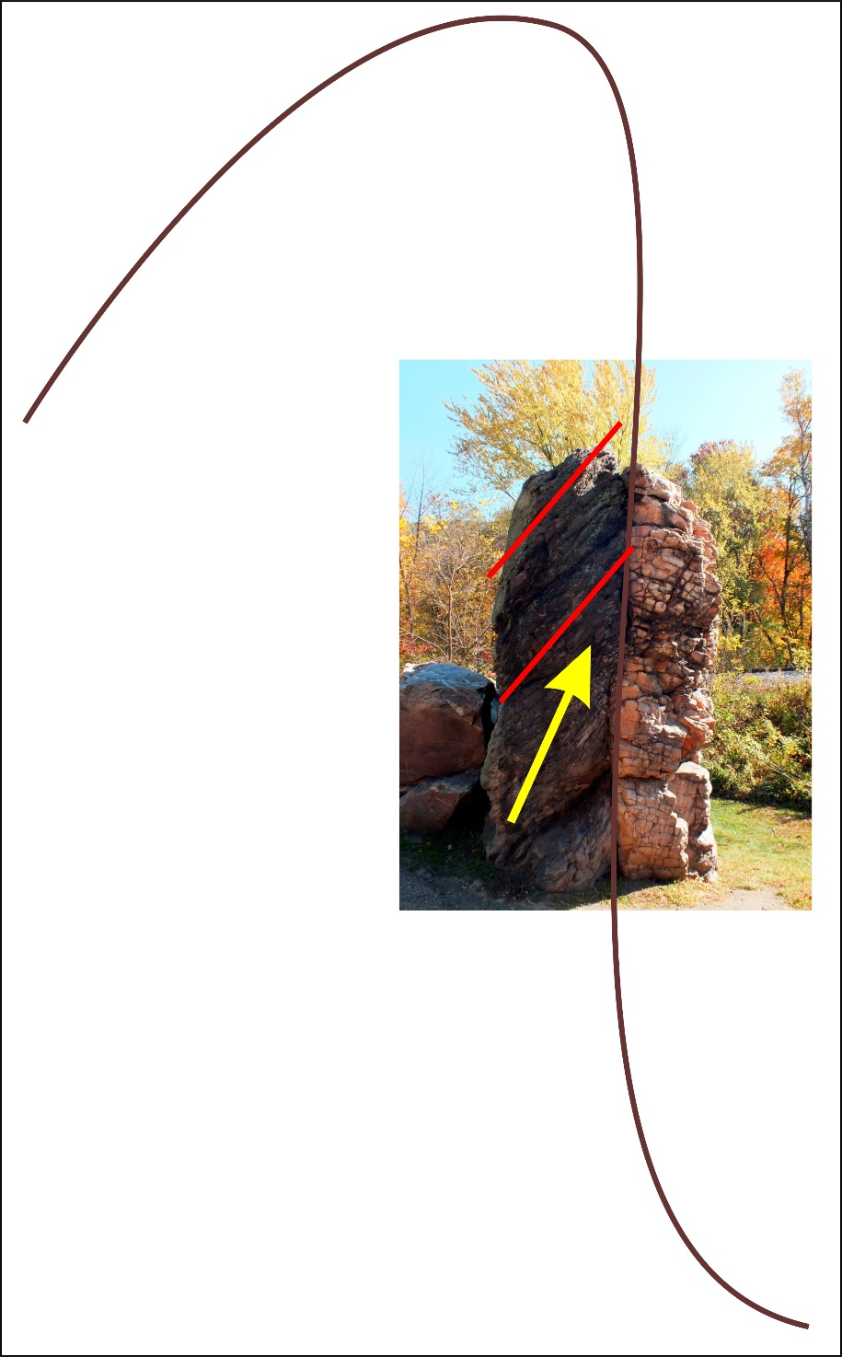
Van Hise Rock

Slide 23
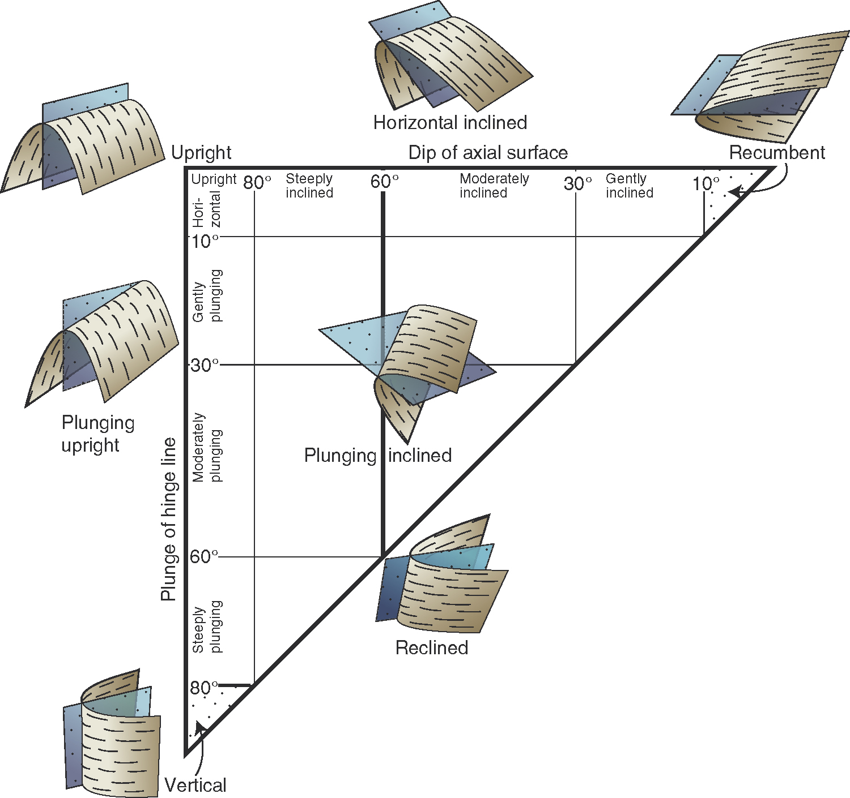
Fleuty - Fold classification by ORIENTATION
orientation of fold axis does not uniquely establish attitude of fold!
folds having same orientation of axis can have strikingly different orientations
axial surface strike and dip
Hinge line trend and plunge
Why is the Fleuty plot triangular?
Axial plane - Decreasing dip
Fold axis - Increasing plunge
A low dip surface cannot contain a steeply plunging hinge line

Slide 24
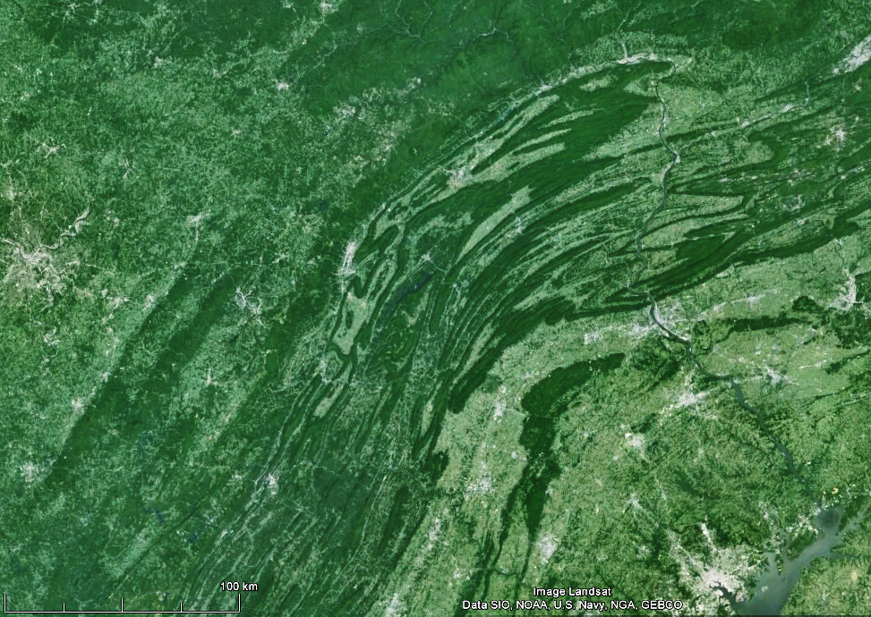
Plunging folds in the Appalachians of Pennsylvania
https://www.google.co.nz/maps/@40.3125586,-77.5780836,199526m/data=!3m1!1e3

Slide 25
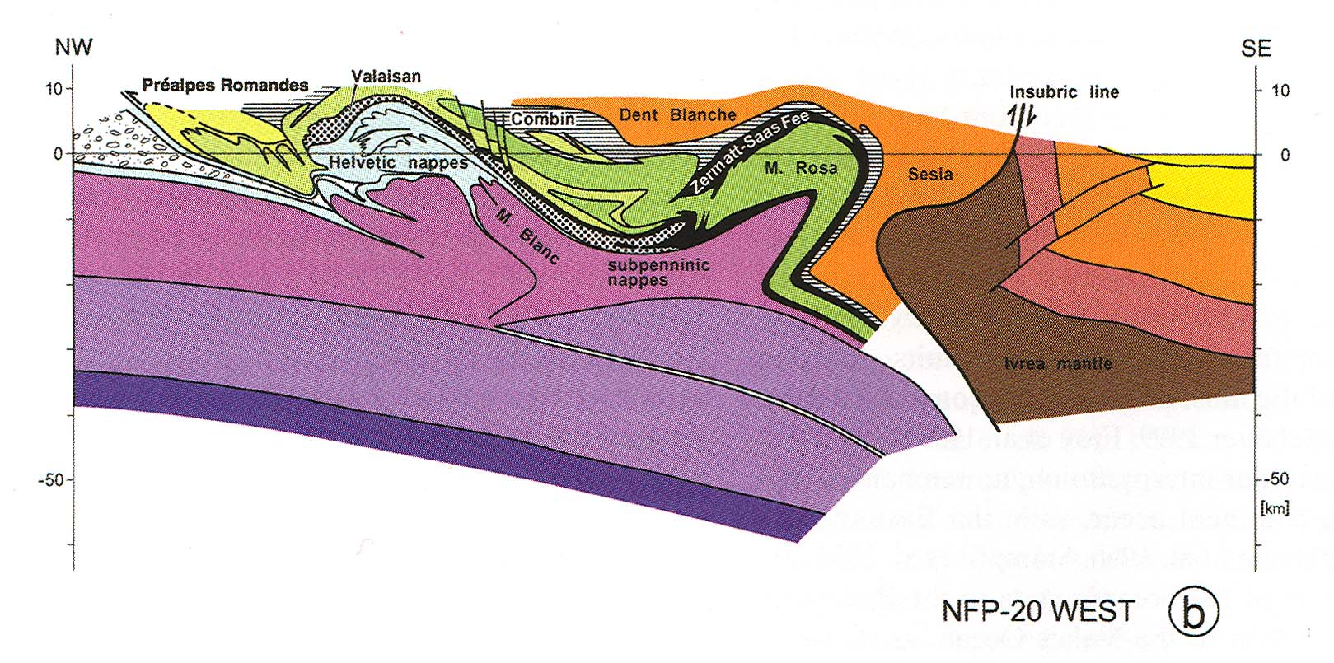
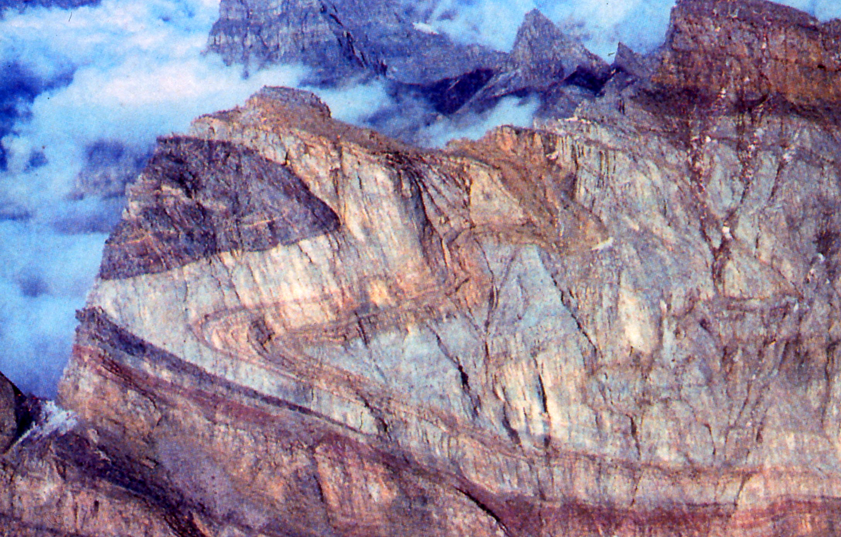
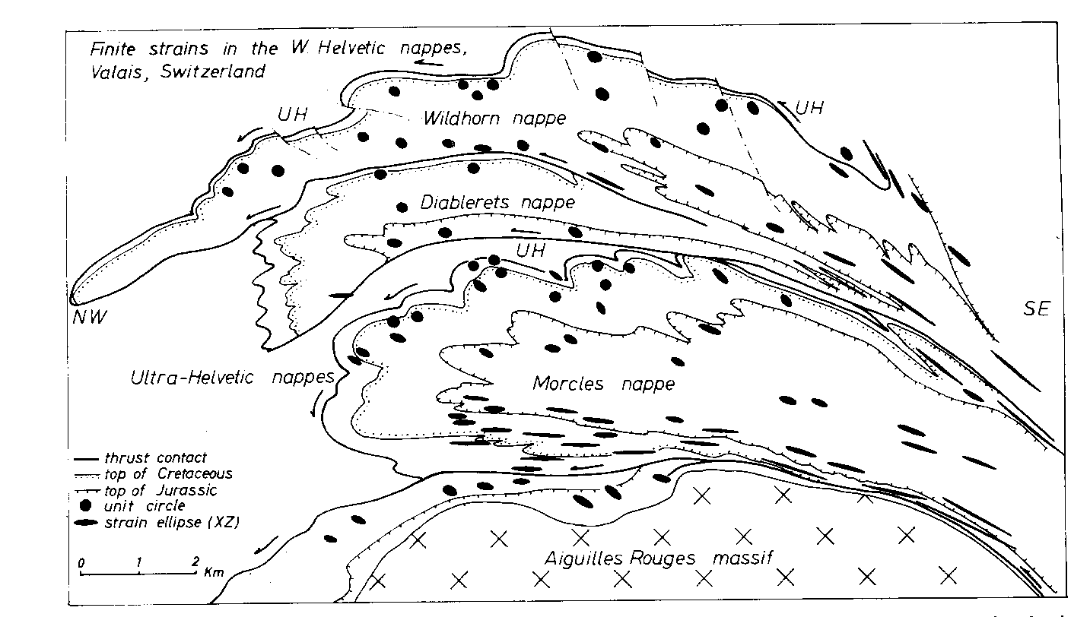
Recumbent folds – Helvetic nappes of the Swiss Alps
Strain localised in the hanging of thrusts at the base of the nappes

