Slide 1


Geol 244 – structural geology
Lecture 14 – fold systems and active folding
Lecture 14 – fold systems and active folding

Slide 2
Fold systems
Folds rarely occur in isolation
By looking at how folds relate to each other, we can find out much more information.
  Fold order
  Enveloping surface
  Symmetry
  Vergence

Slide 3
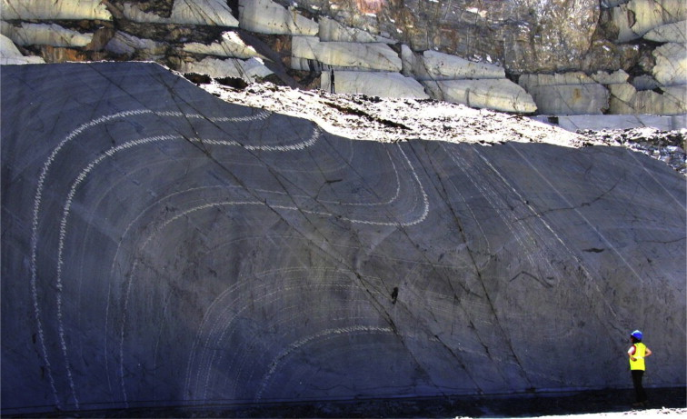

Fold order
Competence contrasts cause different beds or lithologies to fold with different wavelength
Largest wavelength is highest order

Slide 4
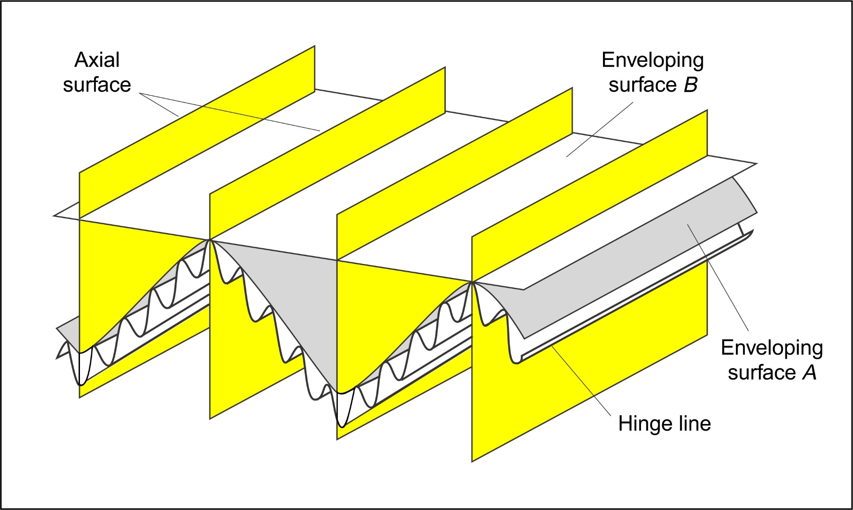
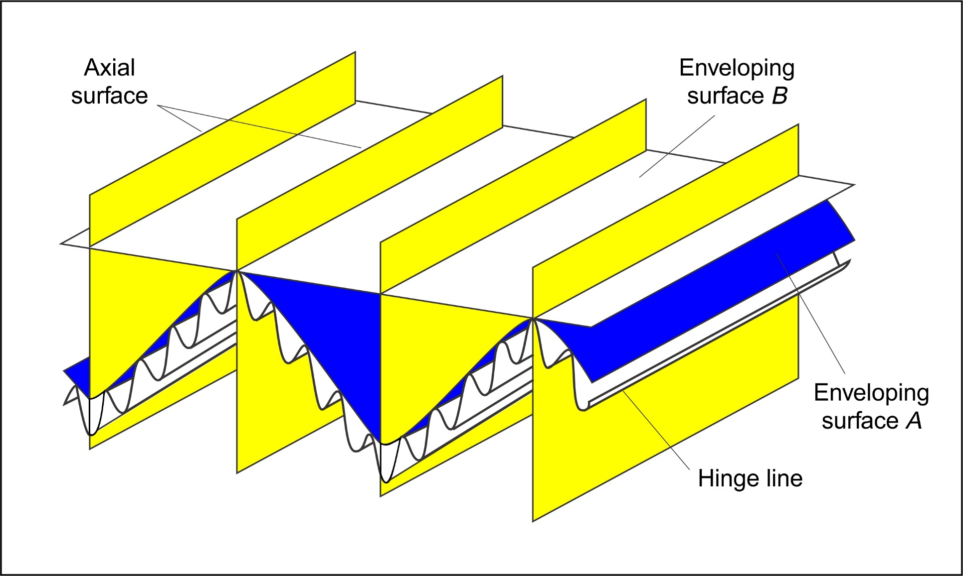
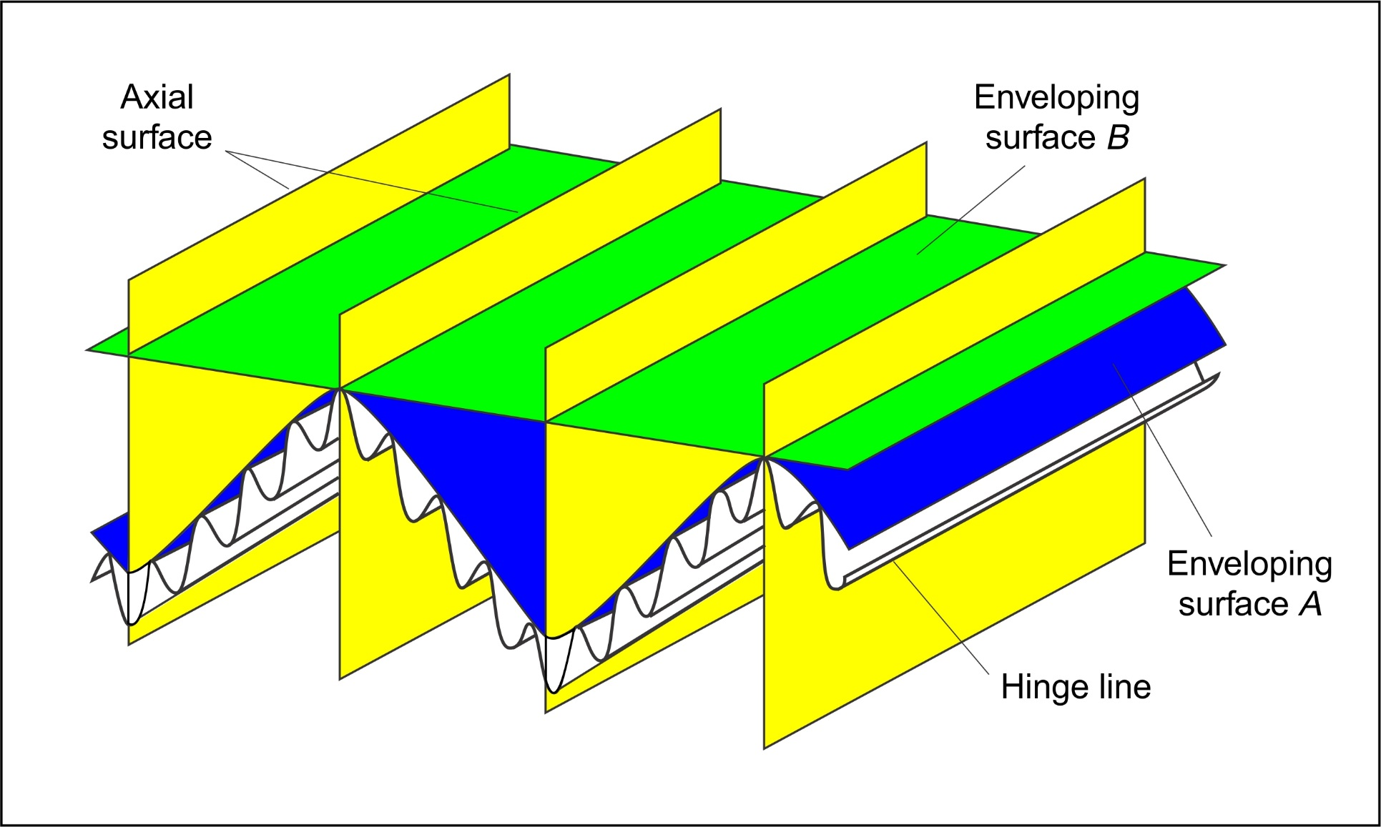
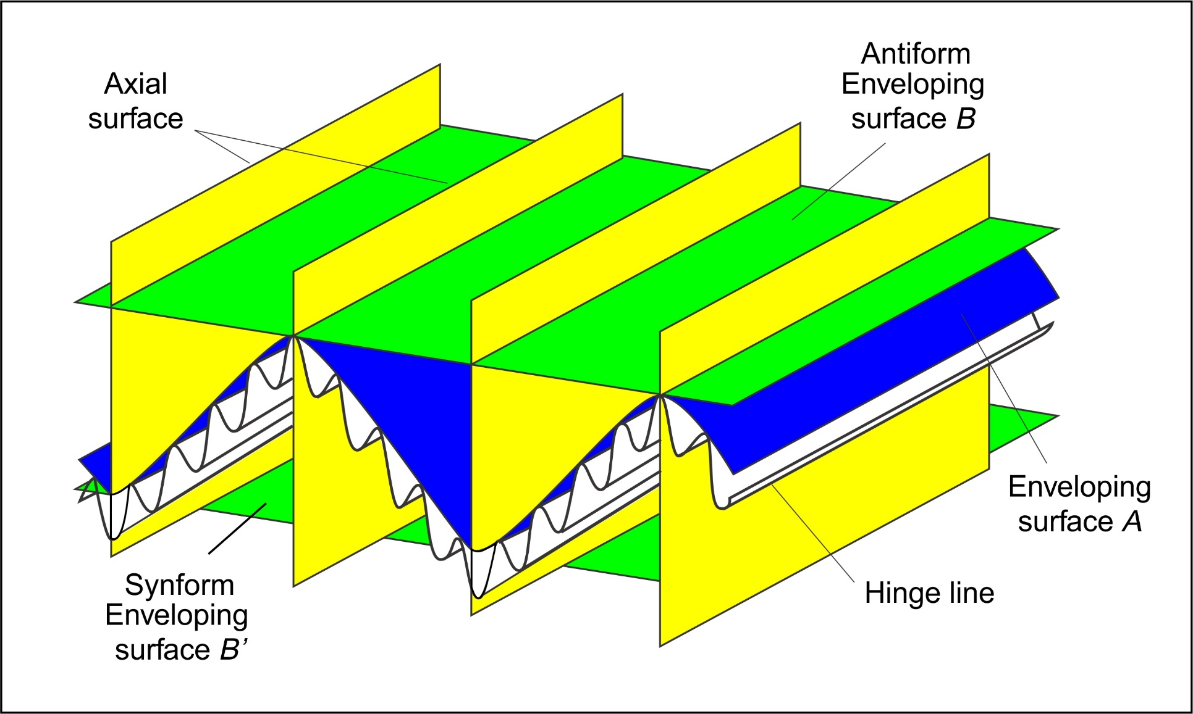
Enveloping surfaces
contain the hinges of consecutive folds
Regional scale first order down to thin section scale
First order fold axial surfaces

Slide 5
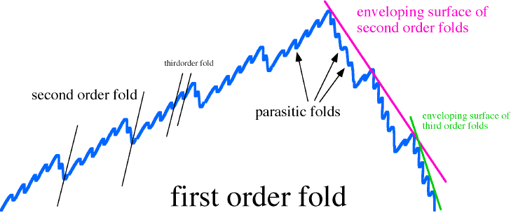
Fold order
First order fold is defined by the surface that envelopes the second order folds

Slide 6
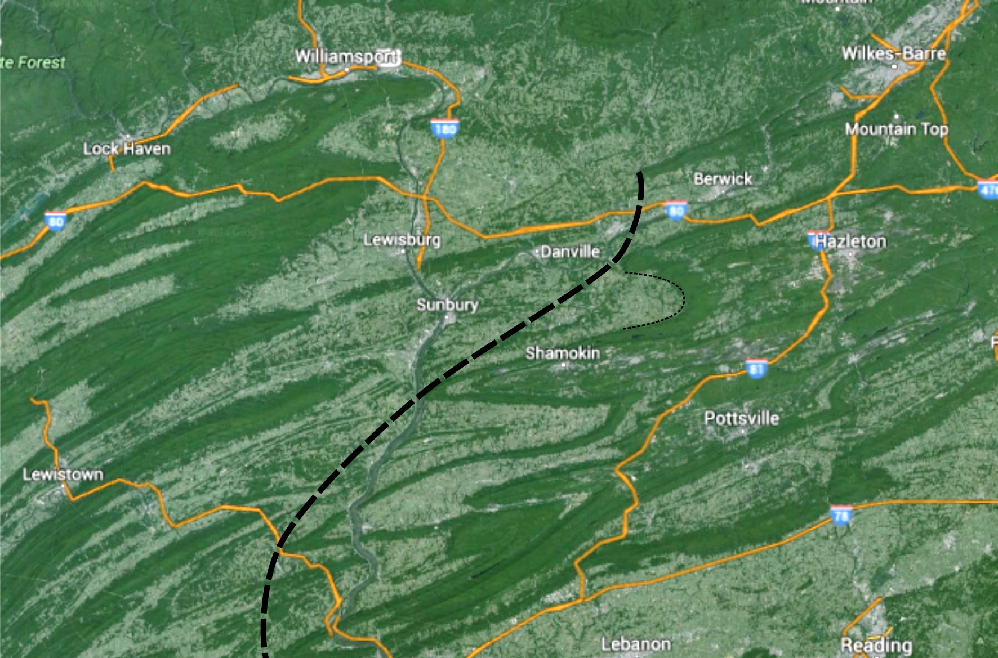
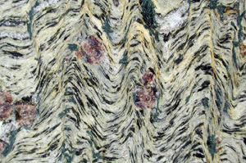
Scales of enveloping surfaces
Two views of the Appalachians

Slide 7
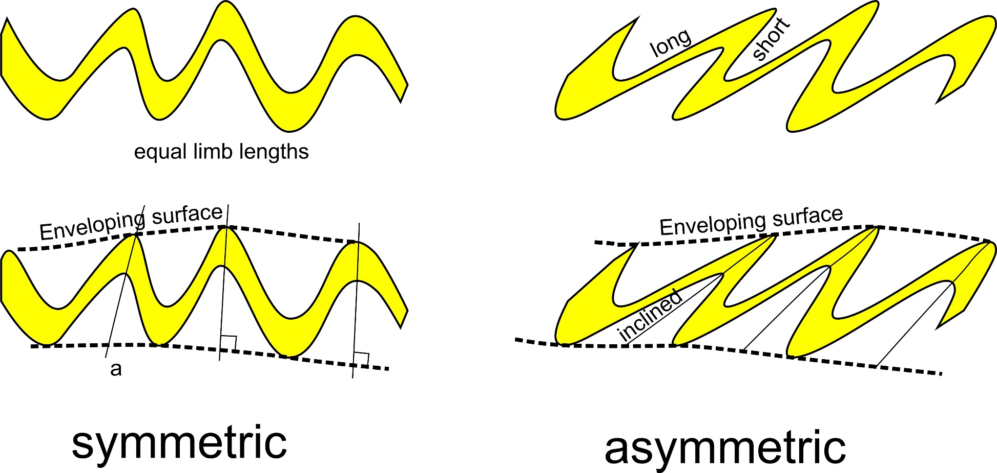
Fold symmetry
Equal limb lengths
Axial surfaces perpendicular to enveloping surface
Unequal limb lengths
Axial surfaces inclined to enveloping surface
Indicates simple shear

Slide 8
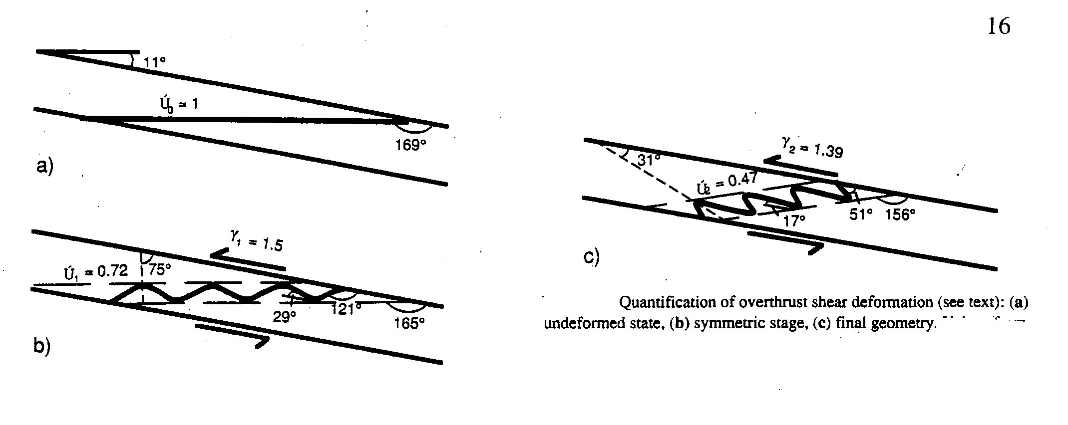
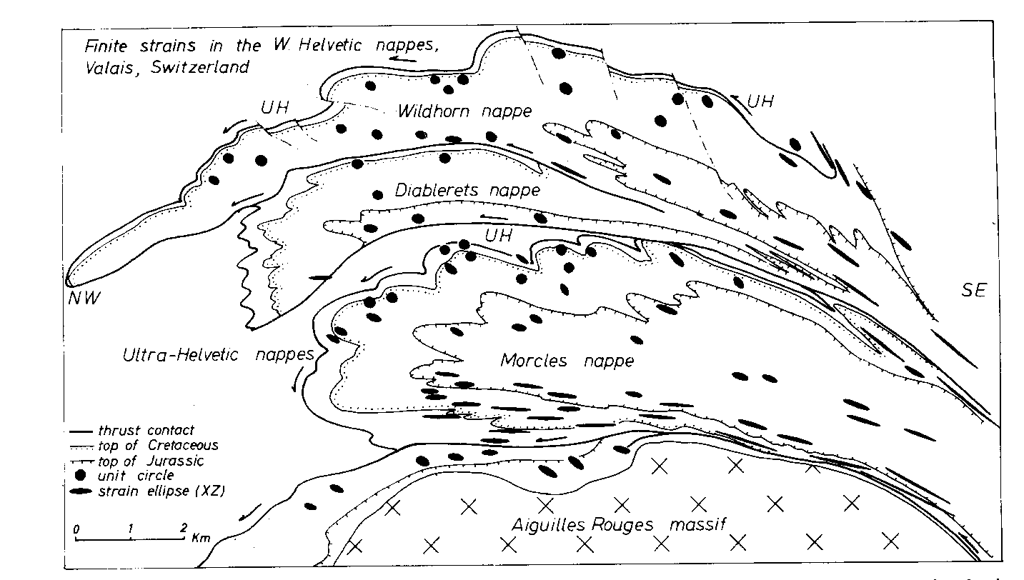
Generation of asymmetric recumbent folds in bed initially oblique to shear zone.

Slide 9
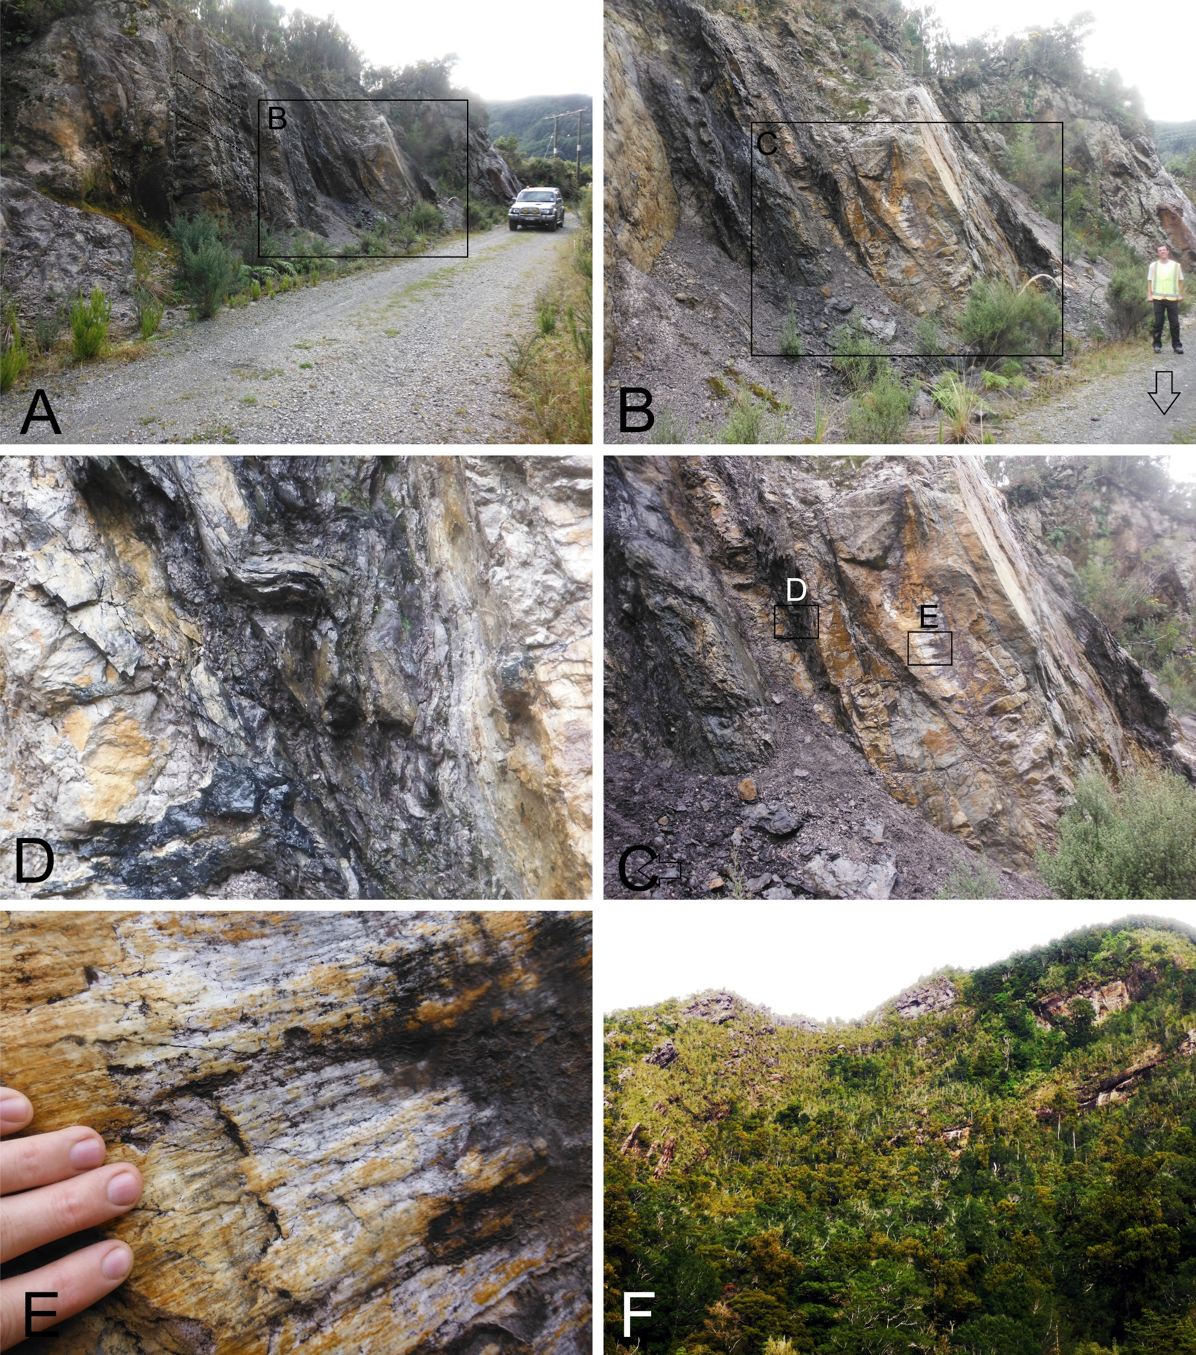

Simple shear within shear zones may create minor asymmetric folds
  Vergence is consistent with the overall shear sense.

Slide 10
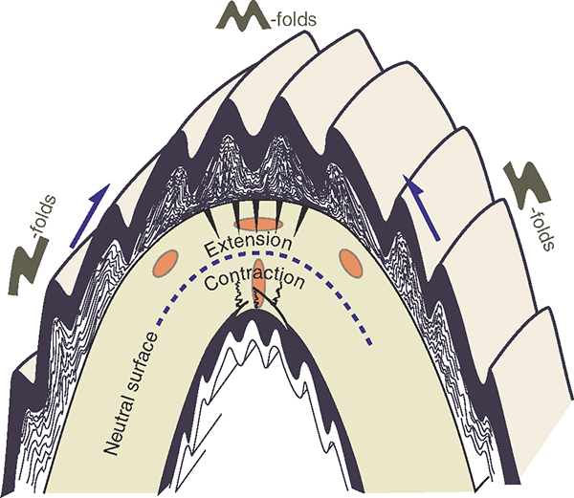
Using fold symmetry S and Z folds
Look at the long limbs as the horizontal part of a letter
Erosion surface
Vergence! What’s the point?
Minor folds verge towards the major folds
Z-shaped and S-shaped minor folds help to map and unravel regional assemblages of folded rocks.
A change from Z to S folds within uniformly dipping strata may signal presence of otherwise hidden fold structure.

Slide 11
Kinematics and mechanics of folding
Distinguish between passive and active folding
Passive folding – layers are not mechanically significant
Active folding – layers are mechanically significant

Slide 12
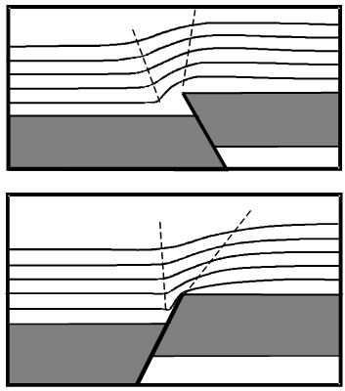
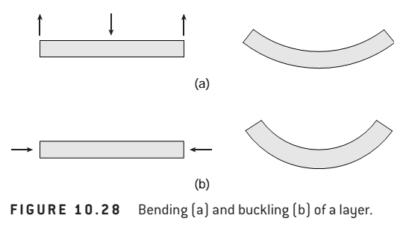
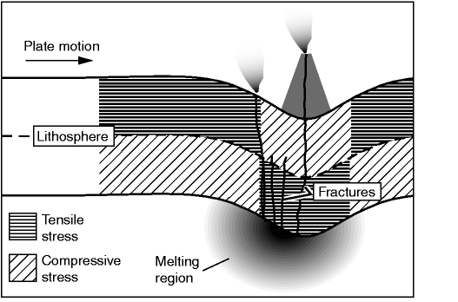
Geological conditions for active folding
Two conditions for active folding
1 - Bending – stress applied at oblique angle to anisotropy
Forced fold - sedimentary cover bending above faults in rigid basement
Bending is passive in that folding is not driven by competency contrasts
Active in that competence contrasts are usually involved

Slide 13
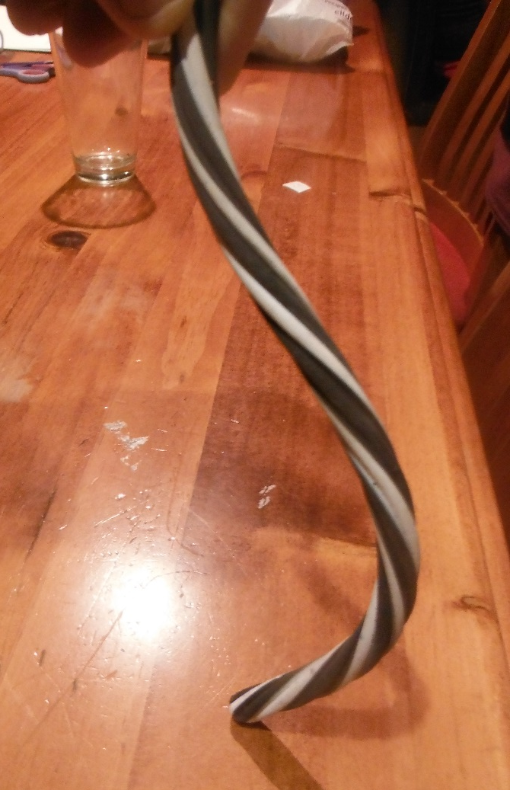
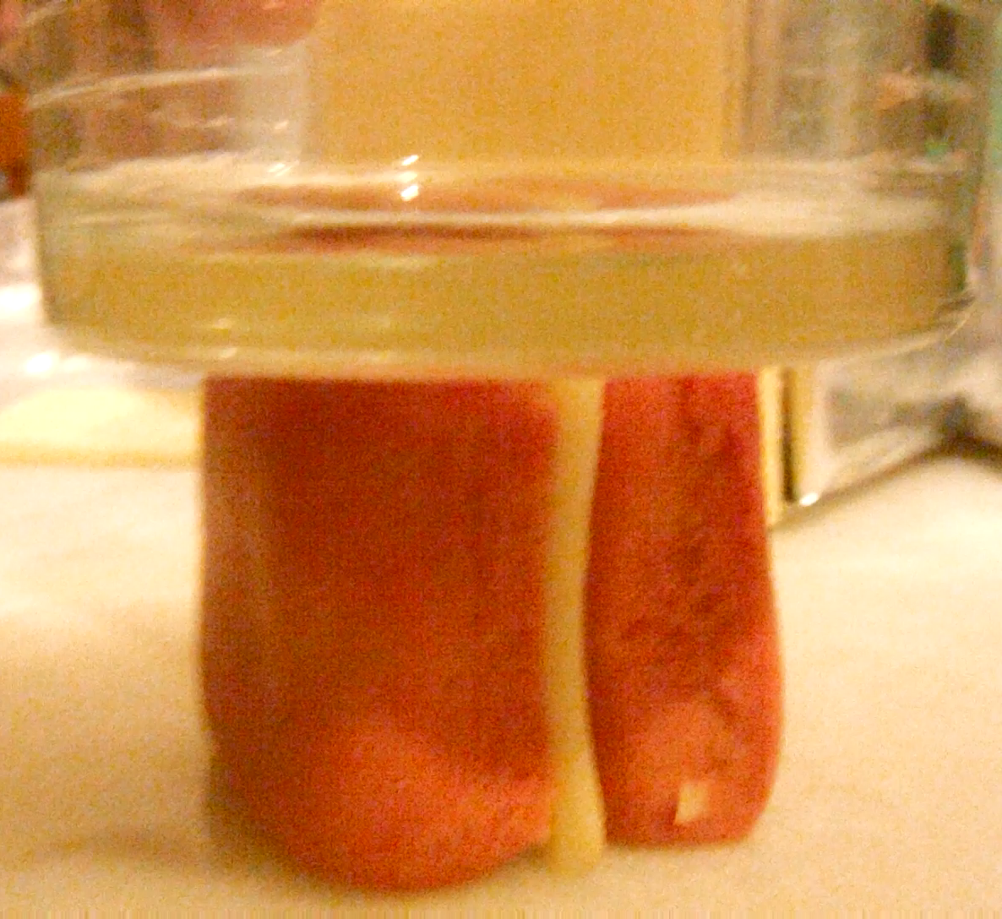
Geological conditions for active folding
Two conditions for active folding
2 - Buckling – stress applied parallel to anisotropy
  Pure buckling does not include layer parallel strain or layer thickening
Cheddar cheese and playdough

Slide 14

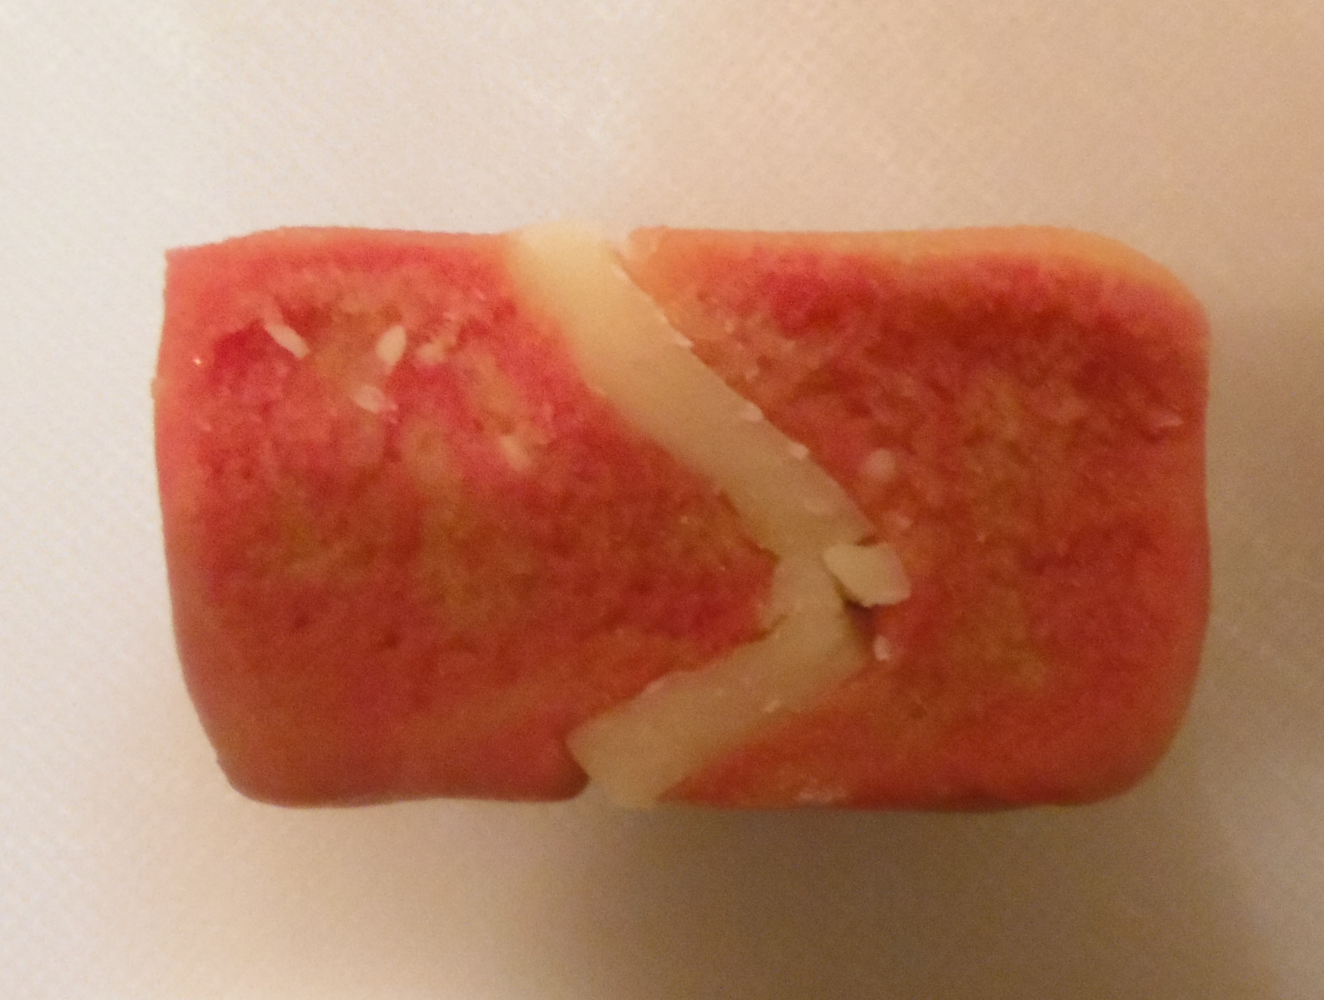
What controls arc-length in single-layer buckle folding?
Remember: Arc length is the length of the folded surface between the alternate hinge points – generally stays the same if buckling is the dominant mechanism
Biot-Ramberg equation
Arc length (L)
  proportional to layer thickness t
  proportional to cube root of the viscosity contrast
η_{M}
η_{L}
η_{M}

Slide 15
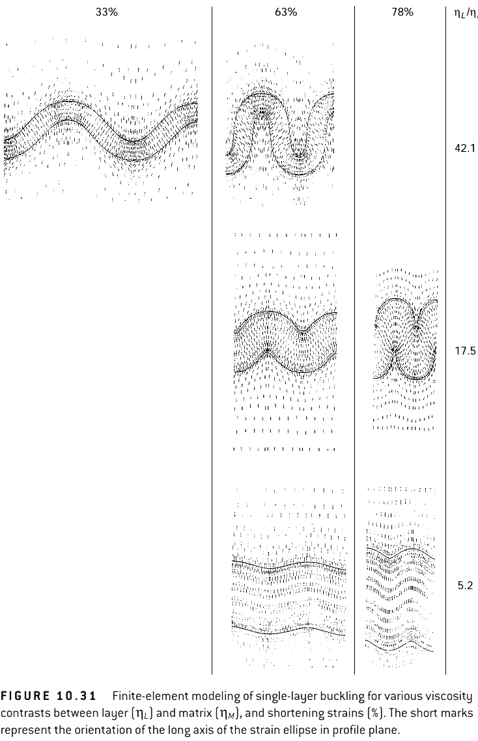
shortening
Finite element models of single layer buckle folds
33%
63%
78%
42.1
Viscosity contrast
17.5
Which contrast gives the longest arc-length?
Less viscosity contrast = thickening
5.2
Notes:
Finite element model of buckle folding
Note that the top layer is thinnest and bottom thickest, top highest contrast, bottom lowest

Slide 16
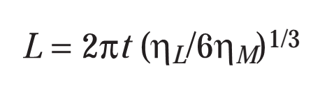
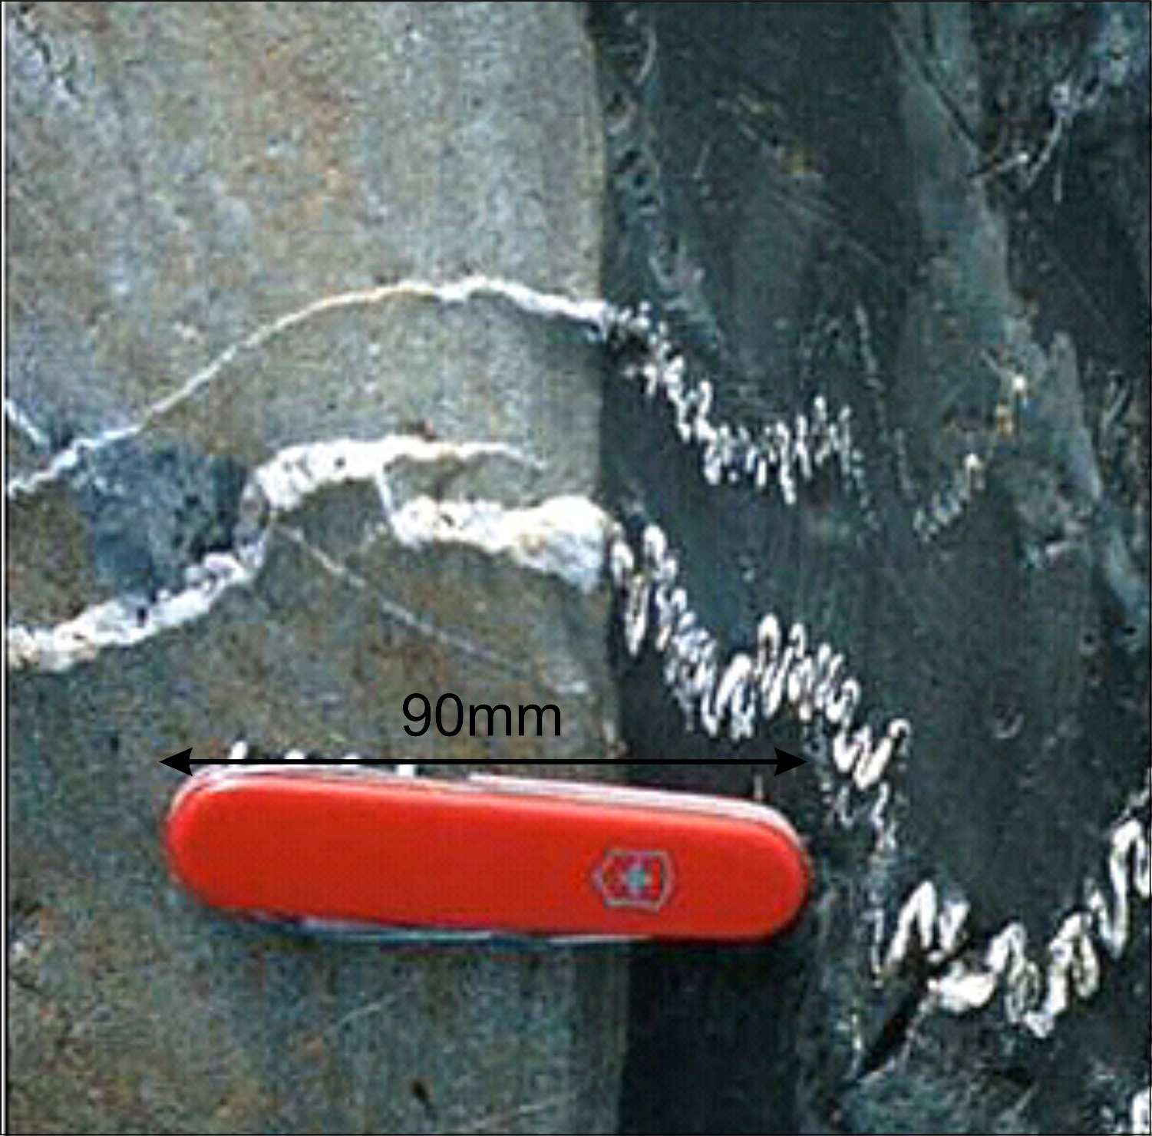
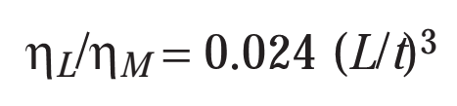
Biot-Ramberg equation
characteristic arc length = ~24 mm
layer thickness = ~2 mm
sandstone
shale
Qz vein
Viscosity contrast between shale and sandstone?
What is the ratio of the viscosities of the shale and the vein? ~42

Slide 17
Fold amplitude is controlled by
Two main factors
  Initial growth rate α₀
    α₀=(4𝑅∕3) ^{3∕2}
    R is viscosity contrast η_{layer}/η_{matrix}
  % shortening.
single-layer fold amplification curve. (calculated for α₀ = 15, corresponding to a viscosity contrast about 50)
growth rate depends on viscosity ccontrast between layer and matrix
greater contrast → greater growth rate
Notes:
Amplification curve shows how single layer folds grow in amplitude with increased shortening.
The slope of the curve depends on the initial growth rate, which is strongly controlled by the viscosity contrast
as well as the amount of shortening
A higher contrast will result in more rapid amplification of folds

Slide 18
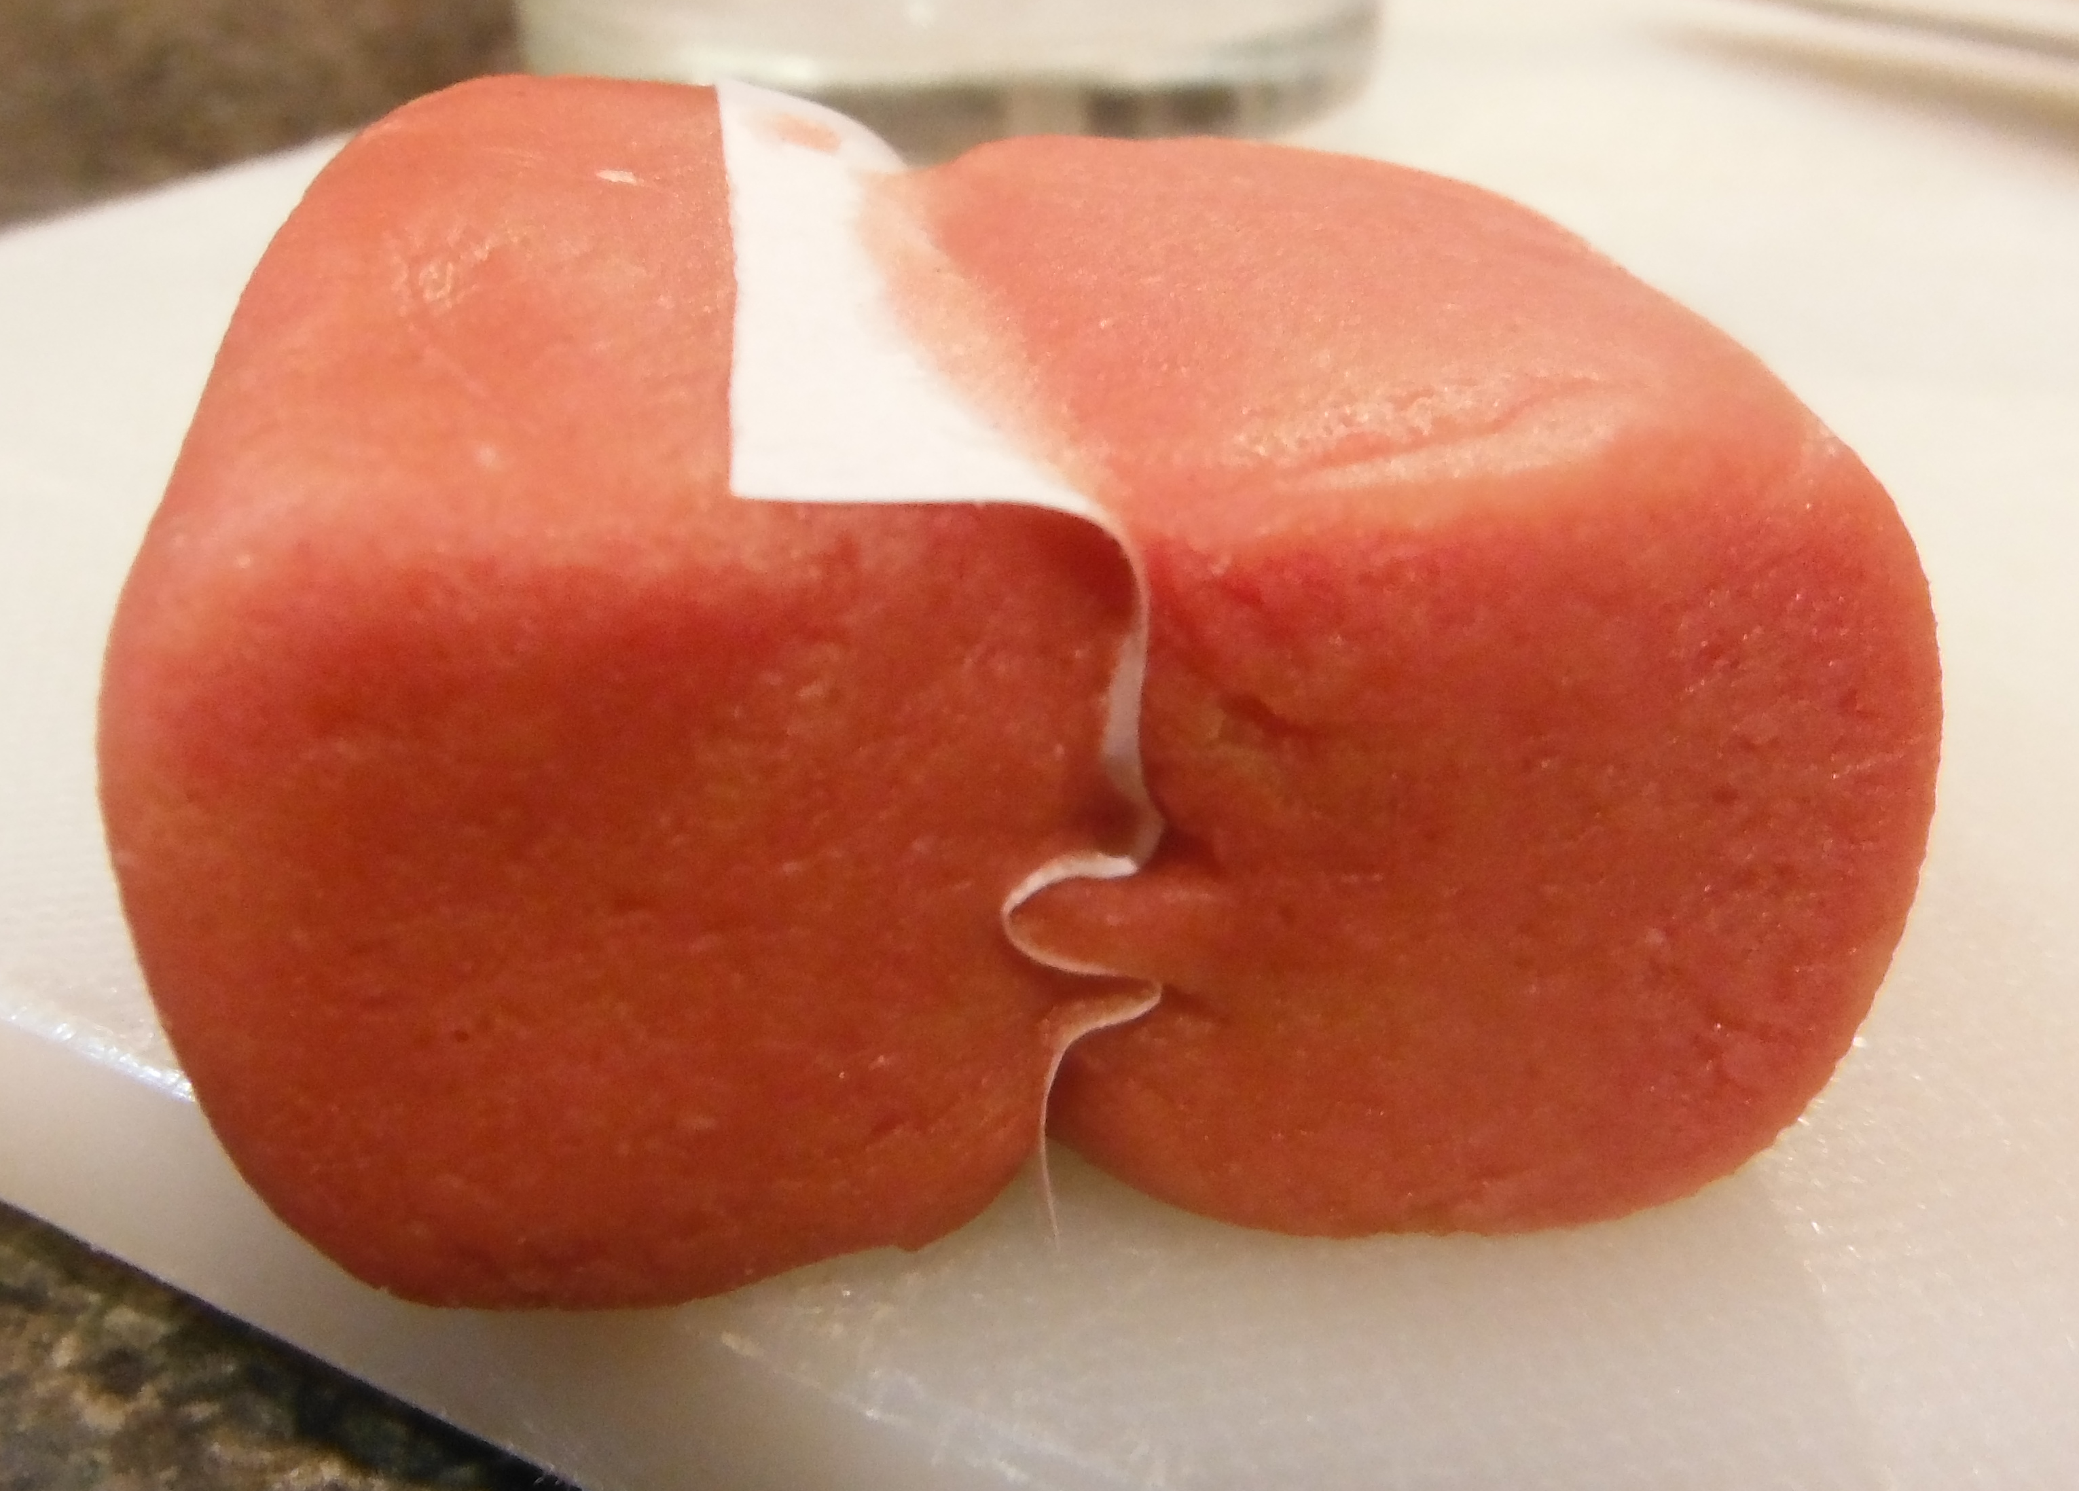
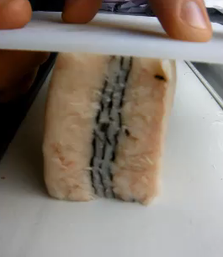
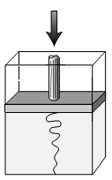
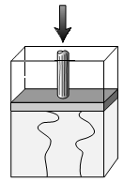
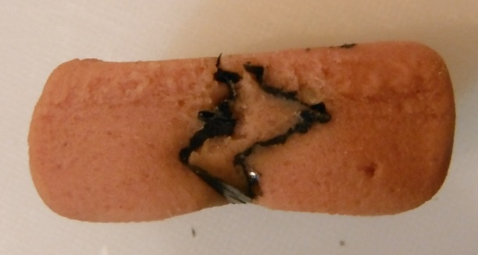
Multi-layer folding
Multi-layer fold wavelength is greater and two thin layers appear to act as a single thicker layer
What happens if several layers are present and folding together?
behavior depends on the combination of layers and their thicknesses
  One thin layer
  Two thin layers

Slide 19
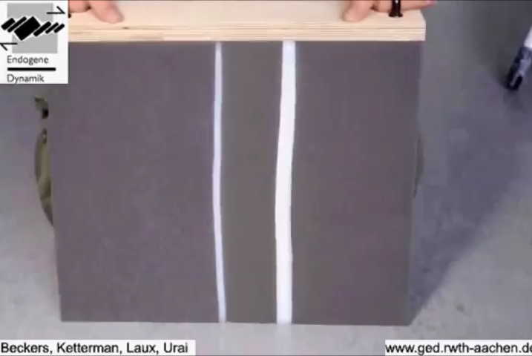
Multi-layer folding
the behavior of a multilayer system is sensitive to the interaction between layers.
watch on you tube

Slide 20
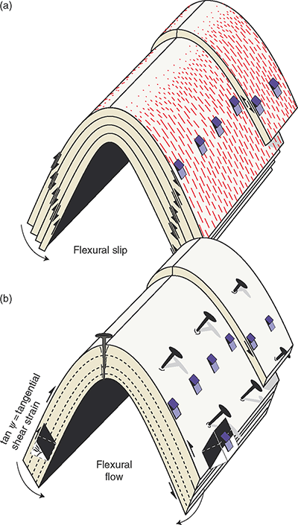
Kinematic models of active folding - Flexural folding mechanisms
Where strata are well bedded and relatively stiff, folding is achieved by layer-parallel slippage (flexural slip)
  Flexural-slip folding accommodates buckling by layer-parallel slip along contacts between layers.
Or layer parallel shear (flexural flow)
Layering actively participates in folding by bending and flexing.

Slide 21
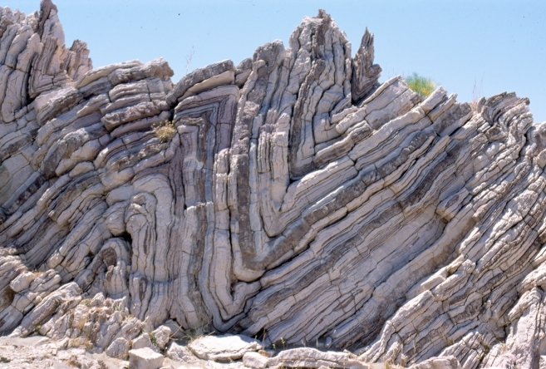
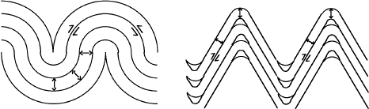
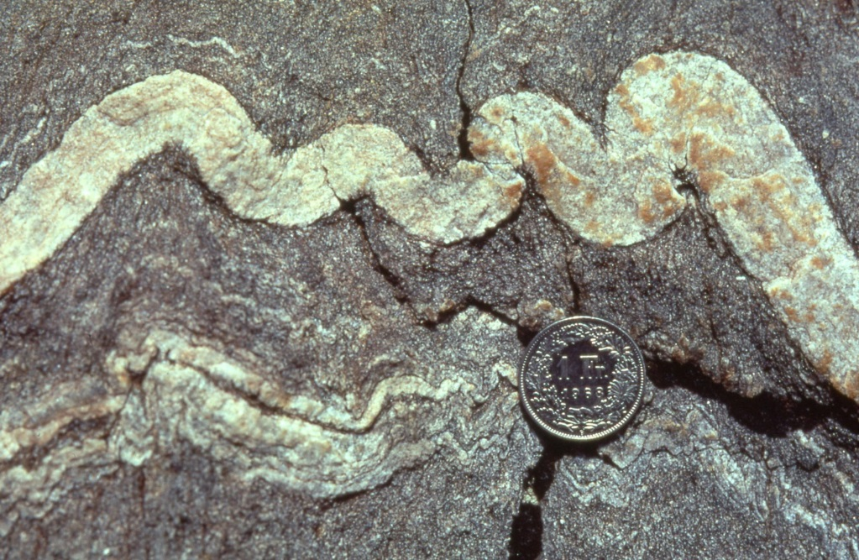
Kinematics of active folding
Two types of flexural-slip folds are concentric and chevron folds. Both types are parallel folds characterized by uniform layer thickness across fold profile.

Slide 22
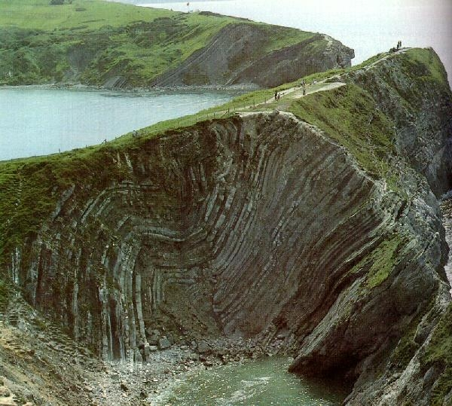
Concentric flexural slip folds – Lulworth Cove, U.K.

Slide 23
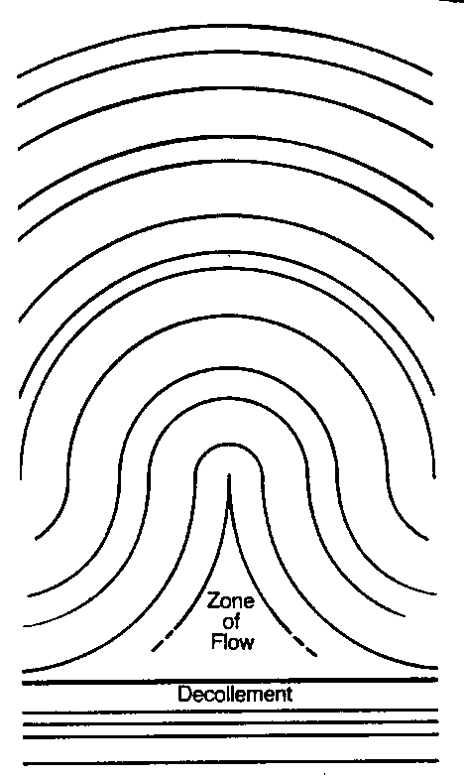
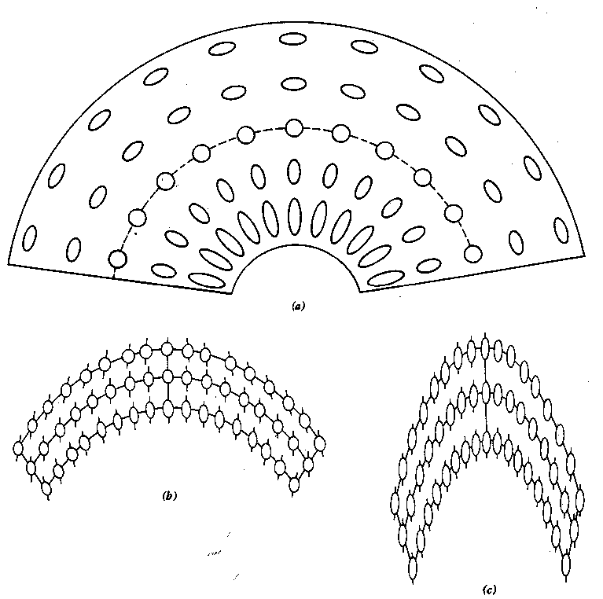
Limits on concentric fold shortening
If you want to accommodate more than ~36% of shortening, you either have to:
allow hinges of folds to thicken (which requires additional ductile mechanism – as in (c)) or,
allow faults (decollements) to form.
a
b
c
Little or no initial shortening
20% homogeneous shortening – cleavage fan
50% homogeneous shortening – near ideal passive (similar) fold
Geometric limitation on shortening by concentric (parallel) folding to 36%

Slide 24
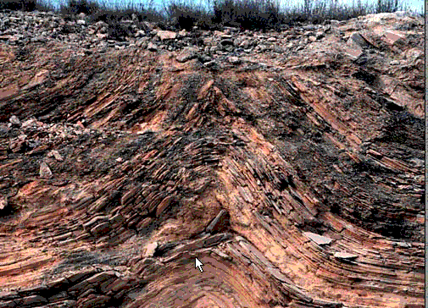
Concentric flexural slip folds forming disharmonic decollement (detachment) surfaces at limit of shortening
Disharmonic decollement

