Slide 1
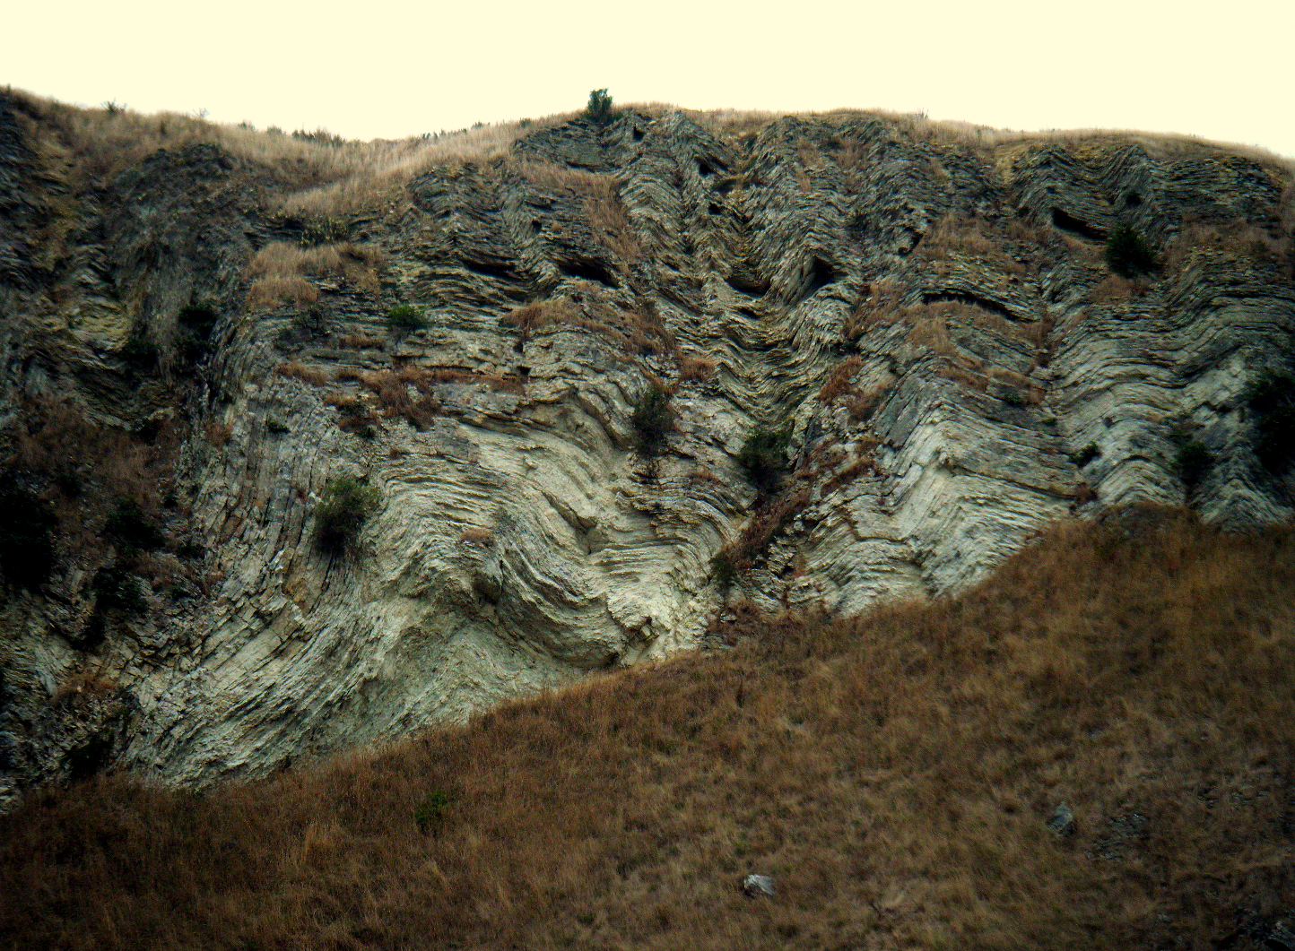
Geol 244 – structural geology
Brendan.duffy@canterbury.ac.nz
Lecture 1 – Introduction

Slide 2
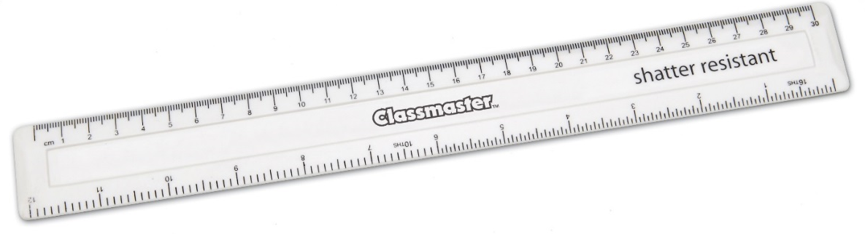
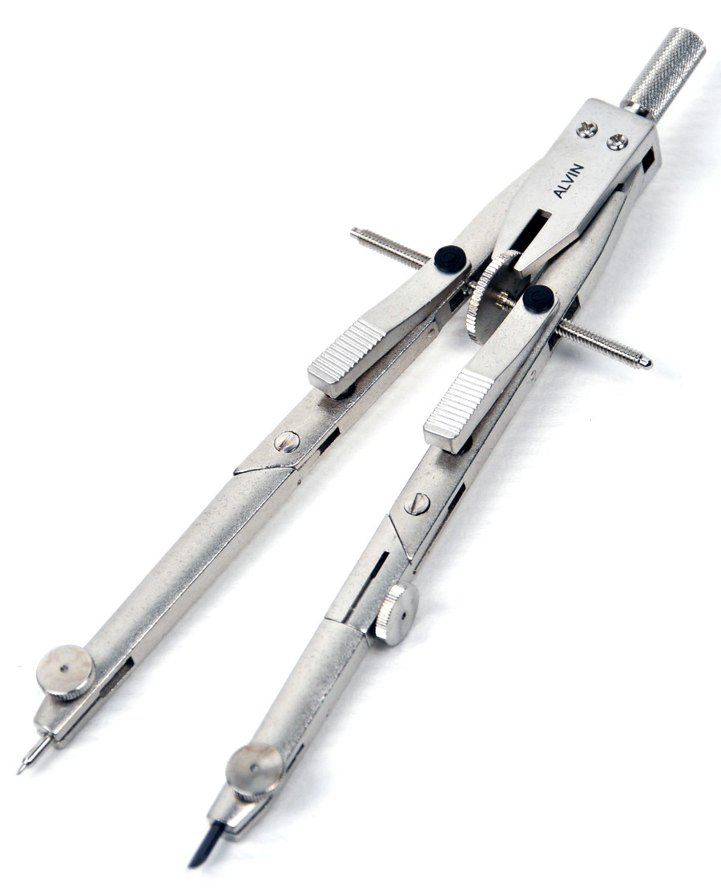
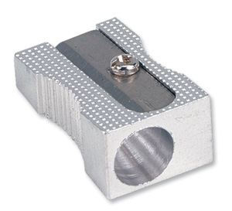
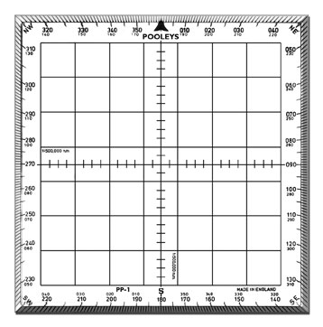
Admin
Labs – please stick to your allocated lab
If labs are overfull, people in the wrong stream will be asked to leave
Please listen as much as you write
Bring these with you for all lectures and lab sessions

Slide 3
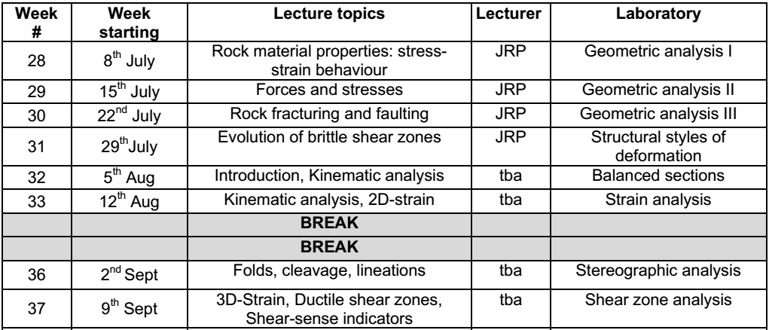
subject | Lectures
Forces, stresses, strain | Stresses and Mohr diagrams States of stress in the lithosphere
Rock as a mechanical material | introduction to strain Elasticity, plasticity, viscosity Stress strain behaviour
Introduction to Deformation | Components of strain - Translation, rotation, dilation, distortion Infinitesimal, incremental and finite strain Measuring and reporting strain
Brittle deformation | Fracturing and jointing Andersonian faulting Conditions for brittle failure and sliding - Mohr circles
Ductile deformation | Fault-related folding Fold description and classification Mechanics of folding Lineations and foliations
Shear zones | Brittle Ductile
Kinematic analysis | Shear sense indicators Fault interactions

Slide 4
Resources
Primary textbook
Van der Pluijm and Marshak (2004) Earth Structure
Other useful books
Davis – structural geology of rocks and regions (electronic) and paper version of Davis
Fossen - structural geology (electronic) and paper version of Fossen
Ragan - Structural geology: an introduction to geometrical techniques (electronic)
Rowland et al. Structural analysis and synthesis - lab resource
Presentation material – illustrations, photographs, videos etc
Will be available on Learn as part of the powerpoint presentation
Journal articles
I may embed links to journal articles

Slide 5
What is structural geology?
Defined as the “study of the ‘architecture’ of the earths crust, as it results from (tectonic) deformation”
How has the crust changed shape and volume?
Architecture reflects large scale fault and flow movements occurring in the crust and lithosphere
Brittle versus ductile behaviour
Interpret movements from an incomplete data set
Construct a deformation history

Slide 6
How does structural geology fit into the geosciences?
Three main scale-related sub-disciplines
Structural geology
Grain to outcrop scale
Tectonics
Outcrop to regional scale
Geodynamics
Plate scale
Jointly, provide information about
how minerals, rocks and the entire crust, lithosphere and mantle deforms
The processes that control deformation

Slide 7
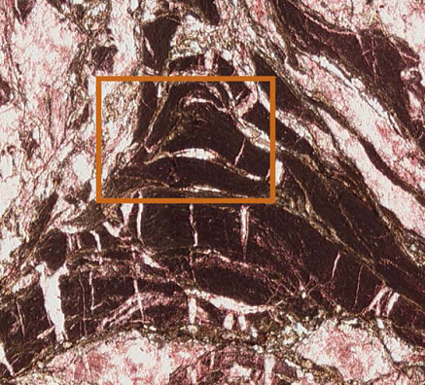
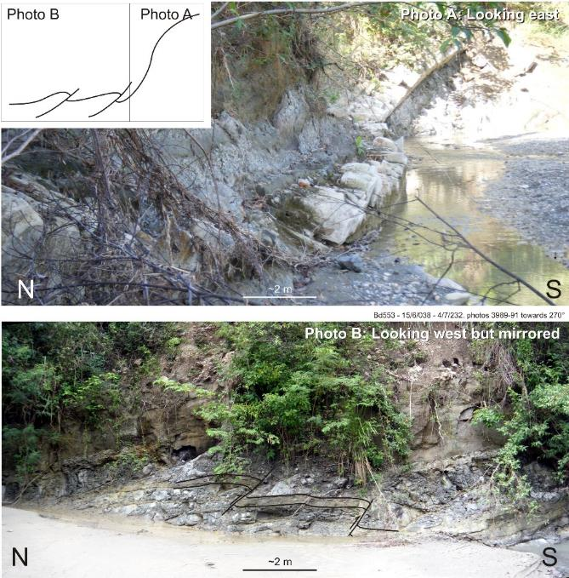
Structural Geology discipline
Use sub-mm to 100 m scale observations to
characterise:
three-dimensional distribution of rock units ▪ deformation structures ▪ cross-cutting relationships (describing the geometry)
relative age of structures (timing)
flow paths followed by particles during deformation (define the kinematics)
Infer orientation, timing and magnitude of the forces that drive deformation (understand the dynamics)
Outcrop of a faults/folds in a river
faults and folds in thin section

Slide 8
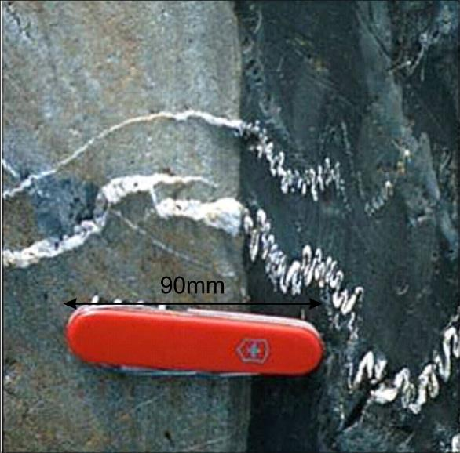
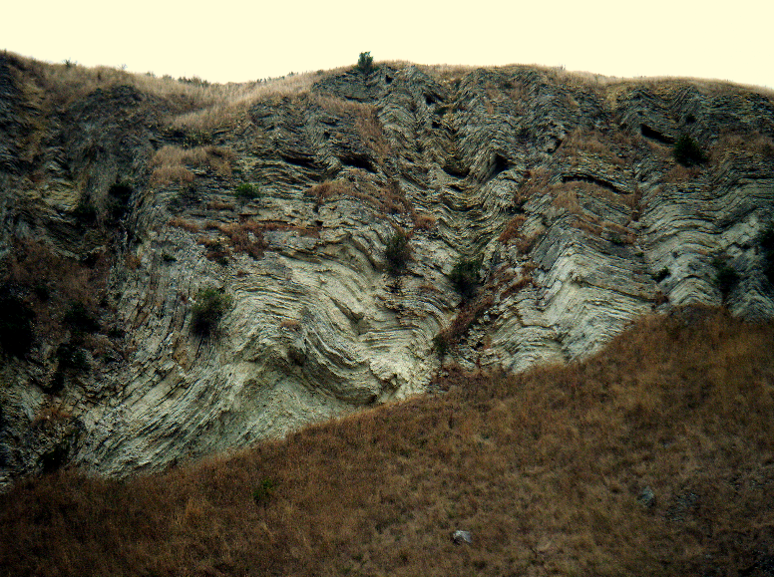
Structural Geologists need to know…
how rocks fail in response to applied stress
how that failure is affected by factors including
Lithology ▪ water content (intrinsic factors - material properties)
temperature ▪ depth (extrinsic factors – tectonics)

Slide 9
Tectonics discipline
Use information across a region to understand the geological context of deformation.
Requires integration of structural geology data ▪ maps ▪ cross-sections ▪ conceptual 3D block diagrams ▪ sedimentology ▪ petrology ▪ geochronology ▪ geochemistry ▪ geophysics ▪ geomorphology
Understand processes such as continental rifting ▪ basin formation ▪ subduction ▪ collisional processes ▪ mountain building

Slide 10
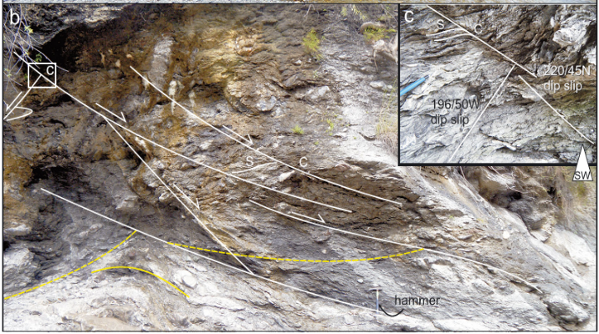
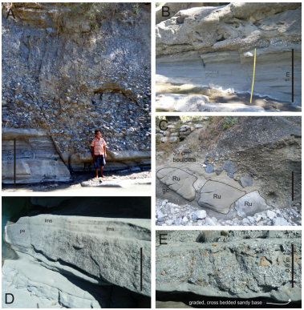
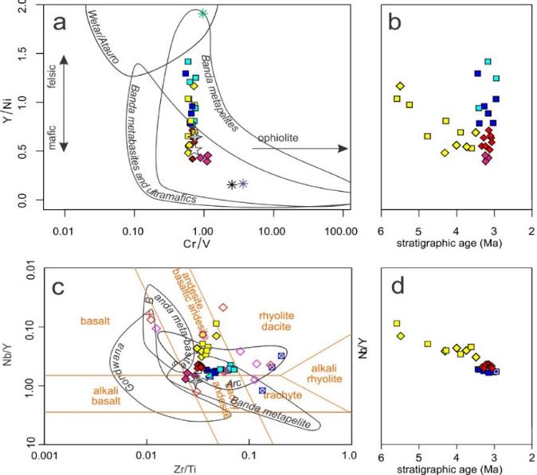
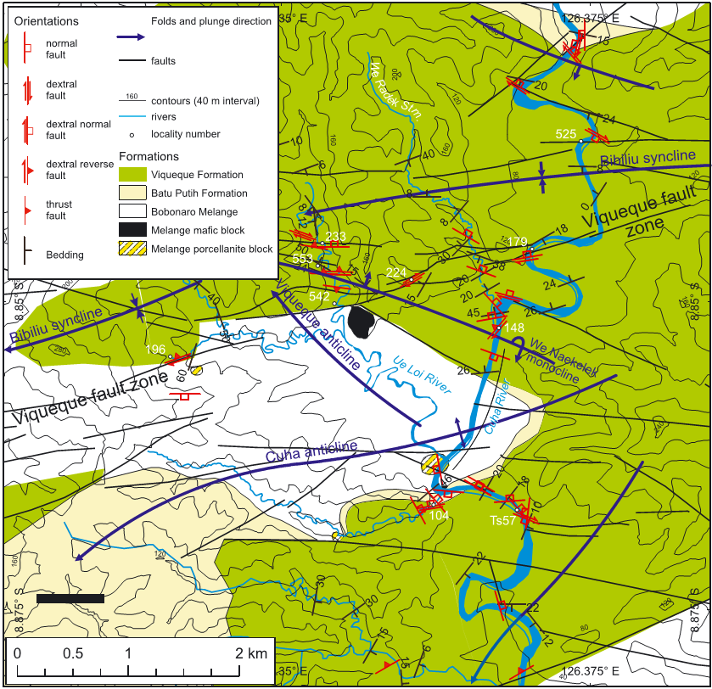
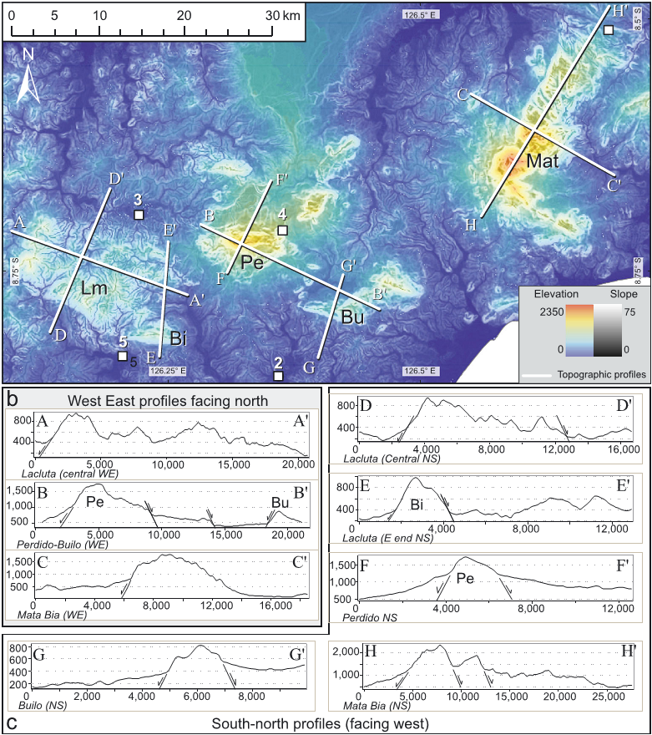
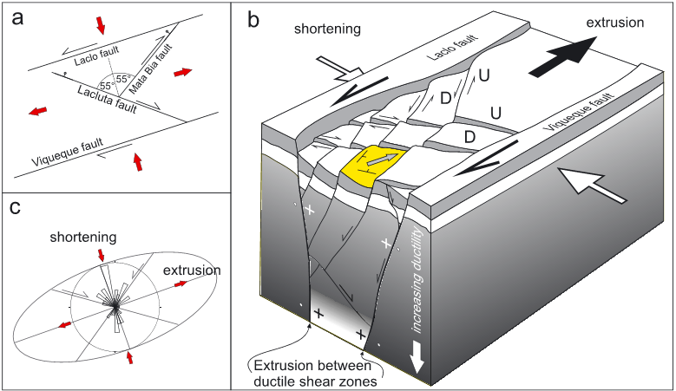
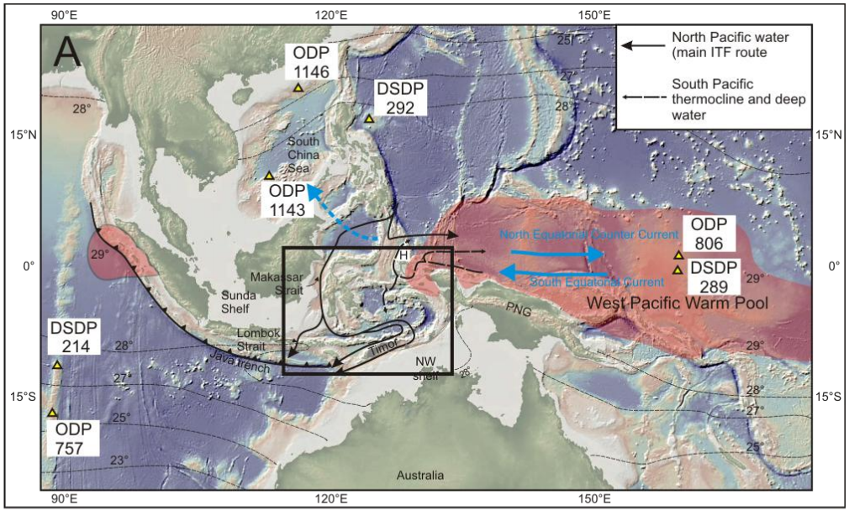
Tectonics example
Structural geology – Geol244
+ Sedimentology – Geol243
+ geochemistry – Geol336
+ field mapping – Geol240/352
+ tectonic geomorphology – Geol479
+ regional structural-stratigraphic correlations – Geol351
= regional tectonic model
Which may have implications for oceanography and climate – Geol357

Slide 11
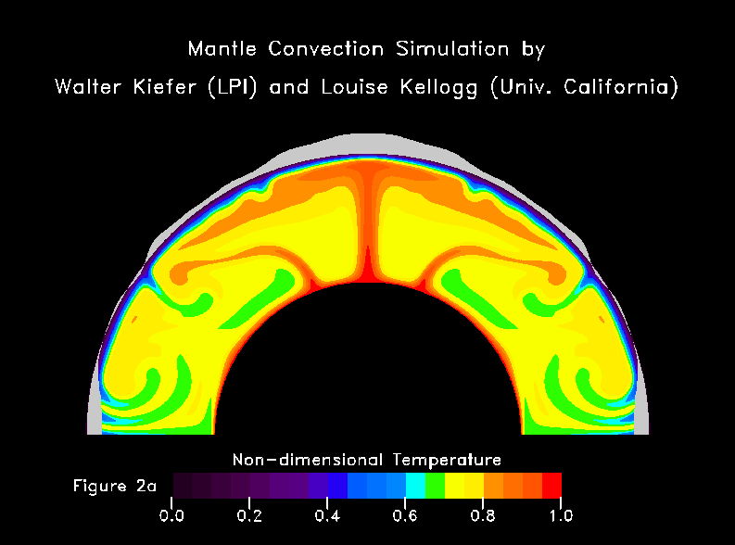
Geodynamics discipline
Mantle convection → plate motion → deformation of Earth's material
Geodynamicisits ask what forces drive mantle convection and hence plate motion
deep mantle processes include
Hot Plumes
cold drips
Cold sinking slabs
numerical models and seismic tomography

Slide 12
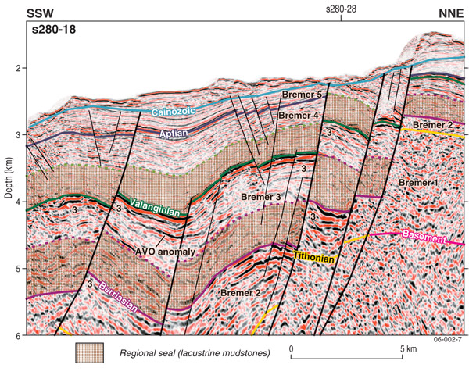
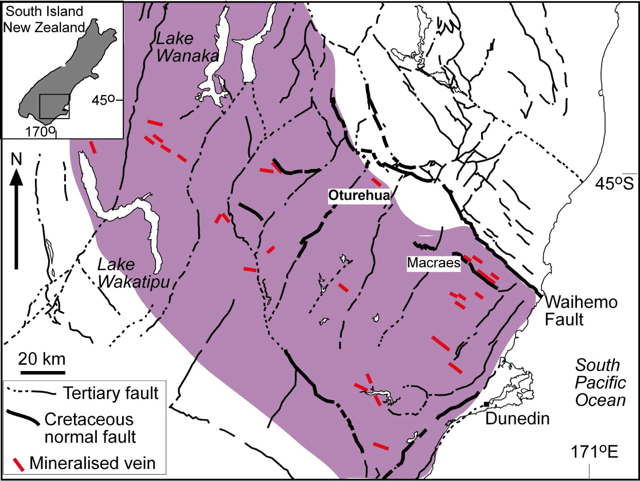
End users of structural geologists
hydrocarbon exploration
Oil and gas – structures control the migration, trapping and escape of hydrocarbon fluids.
mineral exploration
Structural geology critical early stage information when looking for new mineralized provinces.
provides context for interpreting geophysical, geochemical, and geochronological data.
Constant revision of structural geology models during mining.

Slide 13
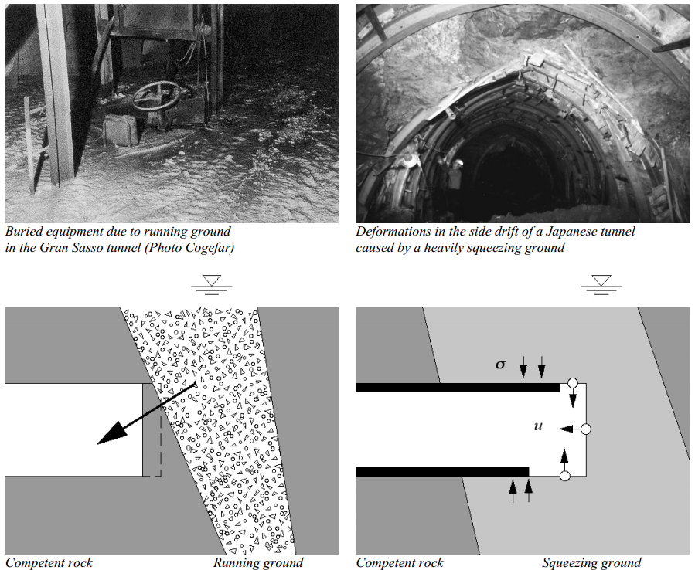
End users of structural geologists
Core discipline in geotechnical site assessment
bridges, dams, tunnels, nuclear reactors, waste disposals etc
Running ground @ 1500m depth - Dr Marlene Villeneuve
Material properties of rocks encountered during excavation for:
Bridges
Dams
Tunnels

Slide 14
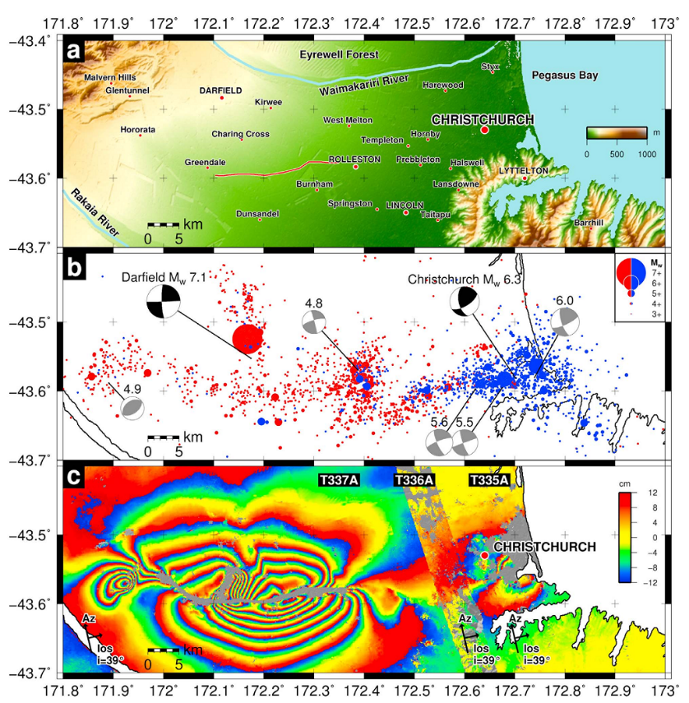
End users of structural geologists
seismic hazard assessment and seismology
Faults cause earthquakes
Faults must be favourably oriented in the regional stress field

Slide 15
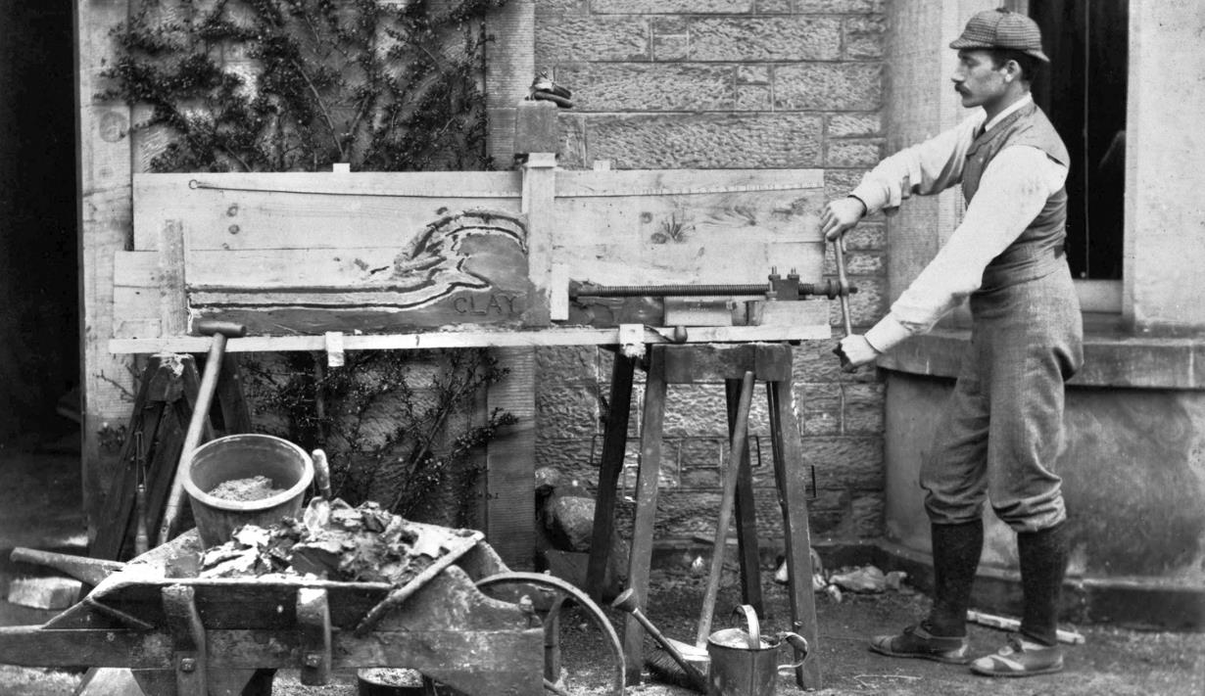
Structural analysis
Three fundamental elements to a detailed structural analysis…
Descriptive analysis
Kinematic analysis
Dynamic analysis

Slide 16
vdP&M p.9

Slide 17
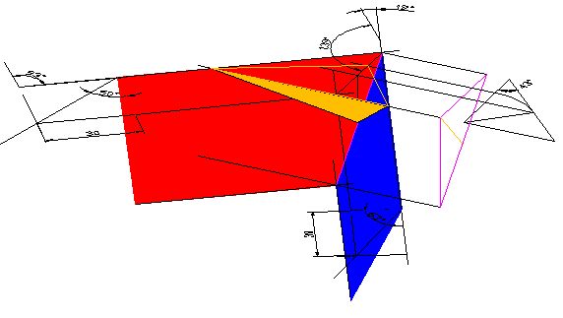
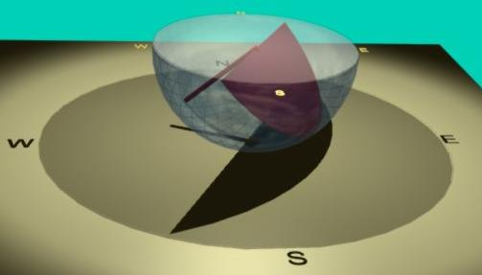
1st type of structural analysis
Descriptive/Geometric analysis
Use techniques that allow representation of three-dimensional objects in two dimensions
Accurately describe the shapes and distribution of rock bodies as they are at the present day.
Orthographic projection/block models (lab exercise)
Stereographic projections (lab exercise)
Maps & Cross sections (lab exercise)
Structure contours
Important part of exploring for mineral and hydrocarbon resources
Where are the resources, what are their shape – important for migration and trapping of fluids

Slide 18
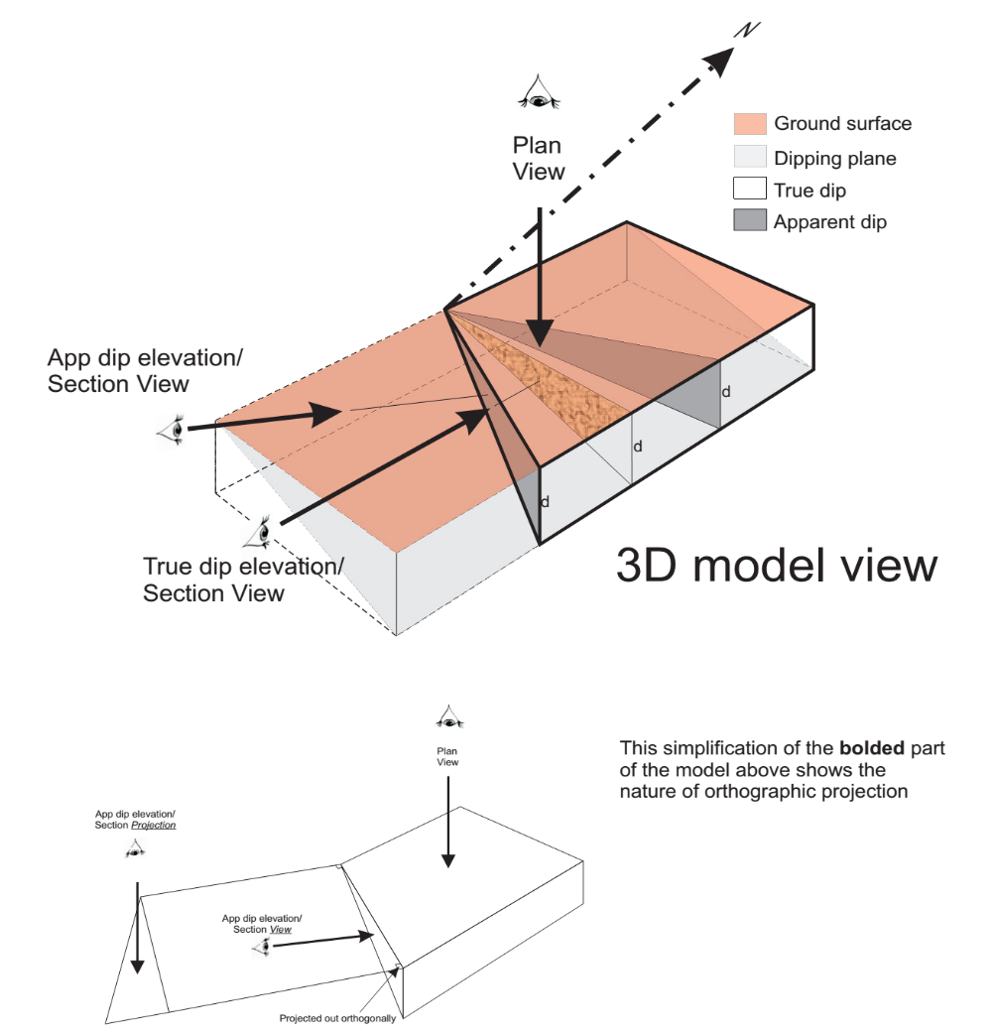

Slide 19
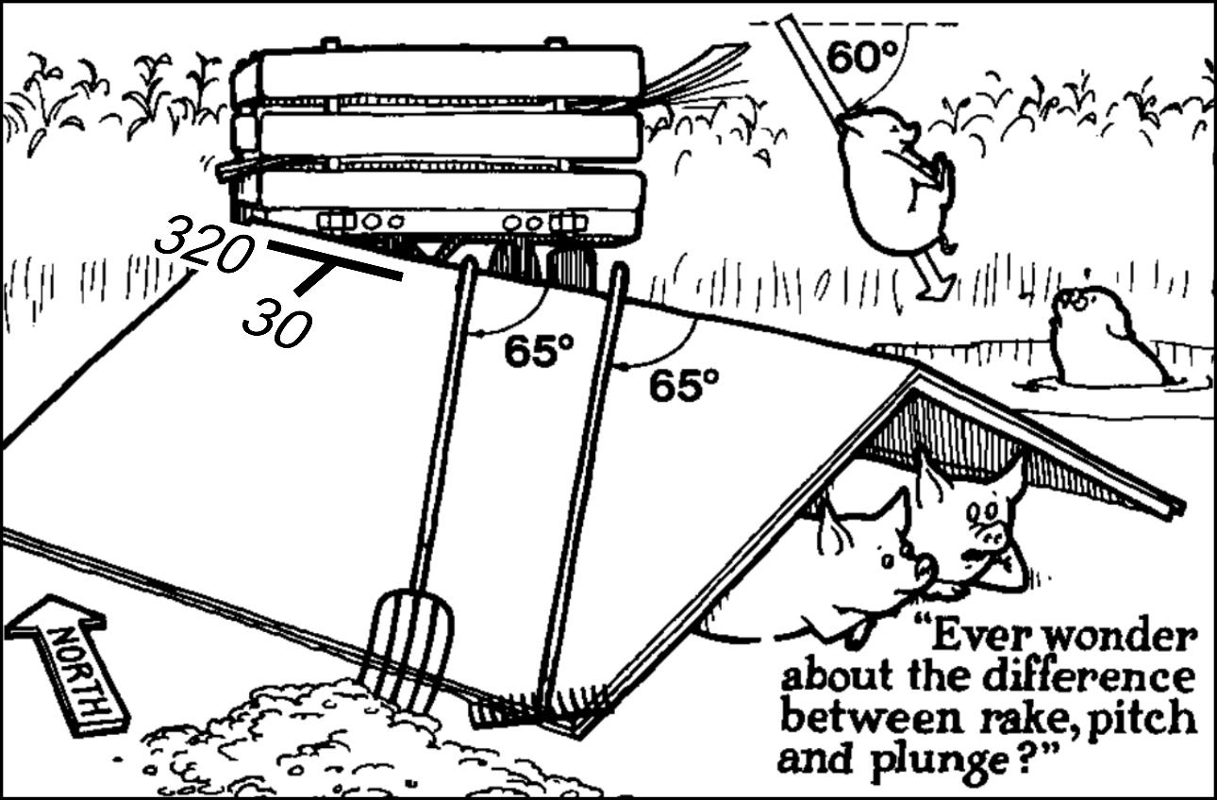
Need to know vocabulary to describe effectively
Rake or pitch
Modified from Davis and Reynolds 1996

Slide 20
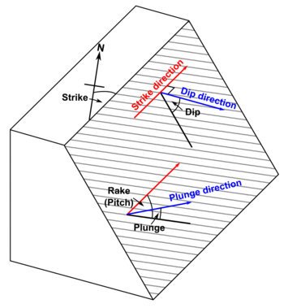
Definitions
Strike – Azimuth (bearing) of a horizontal line in a dipping plane. Measure along the plane

Slide 21
Definitions
True dip is the maximum slope of a surface, measured in an imaginary vertical plane that is perpendicular to the strike
Dip direction - Azimuth of the horizontal line that is perpendicular to the strike (Figure 1.10a
Apparent dip - dip of a plane in a direction that is not perpendicular to the strike. The apparent dip is less than the true dip.
Apparent dip direction of rake and pitchfork

Slide 22
Definitions
Pitch or Rake - Angle between a linear element that lies in a given plane and the strike of that plane
Measure along the plane

Slide 23
Definitions
Plunge - Angle made by a linear element with earth’s surface in imaginary vertical plane
Imagine plunging down a slide into a mud pool
Trend – Azimuth (bearing) of the plunge

Slide 24
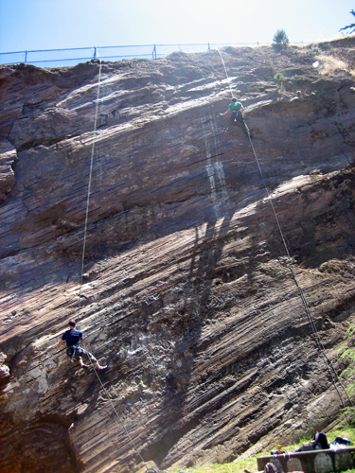
2nd type of structural analysis
Corona heights San Francisco
Kinematic analysis
study movement of the lithosphere - this includes rates and magnitudes of
plate movement – e.g. GPS or seafloor chronology
fault slip
rock distortion by ductile deformation.
Understand four basic types of deformation (change in shape/position of rock):
Translation - changes in position
Rotation - changes in orientation
Strain - changes in shape and size – lab exercise
Importance of shear sense indicators

Slide 25
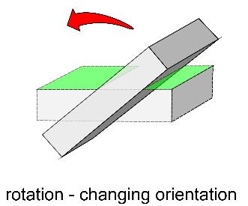
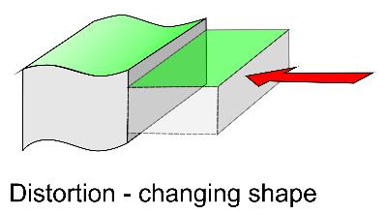
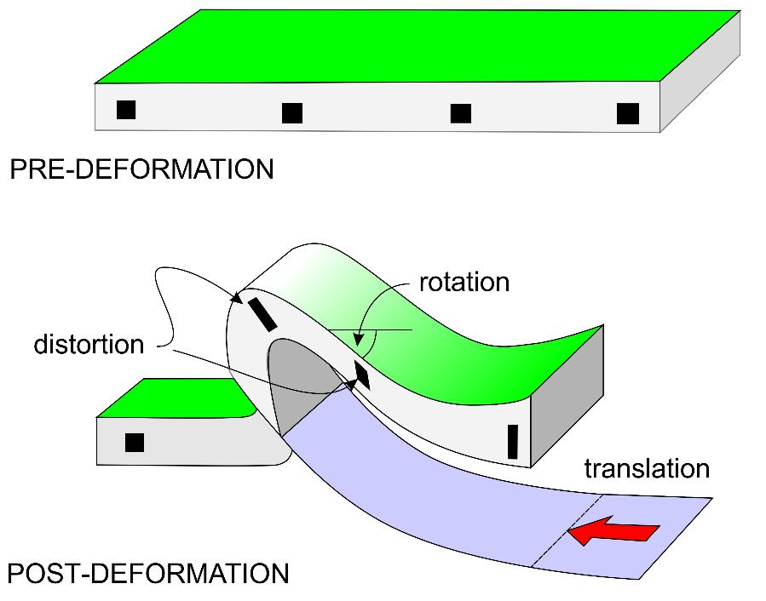
Types of deformation

