Slide 1
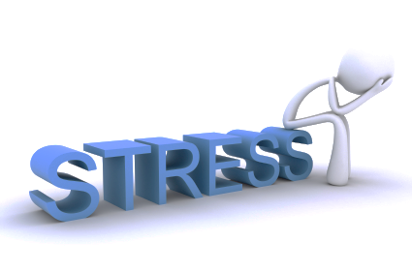
Geol 244 – structural geology
Stress is a 3D concept
Lecture 3 – 3D stress

Slide 2
Exercise – resolve normal and shear stresses for differently inclined planes within a cube
A pillar has a square base of 3 m²
The pillar supports a weight with a mass of 15.000 kg
Calculate σ_{N} and σ_{S}, and the ratio of these, for three planes within the pillar
Plane is normal to axis of pillar
Plane at 45° to pillar axis
Plane at 60° to pillar axis
Acceleration of gravity (g = 9.8 m s⁻²);
Next slide has schematic drawing of problem

Slide 3
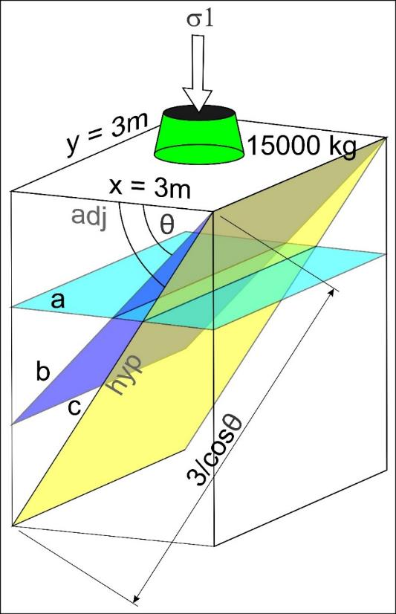
Help for exercise
Calculate the forces
Resolve into normal force and shear force when θ is 0, 45 and 60°
3) Calculate stresses using the area of the plane, which is its down-dip length multiplied by its width
Force
θ
θ
adj
hyp
opp
Opp = Shear force, F _{s} = F sin θ
Adj = normal force, F _{n} = F cos θ
Plane
Area = ……………………….

Slide 4
Answer
A:
σ = (15000 x 9.8) / 9 = 16333.3 Pa
σ_{n} = 16.3 kPa; σ_{s} = 0; ratio = 0
B:
σ = (15000 x 9.8) / (3 x 3/cos45) = 11549 Pa
σ_{n} = σ x cos (45°) = 8.2 kPa
σ_{s} = σ x sin (45°) = 8.2 kPa
Ratio = 1
C:
s = (15000 x 9.8) / (3 x 3/cos60) = 8166 Pa
σ_{n} = σ x cos (60°) = 4.08 kPa
σ_{s} = σ x sin (60°) = 7.07 kPa
Ratio = 1.73

Slide 5
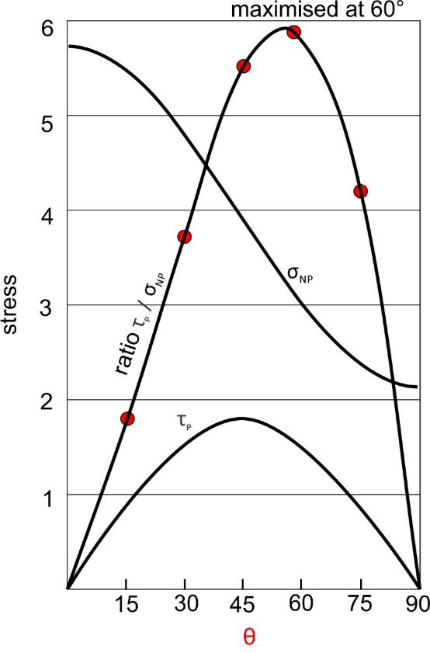
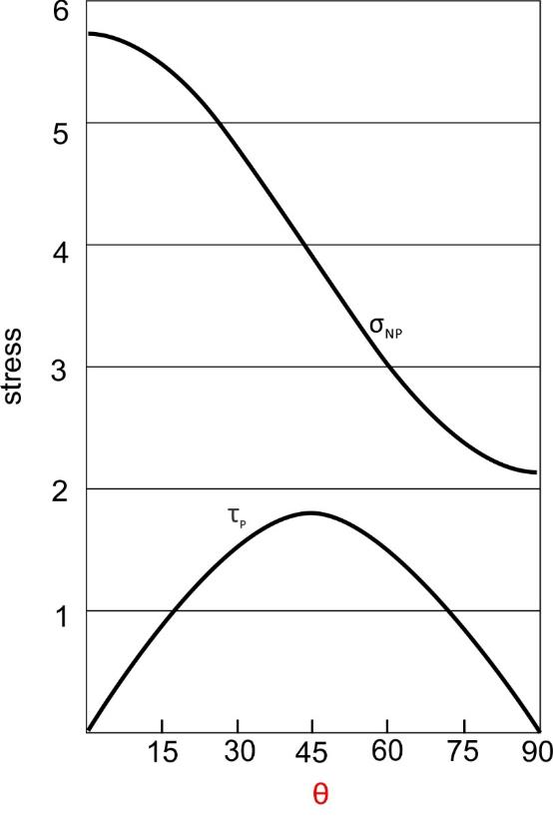
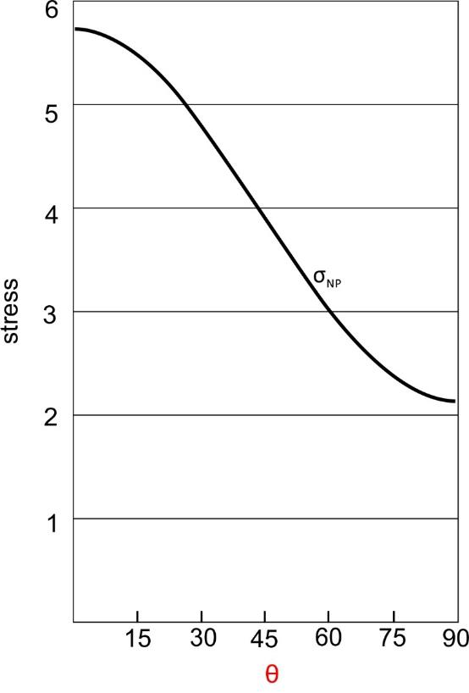
Shear and normal stress and the inclination of the plane
As plane steepens past 45°, area increases dramatically – stress magnitudes drop
Normal stress is at max when θ = 0°
Shear stress is at max when θ = 45°
Ratio of shear stress to normal stress is greatest when θ ~60°
θ is the angle between σ1 and the normal to the plane.

Slide 6
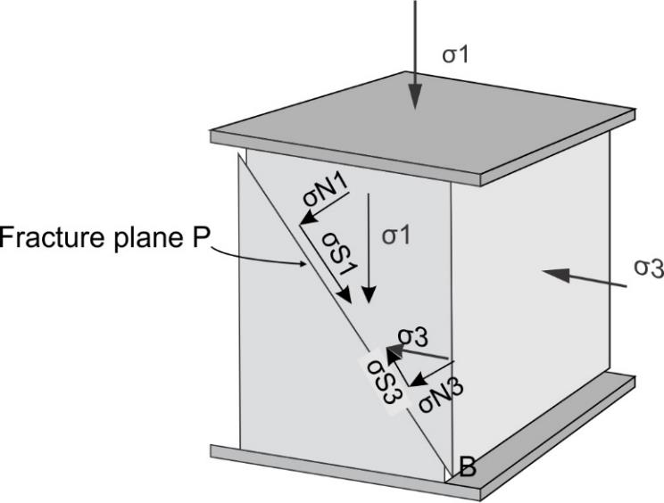
Stress is a 3D concept
Applying force to a 3D body sets up stresses on any and every plane within that body
If body is at rest, equal and opposite forces act on a unit area – stresses are balanced
Stress on every plane has
Normal and shear components
How can we represent all stress on all possible planes?

Slide 7
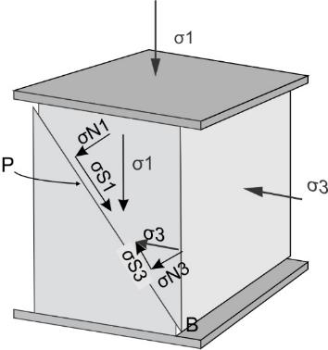
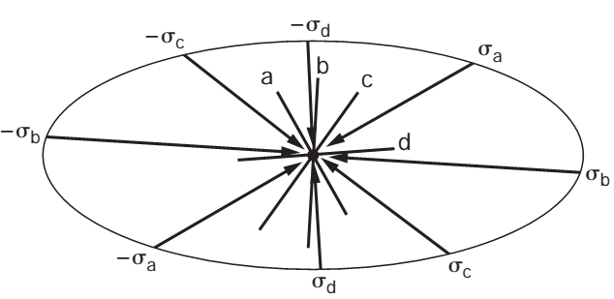
Visualizing stress at a point in 2d – the stress ellipse
If plane is parallel to σ3…
…normal stress = σ1, and vice versa
Note that stress must be balanced
Other orientations, normal stress is some combination
Envelope around all possible normal stress vectors is an ellipse – stress ellipse
σ1
σ3

Slide 8
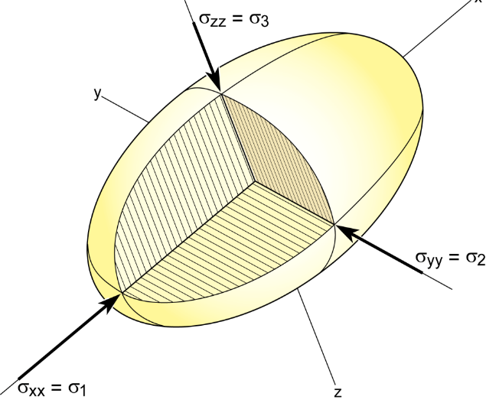
Visualizing stress at a point in 3d – the Stress ellipsoid
2 planes intersect on a line
3 orthogonal planes intersect along mutually perpendicular lines,
Any 3 planes have a point in common
Point is common to any other plane passing through the stress ellipsoid
Stress at a point completely describes the stresses on all planes
σ1 (long axis) ≥ σ2 (intermediate axis) ≥ σ3 (short axis)
Notes:
to describe stress on a randomly oriented plane in space we need to consider the 3d case
Recall that two nonparallel planes have a line in common and that three or more nonparallel planes have a point in common. In
other words, a point defines the intersection of an infinite number of planes with different orientations. The stress state at a point, therefore, can describe the stresses acting on all planes in a body

Slide 9
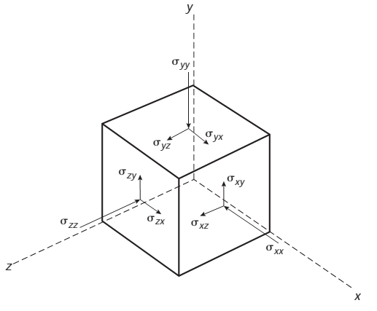
Describing stress at a point – the stress tensor
We just looked at normal stress only (2 component vector)
Also need to account for shear stress
Xyz reference system = 9 stress components
1 Normal and 2 shear components on each cube face, each parallel to a coordinate axis
σxx is normal stress on yz plane
2 shear stresses per plane
Infinitesimally small cube = point
Shear stresses must balance if at rest
Normal stresses

Slide 10
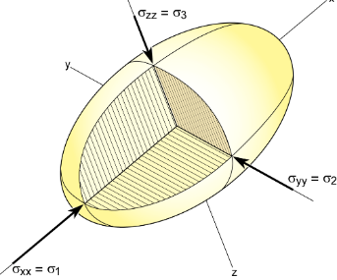
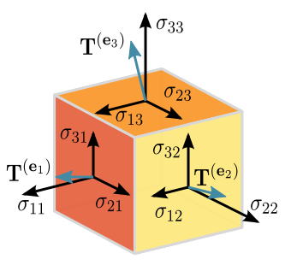
3D stress - Principal planes and principal stresses
If planes are perpendicular to the principal stresses
Shear stress = 0Pa
These are principal planes of stress
If planes are inclined to principal stresses
Shear stresses are non-zero

