Slide 1
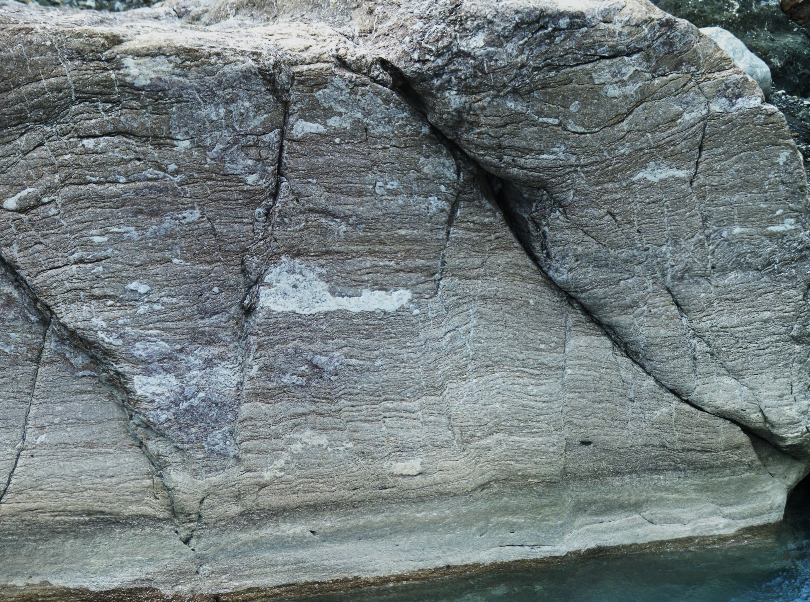
Geol 244 – structural geology
Lecture 5 – Strain and rock material properties

Slide 2
From last lecture: Particle movements during strain
Strain can occur due to
Pure shear
Simple shear
General shear
Combination of Pure and Simple shear
Particles flow along predictable paths during progressive strain accumulation
Pure shear/coaxial strain
General shear
Simple shear – Non coaxial strain

Slide 3
Pure shear
3D homogenous flattening
All incremental strain axes parallel to each other and same material lines
Incremental strain axes
Incremental strain axes
Incremental strain axes

Slide 4
Simple shear
3 D constant volume strain
Volume of card deck remains constant as you shear it

Slide 5
Strain associated with Pure shear is coaxial
Material lines that are not parallel to principal strain axes rotate and change length
Principal strain axes change length but do not rotate
Zone of shortened lines
Zone of lengthened
lines
LNFLS – Line of no finite longitudinal strain
Length has changed but is presently the same as before

Slide 6
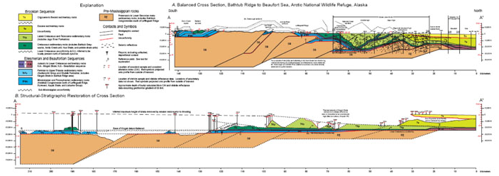
Measuring longitudinal strain
elongation
stretch
$$s$$
<1 – compressional
>1 - extensional
Stretch

Slide 7
Simple shear strain is non-coaxial

Slide 8
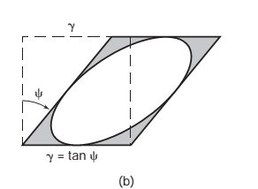
Measuring shear strain
Shear strain
gamma
Angular shear
psi

Slide 9
A car crash analogy

Slide 10
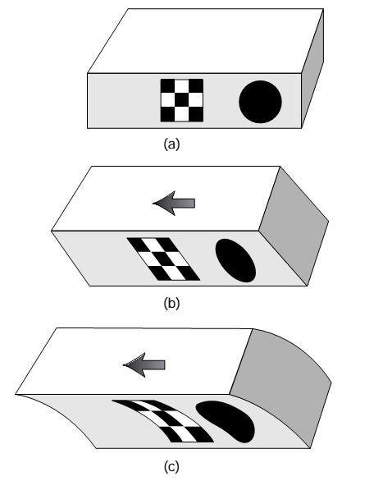
Homogenous or heterogenous?
Distortion is commonly assumed to be homogenous, rather than heterogenous
Heterogenous distortion of a large body consists of small areas of homogeneous strain.
Heterogenous
Homogenous 1
Homogenous
Homogenous 2
Heterogenous
Crash investigator uses observations of the crashed vehicles to understand the kinematics and relative motion of the vehicles

Slide 11
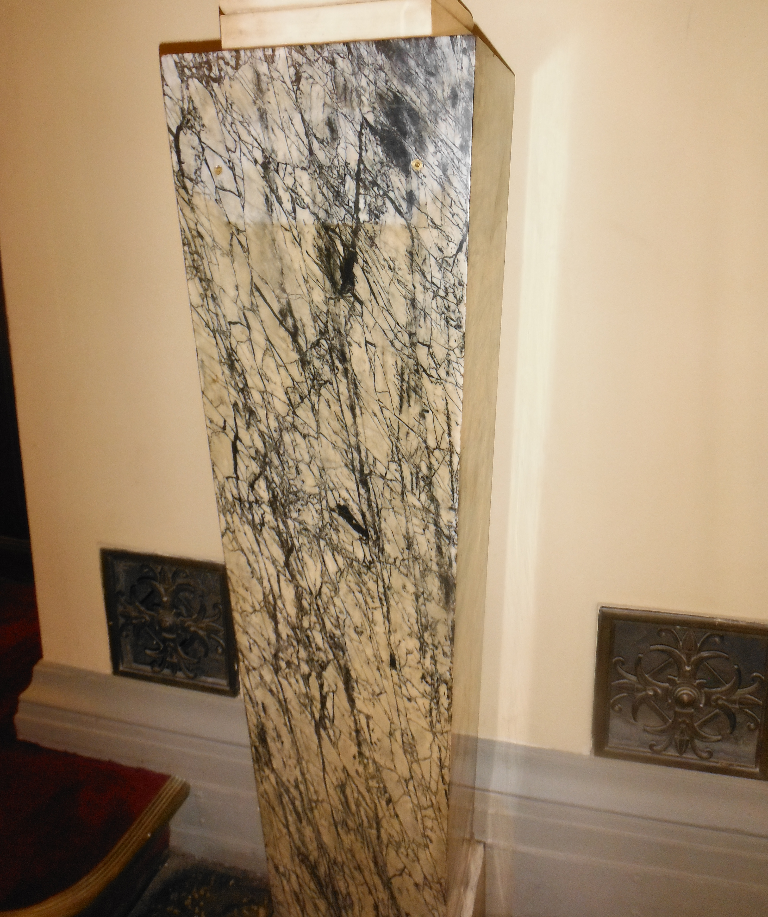
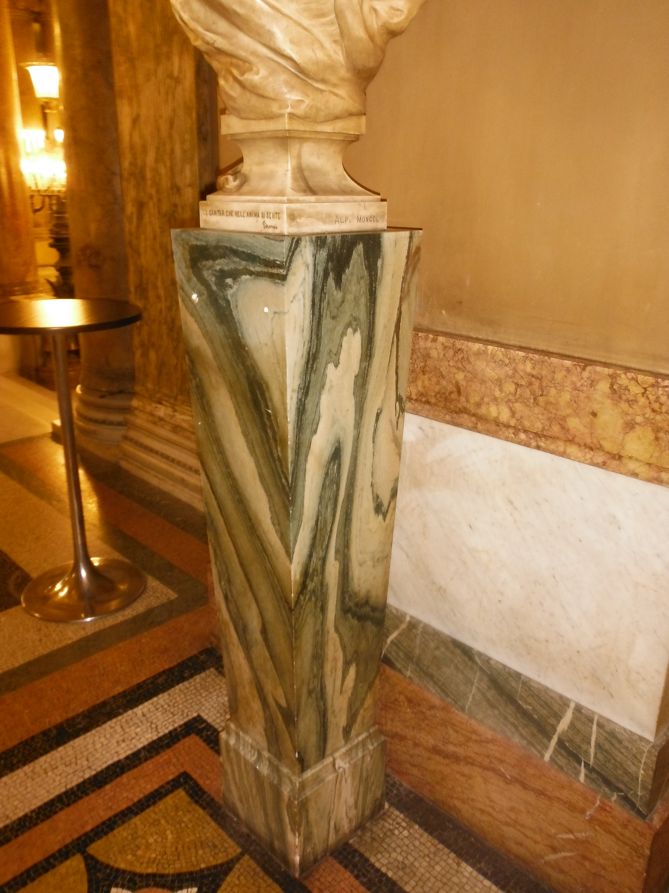
We want to interpret the history of deformation (strain) in the rocks and how it related to stress
The material properties of rocks affect how they deform
affected by factors such as lithology, water content, temperature and depth
Faulting in this marble is brittle – the strength of the rock has been exceeded and it has broken
Folding of this marble is ductile – the rock remains intact but bends like putty
Notes:
We will now look at the characteristics of end member rock materials and work towards an understanding of complex rock materials.

Slide 12
Why do rocks deform in a particular way?
We need to understand…
3 fundamental material classes:
Elastic solids
Viscous fluids
Plastic substances
We will relate these to concepts of
Brittleness
Ductility
Plasticity
Rupture
Strength
Rheology

Slide 13
Importance of rheology for forming small-scale deformation structures
large scale flow sets up forces in rock
rock responds by progressive change in size, shape, and position
nature and speed of change for a given force depends on rheology of rock
Changes remain in rock, even once forces change
$Y=m∙x$
where
Y:deformation
m: rheology (time dependent)
x: force/stress

Slide 14
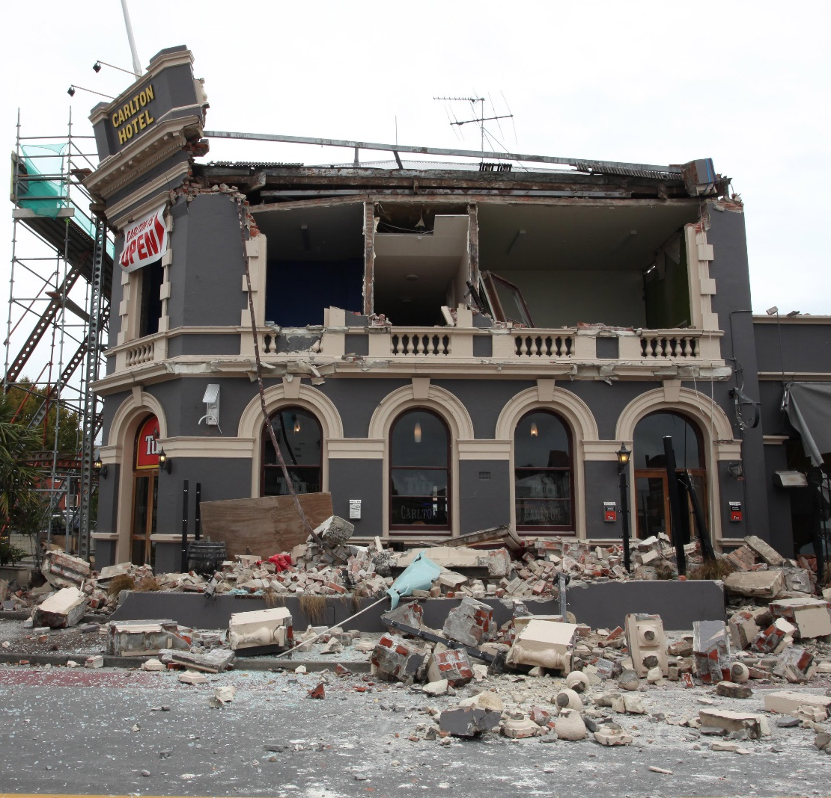
Solids versus liquids
Solid Behavior
Elastic properties
Strain related to stress
rebound
Small strains are temporary
House goes back to normal after earthquake
Rupture at relatively small strains
Steel, wood, concrete, rocks, parts of lithosphere

Slide 15
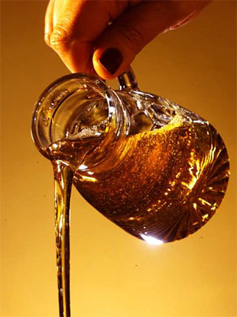
Solids versus liquids
Liquid Behavior:
Viscous fluid properties
no rebound
Strain related to time
shape changes permanently with time
Deformation is not recoverable
Water, oil, melted chocolate, lava, some rocks and some parts of the lithosphere

Slide 16
Elastic deformation
Linear relationship between stress and strain
Instant response to stress
Strain is non-permanent, ie completely recoverable
You feel elastic behaviour when you feel an earthquake
Waves briefly deform rock on which you stand, which then returns to normal

Slide 17
Elastic constants
In terms of stress and strain
Stress σ = E ∙ ε
E is Youngs modulus – slope of stress-strain curve
Same as k in Hookes Law
describes the response of material to linear stress

Slide 18
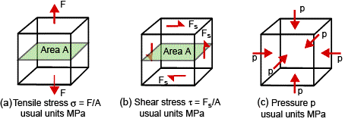
Other elastic moduli
Describe the relationship between stress and strain for different types of stress
Youngs modulus E
describes proportionality between normal stress and strain – in extension or compression
$$σ=E×ε$$
slope of the stress – strain curve
Shear (rigidity) modulus G (or μ)
describes proportionality between shear stress and shear strain
$$σ_{s}=G×γ$$
slope of shear stress – shear strain curve
Bulk modulus K
describes proportionality between pressure (hydrostatic stress) and volume change
$$p=K×\left(\frac{V−V_{O}}{V_{O}}\right)$$

Slide 19
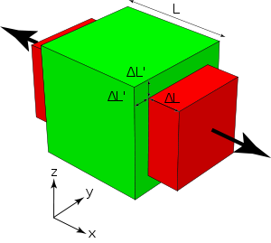
Elastic constants
Poisson’s ratio v
Material stretched one way, thins the other
$$v=\frac{Elongation perp. to σ1}{Elongation parallel to σ1}$$
$$v=\frac{∆L′}{∆L}$$

Slide 20
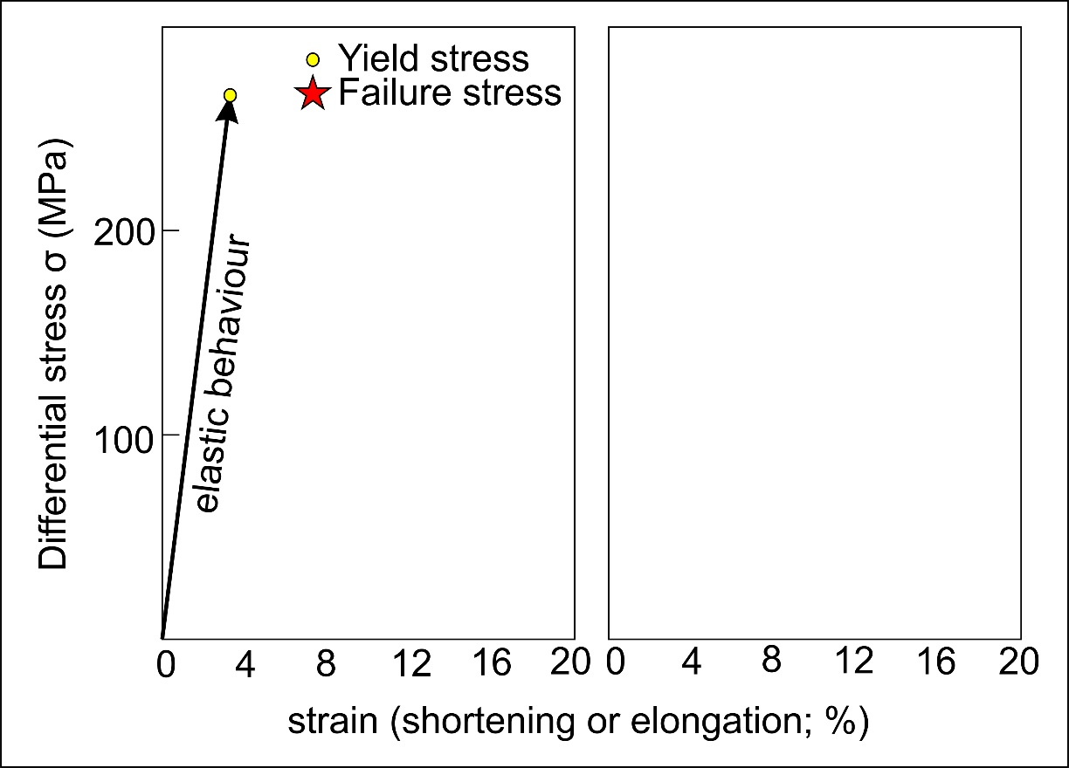
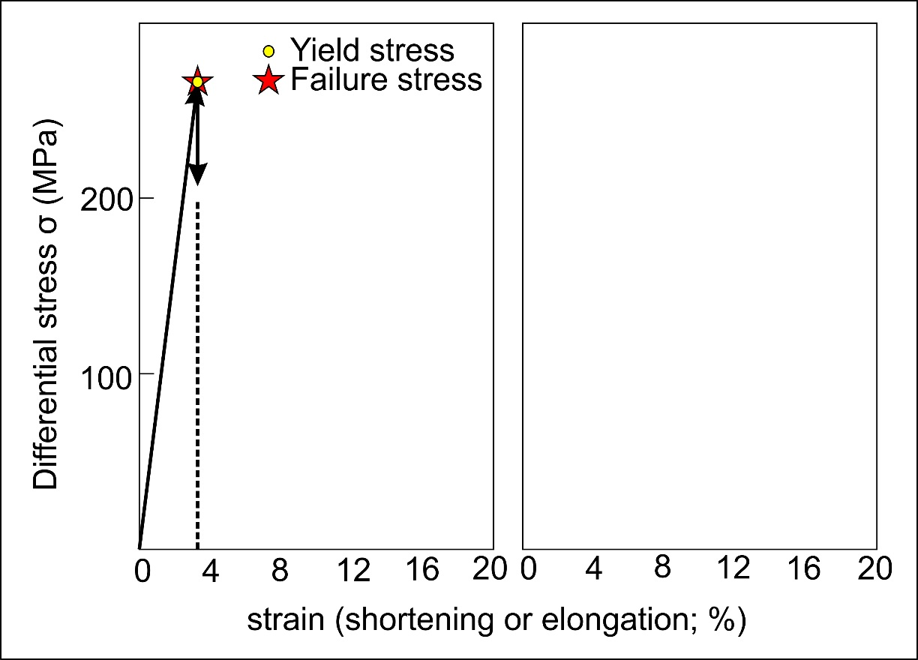
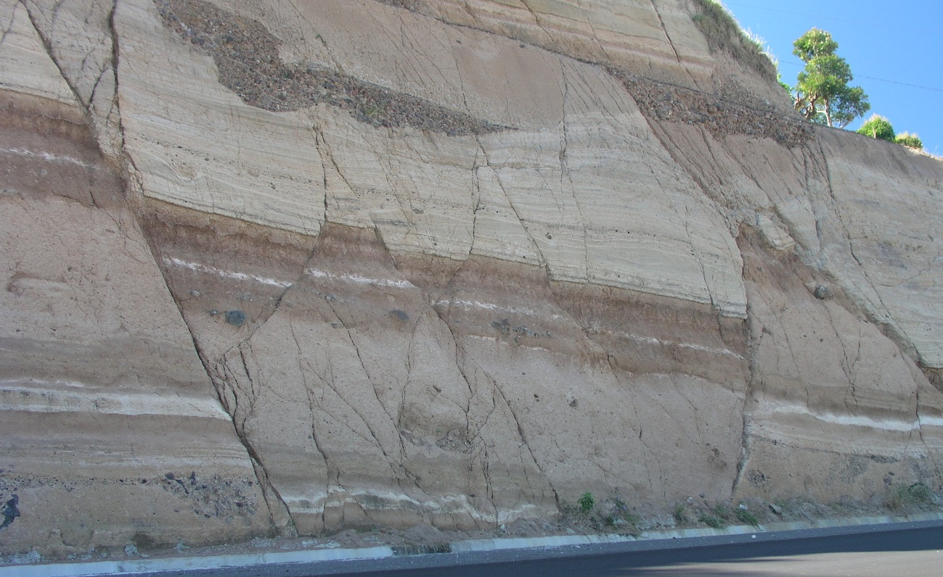
Elasticity and brittleness
Brittle (adj)
Deforms elastically (Accumulates little or no permanent distortion)
Followed immediately by failure (Rupture, loss of cohesion) at yield stress
Yield stress ≈ Failure stress
Common example is glass
Low temperature behaviour only

Slide 21
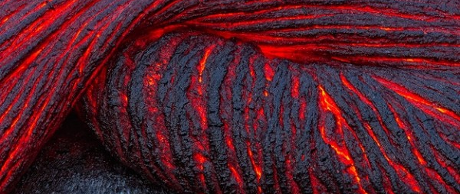
Viscous behaviour
Lava flows downhill with time
Linear stress v strain
Strain accumulates instantly
Strain recovered
released
Stress applied
Strain irrecoverable
Dashpot model
Linear stress v strain-rate
Strain accumulates
with time

Slide 22
tomorrow
Vicous and plastic materials

