Slide 1
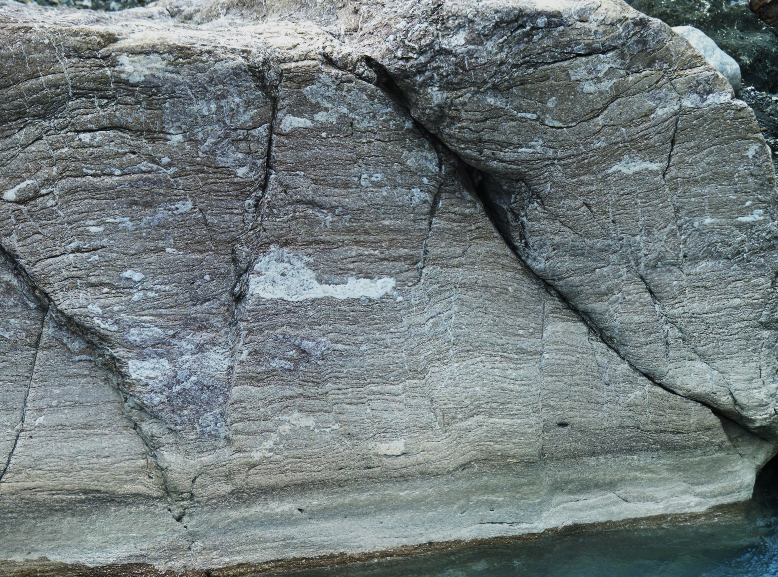
Geol 244 – structural geology
Lecture 6 – rock material properties

Slide 2
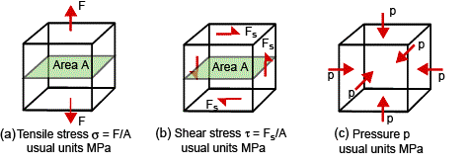
Elastic constants
Describe the relationship between stress and strain for different types of stress
Youngs modulus E
describes proportionality between normal stress and strain – in extension or compression
$$σ=E×ε$$
slope of the stress – strain curve
Shear (rigidity) modulus G (or μ)
describes proportionality between shear stress and shear strain
$$σ_{s}=G×γ$$
slope of shear stress – shear strain curve
Bulk modulus K
describes proportionality between pressure (hydrostatic stress) and volume change
$$p=K×\left(\frac{V−V_{O}}{V_{O}}\right)$$

Slide 3
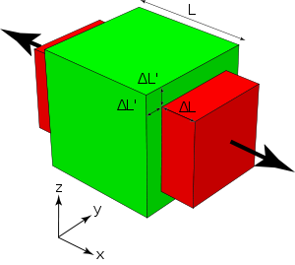
Elastic constants
Poisson’s ratio v
Material stretched one way, thins the other
$$v=\frac{Elongation perp. to σ1}{Elongation parallel to σ1}$$
$$v=\frac{∆L′}{∆L}$$

Slide 4
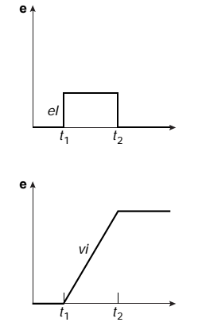
Strain rate
Slope of a strain time curve – strain rate
$ε \left(strain\right)=\frac{l−l_{0}}{l_{0}}=\frac{∆l}{l_{0}}$
$ė \left(strain−rate\right)=\frac{∆l}{l_{0}t}$ (units s⁻¹)
Instantaneous strain accumulation
= very high strain rate
Lower strain rate

Slide 5
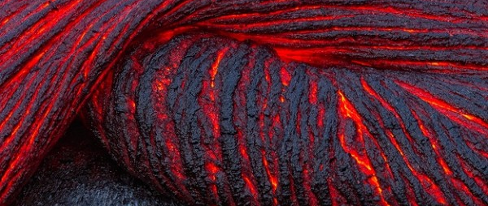
Viscous behaviour
Lava flows downhill with time
Linear stress v strain
Strain accumulates instantly
Strain recovered
released
Stress applied
Strain irrecoverable
Dashpot model
Linear stress v strain-rate
Strain accumulates
with time

Slide 6
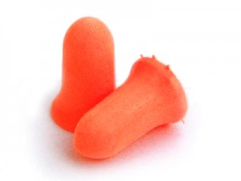
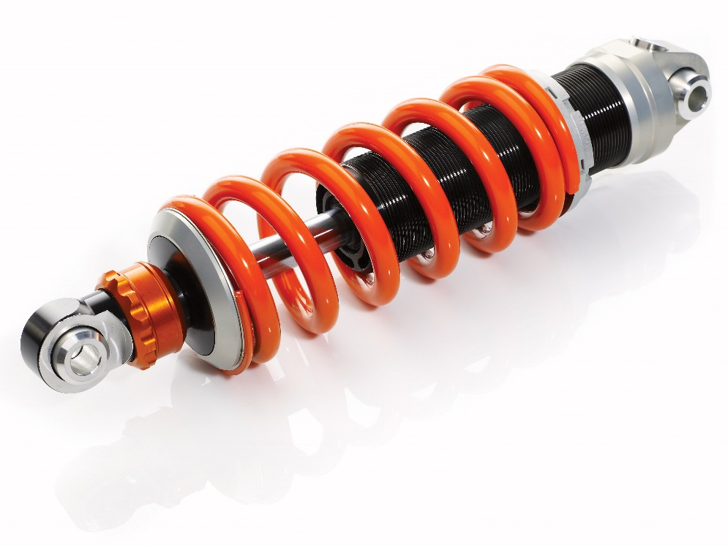
Visco-elastic
Ultimately, strain is recoverable – ie elastic
Strain accumulates slowly when stress is applied
Strain recovered slowly when stress released
Ear plugs are visco-elastic
Shock absorber (oil filled piston)
retards spring compression/extension
Spring forces piston to return to original position
Visco-elastic = Visco, then elastic

Slide 7
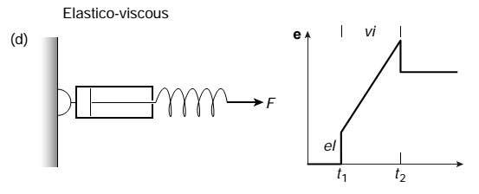
Elastico-viscous
Material behaves elastically at application of stress
Then behaves as a viscous fluid
Ultimately only the elastic strain is recoverable
The remainder is permanent
Elastico-viscous = elastic, then viscous

Slide 8
Silly putty – elastico-viscous
Remember that earthquake waves are elastic phenomena but mantle rocks flow

Slide 9
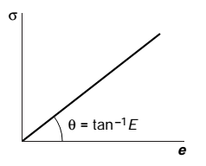
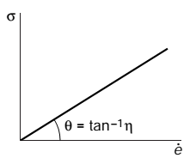
General linear behaviour
Linear refers to the relationship between
stress, and strain
Stress and strain-rate
Proportionality in elastic and viscous materials depends on Youngs modulus or on viscosity
Combined visco-elastic and elastico-viscous
Recover elastic strain
Recover visco-elastic strain (ear plugs)
Apply stress → elastic strain → Followed by viscous strain
first 2/3 of curve is elastico-viscous
Followed by elastic behaviour – strain stays consistent
Second 2/3 of curve is visco-elastic

Slide 10
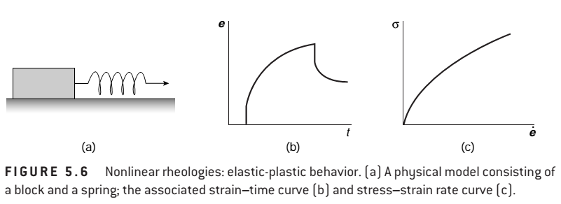
Elastic-plastic
Modeled as a sliding block with a spring attached
We will try this in the lab

Slide 11
Elastic plastic deformation
Plastic materials stay where you put them.
No elasticity – no viscosity – they deform permanently above their yield stress
What happens if you exceed the force from which a spring can recover?
Ultimate strength
Strain hardening allows creeping faults to have earthquakes
No difference at the start

Slide 12
Strain - Some fundamental definitions
Elastic strain – recoverable after removing the load
Material returns to pre-load shape and size
A material that deforms elastically has the property of elasticity
Elastic Strain is related linearly to stress
Viscous strain – a concept related to thickness of a fluid
blood is thicker (ie more viscous) than water
Viscous strain accumulates as a function of time – like water flowing downstream
Plastic strain – cannot be recovered after removing the load
Material does not return to pre-load shape/size
A material that deforms plastically has the property of plasticity
Plastic Strain is related non-linearly to stress
Plastic strain is strongly controlled by the relative importance of elasticity and viscosity in the rock

Slide 13
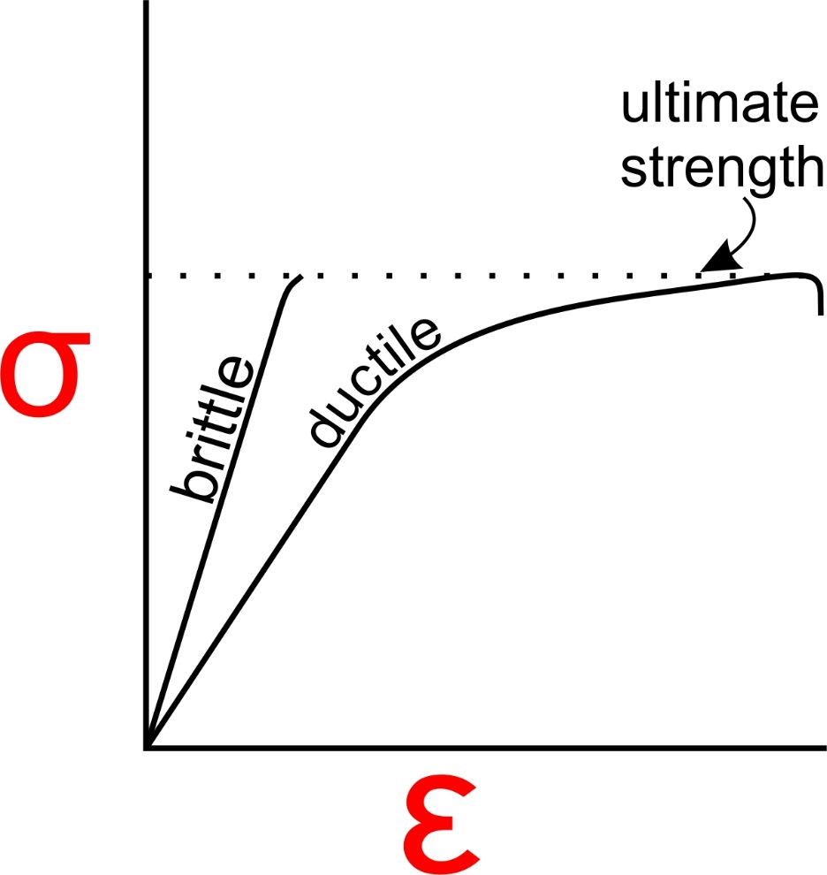
Brittle versus ductile
Brittle rocks - deformation is localized on the mesoscopic scale and involves the formation of fractures.
In natural rocks, brittle fracturing occurs at finite strains of 5% or less.
a faulted rock displays brittle deformation
Ductile rocks accumulate significant permanent strain with deformation that is distributed on the mesoscopic scale.
A block of dough is ductile
A folded rock displays ductile deformation
Vdp&M p.108

Slide 14
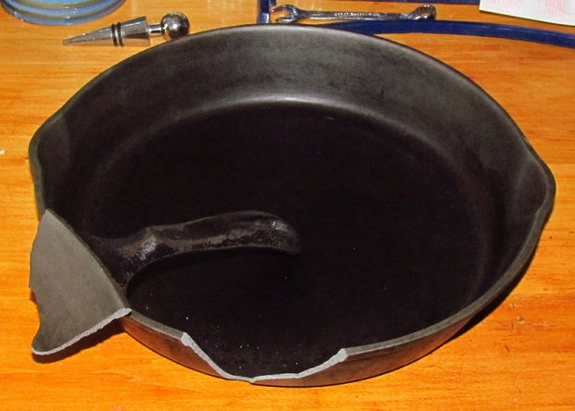
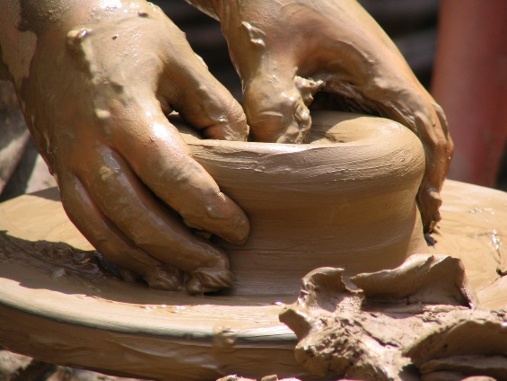
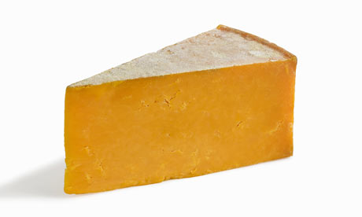
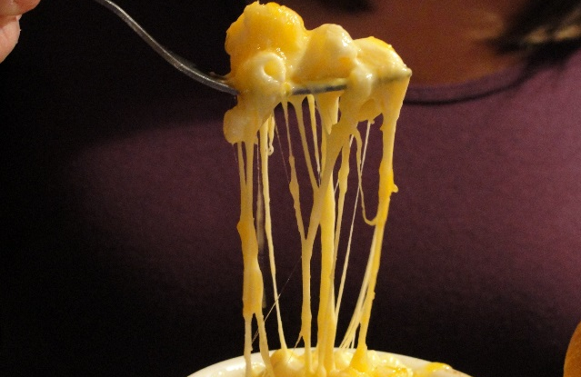
Brittle or ductile?
Composition
Crystallinity and hydration
Temperature

Slide 15
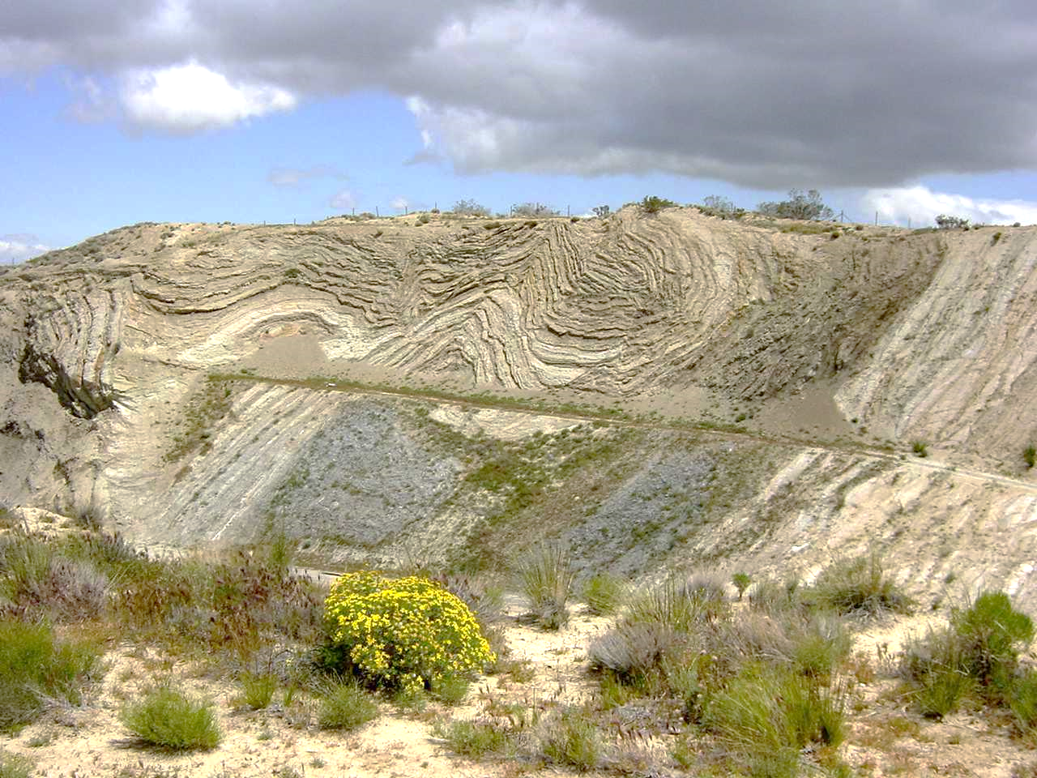
Brittle or ductile?
faulting and folding occurred simultaneously
No reason that confining pressure, temperature or pore fluid pressure are significantly different so why two modes of deformation?
Importance of localization of strain and strain rate
may vary considerably in any given body of rock.
Silly putty fractures at high strain rate but flows at lower rates
Faulting at high strain rates, folding at low strain rate

