Slide 1
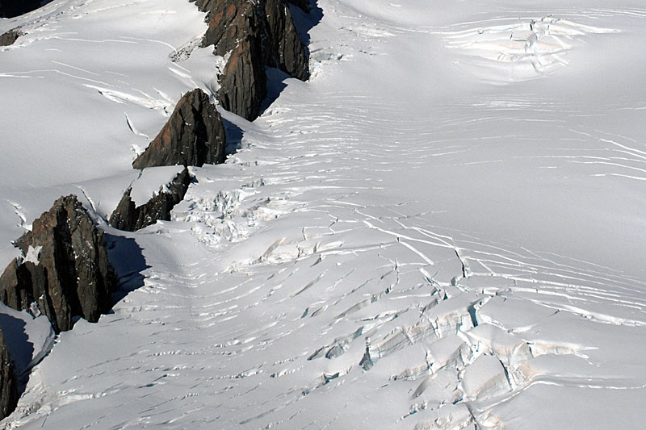
Geol 244 – structural geology
Lecture 7 – Brittle and plastic deformation

Slide 2
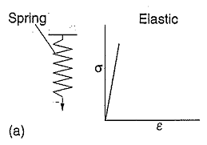
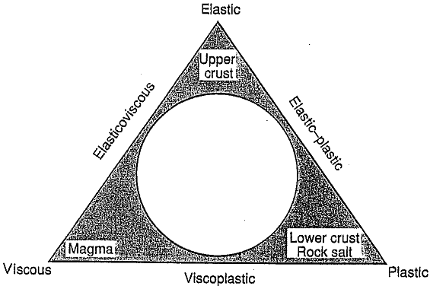
Typical material behaviour modes
Most rocks not ideal (not on the points of the triangle
Most rocks dominated by two behaviour modes (not middle of circle)
σ ∝ ε

Slide 3
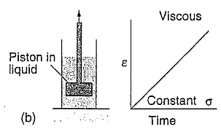
Typical material behaviour modes
Most rocks not ideal (not on the points of the triangle
Most rocks dominated by two behaviour modes (not middle of circle)
ε ∝ t

Slide 4
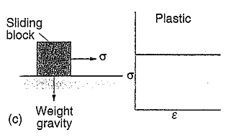
Typical material behaviour modes
Most rocks not ideal (not on the points of the triangle
Most rocks dominated by two behaviour modes (not middle of circle)
strain hardening
strain softening
irrecoverable strain above yield strength
crystallization

Slide 5
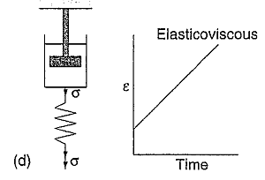
Typical material behaviour modes
Most rocks not ideal (not on the points of the triangle
Most rocks dominated by two behaviour modes (not middle of circle)

Slide 6
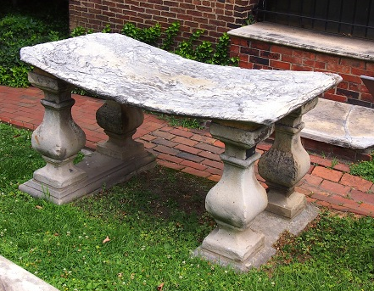
Typical material behaviour modes
Marble seat that deforms permanently, without rupturing, under its own weight, strain accumulates with time
Most rocks not ideal (not on the points of the triangle
Most rocks dominated by two behaviour modes (not middle of circle)
Seat won’t deform without stress (e.g. lying on ground)

Slide 7
Typical material behaviour modes
Marble seat that deforms permanently, without rupturing, under its own weight, strain accumulates with time
Most rocks not ideal (not on the points of the triangle
Most rocks dominated by two behaviour modes (not middle of circle)
Typically elastic plastic
Seat won’t deform without stress (e.g. lying on ground)

Slide 8
Typical material behaviour modes
Most rocks not ideal (not on the points of the triangle
Most rocks dominated by two behaviour modes (not middle of circle)
Typically elastic plastic
Most rocks lie along this axis
Small components of viscosity
Movements within the triangle controlled by temperature, pressure and rock type

Slide 9
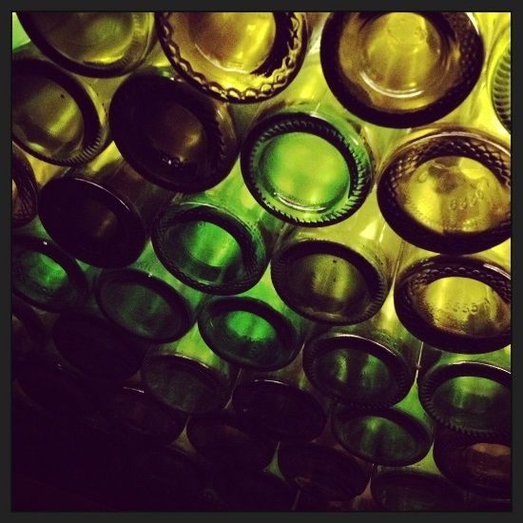
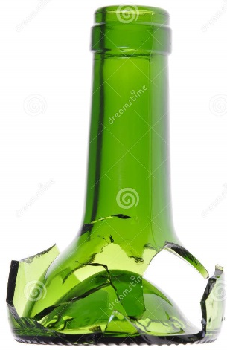
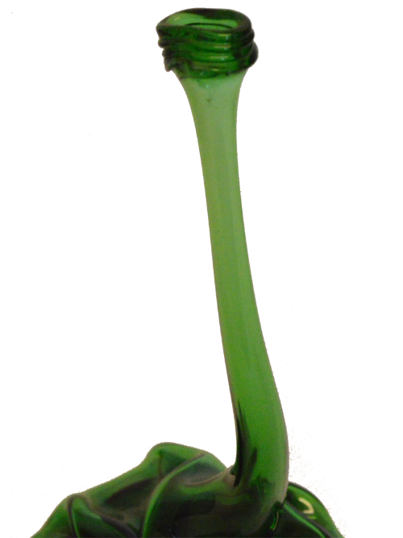
The role of temperature
Lets think about glass…
At low temperatures bottle is strong
Brittle - fractures at very small strains
At high temperature malleable at small stresses (even air pressure)

Slide 10
The role of temperature
Change in temperature causes change in properties of glass
Elastic behaviour and brittle failure
Plastic behaviour and plastic failure
What about transitional behaviour?
Increasing temperature
Increasing ductility
Transitional behaviour
Ductile folding
Brittle fractures

Slide 11
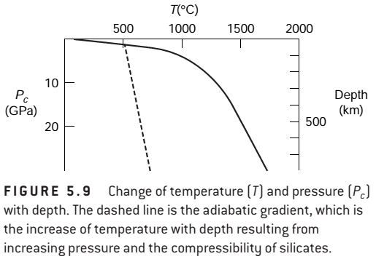
The role of depth in the crust
Temperature increases with depth
Rocks deform differently when hot
Less prone to fracturing, more prone to folding
So does pressure
Rocks deform differently when squeezed
Less prone to fracturing, more prone to folding
Expect to see less fracturing at depth!

Slide 12
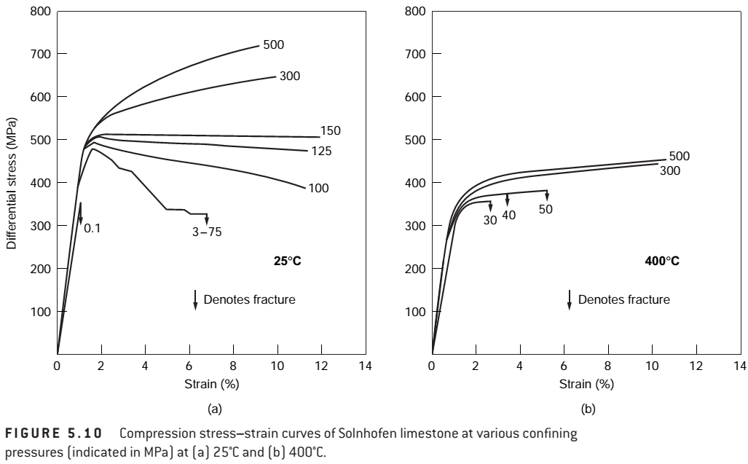
Fracture, flow, pressure, temperature
Flow at higher confining stress
Big strength reduction with temperature
Strain hardening
Increased strength
Flow at higher confining stress
Strain softening
Fracture at
low confining
stress
Fracture at
low confining stress
Low temperature
High temperature
This is limestone

Slide 13
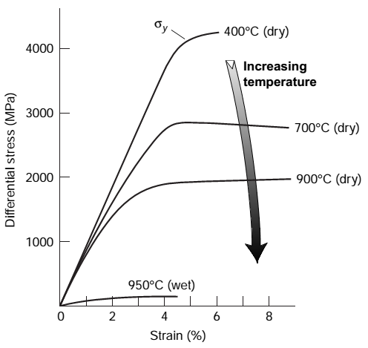
Quartz at high temperatures
yield
Increased temperature of quartz (depth) leads to decreased strength
Elastic strain accumulation
Reduced strength
Trade off : confining stress strengthens, temperature weakens
No elastic strain

Slide 14
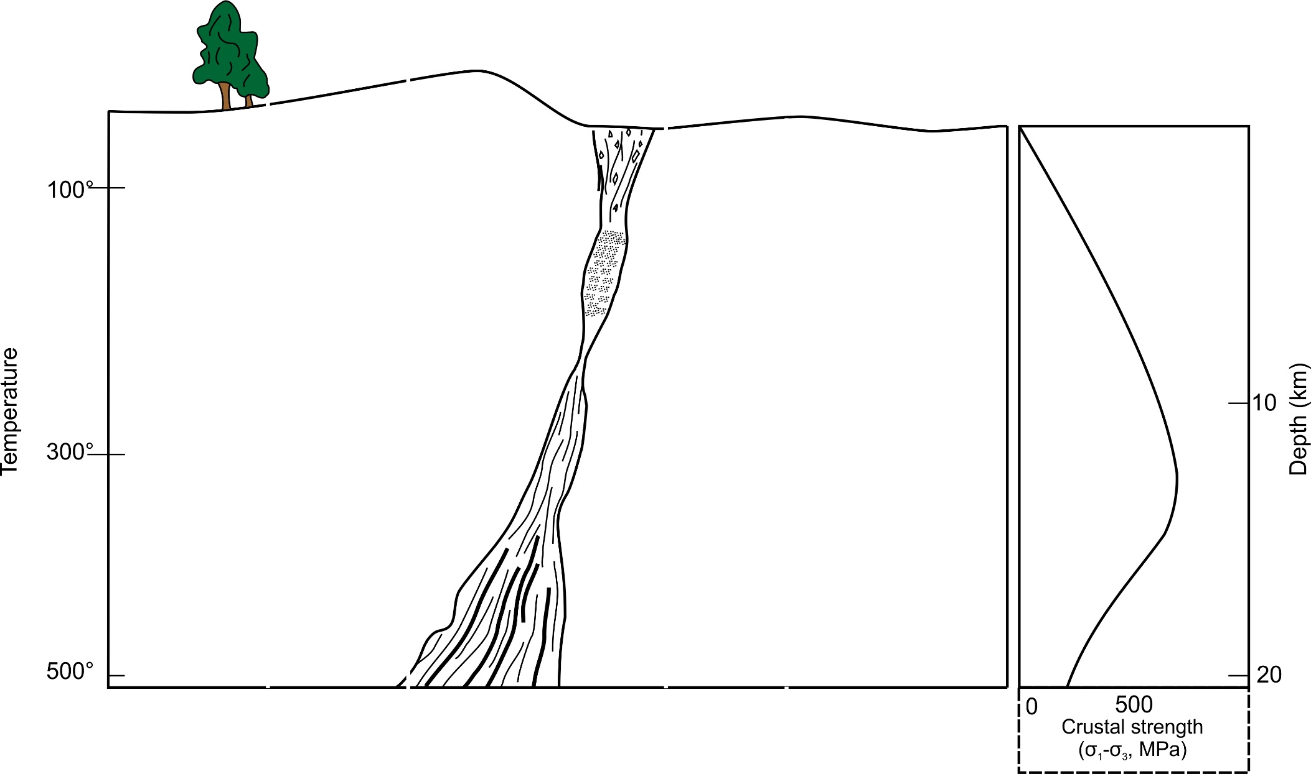
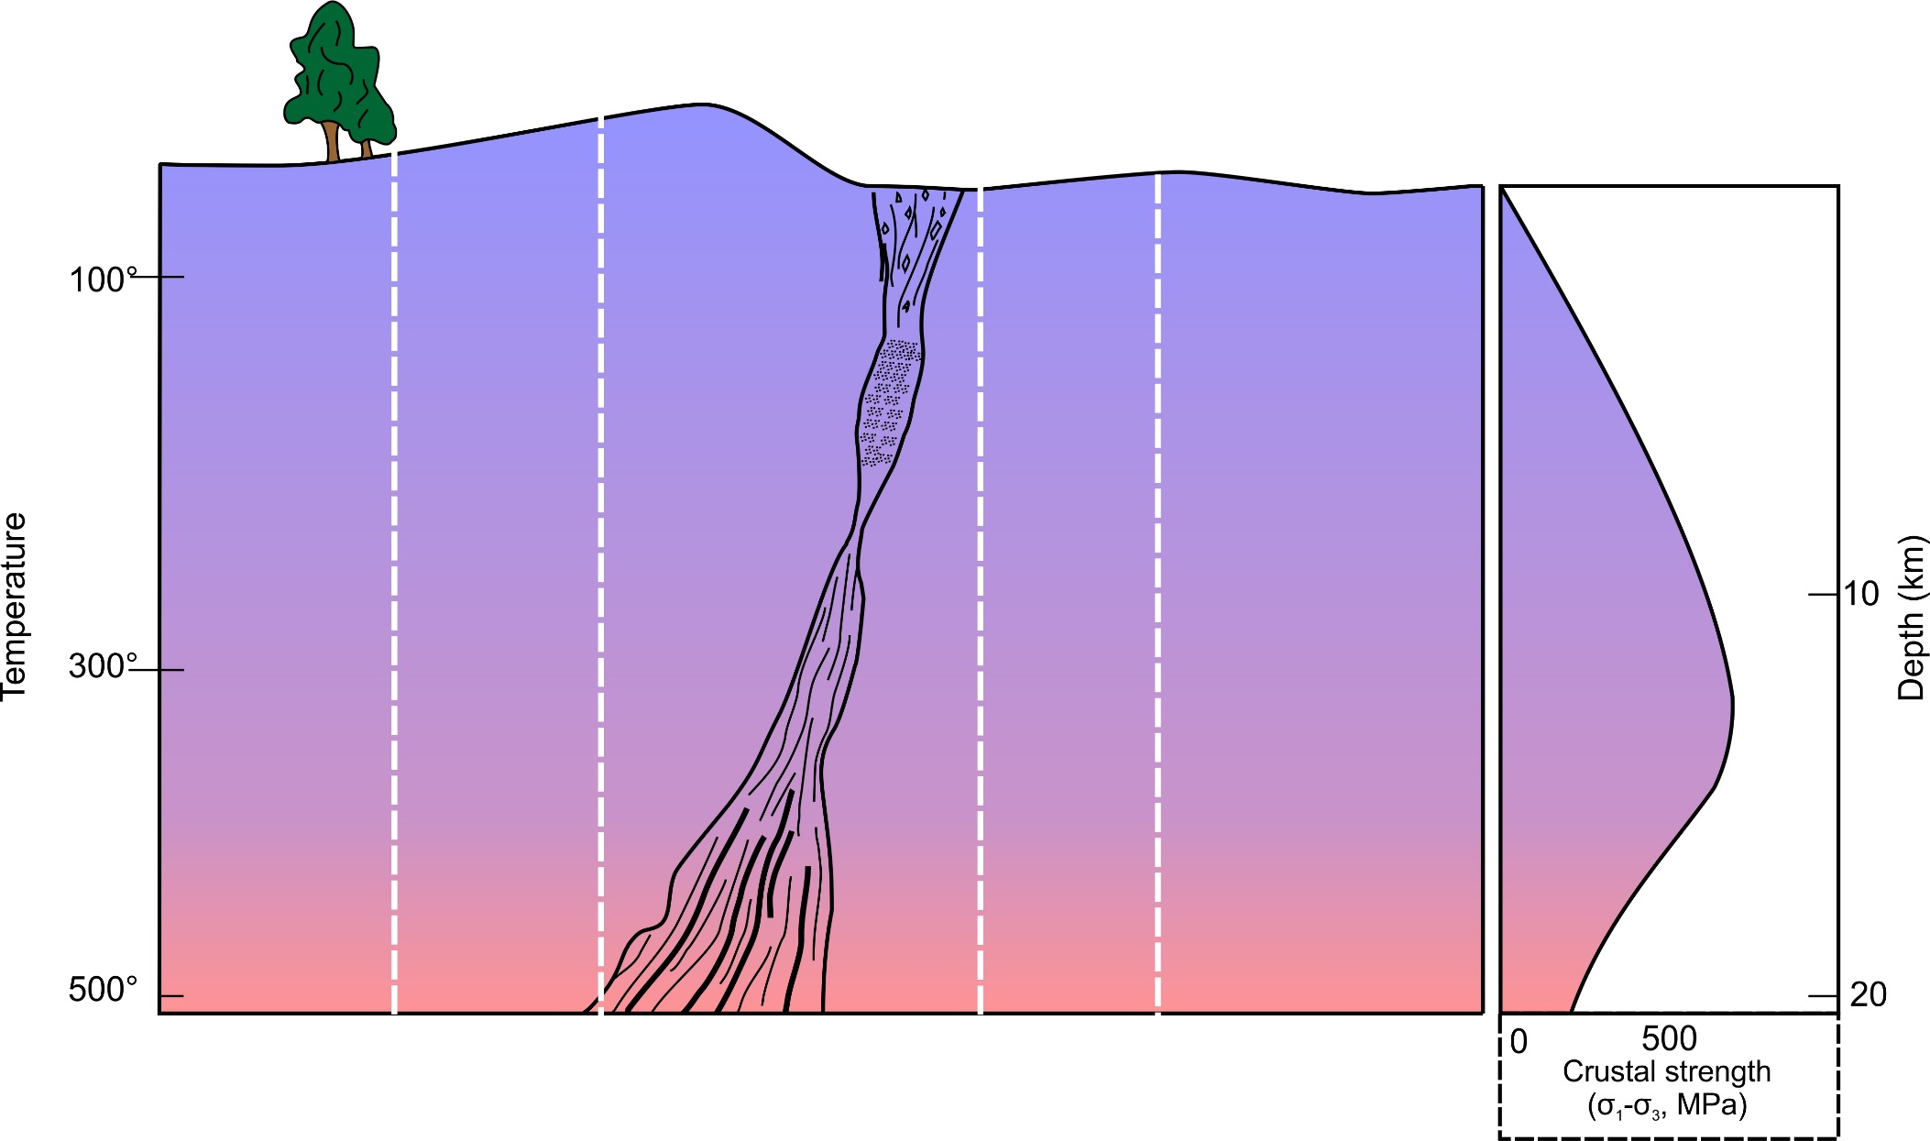
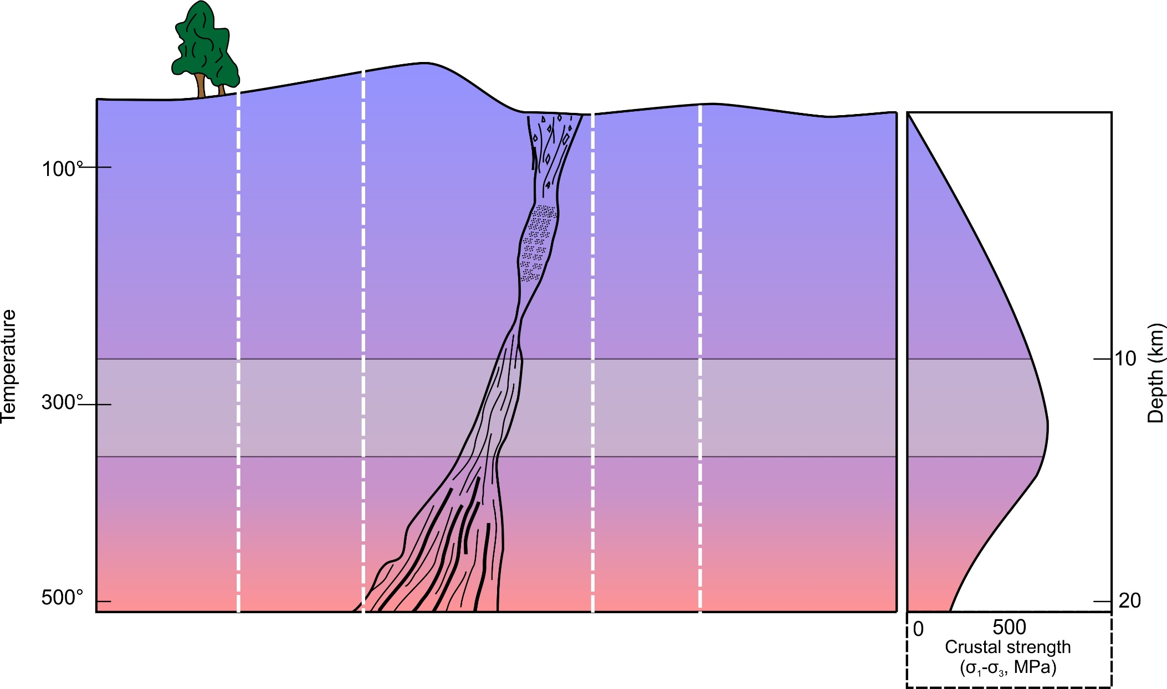
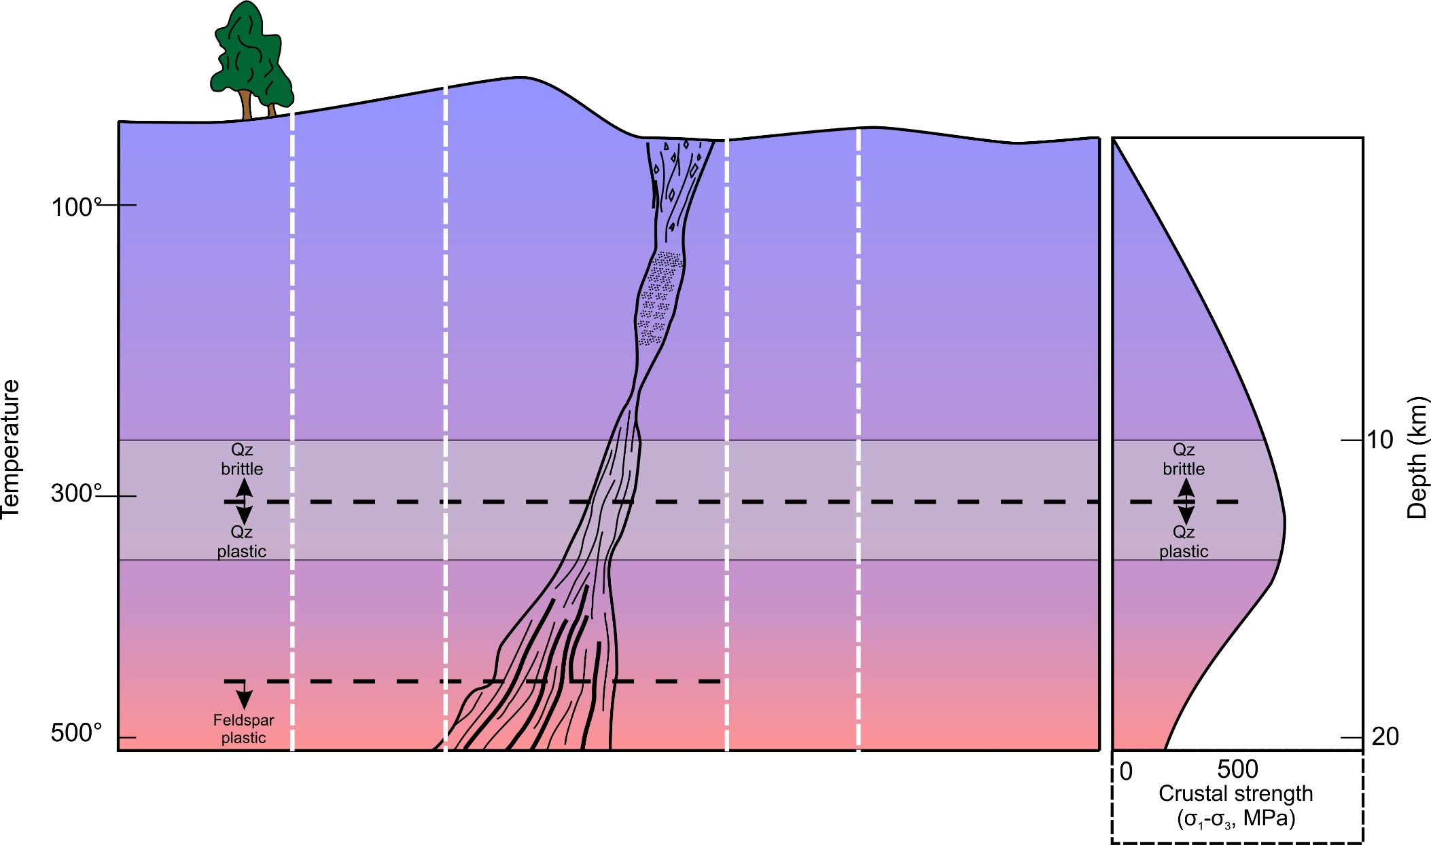
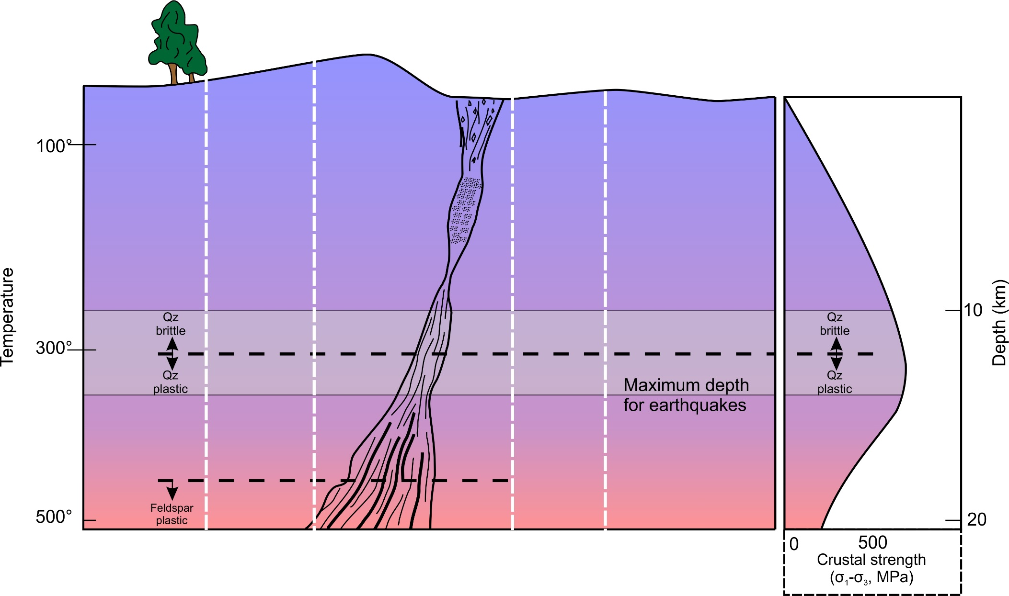
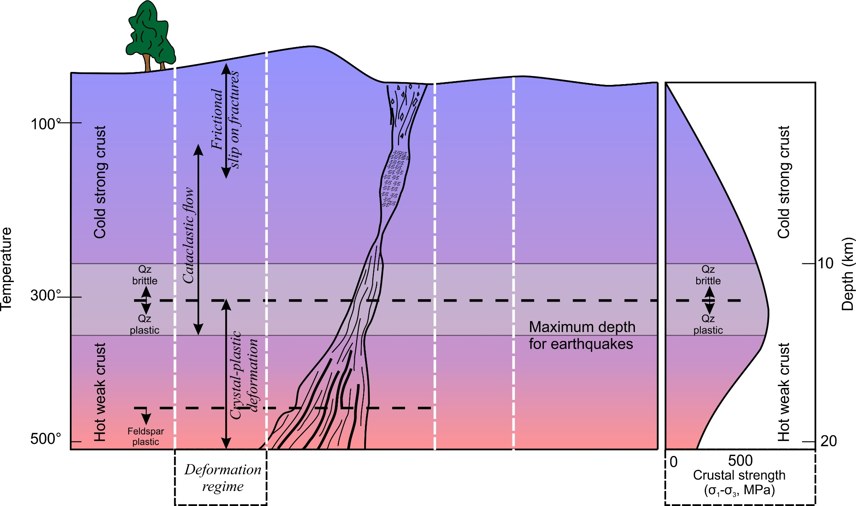
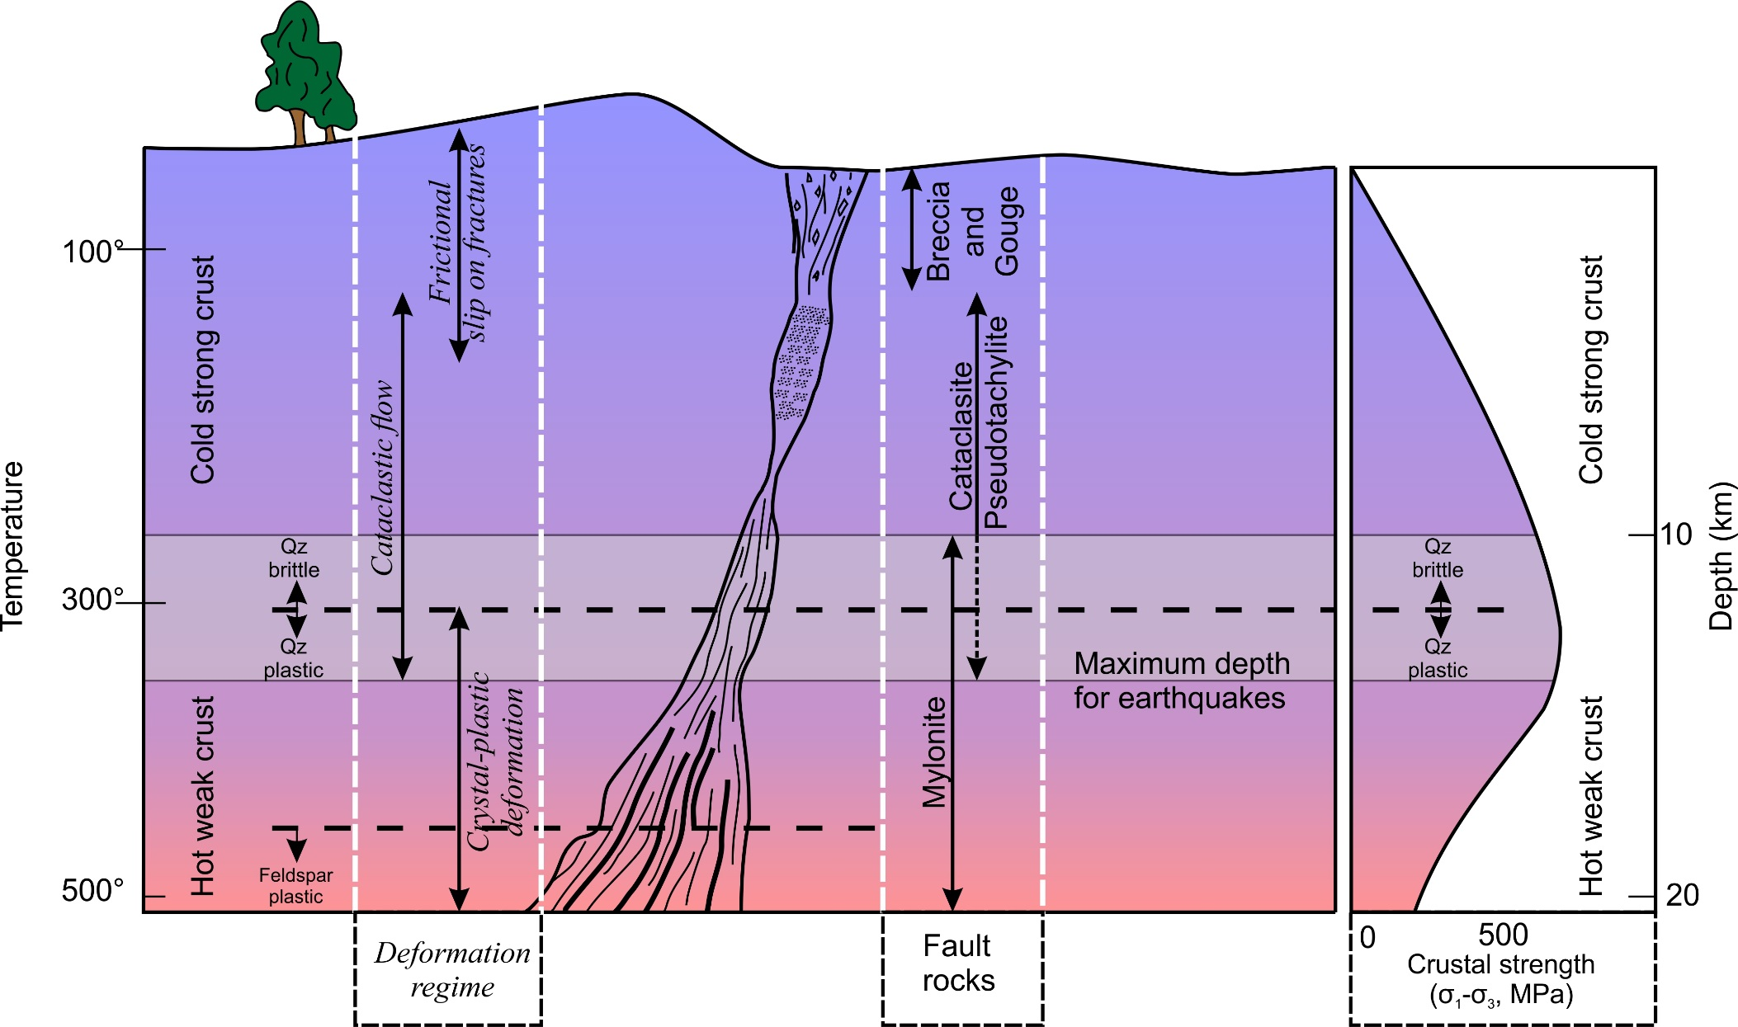
The Brittle-plastic transition
Under what circumstances might earthquakes occur deeper?
Cataclasites and gouges are ductile but not plastic
Increase with depth
decrease
Ductile deformation is continuous at outcrop and hand specimen scale
Plastic deformation is continuous, even at microscopic level

Slide 15
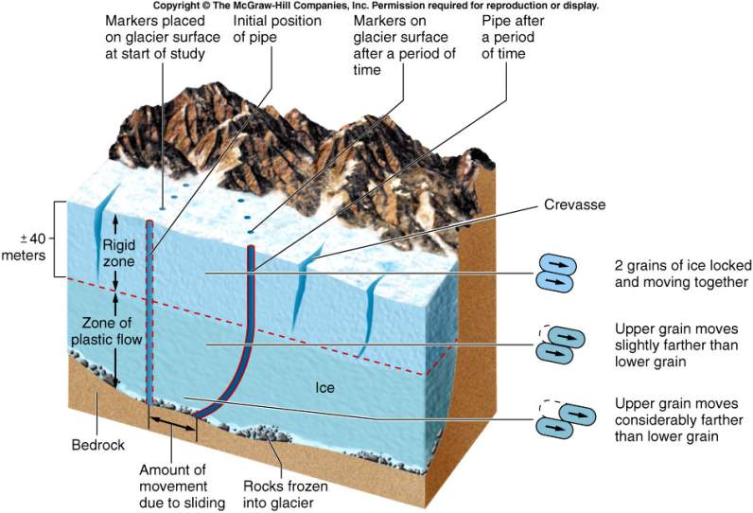
Glacial Processes > Rheology
glacier starts moving when somewhere in the glacier, stresses exceed the plastic limit of snow at that P-T.
The upper part of the glacier is elastic
Crevasses form in the upper part and do not continue into plastic part
The lower part of the glacier deforms plasticly below 40 m depth
Notes:
A glacier starts moving when somewhere in the glacier, stresses exceed the plastic limit of snow at that P-T.
The upper part of the glacier is elastic and brittle. Crevasses form in the upper part and do not continue into plastic part
The lower part of the glacier deforms ductilely (plastically or viscously) in response to ice-top elevation.
Glaciers are plastic or very viscous, and can transport enormous quantities of sediment, without regard for the size of the particles.

Slide 16
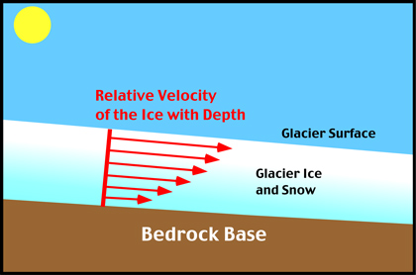
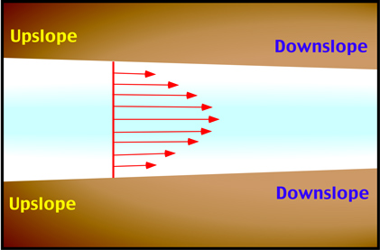

Slide 17
Brittle extensional fractures (crevasses)
Franz Josef ice moving over uneven bedrock

Slide 18
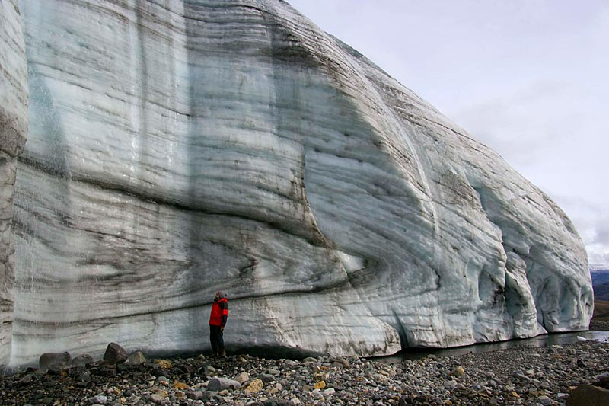
Ductile (probably plastic) folding in ice
http://www.swisseduc.ch/glaciers/axel_heiberg/crusoe_glacier/crusoe_front_west/index-en.html?id=2
Intermediate-scale folding by internal plastic deformation of the Crusoe Glacier.

Slide 19
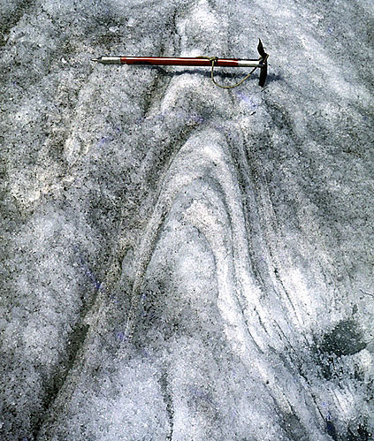
Ductile folding in ice
Ductile deformation folds debris layering deep in a glacier, and is then exhumed in the ablation zone
Small scale example
http://www.swisseduc.ch/glaciers/earth_icy_planet/glaciers05-en.html?id=6

Slide 20
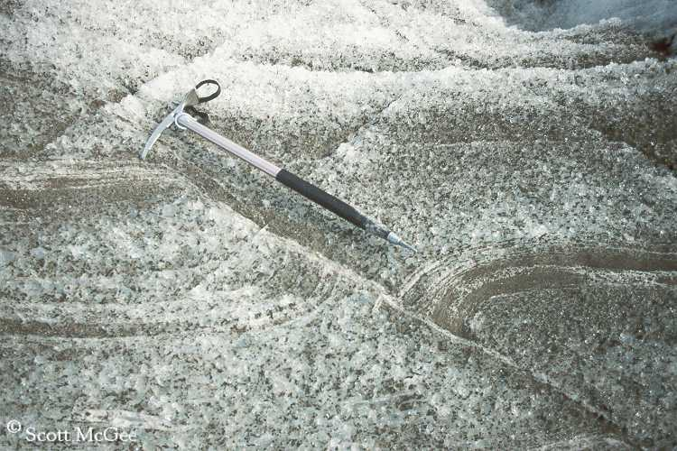
Brittle plastic transition in ice
folding of crevasses closed by compression
http://www.crevassezone.org/photos/2520L-(Fault).jpg

Slide 21
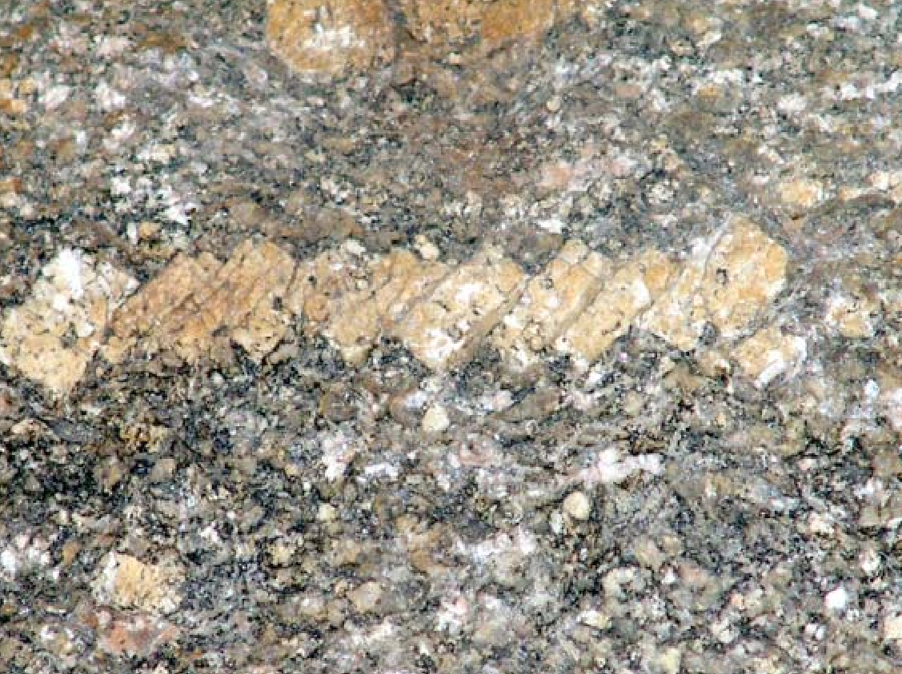
Brittle faulting of feldspar in granite
Slight foliation of quartz and micas
Difficult to see shear in bulk of the rock

Slide 22
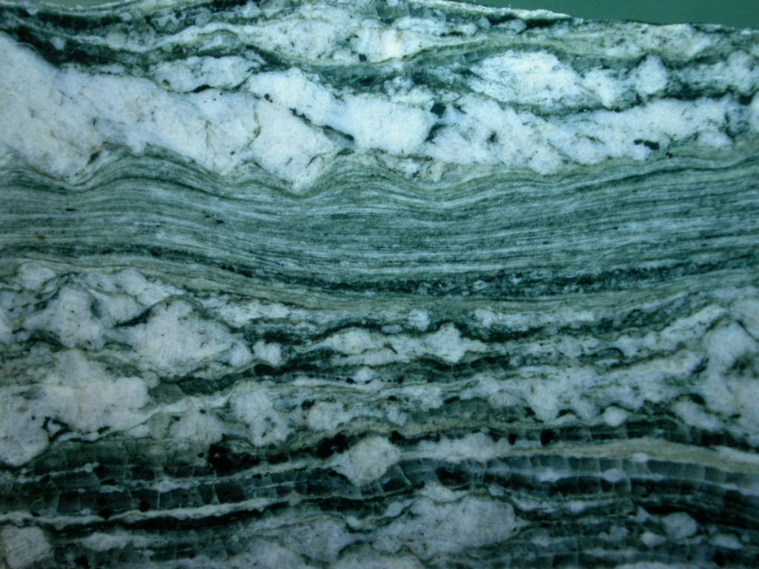
Feldspar brittle
Quartz plastic

Slide 23
Lecture plan
3-4 weeks, then Jarg Pettinga
Frictional regime
Brittle faulting (mechanics, mechanisms, fault rocks)
Fault classification
Ductile deformation
Ductile deformation mechanisms
Folds
Folding
Foliations and lineations
Shear zones and kinematic indicators

