Slide 1
Lecture plan
3-4 weeks, then Jarg Pettinga
Finish last weeks lecture
Frictional regime
Brittle faulting (mechanics, mechanisms, fault rocks)
Fault classification
Ductile deformation
Ductile deformation mechanisms
Folds
Folding
Foliations and lineations
Shear zones and kinematic indicators

Slide 2
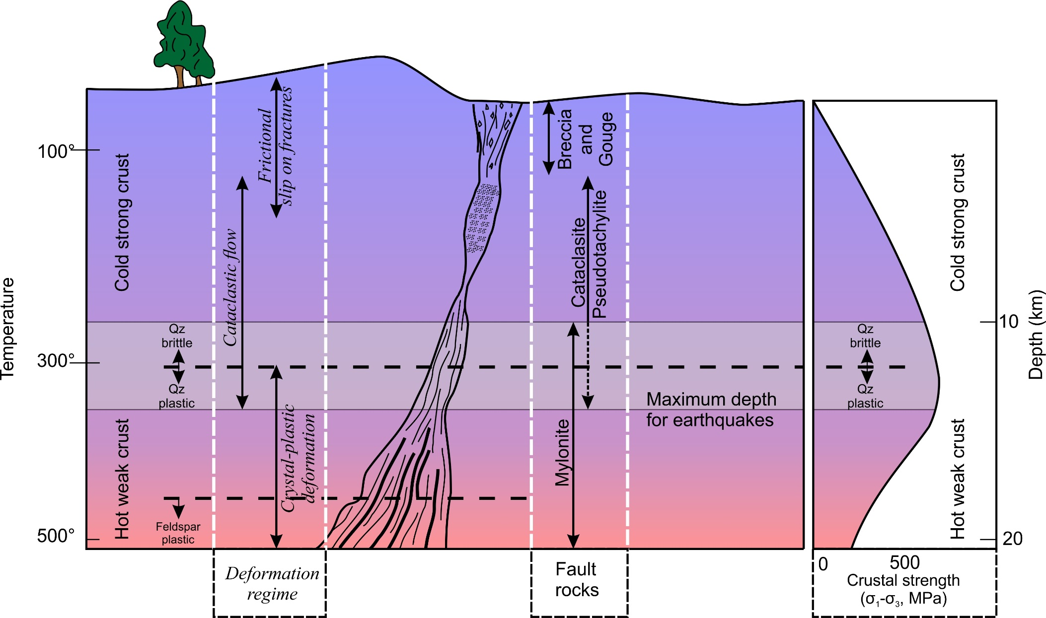
The Brittle-plastic transition
You should know how to draw this diagram and understand the relationships it shows
Cataclasites and gouges are ductile but not plastic
Increase with depth
decrease
Ductile deformation is continuous at outcrop and hand specimen scale
Plastic deformation is continuous, even at microscopic level

Slide 3
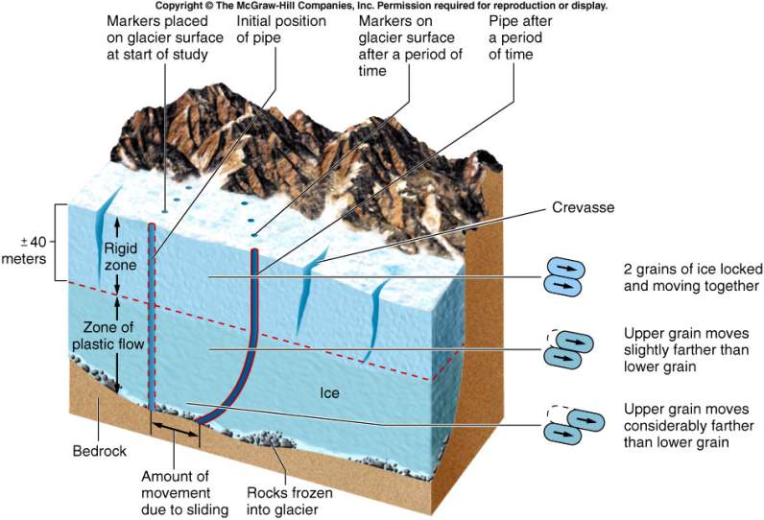
Glacial analogy for brittle plastic
Notes:
A glacier starts moving when somewhere in the glacier, stresses exceed the plastic limit of snow at that P-T.
The upper part of the glacier is elastic and brittle. Crevasses form in the upper part and do not continue into plastic part
The lower part of the glacier deforms ductilely (plastically or viscously) in response to ice-top elevation.
Glaciers are plastic or very viscous, and can transport enormous quantities of sediment, without regard for the size of the particles.

Slide 4
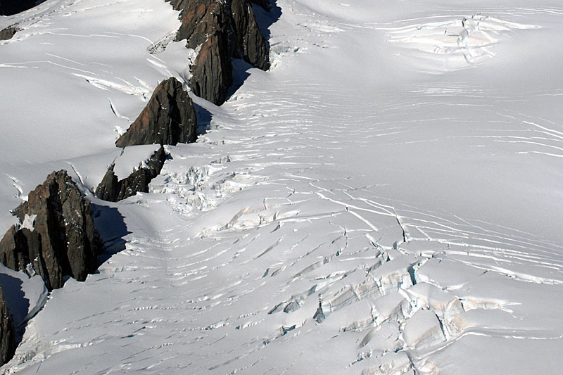
Brittle extensional fractures (crevasses)
Franz Josef ice moving over uneven bedrock

Slide 5
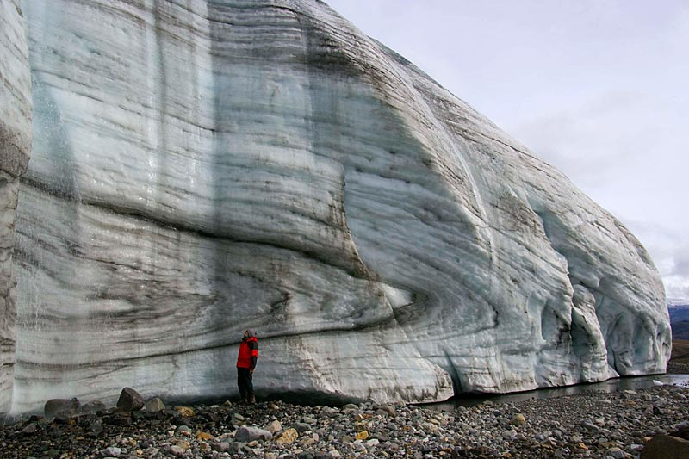
Ductile (probably plastic) folding in ice
http://www.swisseduc.ch/glaciers/axel_heiberg/crusoe_glacier/crusoe_front_west/index-en.html?id=2
Intermediate-scale folding by internal plastic deformation of the Crusoe Glacier.

Slide 6
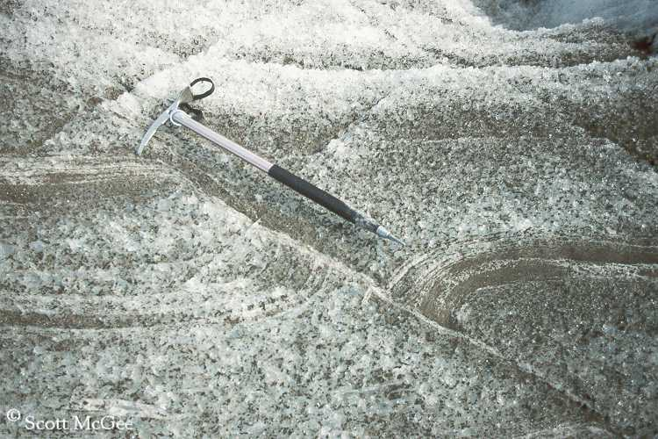
Brittle plastic transition in ice
folding of crevasses closed by compression
http://www.crevassezone.org/photos/2520L-(Fault).jpg

Slide 7
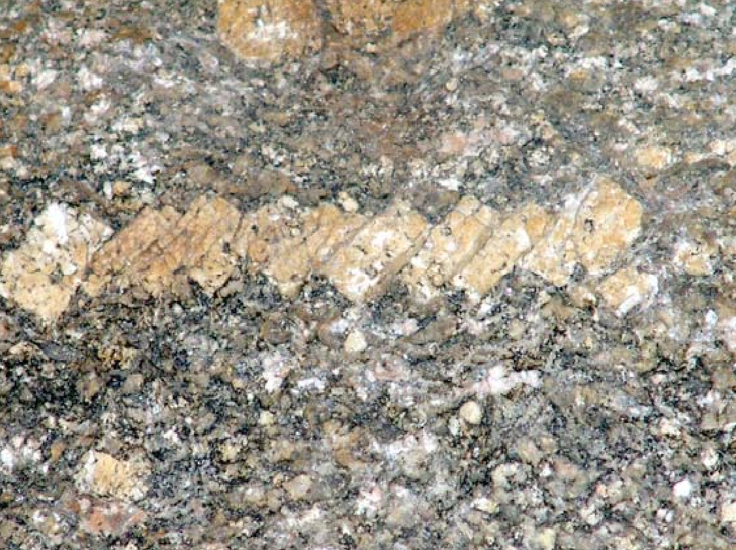
Brittle faulting of feldspar in granite
foliation of quartz and micas
Difficult to see shear in bulk of the rock

Slide 8
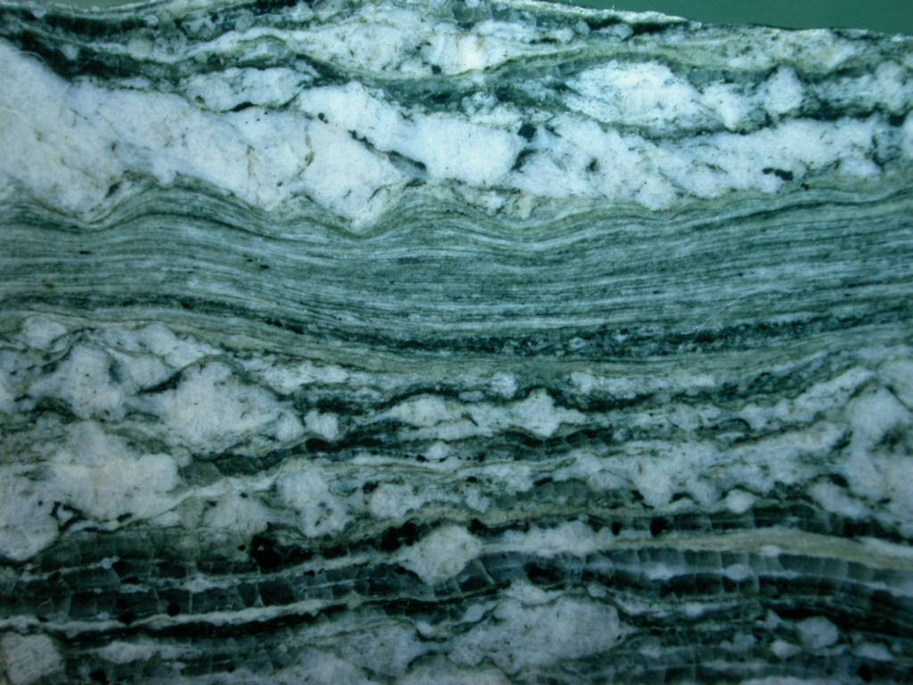
Feldspar brittle
Quartz plastic

Slide 9
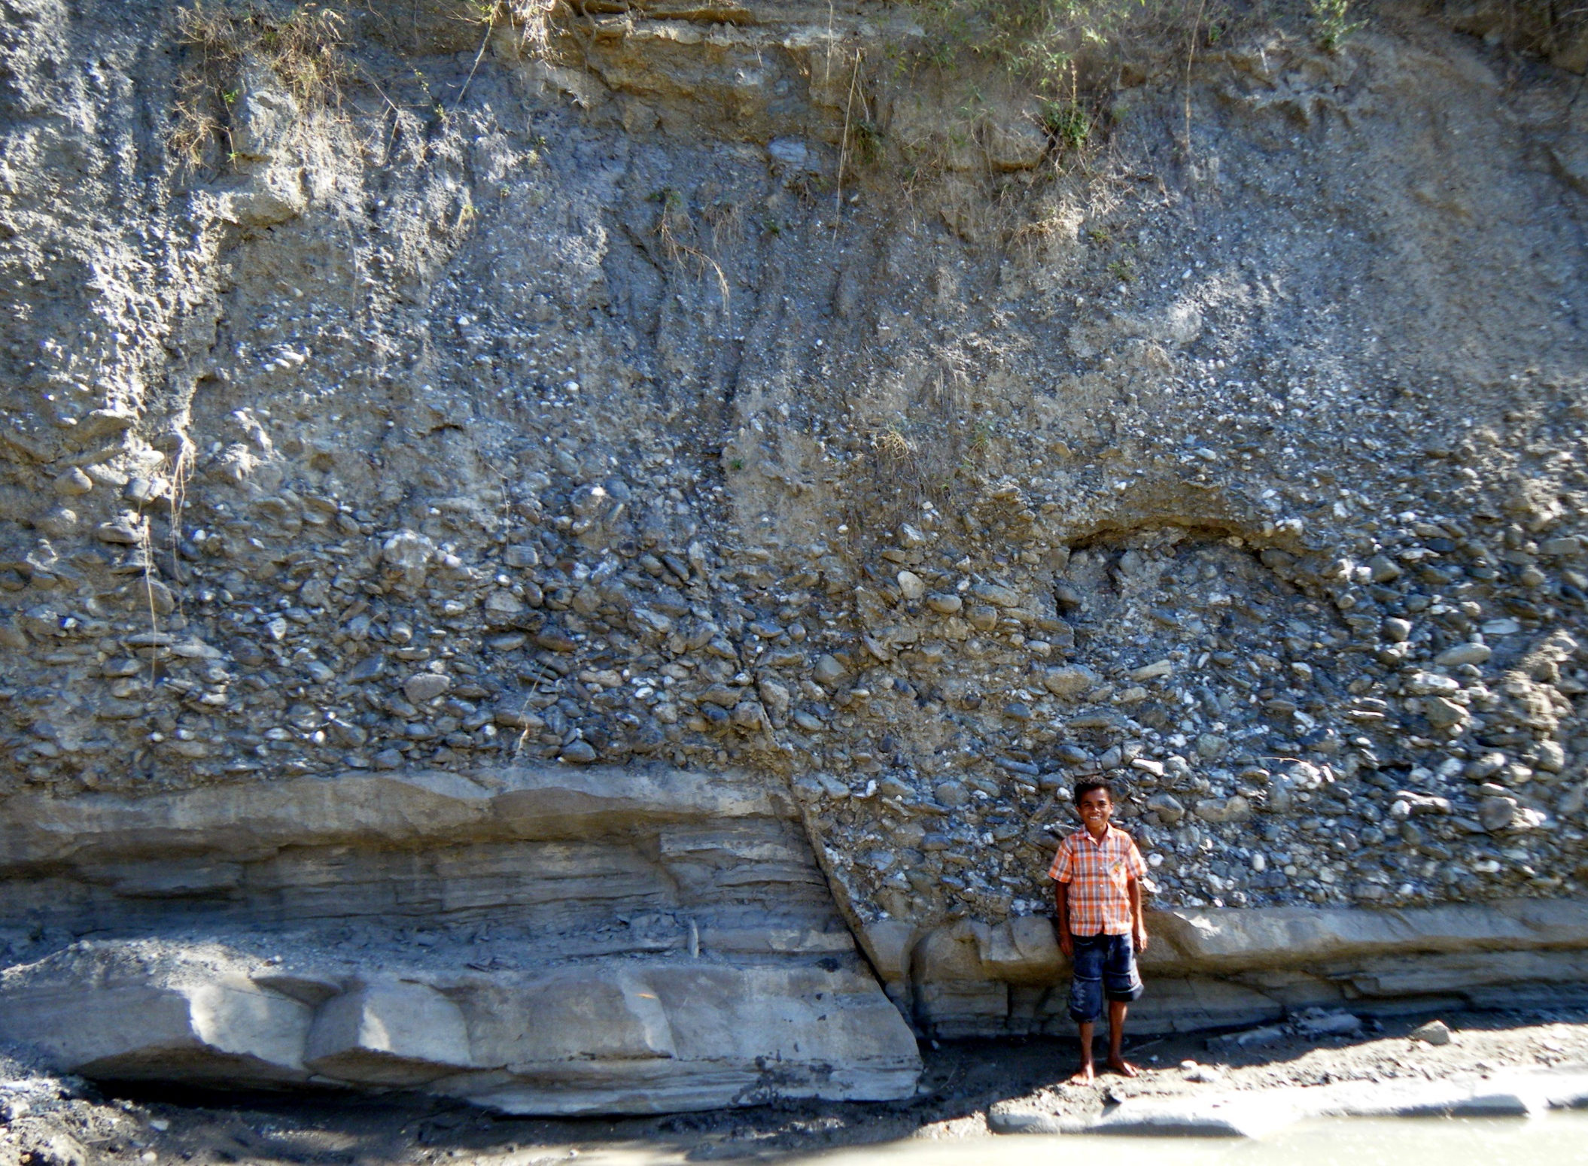
Geol 244 – structural geology
Lecture 8/9 – Brittle faulting

Slide 10
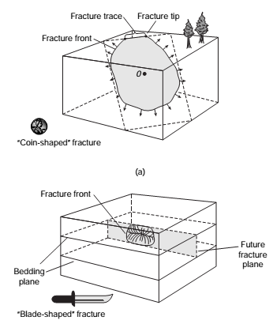
Brittle deformation
Permanent change in a solid material due to the growth of fractures and/or sliding on existing fractures
Fracture is any surface of discontinuity across which the material is no longer intact
Any fracture has a finite size
Notes:
most rocks are brittle at low temperature and low lithostatic stress
virtually every rock at or near Earth’s surface exhibit evidence of brittle failure, i.e. deformation-induced loss of cohesion
brittle failure results from irreversible and very rapid fracturing – initiation, propagation and connection of cracks
cracks are grain-scale planes that pre-exist or nucleate under stress on some microscopic defect of material

Slide 11
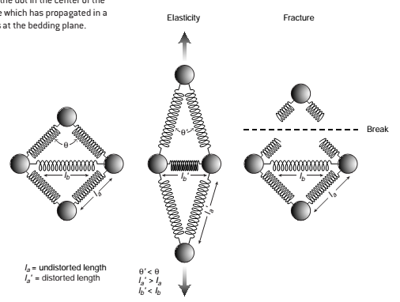
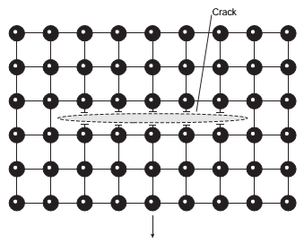
Fractures cracks and shears
Chemical bonds in rock stretch during elastic strain
Beyond their strength they rupture and release elastic strain
Multiple bond ruptures form cracks (fractures without displacement)
Displacement parallel to cracks forms shear fractures

Slide 12
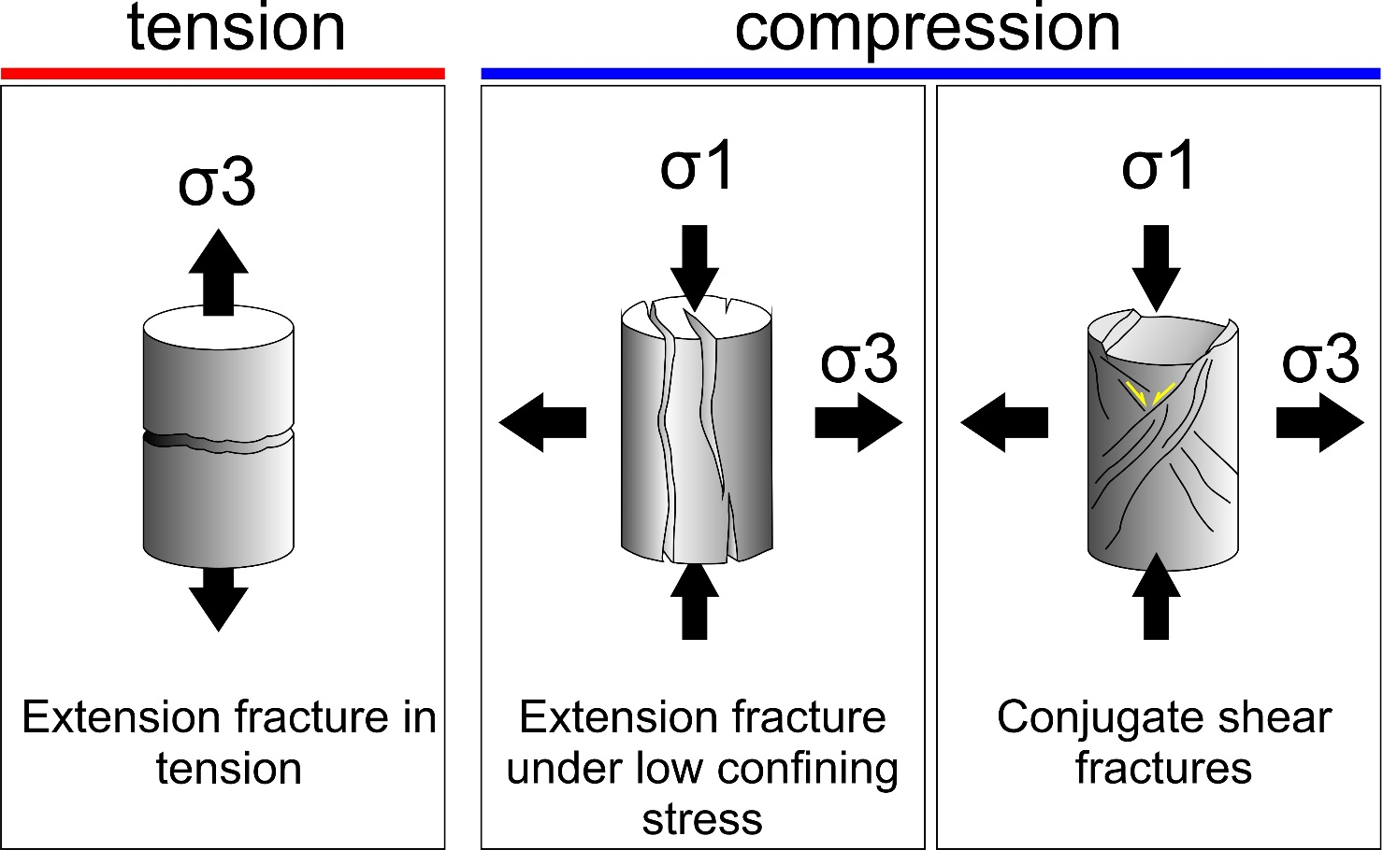
Two general types of fractures
-
Extension fractures, resulting from initial separation of two formerly contiguous surfaces
displacement parallel to σ3 (minimum principal stress, maximum tension), orthogonal to fracture plane – 2 cases (left - right)
Shear fractures resulting from initial sliding along fracture plane;
fractures and displacement are oblique to maximum principal stress (maximum compression)
confining stress –
stresses other than σ1, typically the combination of hydrostatic stress (water weight) and lithostatic stress (rock weight) above a specified depth

Slide 13
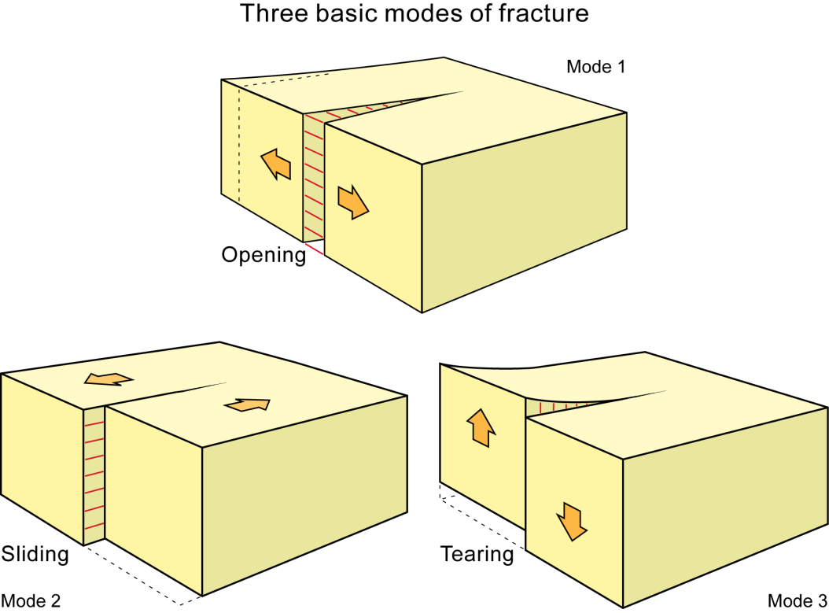
Three general modes of fractures
Extension fracture
(first two on previous slide)
Mode I
Try with a piece of paper
Shear fractures
(Last one on previous slide)
Mode II
Mode III

Slide 14
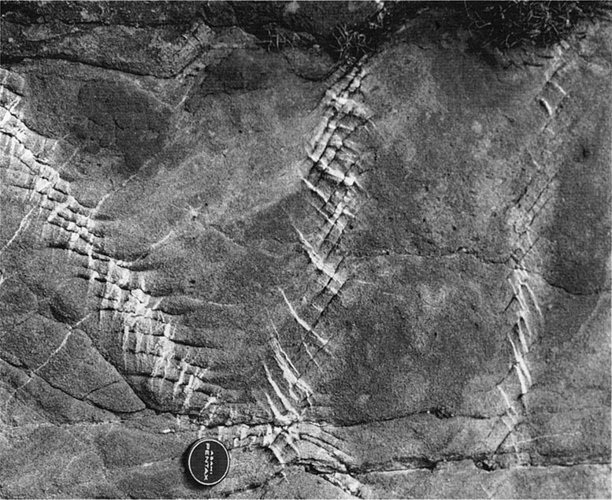
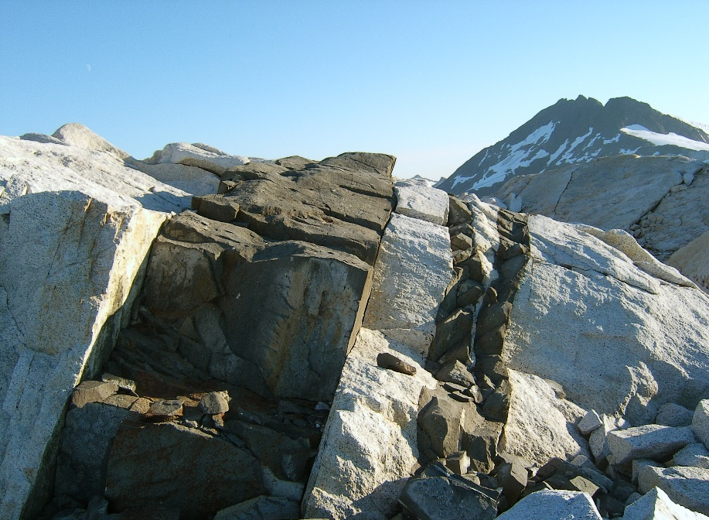
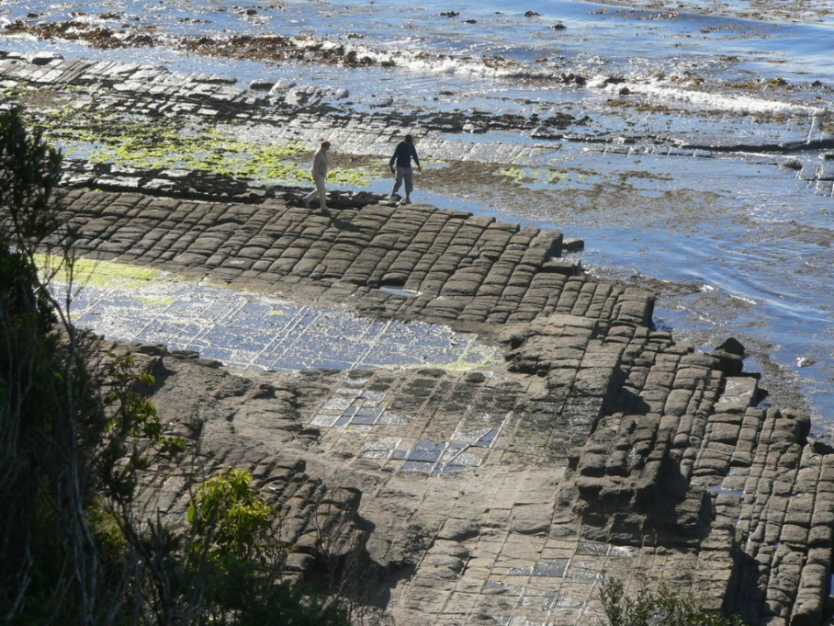
Types of fractures
Veins – displacement perpendicular to plane and filled with minerals
Shear fractures – displacement parallel to plane
Dikes – like veins, displacement perpendicular to walls and filled with igneous or sedimentary intrusion
Faults – measurable displacement by sliding - i.e. large-scale shear fractures
Joints – no displacement

Slide 15
Scale of fractures
San Andreas fault 1300 km long
Alpine fault ~500 km long
discontinuous behaviour common – earthquakes !
Both capable of generating large earthquakes (Mw >8)

Slide 16
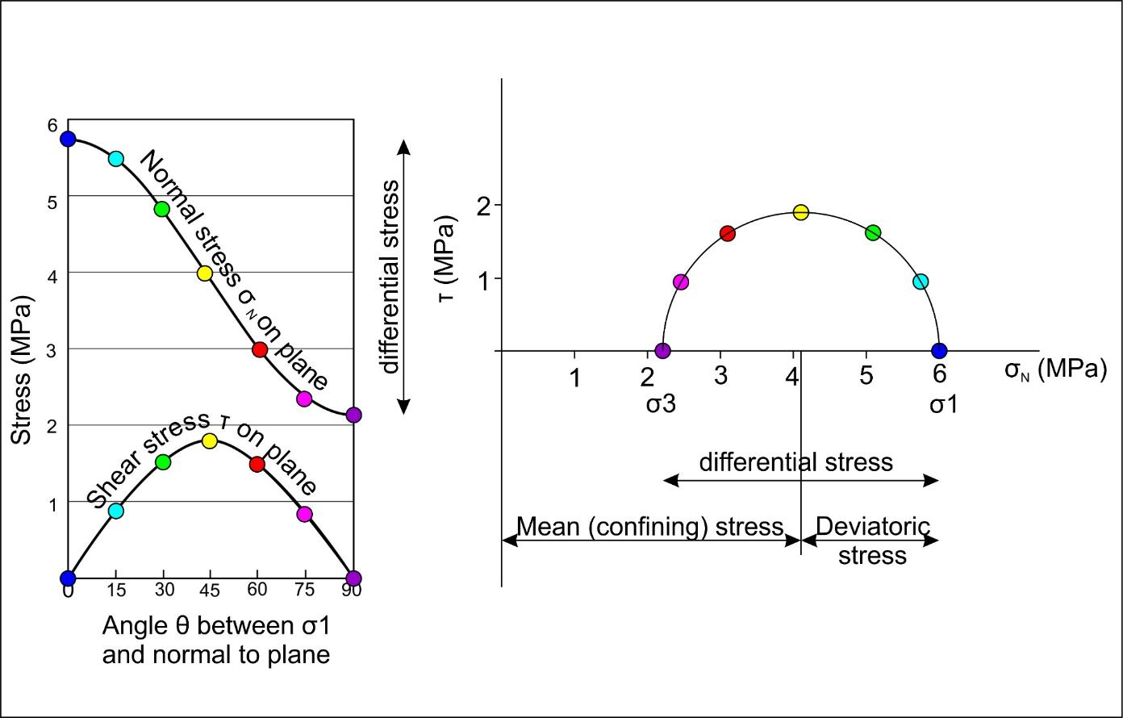
Mohr circles illustrate the state of stress on any plane
so lets look at them again.

Slide 17
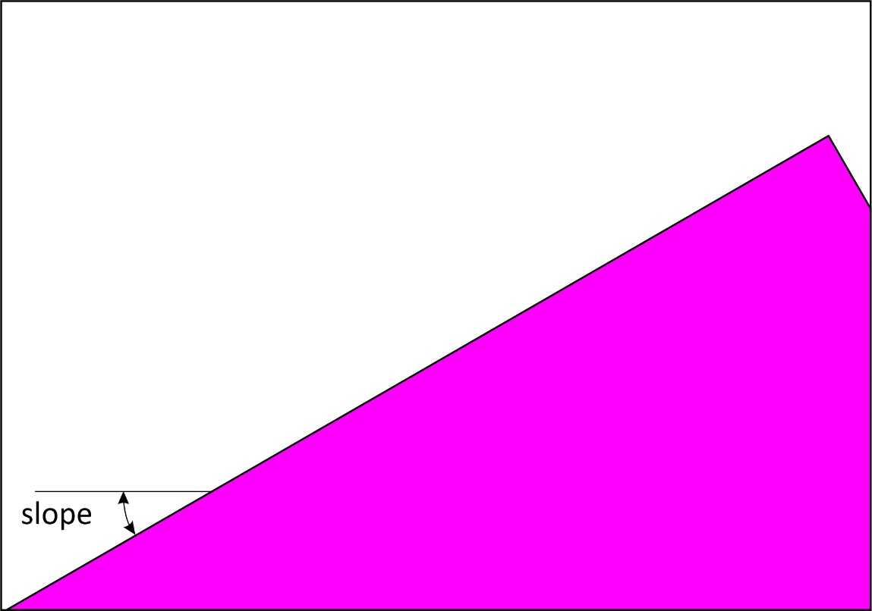
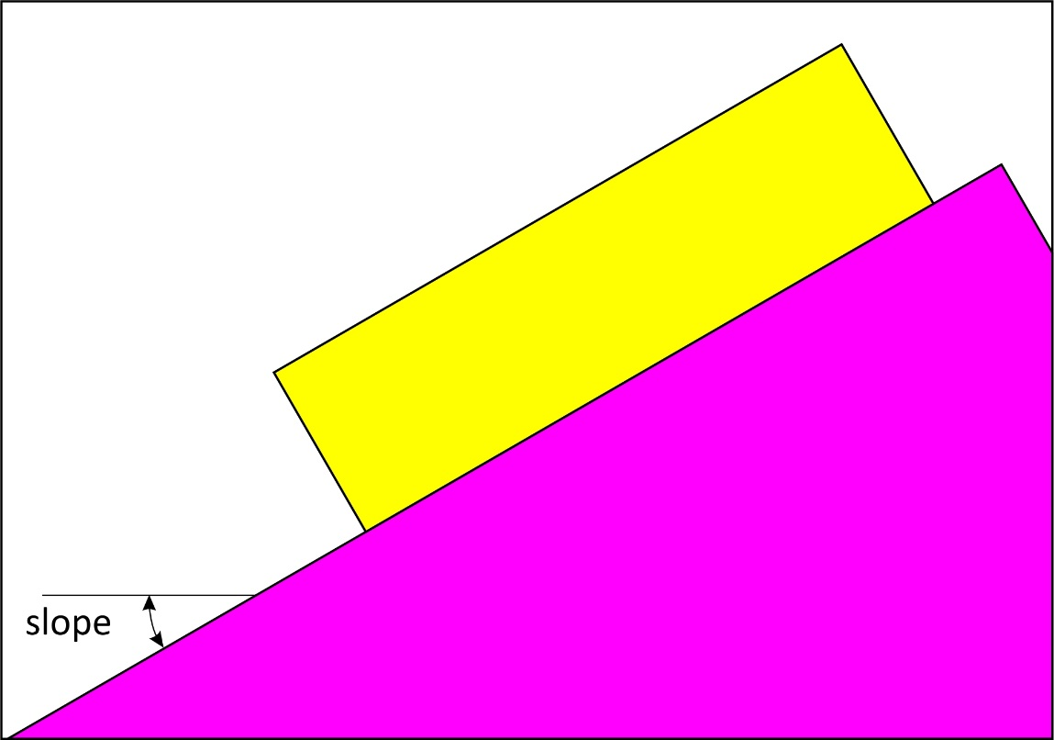
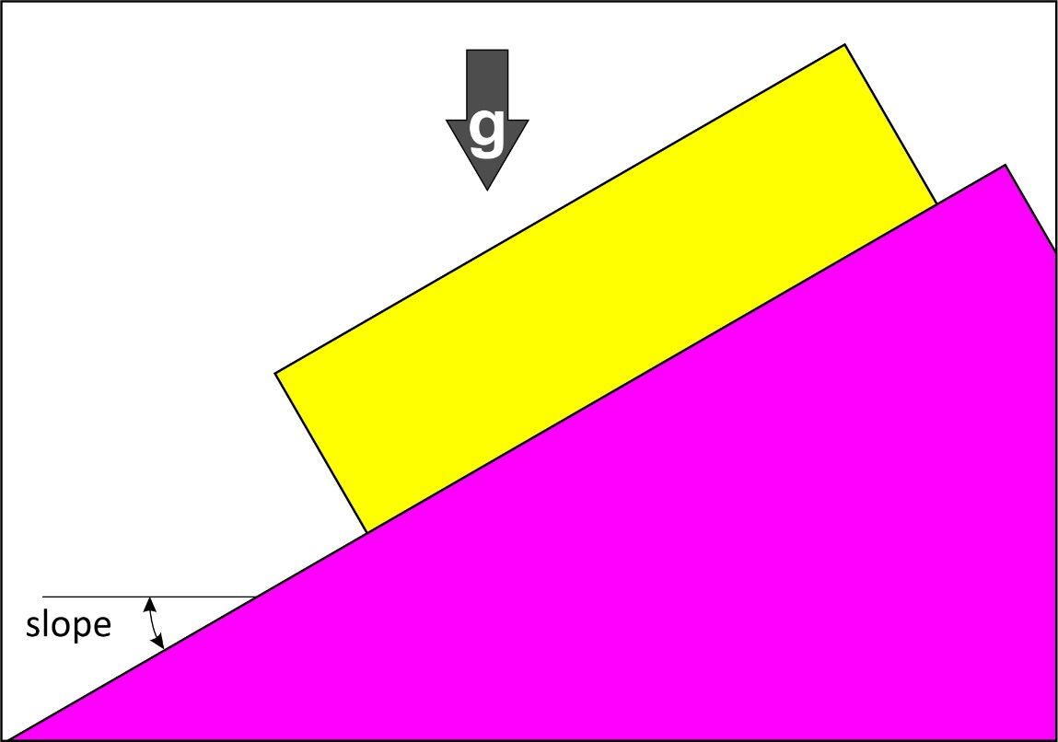
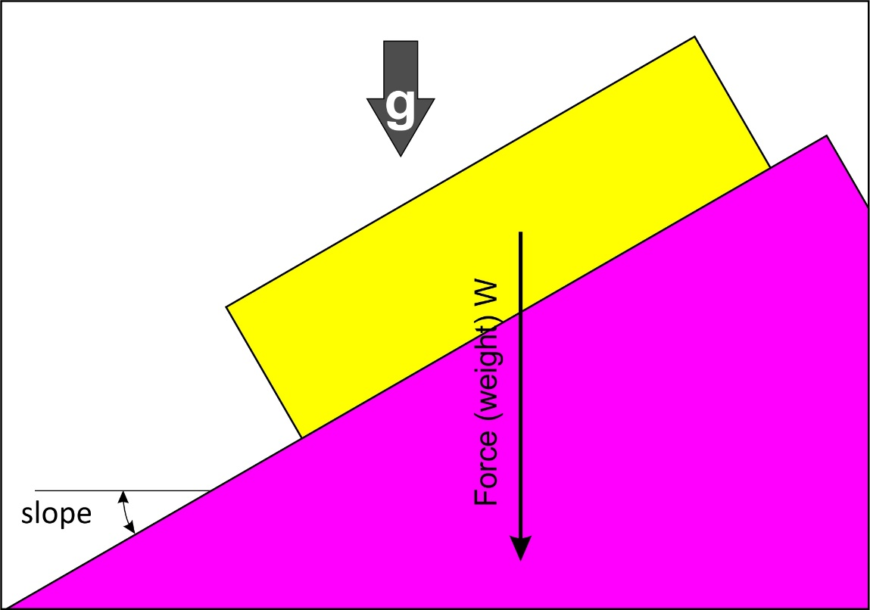
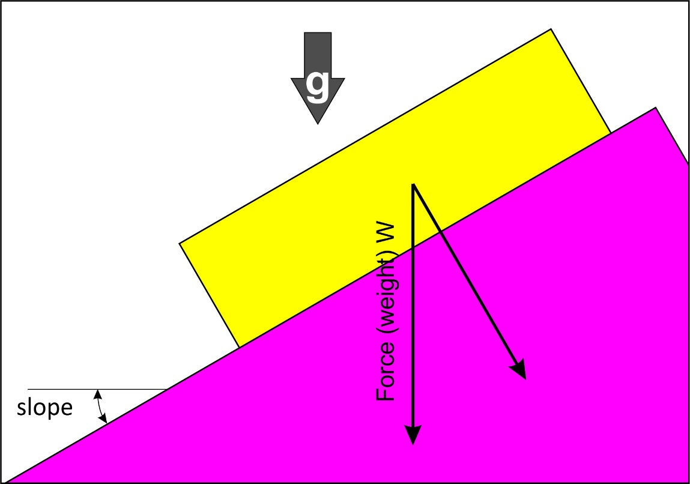
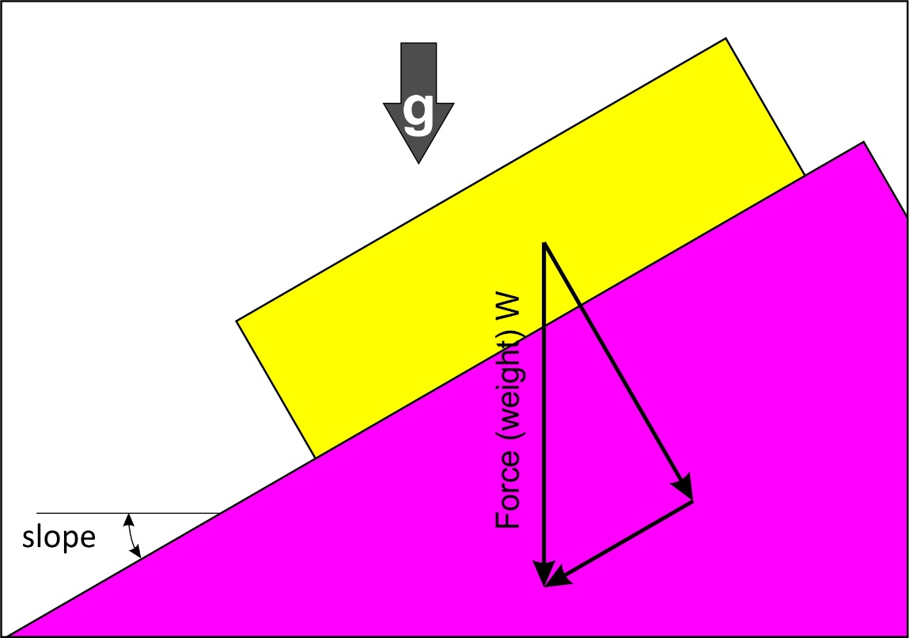
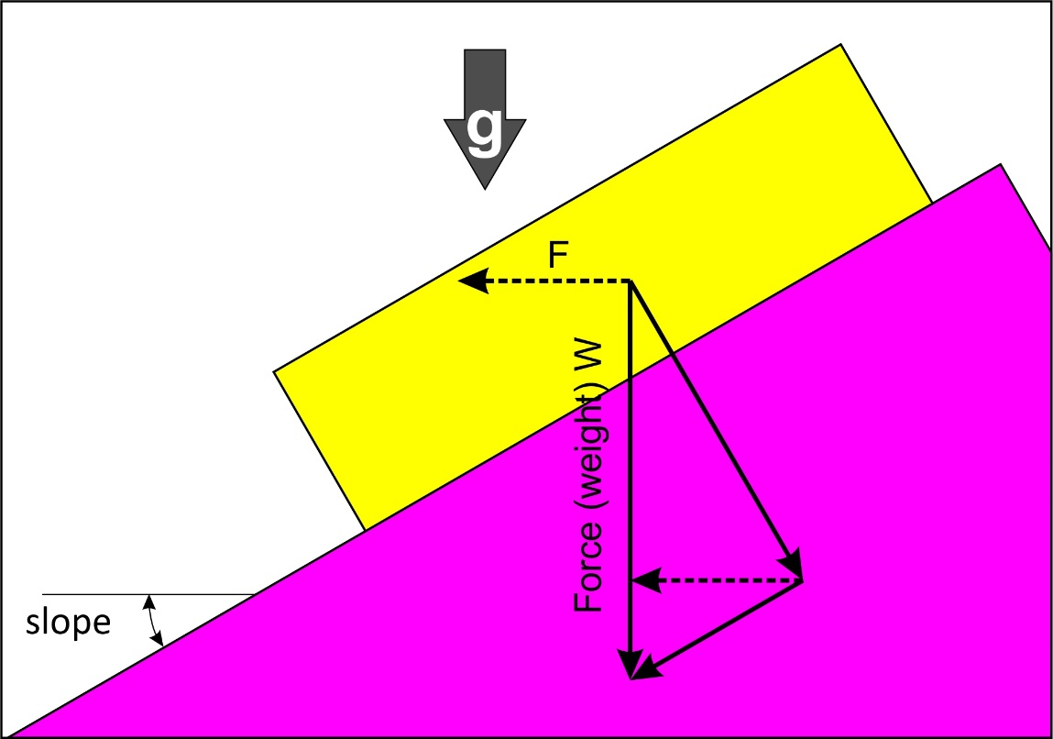
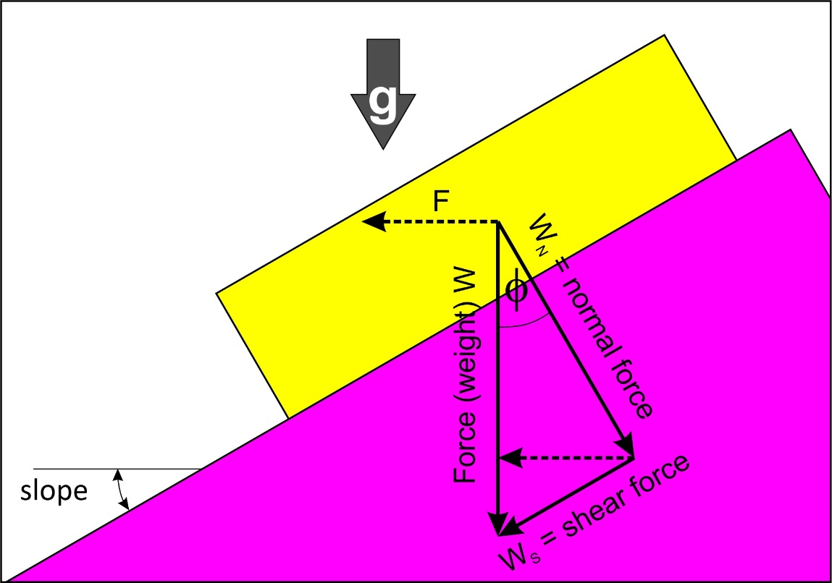
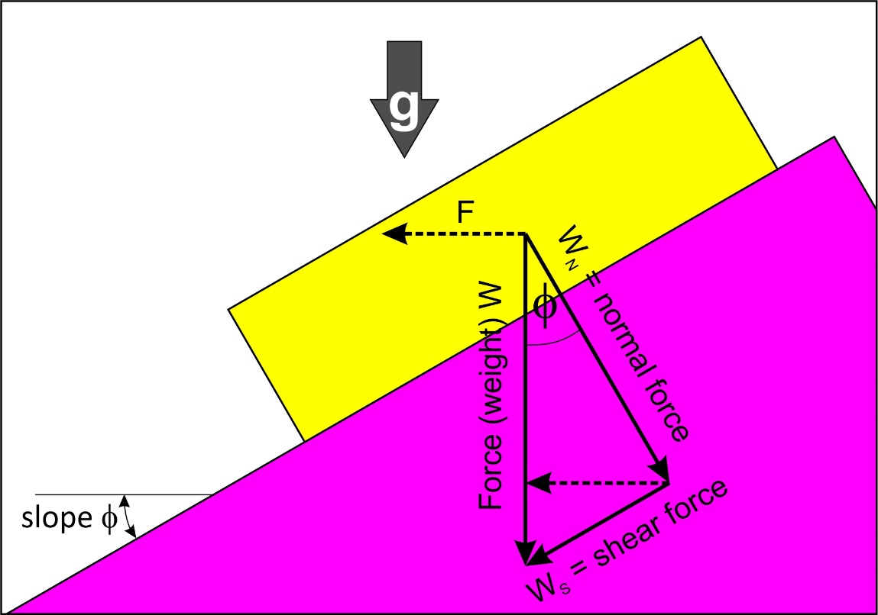
When will a rock slide?
A block sitting on a plane
Acting under influence of gravity
Has a vertical weight (W)
Resolves into a force perpendicular to plane
And parallel to plane
Sets up a horizontal force downslope
As the plane becomes steeper, sliding is initiated when the shear component of weight, W_{S}, acting parallel to inclined plane, reaches a critical value
Sliding resisted by normal component of weight, W_{N},
The co-efficient of sliding friction, μ_{S}, is ratio of shear stress to normal stress required to initiate sliding:
Assuming unit width, μ_{S} = W_{S} / W_{N} = tan φ
inclination of plane at initiation of sliding is termed angle of sliding friction φ
Assuming unit width of the plane, and rewriting the friction equation for stresses, the critical shear stress:
σ_{S} = σ_{N} tan φ but Tan φ = μ_{S} so σ_{S} = μ_{S} σ_{N}
meaning that shear stress is controlled by normal stress (stress acting on rupture plane) and angle between vector and the normal to rupture plane (for vertical stress only this is the dip of the plane)
σ_{S} = μ_{S} σ_{N}
σ_{S} = σ_{N} tanφ
Slope=μs =σs/σn= tanφ
φ

Slide 18
When will a rock break ?
Once failure has occurred, the sample is no longer intact and frictional resistance to sliding on the fracture surface determines its further behavior.
shear fracture occurs when shear stress along potential fault plane overcomes two things:
(1) cohesive strength of material before failure on that plane
(2) sliding friction along that plane once it has formed
Therefore, shear stress at instant of fracture related to normal stress by
Coulomb fracture criterion
σ_{s} = c + μ σ_{n} or σ_{s} = c + σ_{n} tanφ (KNOW THIS!)
This just adds a cohesion factor to the equation for frictional sliding (previous slide)
c = cohesion or shear strength (material constant)
μ = coefficient of sliding friction (material constant)
A lot boils down to material that is being stressed (controls μ and C)!
and confining pressure (controls relative magnitudes of σ₁ and σ₃)!
Notes:
Scherbruch in Festkörpern von zwei Faktoren abhängt:
- einerseits vom Brechen von kohäsiven Bindungen zwischen Partikeln des intakten Gesteins (mit c bezeichnet),
- andererseits auf Reibungsgleiten zurückzuführen ist (bezeichnet mit μ, das proportional zur
kompressiven Normalspannung σN auf der potentiellen Bruchfläche ist), das eine lineare Beziehung
des Reibungsterms.
Diese physikalische Interpretation sagt eine lineare Zunahme der Gesteinsfestigkeit mit der
Normalspannung voraus, die auf das Gestein wirkt, und stimmt mit sehr vielen Experimenten
überein. Die Experimente ergeben Kohäsionsfestigkeiten in der Ordnung von 10-20 MPa für die
meisten Sedimentgesteine

Slide 19
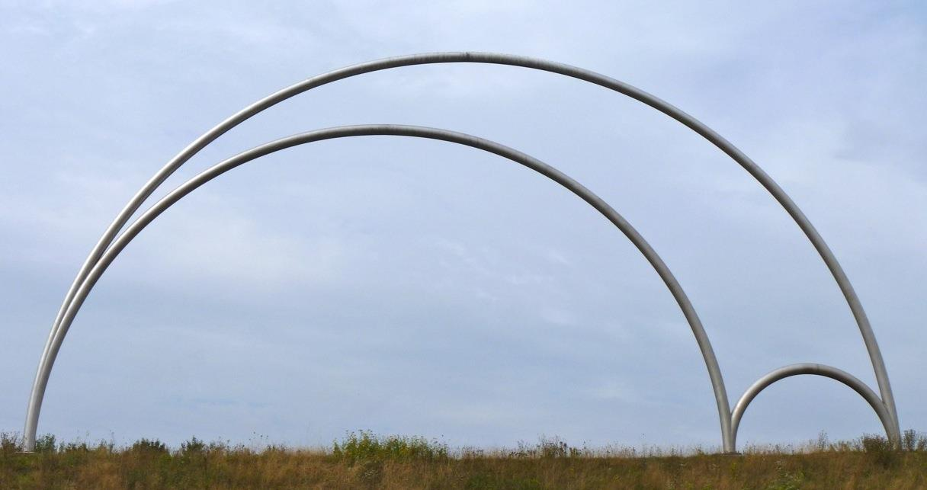
Coulomb failure criterion
Paris Opera House
σ_{s} = c + μ σ_{n}
describes the stress state at which a shear rupture forms and separates a sample into two pieces.
Need to understand that more than one stress acts on a geological plane.
Can be understood graphically using a Mohr diagram

Slide 20
Graphical representation of Coulomb failure criterion
2 planes lie either side of σ1
Linear form of criterion:
σ_{s} = c + μ σ_{n}
predicts that failure points in diagram should lie on straight line
with slope μ
intersecting σ_{s} ordinate at shear strength c
- line is characteristic of many rocks tested at moderate confining pressures and describes shear failure of material
Plane orthogonal to σ2

Slide 21
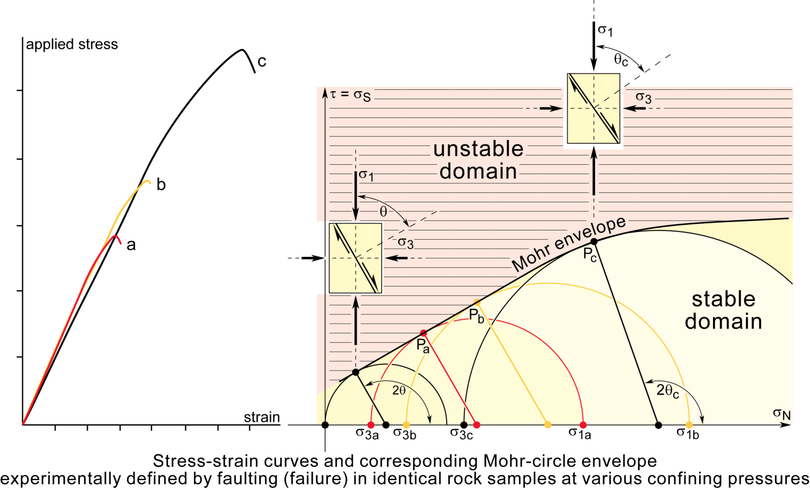
Determination of failure criterion for shear fractures
Compress cylinder of rock along its axis under constant confining pressure until failure
Use confining pressure as σ3 and axial stress to construct Mohr circle
Mohr circle at failure contains point P, which represents σS and σN stresses on failure surface and indicates orientation of planes along which rock has failed at angle θ to σ1
Same again at higher confining pressure repeatedly yields different Mohr circles
tangent to circles, which passes through all P points represents Mohr envelope or failure envelope for the particular rock

Slide 22
Three general stress conditions for shear fracture
σ_{s}
Coulomb failure criterion
σ_{s} = c + μ σ_{n}
σ_{n}
stable stress condition
σ_{s}
σ_{s}
Coulomb failure criterion
Coulomb failure criterion
σ_{n}
σ_{n}
critical stress condition
unstable stress condition

Slide 23
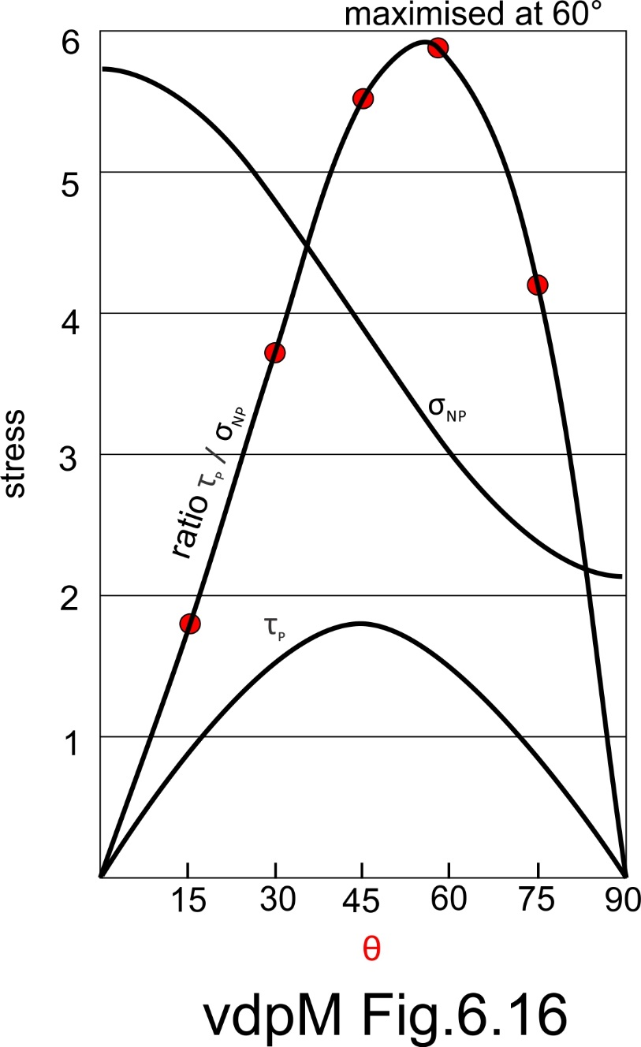
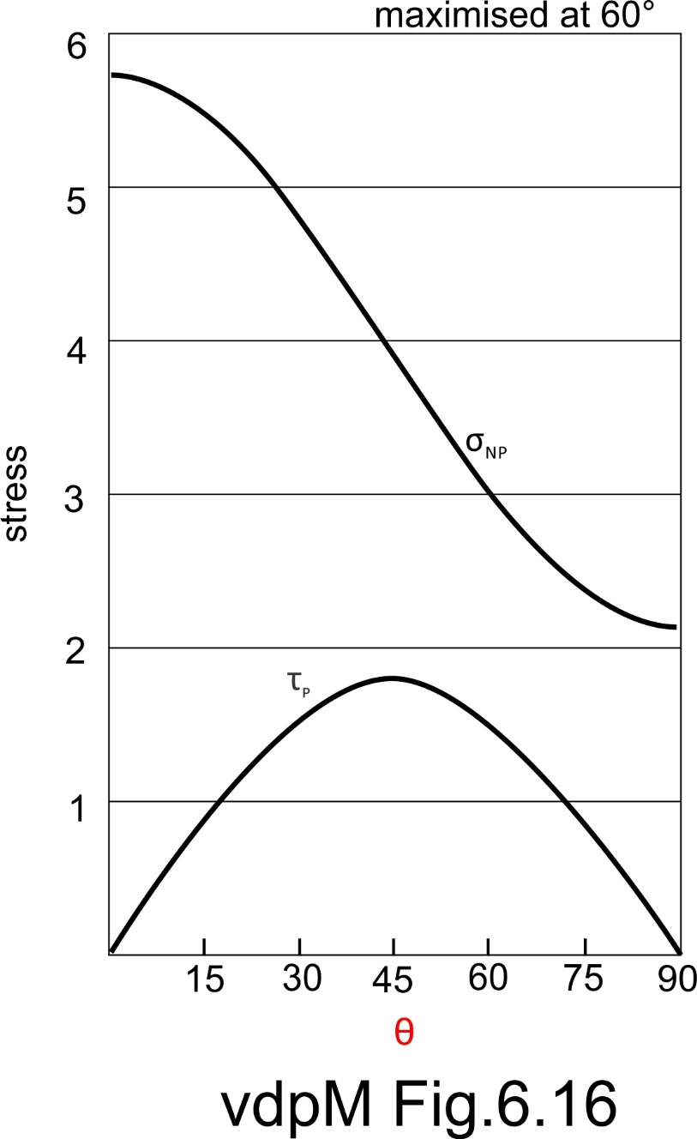
At what angle will a rock break relative to principal stresses?
Remember that coefficient of friction is the slope of the failure criterion, ie the ratio of shear stress to normal stress
μ_{S} = W_{S} / W_{N} = tan φ
Normal stress impedes slip – always max when θ = 0
Shear stress favours slip – always max when θ = 45
Fracture will occur when maximum shear stress to normal stress ratio = the internal friction angle of the rock
ϴ not fixed and actually depends on the magnitude of σ3
Uniaxial stress
Small differential stress
(almost confining stress only)
θ is the angle between σ1 and the normal to the plane.

Slide 24
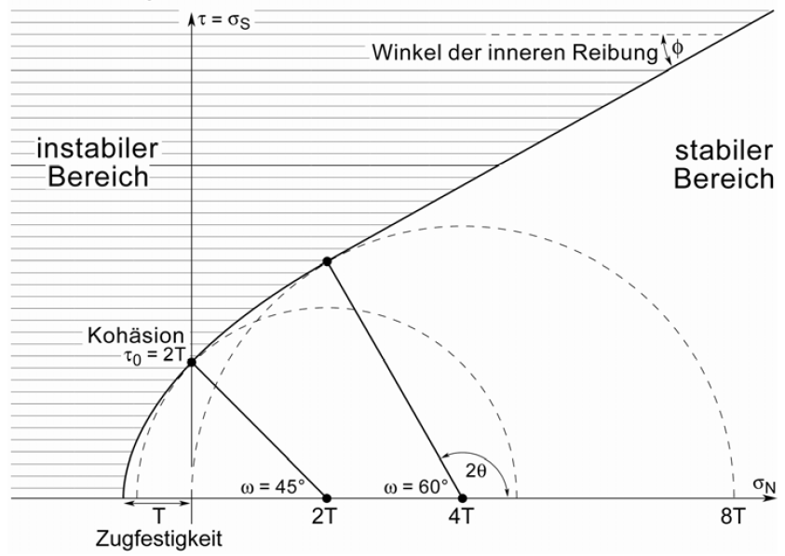
Extension (Mode I) fractures
Veins, joints, dikes etc. form perpendicular to σ3 and parallel to σ1σ2 plane
Fractures have no shear offset.
Commonly form vertical and parallel to max horizontal stress
Often result from high fluid pressure
cohesion
Tensile
strength
pore fluid pressure exceeds the value of σ3
Notes:
Mode I Fractures (also called extension fractures, extensional fractures) are planar discontinuities in rocks, which have no shear offset. The two walls typically remain in matching contact. Commonly form vertical and parallel to max horizontal stress the compressive stresses in front of a mountain belt), folding (due to the bending of Stratification), fracture or discharge during elevation or cooling occur and are usually open. They often form under high fluid pressure (ie low effective stress), perpendicular to the minor principal stress.

Slide 25
Pore Pressure
Brittle faulting part 2

Slide 26
Effects of fluids (pore pressure)
Affects failure of rocks in three ways:
mechanical effect of fluid pressure accelerates propagation of microfractures – wedging open
chemical interactions between rock and fluid weakens crystalline framework at highly stressed tips of cracks
stress corrosion breaks down silicon-oxygen bonds
Fundamentally, fluid pressure counteracts and therefore decreases confining pressure

Slide 27
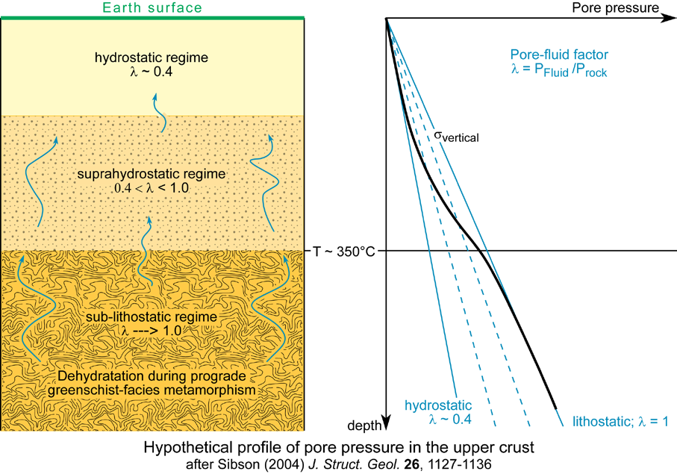
Pore pressure in the earth
If pores interconnected and communicate with Earth's surface, hydrostatic pressure in pore water at any depth is equal in all directions, outward from the pore space, to weight of water column from this depth to surface
Therefore, pore fluid pressure within rock increases as rock is buried
Hydrostatic pore pressure at any depth ≈0.25 - 0.3 times lithostatic or rock pressure, if mean density of rock column 2.5 to 3.0 g cm⁻³.
Deeper in the earth, connections to the surface are lost and pore pressures can approach lithostatic values
Pore-fluid factor
λ = P_{fluid} / P_{rock}
fluid pressure counteracts and therefore decreases confining pressure

Slide 28
Pore pressure and effective stress
Rates of loading or dehydration may exceed rate of escape of pore fluids in low permeability rocks (particularly if pores do not form open system connected with surface)
Fluid pressure opposes lithostatic stress caused by overburden
Pore fluids support some of load that would otherwise be supported by rock matrix
Therefore, pore pressure component of total stress acts uniformly against normal stress on rock
σ_{e} = σ_{n} - P_{f}
Increased pore-fluid pressure REDUCES effective stress (without changing differential stress)

Slide 29
λ = Pfluid / Prock = 0 for dry rock
Deeper in crust fluids internally expand at elevated temperatures and new fluids added by fluid-releasing metamorphic reactions
λ increases
Implications
presence of fluids can considerably reduce effective brittle strength of rocks
rock overpressured by fluids at great depths may break as if near surface
fluid-triggered crack propagation assists emplacement of magmatic intrusions

Slide 30
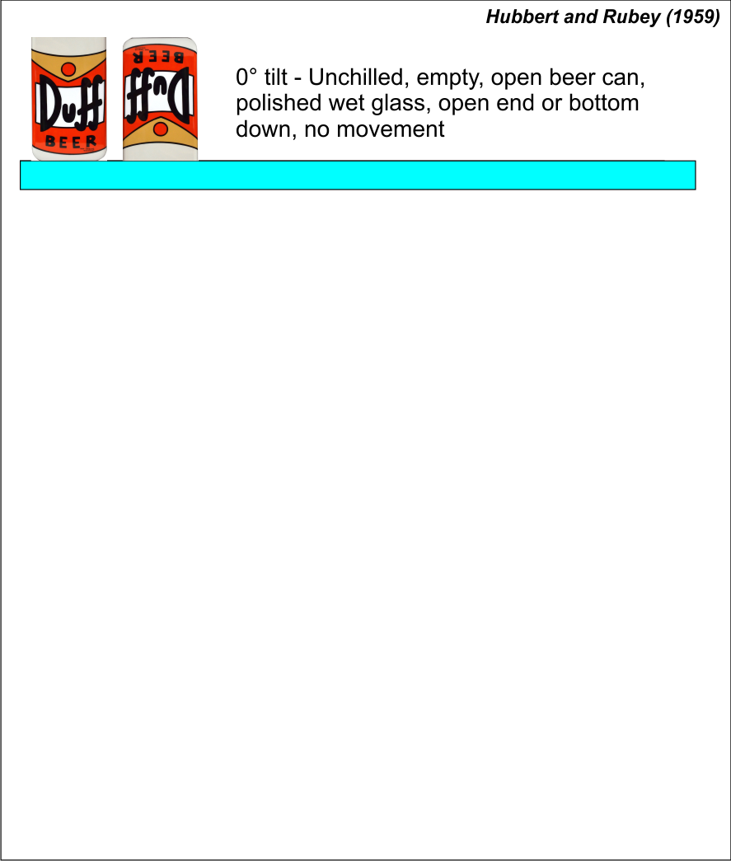
The effect of pore pressure on sliding
Initiation of sliding depends on the coefficient of sliding friction μ of the material
A block of wood on a piece of glass will slide quickly
A block of wood on a piece of sandpaper will need a steeper slope
Also on uplift pressure

Slide 31
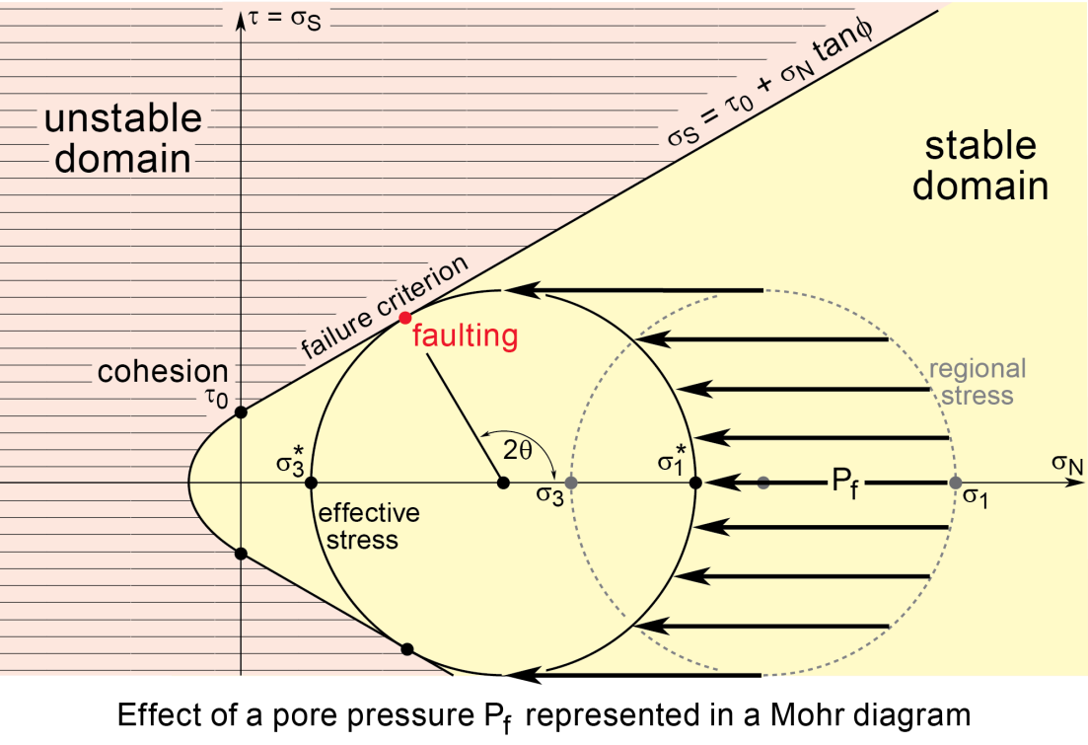
Pore fluid pressure – Effective normal stress
if fluid pressure large enough circle will hit Mohr envelope and faulting occurs
High fluid pressure thus allows faulting even though shear stresses too small for faulting in dry rock, or in wet rock at lower pore pressures
Can allow slip on unfavourably oriented faults
Reduces markedly both fracture strength and ductility of rocks (both functions of effective confining pressure)

Slide 32
Pore fluid pressure and shearing resistance
normal stress, tends to strengthen fault plane by pushing together opposing rock blocks, hence increasing friction
fluid pressure weakens fault by pushing opposing rock blocks apart
i.e., increased pore pressure dampens down effect of confining pressure, which strengthens fault with depth
thus has lubricating effect on faults
reduces frictional shearing resistance to movement

Slide 33
Pore pressure and hydraulic fracturing
recent research on earthquake control concerned with Pf because critical variable that can be manipulated to some extent by man
basic idea is that suitable local increase in Pf (by pumping fluids into drill holes) could lower shearing resistance of rocks triggering local faulting and small earthquakes
may gradually release stored energy that would otherwise accumulate for large and catastrophic earthquake
correlation between rate of fluid injection and earthquake frequency observed
not yet clear what effect such control of small earthquakes will have on occurrence of large ones
Stress drop but also redistribution around fault tips

Slide 34
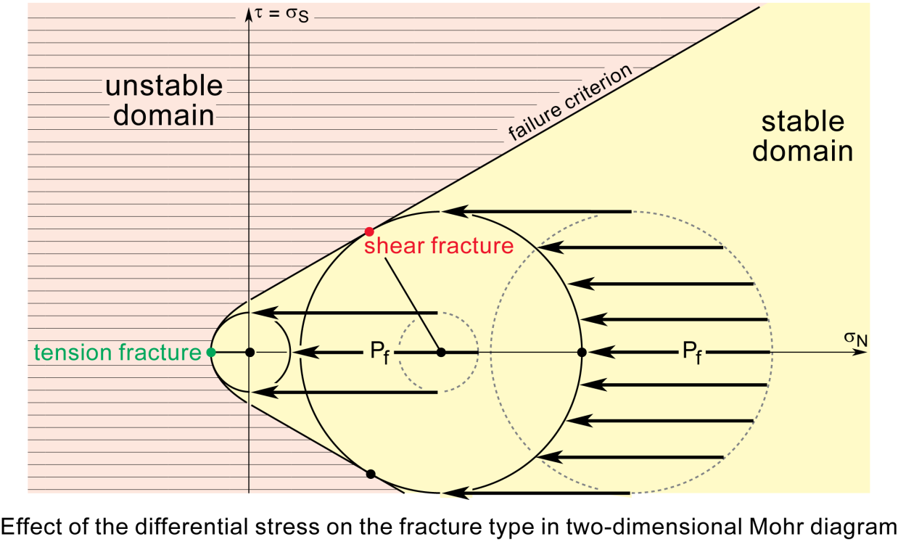
Hydraulic fracturing
increasing P_{f} outward push of the injected fluid creates tensile stress sufficient to cause crack propagation at pore and crack tips (hydraulic fracturing)
originally compressional stress regime can be changed so that one or more of principal stresses become effectively tensile satisfying conditions for tensile failure

Slide 35
Pore fluid pressure – Shearing resistance and thrusts
High pore pressures considered vital for low-angle thrust faulting
Thrust sheets 30-100 km wide pose serious mechanical problems if they moved dry, because
friction along their bases require either impossibly high shearing stresses in the sheets (if pushed from behind)
or
unreasonably steep slopes (if slide downhill under influence of gravity)
Pore pressures higher than normal could allow thrust sheets to be pushed more easily or to slide down slopes with dips as low as a degree or two

Slide 36
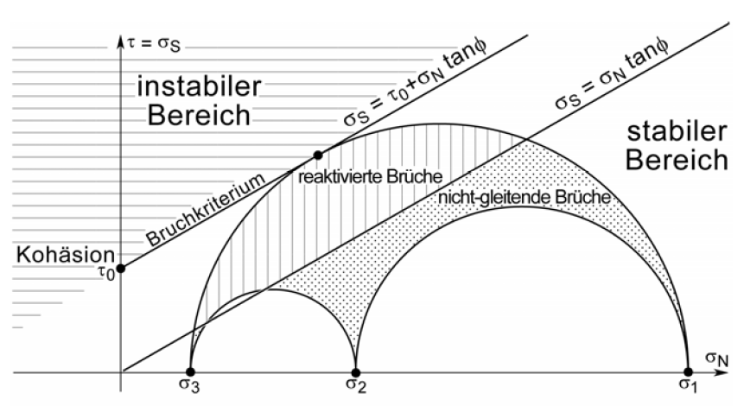
Reactivated and newly formed fractures
Many structures will be reactivated before new fractures are formed
Instable
domain
Stable
domain
Coulomb failure criterion
reactivation
cohesion
Isotropic
material
Anisotropic
material
- Rocks typically anisotropic and have pre-exisitng planes
- Two fracture criterions exist:
(1) Failure criterion for newly forming fractures
(2) Failure criterion for pre-existing, reactivating fractures
Notes:
Im Falle eines anisotropen Gesteins gibt es zwei Hüllkurven, eine für die Bruchbildung entlang der Schieferung (inneres Paar), und eine für die gesamte Bruchbildung schräg zur Schieferung (äußeres Paar).Die Schieferungsorientierung hinsichtlich σ1, ist als Punkt auf dem Kreis gegeben. Das Gestein wird an der äußeren Hüllkurve brechen, wenn irgendein Punkt auf dem Kreis diese Hüllkurve berührt. Wenn der Punkt auf dem Kreis, der die Schieferung darstellt die innere Hüllkurve erreicht, bevor ein anderer Punkt auf dem gleichen Kreis die äußere Hüllkurve berührt, werden sich entlang der Schieferung Brüche bilden. Die Animation zeigt, wie dieser Vorgang für vier Orientierungen der Fläche in einem Handstück abläuft.

