Slide 1
Cenozoic affinity of the Gondwanan rocks of eastern Timor: evidence from geo-thermochronometry
Brendan Duffy, Brian Lew, Kevin Boland, Barry Kohn, Erin Matchan, Roland Maas, David Dixon, Lourenco Pedro, Paulo de Carvalho, Mike Sandiford
I acknowledge the valuable support of Timor Resources (especially Jan Hulse) and IPG (Timor-Leste geological survey)

Slide 2
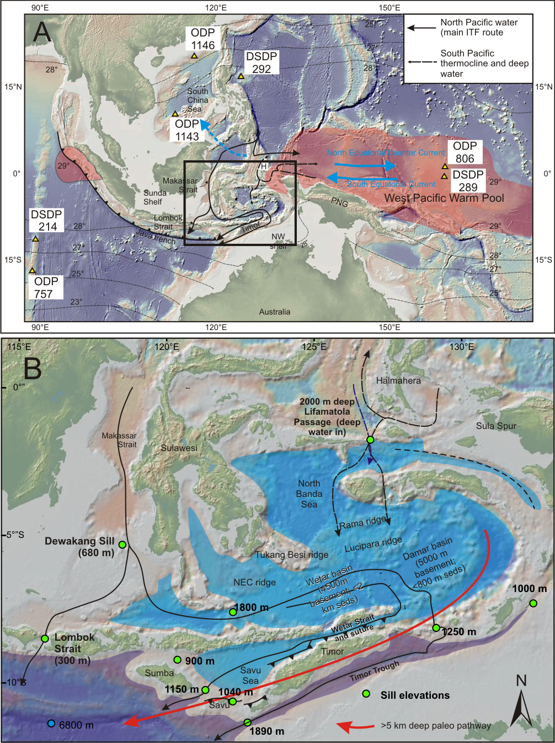
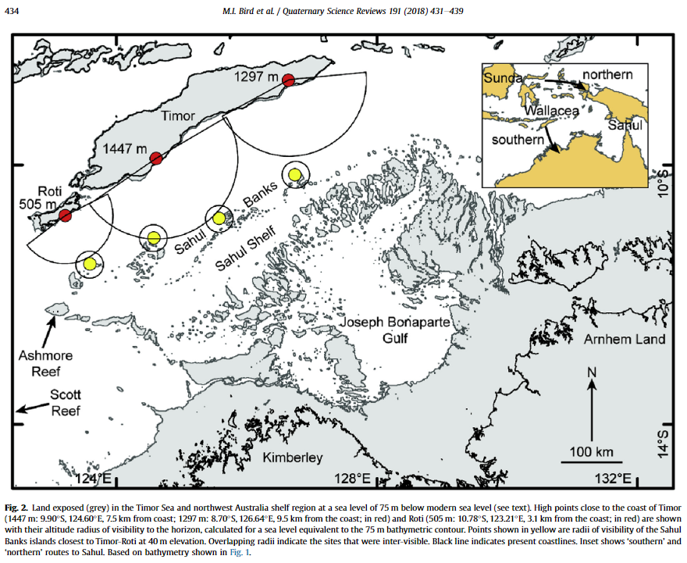
Importance of Timor’s paleogeography
>40kyr (Langley et al. 2016)
Bathymetric development of the maritime continent has controlled the Neogene Indonesian throughflow
Also provided stepping stones for modern humans to reach Australia
Bird et al. 2018
Notes:
Timor is a key topographic feature within Wallacea and bathymetric barrier in the Indonesian Throughflow
CLICK – during lowstands, the Sahul Banks may have been visible from Timor, making this an important potential stepping stone for indigenous occupation of the Australian continent
CLICK – the record of human activity of Timor extends back >40 thousand years
The island therefore has huge significance for Quaternary climate and biogeography at multiple timescales, but understanding that significance, especially at older timescales, requires us to differentiate the rocks of the upper and lower plates correctly.

Slide 3
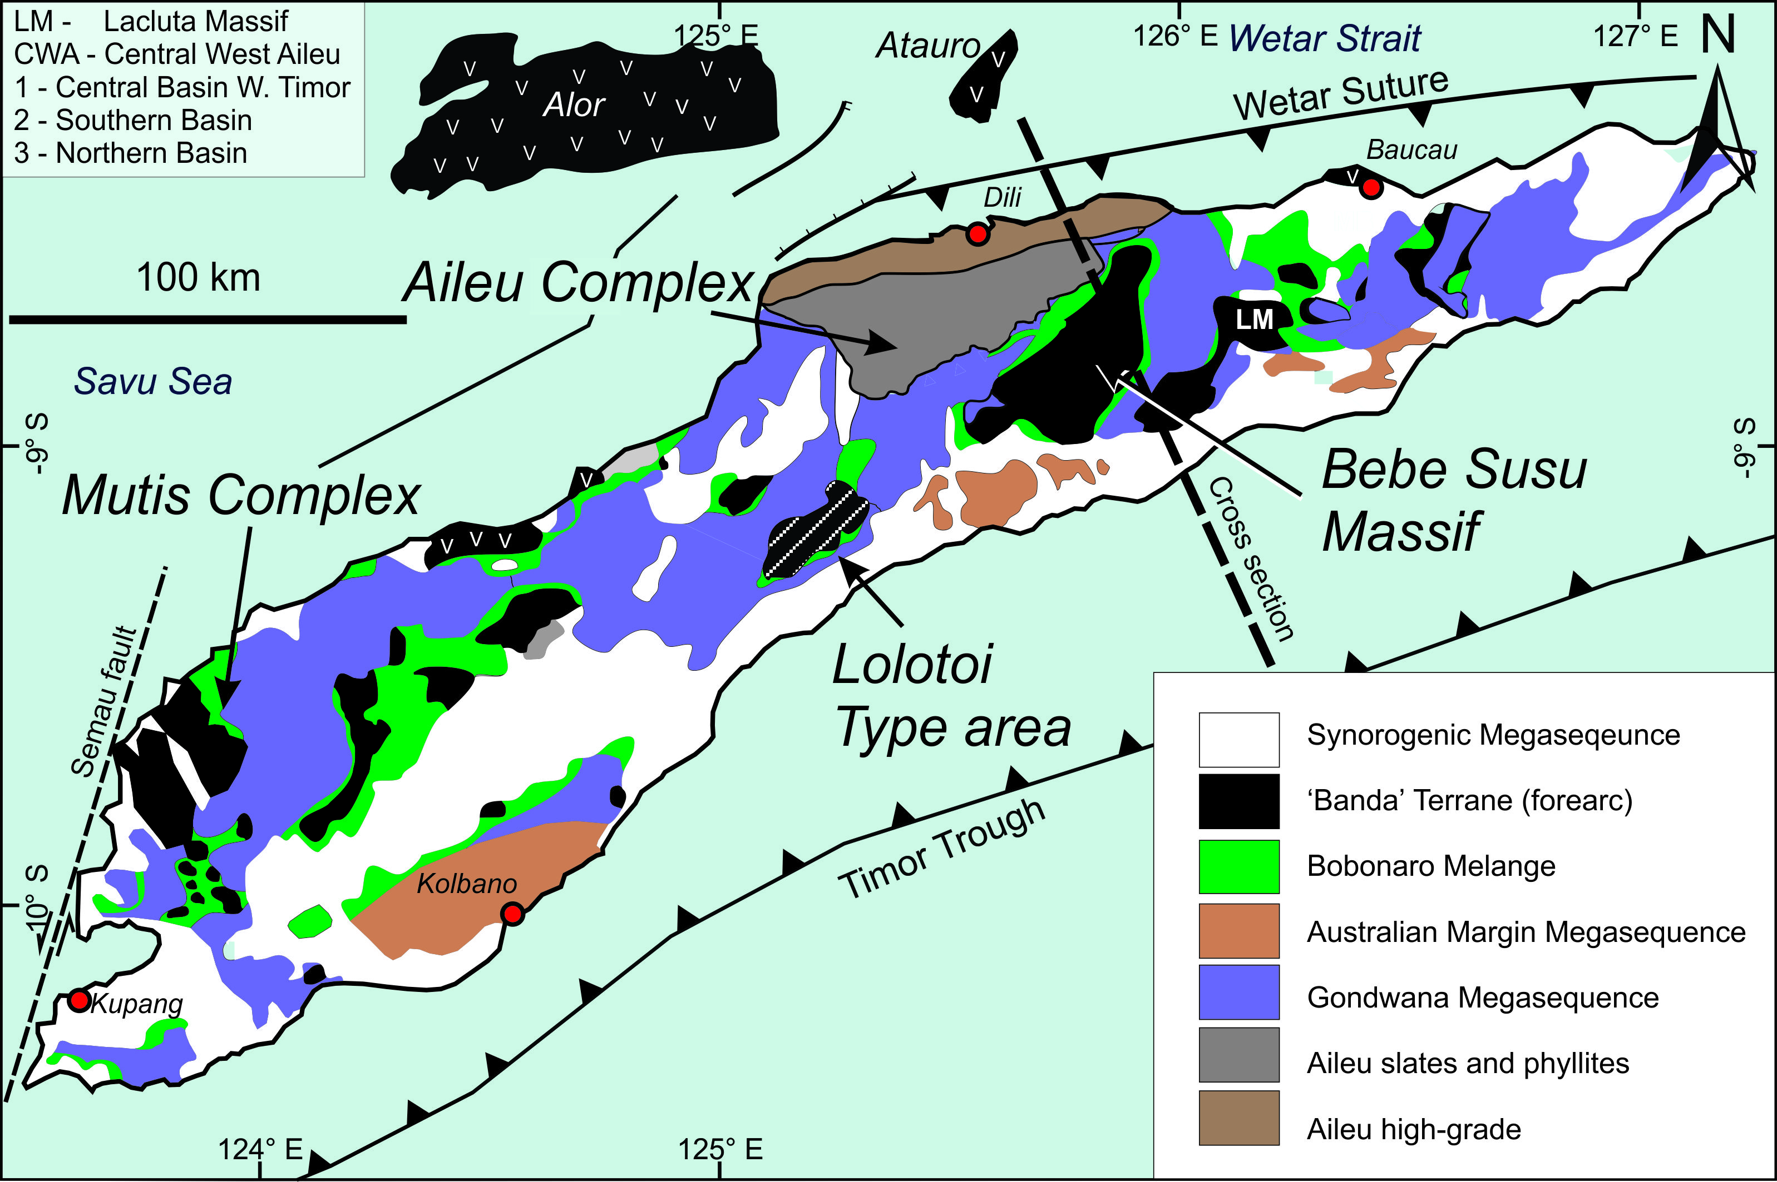
The building blocks of Timor
Gondwana –
  Permian – Jurassic
  Intracratonic rift basins
  Usually correlated with NW shelf (lower plate?)
Two [Three?] met’c complexes
  Paleogene Mutis
  Lolotoi?
Modified from Duffy et al. (2017)
Notes:
The main rock groups in Timor include the Gondwanan-affinity rocks shown in purple and the Banda affinity rocks shown in black.
The latter include extensive metamorphic rocks known as the Mutis Complex, mostly considered to be Jurassic and cretaceous rocks, metamorphosed in the Paleogene.
U-Pb ages on detrital zircons and Lu-Hf ages on garnets in the Bebe-Susu massif are generally equivalent to Mutis but the metamorphic event and protolith age has not been dated in the Lolotoi Metamorphic massif

Slide 4
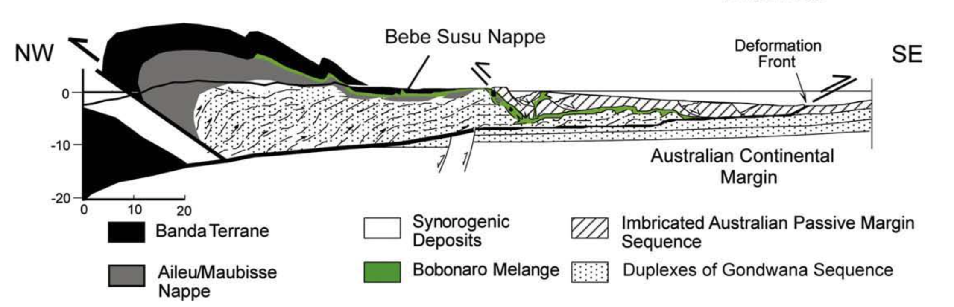
Models for Lolotoi/Mutis
must account for the observed structural and stratigraphic relationships and radiometric ages of the various units
  Allochthonous upper plate crust (Harris and others)
Eocene metamorphism of Cretaceous protolith
Eocene metamorphism
    Jurassic-Neogene U-Pb zircon ages of prototliths
    a thermal history incompatible with NW shelf
    correlation of the Gondwana sequence with the NW shelf
    limited structural mapping
Notes:
Tectonic models must account for the observed structural and stratigraphic relationships and geo and thermochronology of the various units
Harris and many coauthors (me included) have favored an overthrust model with the Paleogene metamorphics on top of the Gondwanan (Australian) rocks.
CLICK - This simply explains Eocene metamorphic ages from the Bebe-Susu massif and
CLICK - is consistent with the stratigraphy and thermal history of the NW shelf.
A key focus of this model for Timor-Leste is the Bebe-Susu massif

Slide 5
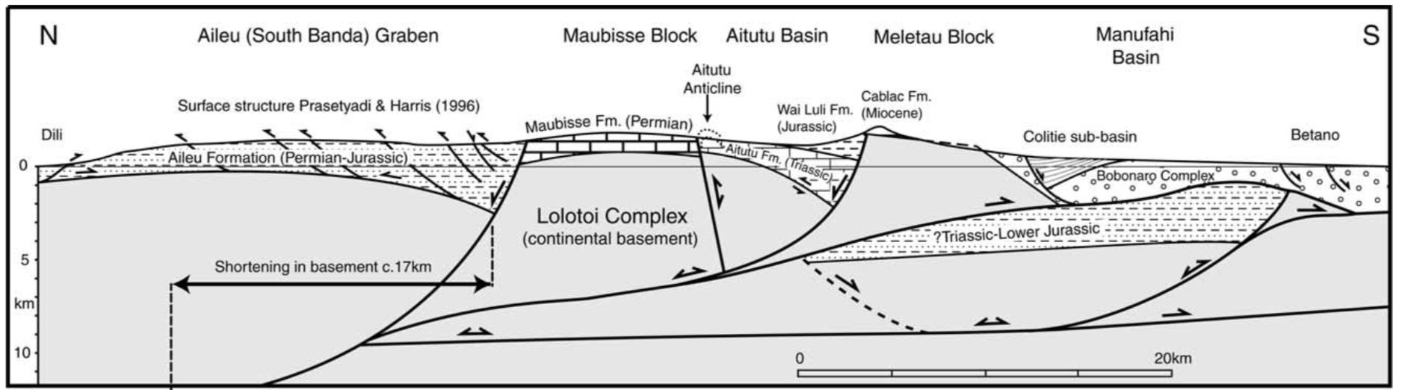
Models for Lolotoi/Mutis
must account for the observed structural and stratigraphic relationships and radiometric ages of the various units
  Autochthonous lower plate (primarily led by Charlton)
(Charlton 2002)
    limited structural mapping
    Interpretation of the Lolotoi as being overlain by Permian rocks
    Disregard for geochronology and thermal history
Notes:
In contrast, Charlton considers the entire Lolotoi complex to be Australian basement, despite geochronological evidence to the contrary.
However, the idea of the Lolotoi as basement has reappeared many times and deserves to be addressed.

Slide 6
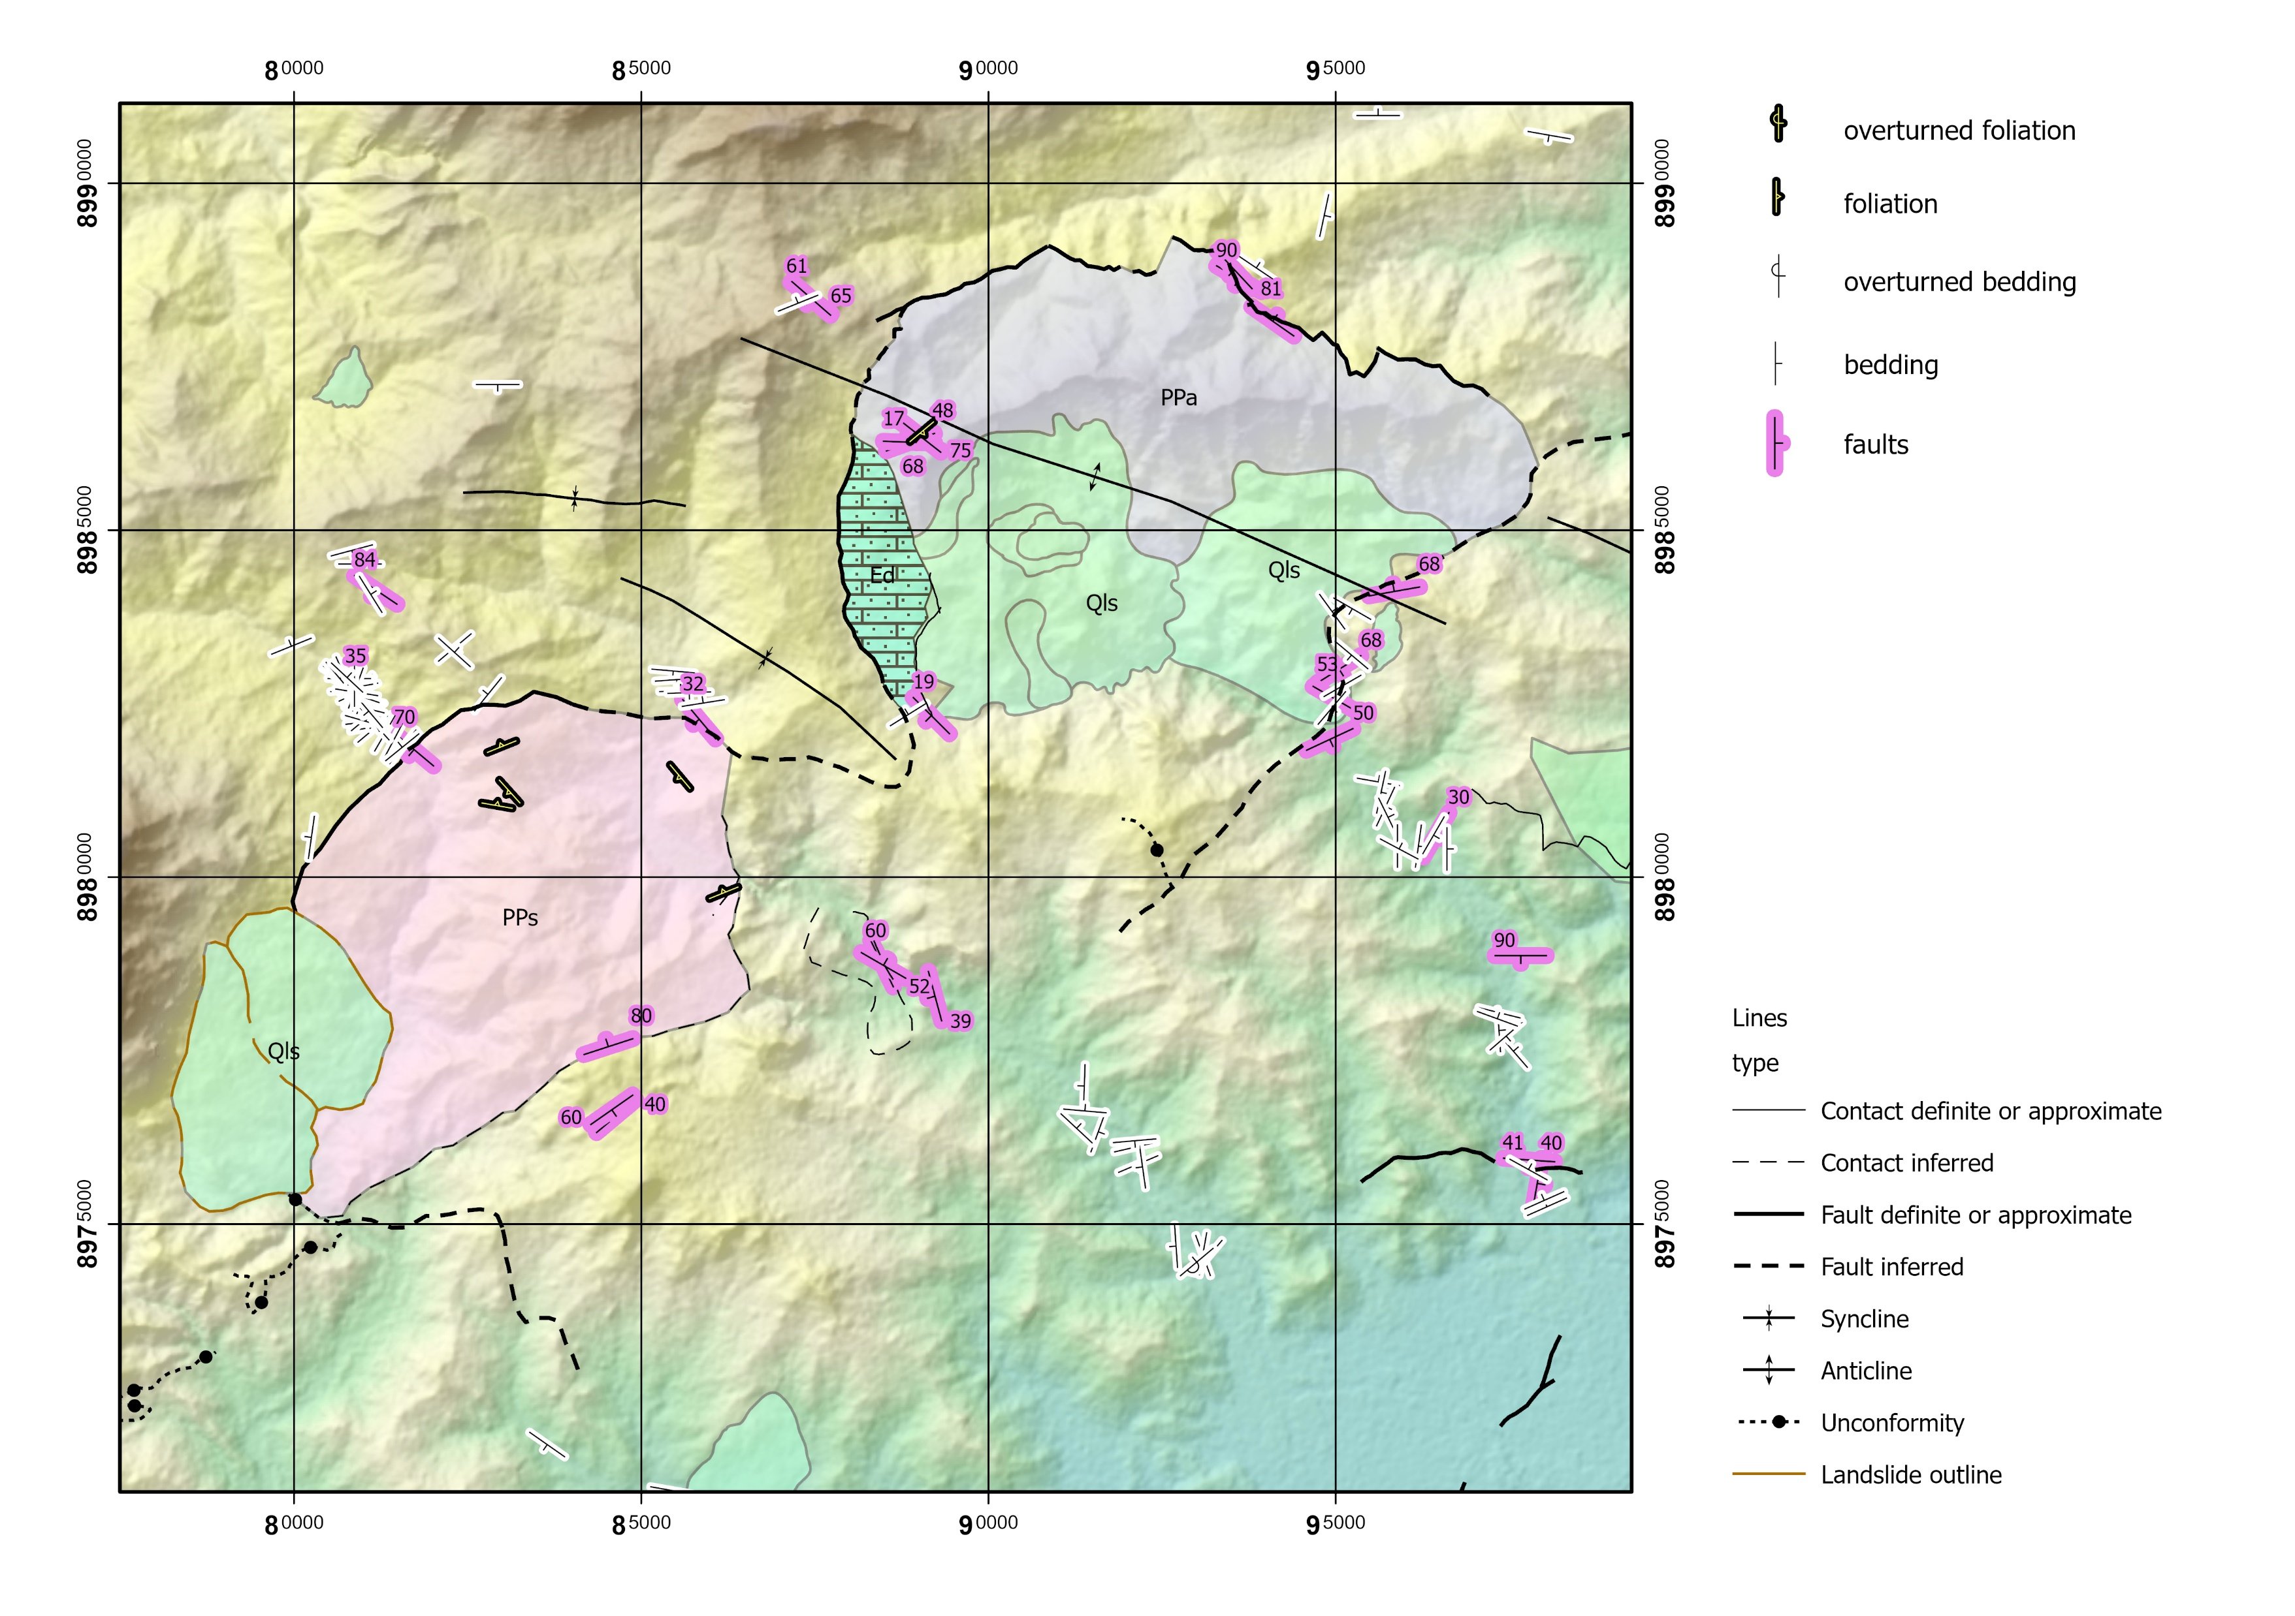
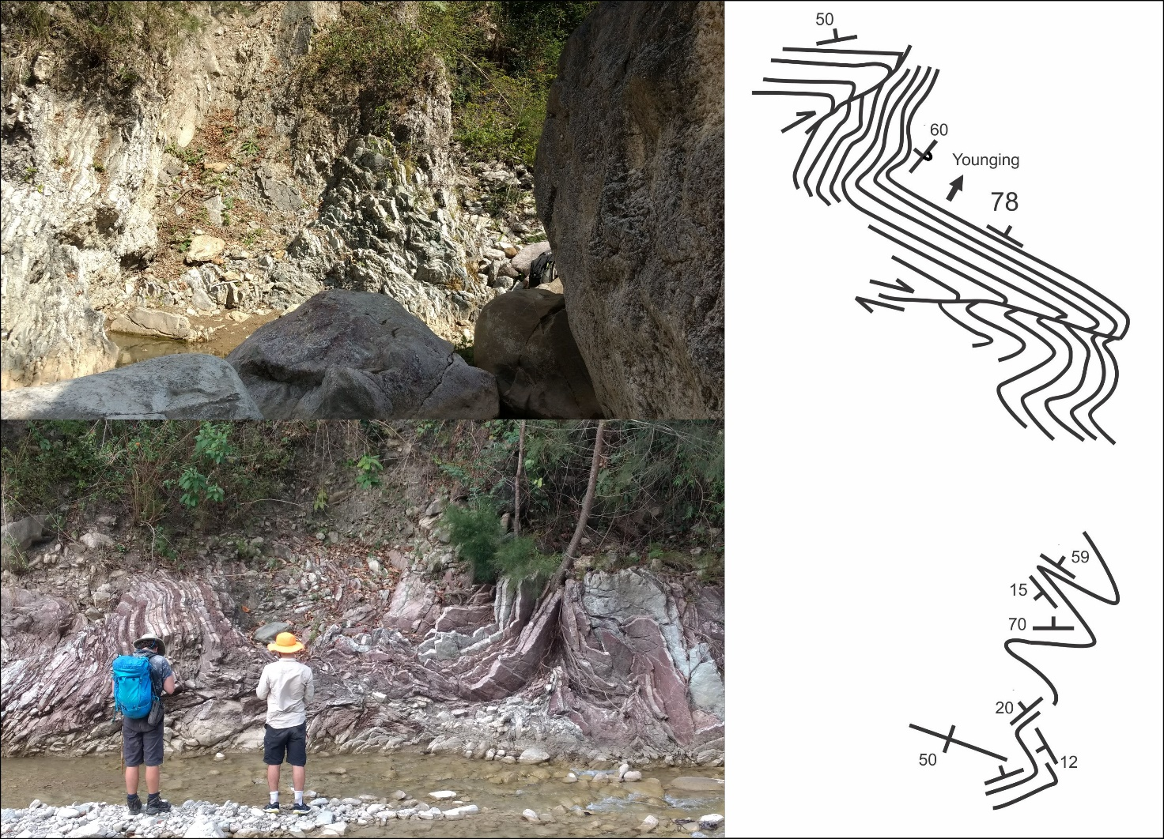
Structural position?
Notes:
The fault to the north and west of the Lolotoi Metamorphics is a reactivated, folded, north-dipping detachment fault with greenschist facies in the footwall and
CLICK – complexly folded Triassic/Jurassic rocks of the Aitutu and WaiLuli Formations on the hanging wall.
To the south and east of the metamorphic rocks, the typical Banda cover sequence of volcaniclastics and limestones can be found apparently unconformably overlying Permian and Triassic rocks.
There is ample evidence of superposed folding on NW and NE trends, which makes mapping challenging, but the key observation is that the Lolotoi metamorphic complex is structurally below the Gondwanan rocks.
So, how old is it?

Slide 7
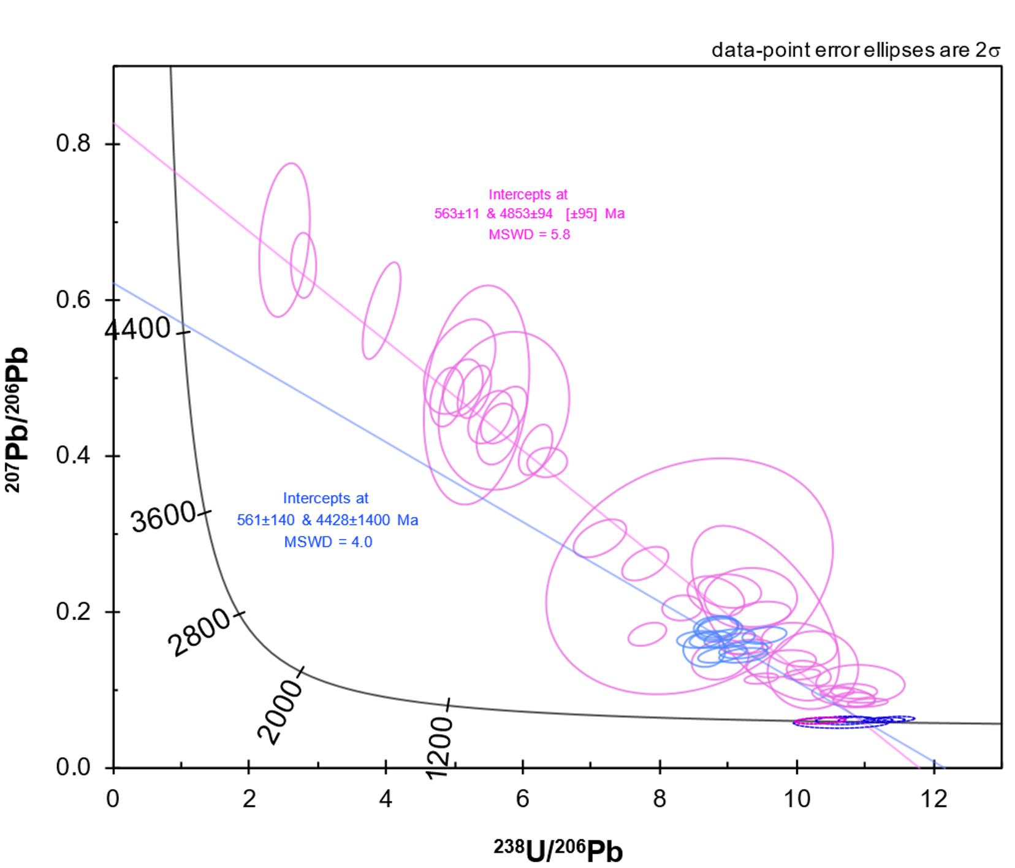
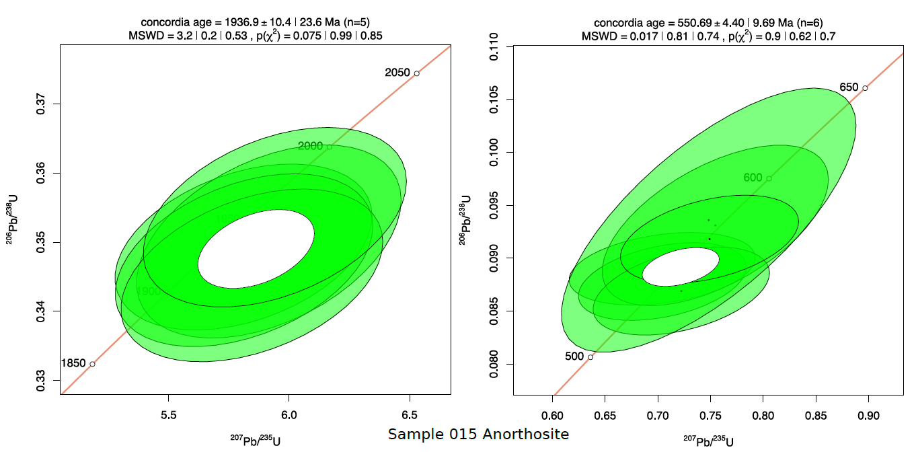
Pre-Permian crust
Mica schist apatites (pink)
Anorthosite titanite (blue)
Shared mineral growth event ~550 Ma
Anorthosite zircon cluster
550.69 ± 4.40 Ma
Anorthosite zircon cluster
1936.9 ± 10.4 Ma
Pre-Permian basement
Apatite discordia age
Titanite discordia age
Anorthosite Zircons shown on concordia
Notes:
Minerals like apatite and titanite incorporate substantial common Pb and will fall along a linear Discordia on a Tera-Wasserburg diagram with a lower intercept at the closure age
This plot shows U-Pb data of titanites from an anorthosite, and apatites from a mica schist, dated using laser ablation ICPMS.
CLICK – The Anorthosite yields a weakly constrained lower intercept age of c.561 Ma, as does
CLICK – the apatite ages from the mica schist and these correspond to
CLICK – the youngest concordant ages for zircons in the anorthosite.
CLICK – this indicates a shared mineral growth event in the mica schist and anorthosite at 550 Ma, after which the temperatures were not high enough to subsequently reset those ages, and even though the titanite U-Pb ages have error bars of ± 140 Myr, they cannot be Permian
CLICK – the anorthosite also yielded a concordant cluster at around 1937 Ma.
Overall, these metamorphic rocks are clearly pre-Permian basement, which seems to support Charlton’s model, but what evidence is there for post-500 Ma events?

Slide 8
Source of the block?
Glenburgh orogen – 2000-1950 Ma
Pinjarra orogen – c. 530 Ma
King Leopold / Halls Ck orogen - 670–510 Ma & 1860 Ma
Hall, 2012
PIL
KIM
YIL
Notes:
Timor’s present position is shown by a yellow rectangle. So where did the basement come from?
Several orogens mark the boundaries of the Yilgarn, Pilbara and Kimberley cratons including the
CLICK – Glenburgh orogen that provides a good match for the old zircons in the anorthosite
CLICK – Pinjarra orogen that is a bit too young and too far southwest for existing reconstructions
CLICK – King Leopold and Halls Ck orogen that match the younger ages but not really the older ones.
Ultimately, there is abundant activity of the right age along the Australian margin within the paleogeographic region of the
CLICK – Argo block, but if this block spent the Cenozoic in Asia, where is the evidence of Banda thermal events in the Cretaceous and Eocene?

Slide 9
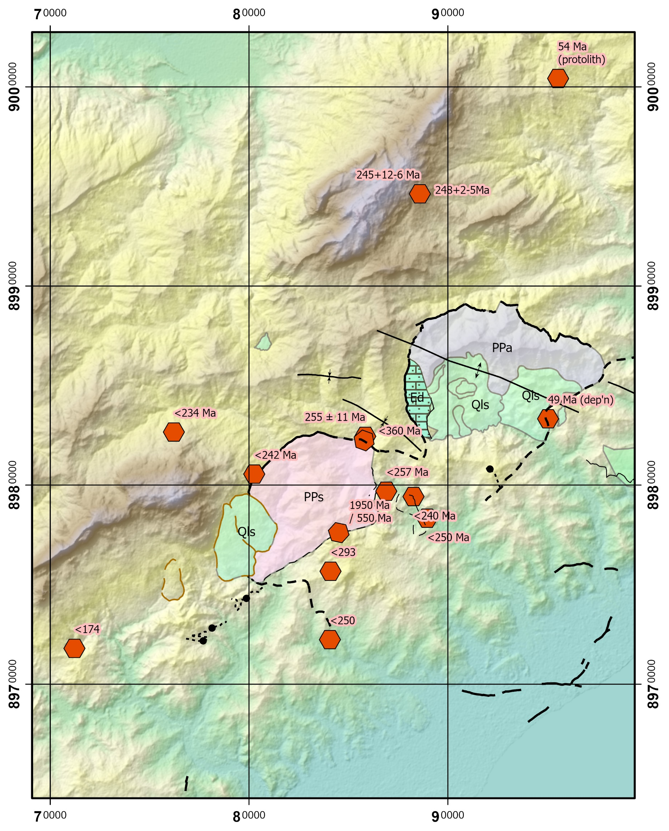
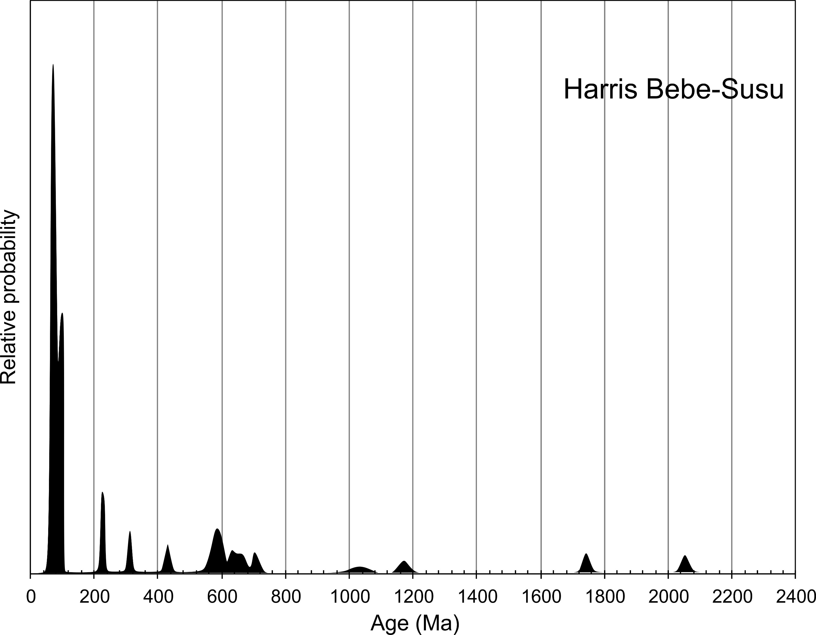
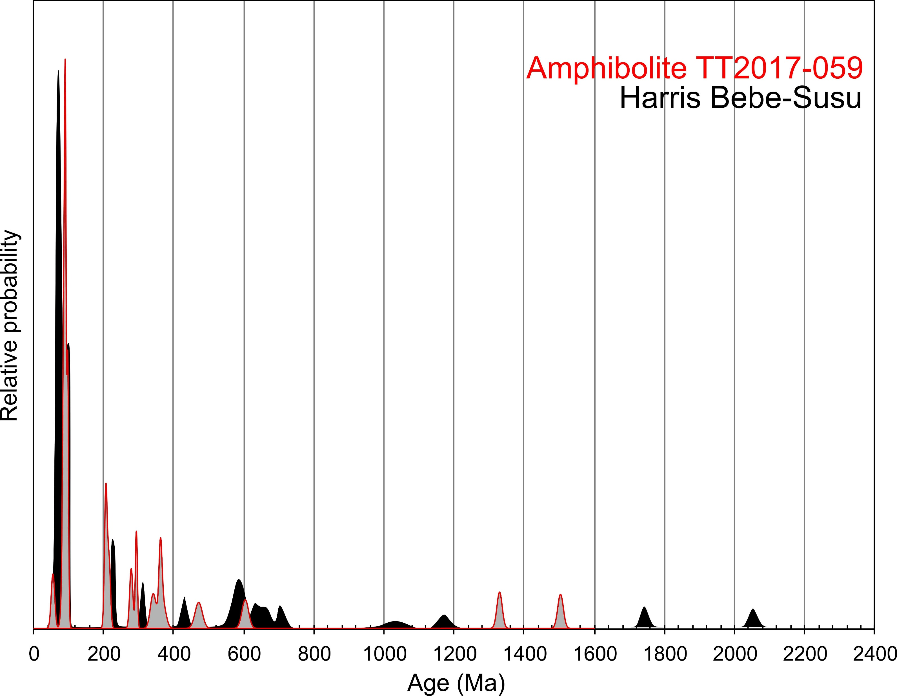
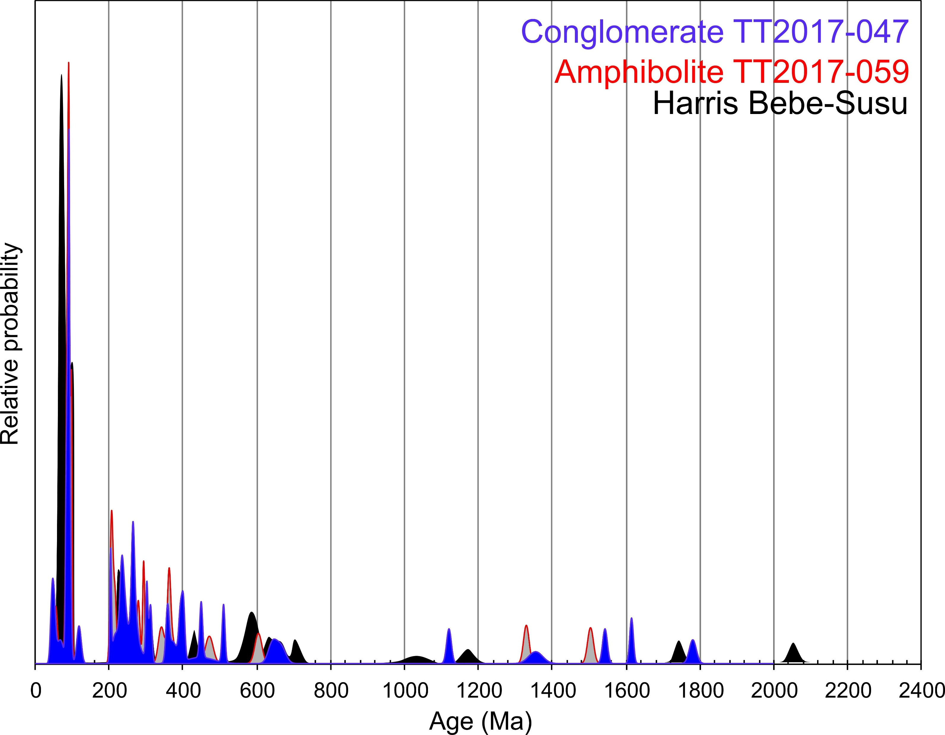
Amphibolite contains abundant Cretaceous zircons and a single zircon of 54 Ma
  Note peak metamorphism per Harris was at c.45 Ma
Eocene conglomerate has zircons as young as 49 Ma
Notes:
Although we don’t see a Mesozoic thermal signature for Permian/Jurassic extension or Cretaceous collision, we do see the zircons shed off the denuding Cretaceous volcanos. These are previously documented by Harris etc in the Bebe Susu massif.
CLICK - We see the same pattern of Cretaceous zircons in amphibolites from melange zones just north of Lolotoi and more importantly
CLICK – we see the same pattern in coarse sediments under the Dartollu limestone and apparently on top of Gondwanan shales east of Lolotoi.
Note the small but consistent contributions of inherited Proterozoic Zircons, presumably derived from continental crust

Slide 10
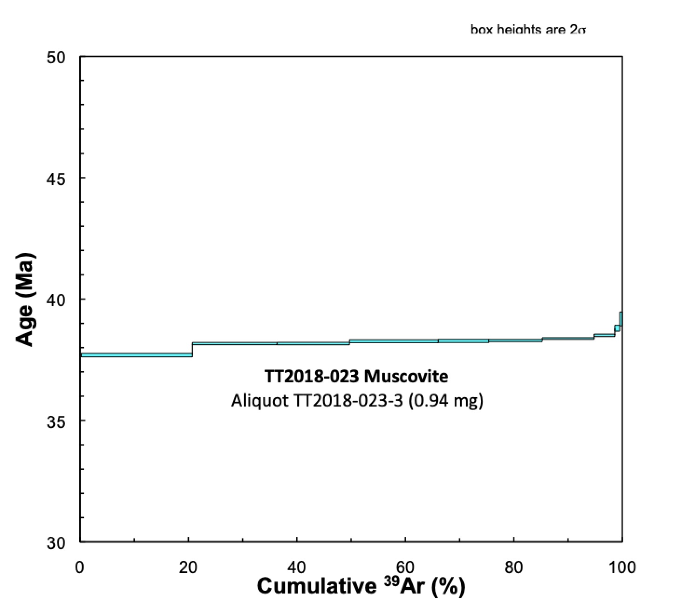
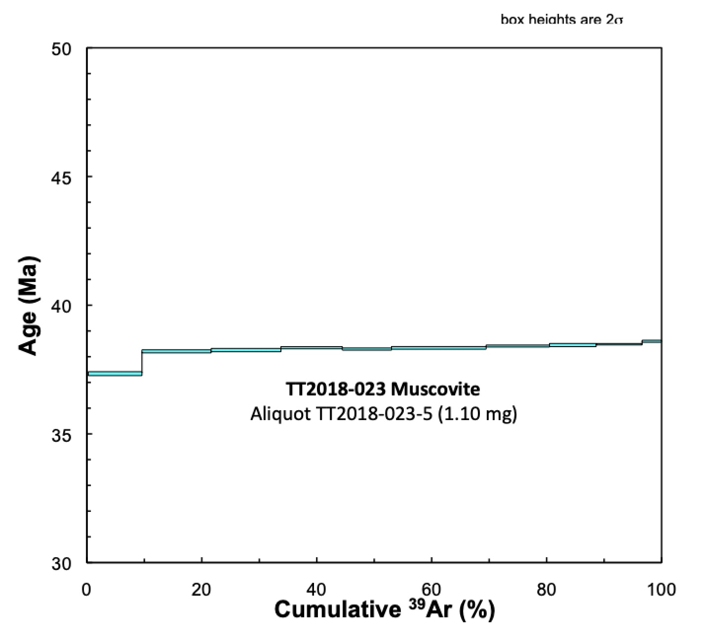
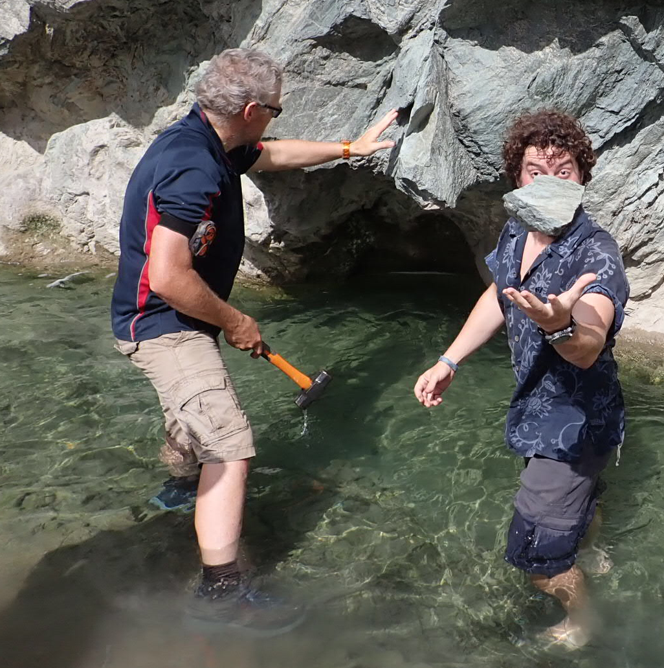
⁴⁰Ar/³⁹Ar dating of fault zone mica
Harris, 2006
Notes:
Evidence for post-Eocene activity is found in the fault on the northern edge of the metamorphic window.
Harris reported Ar-Ar ages for several minerals from the Mutis Complex, all clustered between 33 and 39 Ma.
CLICK – We separated white mica from a mylonite on the northern edge of the metamorphic window
CLICK – Two aliquots yielded reproducible ages of c.38 Ma, indicating that mineral growth during fault activity aligns with co-eval events in the Mutis Complex of West Timor

Slide 11
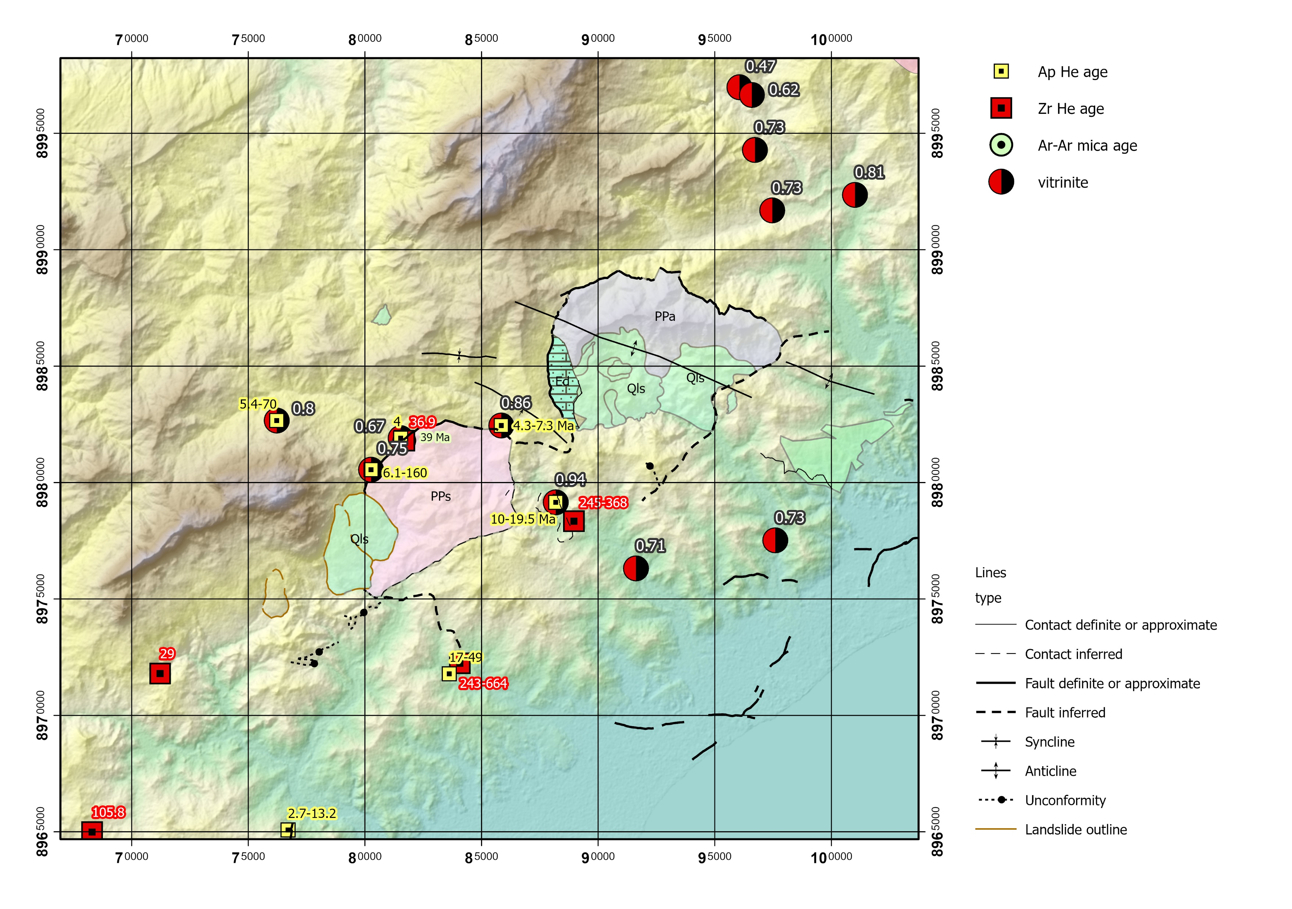
Zr and Ap U-Th/He ages
Zr (U-Th)/He ages are depositional/inherited in the south
  No overthrusting
Oligocene ages along the northern edge of the Lolotoi
  Includes Park et al. zircons
Notes:
So we have evidence linking pre-Permian basement to the Eocene and Oligocene activity on the Sunda margin. This implies that the Lolotoi complex is upper plate, as are all the Gondwana sediments. So what about overthrusting? Well, low temperature thermochronology is not consistent with the notion that the Lolotoi area is a klippe, because the ages do not record any significant thermal perturbation.
CLICK – We see depositional Zr (U-Th)/He ages south of the Lolotoi Massif and
CLICK – reset ages only along the northern fault.
CLICK – Vitrinite reflectance values are low either side of the metamorphics and highest close to them.
Overall, this is consistent with a relatively low temperature history for the entire area, except along the fault.

Slide 12
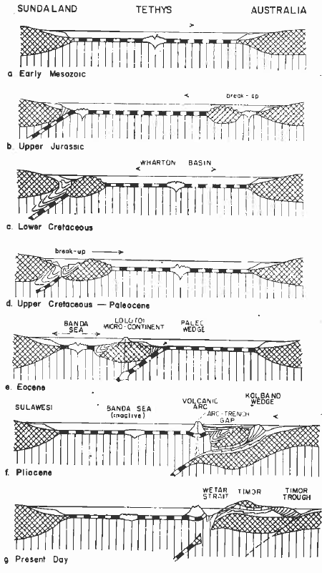
Revival of Barber’s interpretation
  Rifted from Gondwana in Jurassic
  Accreted to Sundaland in Cretaceous
  Rifted in forearc in Eocene
  Reaccreted to Australia in Pliocene
  Likely that Supendi et al. 2020 forearc sliver is continuation of Bebe-Susu massif, sandwiched between two continental fragments
Notes:
On the basis of these data, we revive Barber’s (1981) interpretation that almost all of the pre-Neogene exhumed rocks of eastern Timor, including the Gondwanan rocks, resided in Sundaland during the Cenozoic. This finding strongly supports hydrocarbon prospectivity onshore in Timor and has implications for the geodynamics of the Banda Arc, reconstructions of Wallacea, and the Neogene paleogeography of the Indonesian Throughflow.

