Slide 1
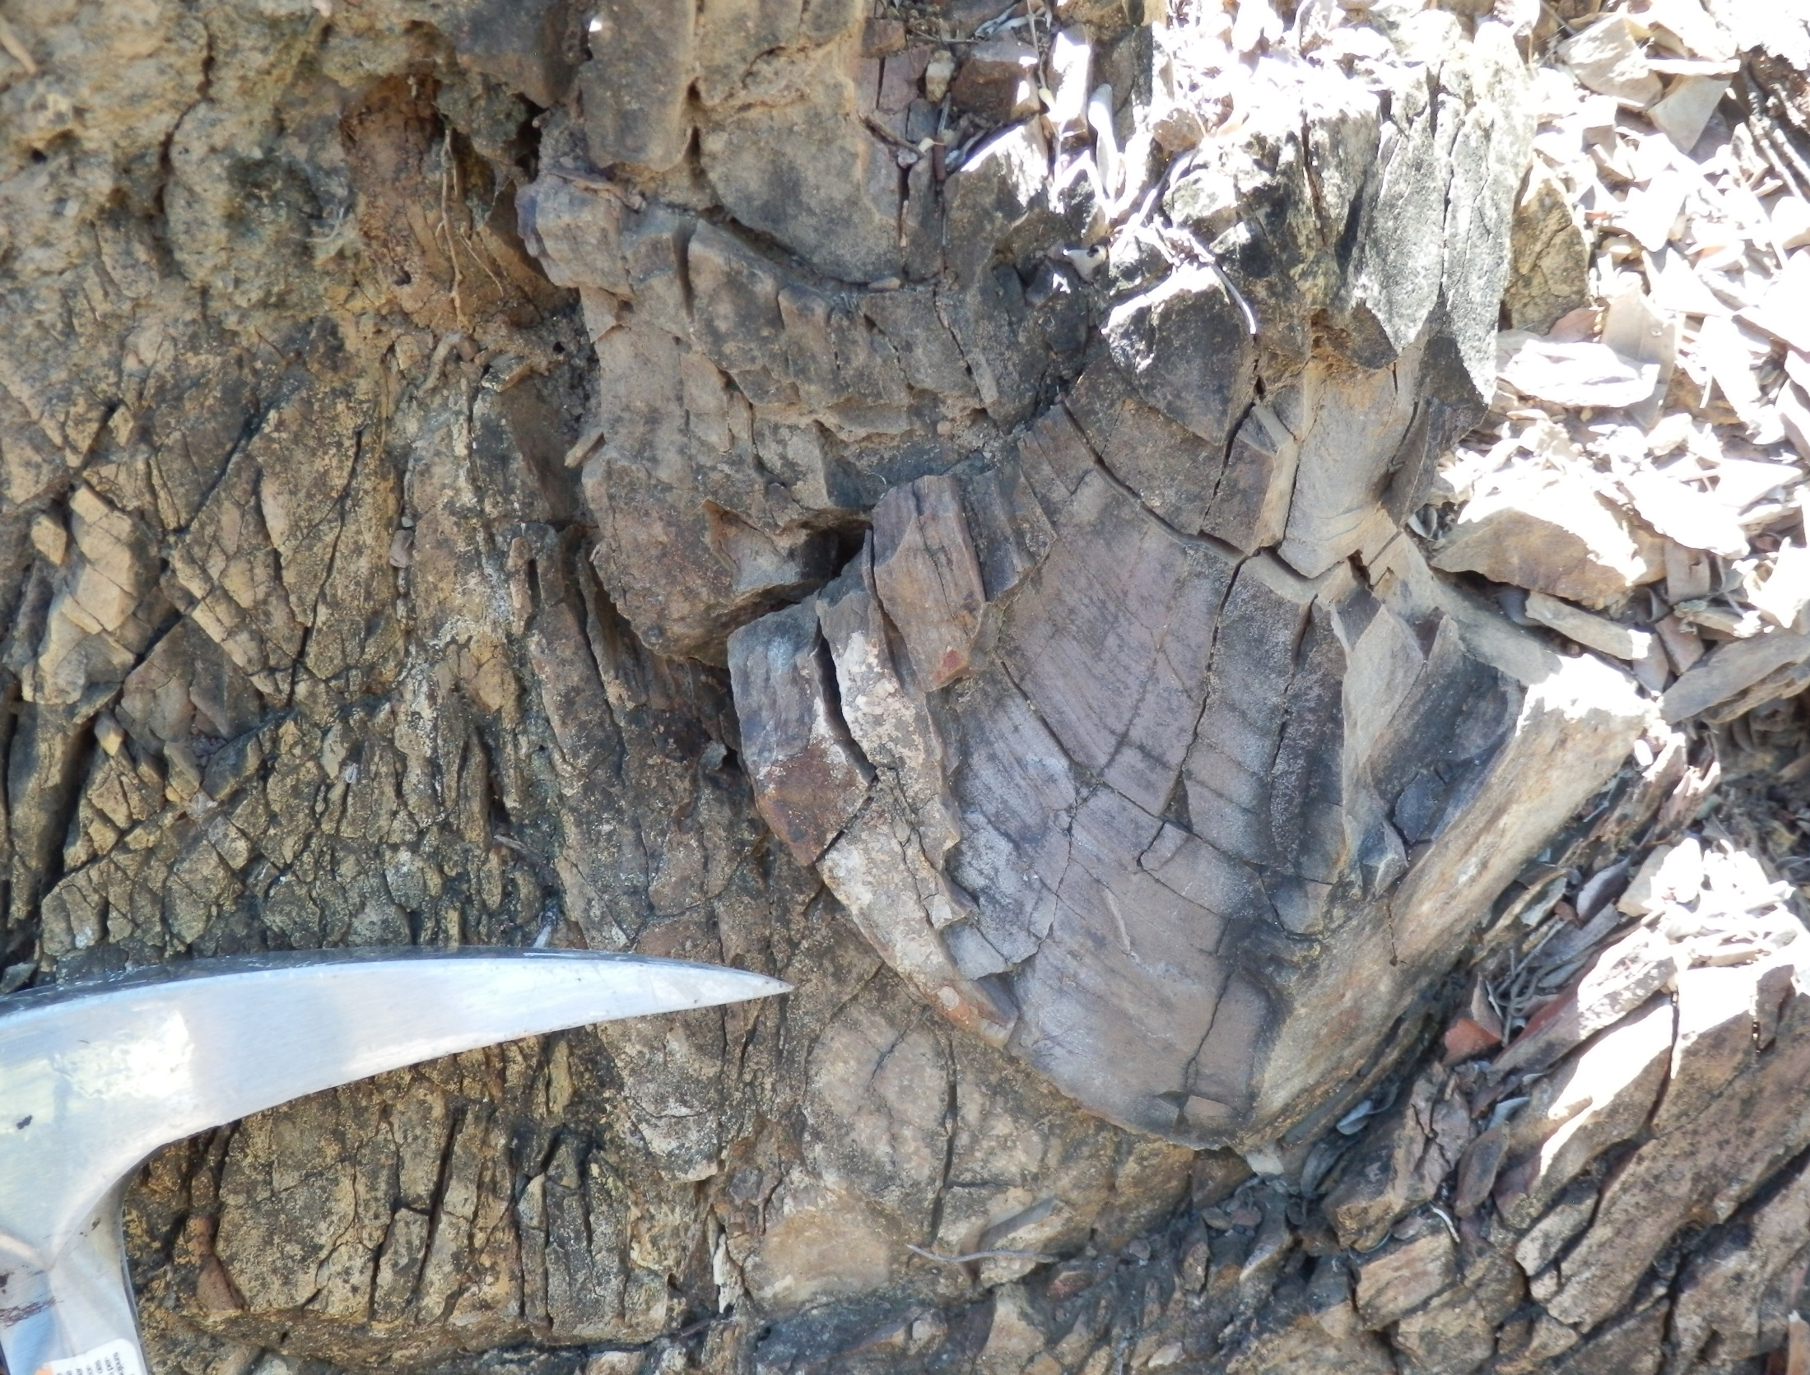



Portable XRF geochemistry: new insights from an old friend
Brendan Duffy¹, Simon Beams², Tim Beams², Verity Borthwick³
¹ Univeristy of Melbourne
² Terra Search, Townsville
³ MGT Resources
Notes:
Known mineral deposits may remain under-estimated and under-exploited
Problem related to -
limited understanding of their structural setting
difficulties mapping the distribution of barren cover rocks.

Slide 2
Motivation
Known mineral deposits may remain under-estimated and under-exploited because of
  limited understanding of their structural setting
  difficulties mapping the distribution of barren cover rocks
Junior explorers cannot necessarily afford full geochemical characterization
We provide a case study for cost-effective rapid discrimination of rock types and mineralisation potential

Slide 3
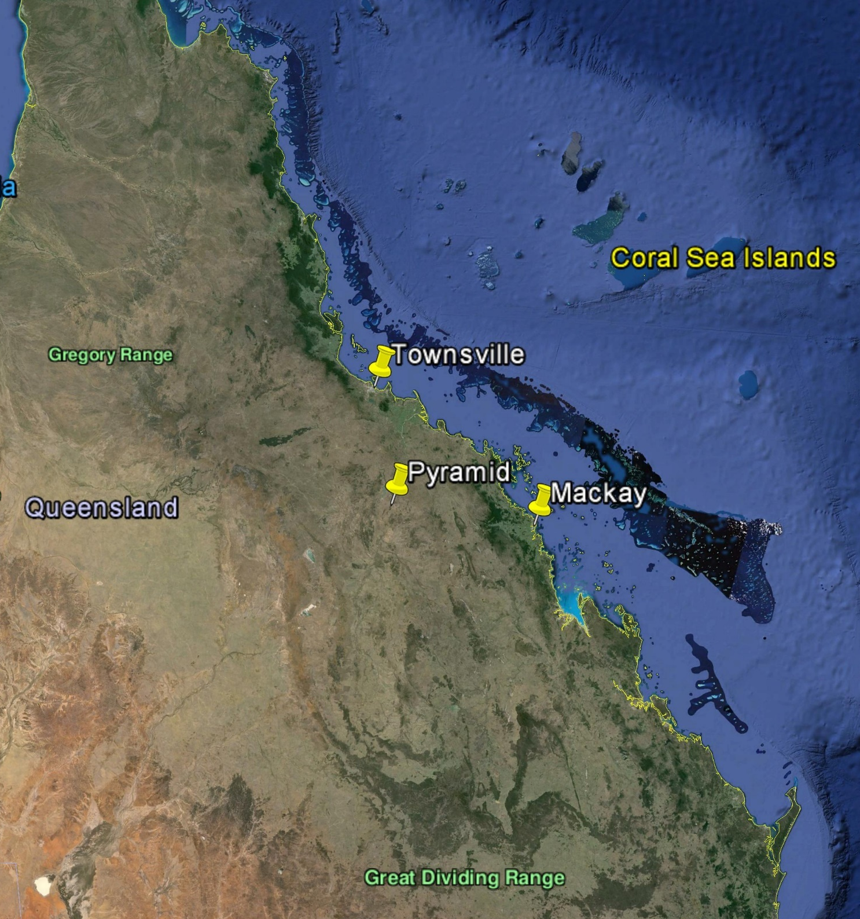
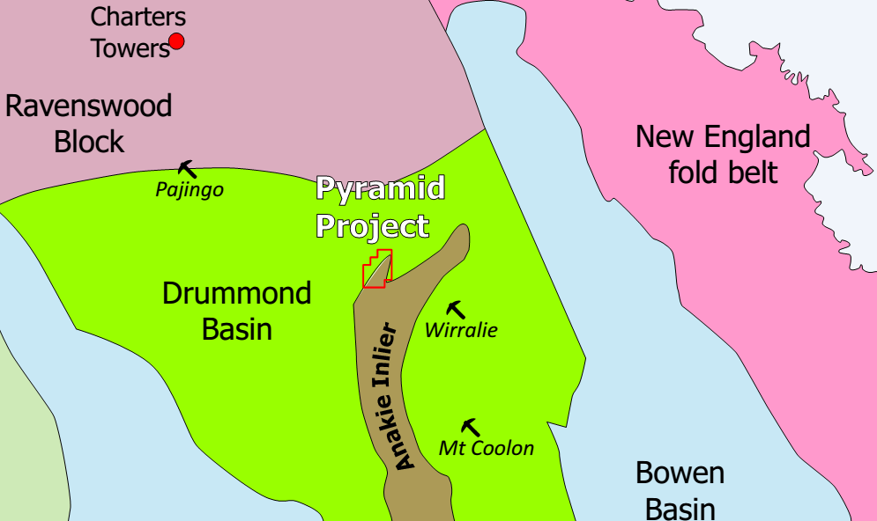
Site: The Pyramid Project
  180 km south of Townsville
  boundary between Drummond Basin and the Proterozoic basement of Anakie Inlier

Slide 4
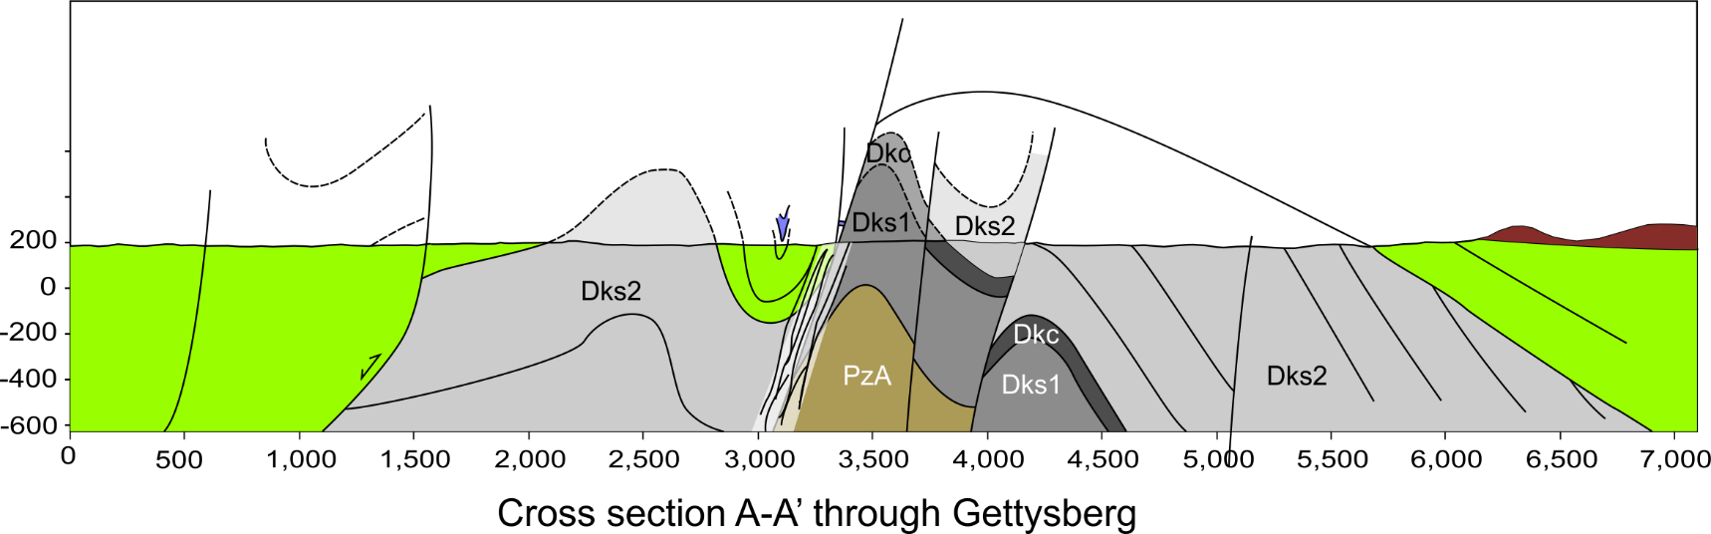
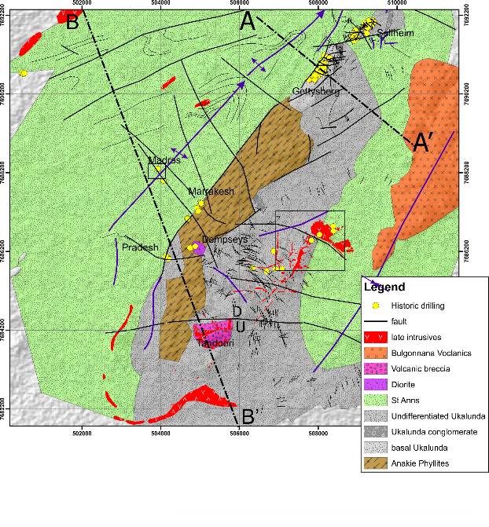
Inversion structure
Both sediment thickness (original throw) and inversion increase southwards
Gettysberg – within shear zone
  West boundary is NE –striking Anakie/Drummond fault.
      Drummond Basin boundary
      strongly inverted
      renewed extension
Notes:
These structures throw apparently barren Late Devonian Drummond Group sediments against mineralised Lower Devonian Ukalunda Formation underlain by phyllite of the Neo-Proterozoic Anakie Inlier.

Slide 5
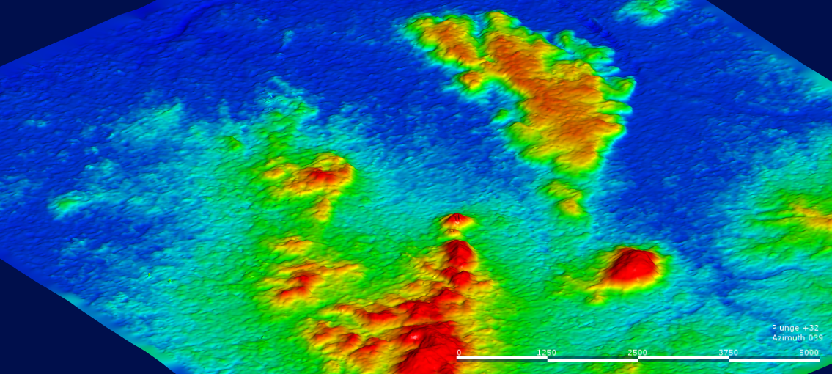
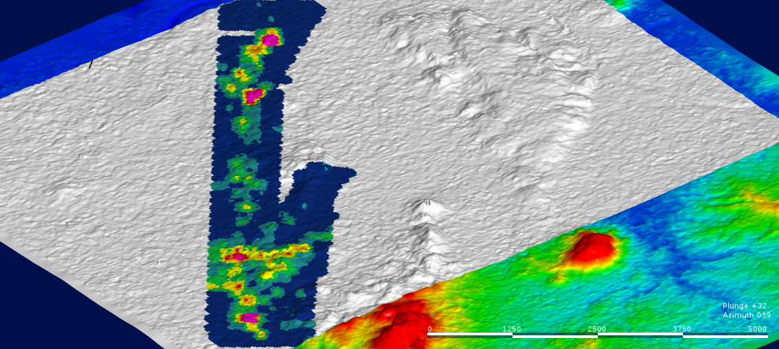
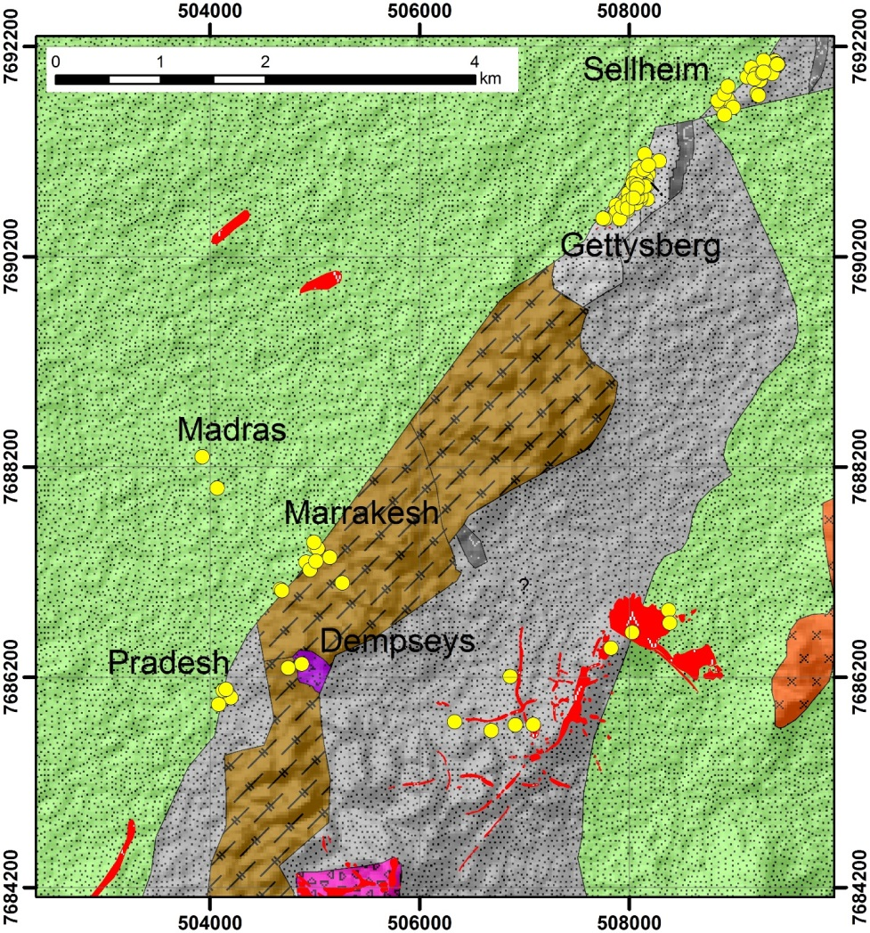
Soil Au survey 2015
Outcropping /shallow-drilled gold mineralization
Sellheim
Gettsyberg
Marrakesh
Bombay
Anakie/Ukalunda
Drummond Basin
View to Northeast

Slide 6
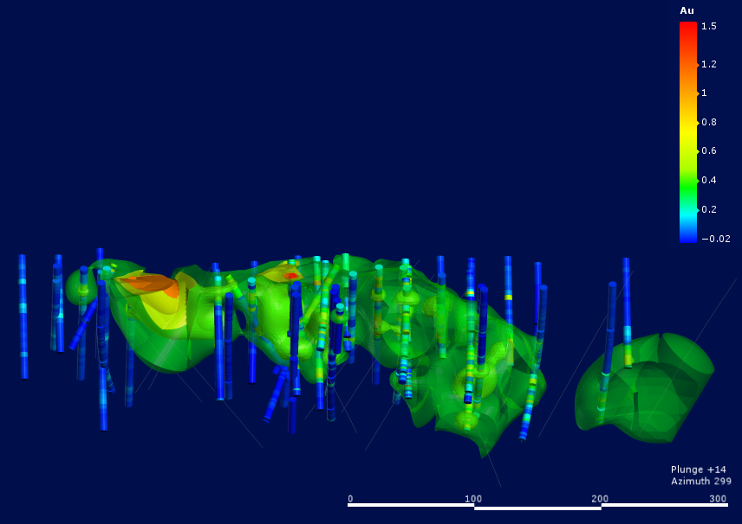
Gettysberg prospect
Gold zones plunge northwards
Soil anomalies <~800 ppb
Poor coverage at stream
(discovery site)
SW NE
View to northwest

Slide 7
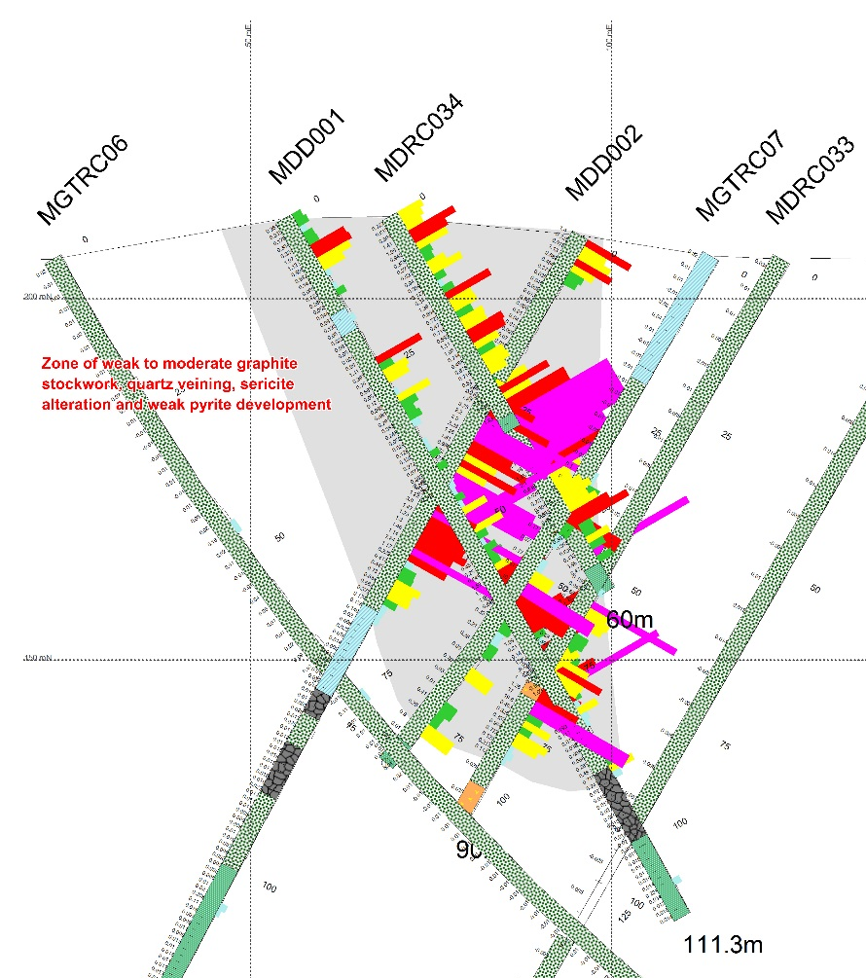
Diamond holes
W E
Only two diamond holes intersect significant fault …
  Truncates grade
  No other holes intersect fault
  must strike NW

Slide 8
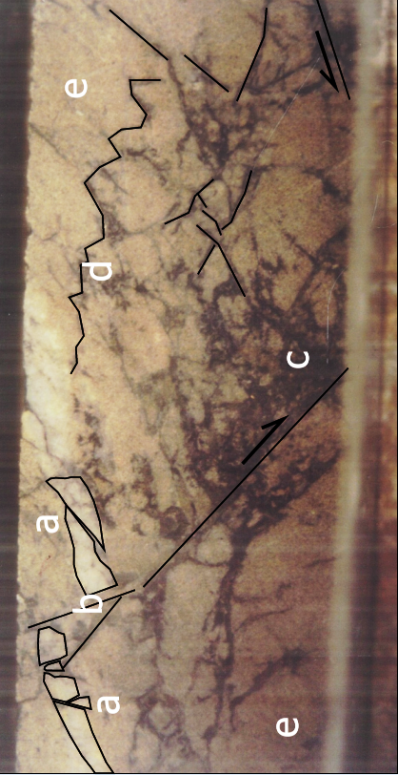
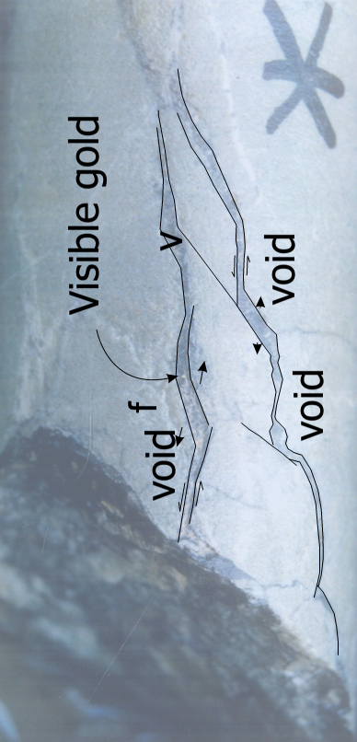
Style of mineralization
Host rock (Gettysberg – Sellheim)
  sericitic sandstone of Ukalunda Formation
Barren sub-vertical tension gashes cut by low angle shears
Visible gold in subhorizontal tension gashes
linked by steeply dipping shears
Extension parallel to core - probable fault valve behaviour during reverse reactivation of mis-oriented normal fault
Need new oriented core

Slide 9
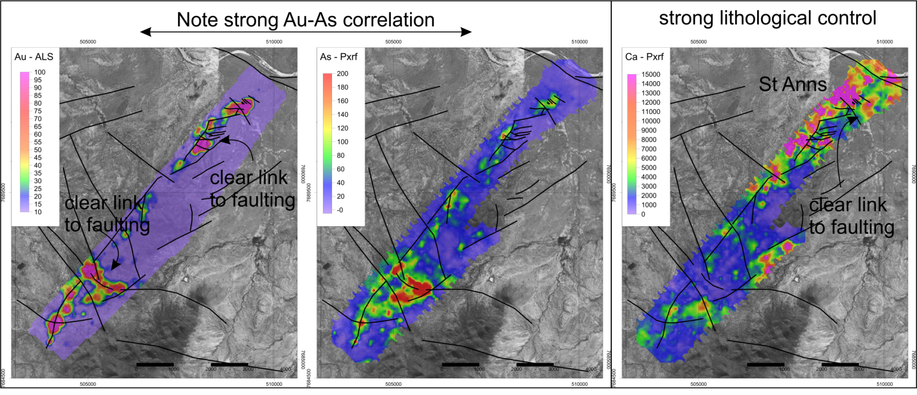
soil geochemistry v structural mapping
Faulting can be seen in soil anomalies
but not at Gettysberg
St Anns downthrown against high soil Au – incomplete inversion
Notes:
These structures throw apparently barren Late Devonian Drummond Group sediments against mineralised Lower Devonian Ukalunda Formation underlain by phyllite of the Neo-Proterozoic Anakie Inlier.
Both Devonian units contain strongly sericite altered medium sandstones and are difficult to distinguish, which complicates surface mapping

Slide 10
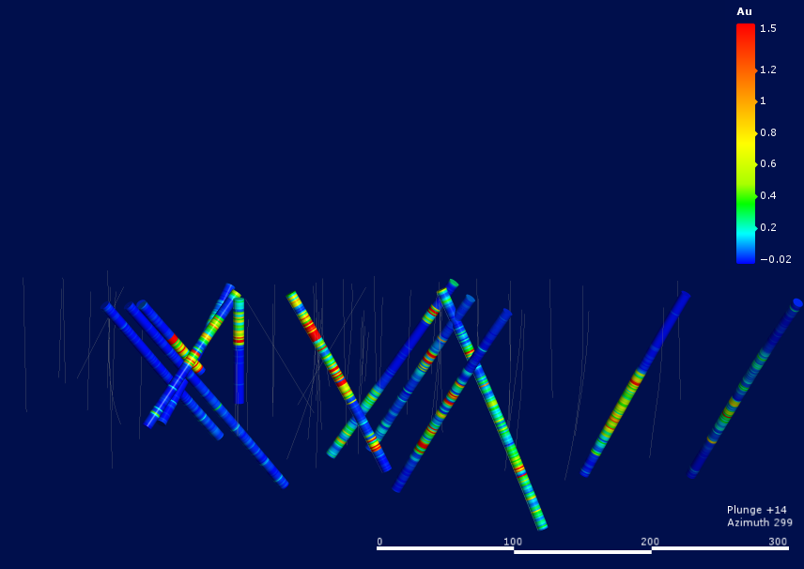
Drill program reoriented to target NW strike!
Drilling under Devils Den stream
Down plunge of interpreted faults
Best result
  1 m @ 146 g/t Au
View to northwest

Slide 11
Significant intercepts
Could same results have been achieved with geochemistry instead of structural geology?
Best result
  1 m @ 146 g/t Au

Slide 12
Drillhole multi-element geochemistry
All percussion chip samples analysed at Terra Search Townsville
  Bench mounted Niton PXRF, using Au pulps
  PXRF can reliably measure ~ 40 elements
  Includes all the base metals and pathfinders e.g.:
    Cu, Pb, Zn, As, Ni, Cr, V, Mo, Bi, Fe, S, U, Th, Sn, W, Sb, Cl
  many litho-geochemical elements that relate closely to alteration
    Si, Mg, Ca, K, Rb, P, Al, Mn, Sr, Ba, Ti, Zr

Slide 13
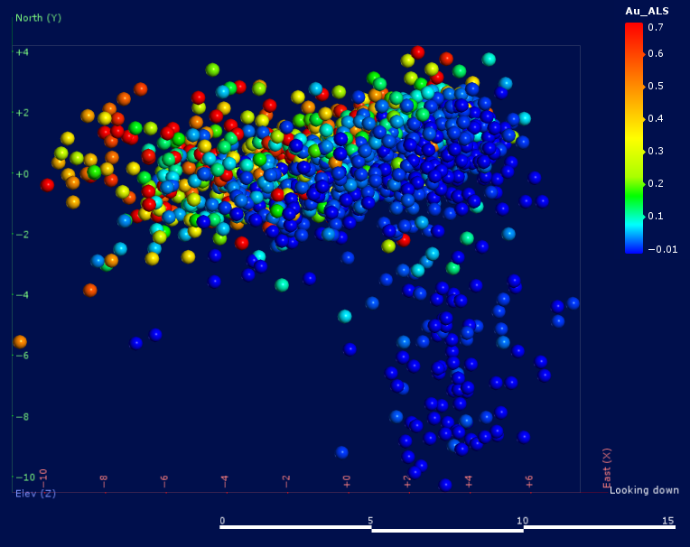
Principal component analysis
divided the percussion chip geochemistry into various populations that can be attributed to host and mineralized rock lithology.
Utilized multi-element PXRF geochemistry
Did not use Au assays
principle components cross-plotted, coloured by Au assay
overlap zone
PC0-1 coloured by Au

Slide 14
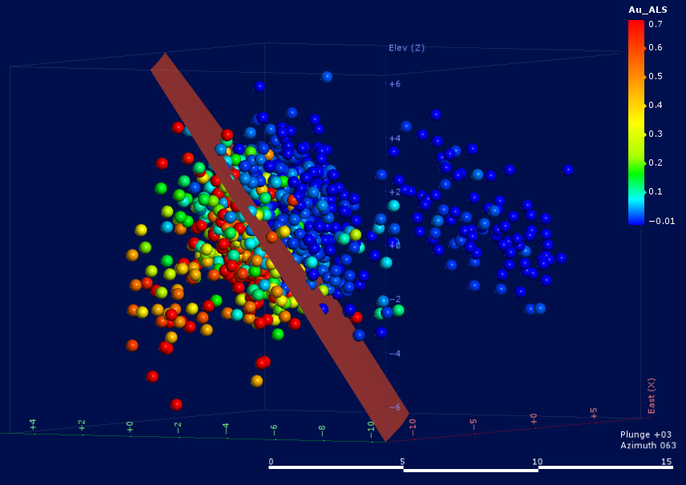
Principal component analysis
PC3 as z-axis
Mineralized and unmineralized largely separated by a plane in pseudo-3D space
PC0-1-3 coloured by Au

Slide 15
Principal component analysis
How to get clear 2D separation independent of Au
Strategy –
  Seed principle component analysis with PC00 to 04 from first iteration
PC0-1-3 coloured by Au

Slide 16
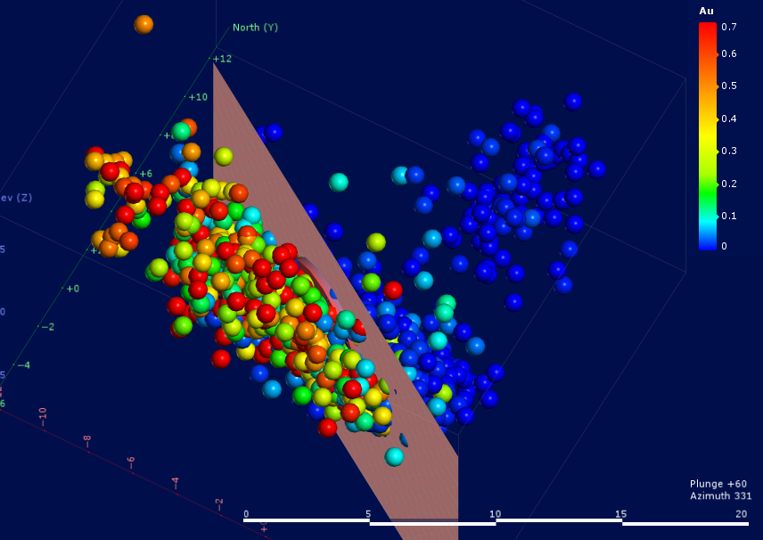
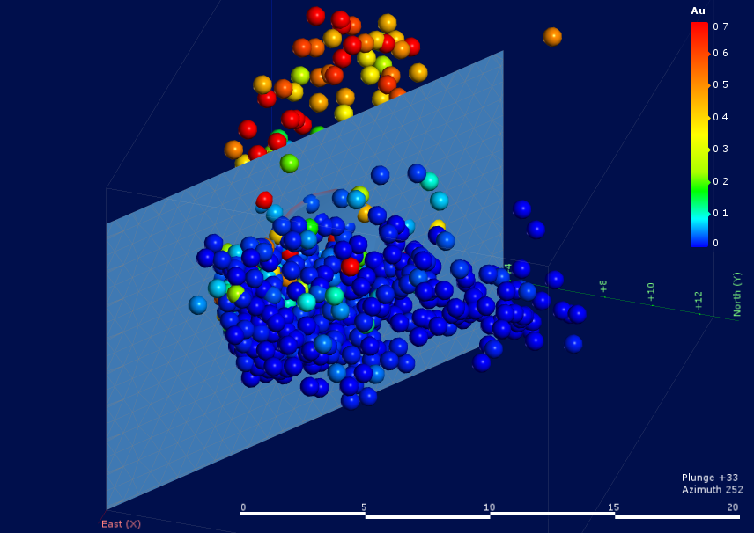
Reanalysis twists the PCs
achieves reasonable separation by vertical plane

Slide 17
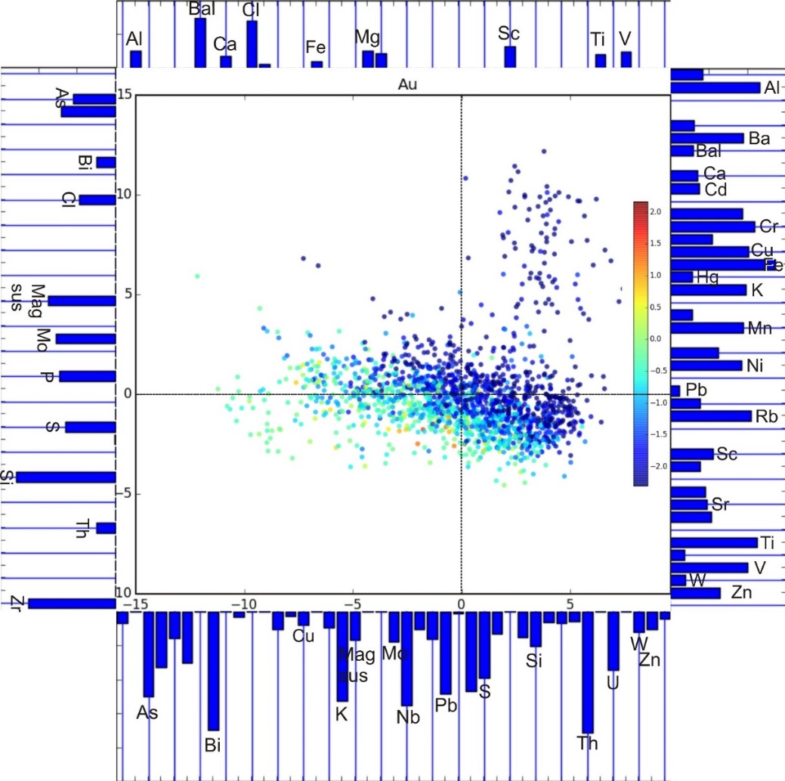
Plot of PC0 v PC1, coloured by Au
Plot statistically identifies geochemical populations.
Elements marked along margins pull the points in those directions.
influence is measured by the length of the bar.
micaceous – feldspathic sandstones and siltstones of the Drummond Group
Fine quartzose sandstones
Silts and shales
Enhanced Bi (Th), Mo, P, S and Si
elevated Mag Sus for As – rich samples
sulphides and sericitic alteration

Slide 18
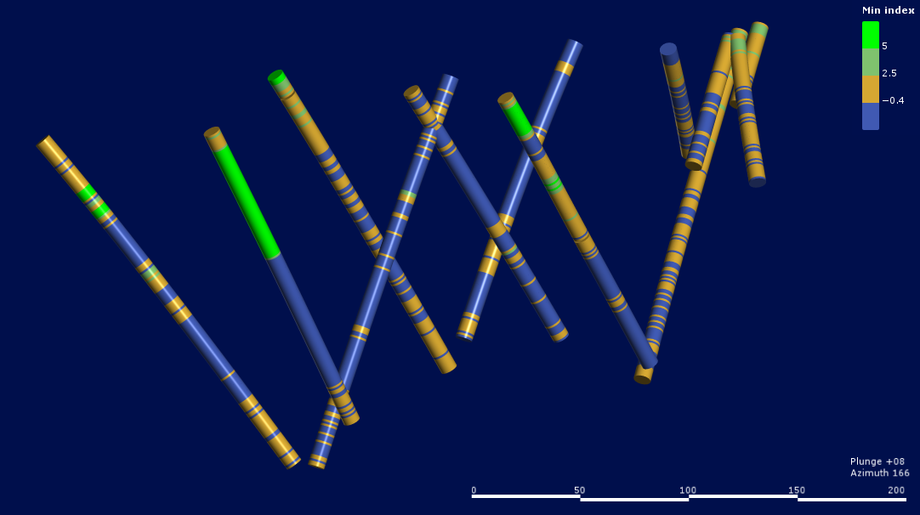
Indexed drill geochemistry
Blue – mineralized Ukalunda
Green – Drummond
Brown – Unmineralized, some may be Drummond

Slide 19
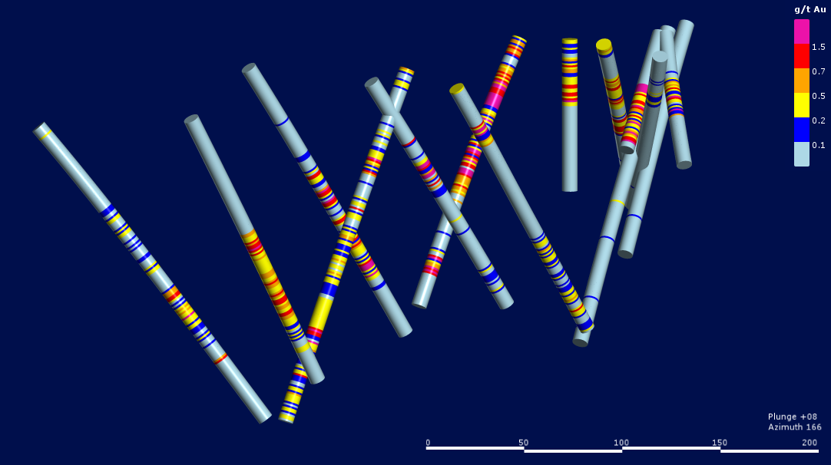
Strong correlation
Barrend Drummond rocks at surface underlain by mineralized Ukalunda rocks
PCA of PXRF soil and drill chip geochemistry, appears to reliably discriminate gold bearing and barren rocks in 3D

Slide 20
3D discrimination of barren Drummond
Barrend Drummond rocks at surface underlain by mineralized Ukalunda rocks

Slide 21
Conclusions
NW trending structures can be retrospectively delineated based on PXRF multi-element soil geochemistry
Drill-chip geochemistry, supplemented with PCA and incorporated in 3 D modelling confirm the presence of the NW trending structures
NW trending structures and the distribution of barren and mineralized units could have been detected without in-depth structural analysis
New insights from the combination of PXRF, PCA and structural analysis has reinvigorated a 30 year old prospect

Slide 22
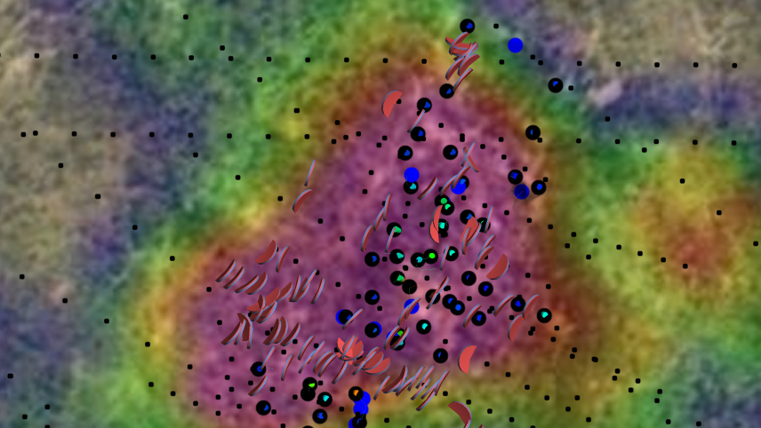
Thank you
brendan.duffy@unimelb.edu.au
www.faultrock.nz

